Slide 1
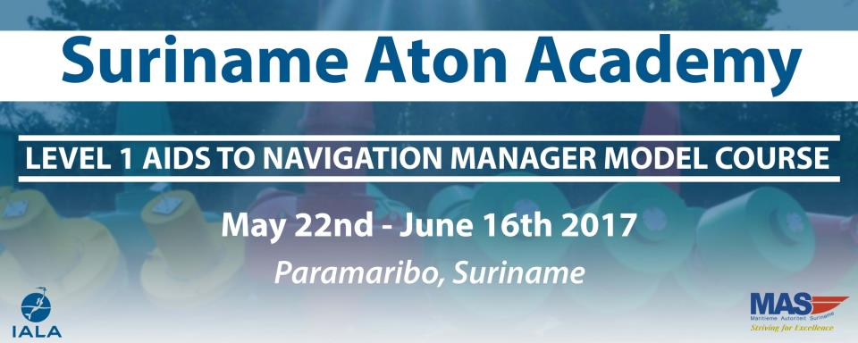
Bernice Mahabier,
Coordinator Suriname Aton Academy

Slide 2
IALA Goals for 2026
Goal 1
Ensure that aids to navigation systems and related services, including e-Navigation, Vessel Traffic Services, and emerging technologies, are harmonised through international cooperation and the provision of standards.
Goal 2
All coastal states have contributed to an efficient global network of aids to navigation and services for the safety of navigation, through capacity building and the sharing of expertise.

Slide 3
Establishment Suriname Aton Academy.
The Maritime Authority Suriname is the national authority that is legally responsible for the provision, maintenance and operation of marine Aids to Navigation in Suriname.
As National member of the International Association of Marine Aids to Navigation and Lighthouse Authorities (IALA), the Maritime Authority Suriname established the Suriname Aton Academy ( S.A.A.)
A Memorandum of Understanding was signed between the Maritime Authority Suriname and the IALA World Wide Academy to provide the Suriname Aton Academy with the necessary technical assistance for delivering the Level 1 Aids to Navigation Manager Course.

Slide 4
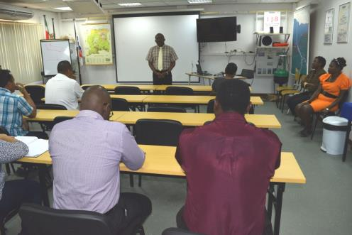
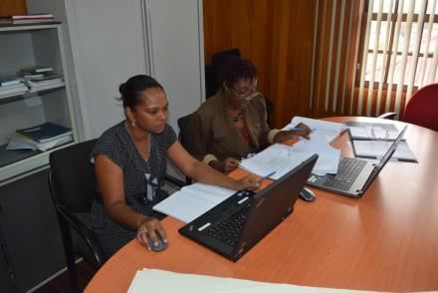
Accreditation
The Suriname Aton Academy is very unique because it is the only Training Organization for North and South America accredited to deliver Aids to Navigation training based on the IALA Recommendation E-141.

Slide 5
Primary goals of S.A.A.
The Primary goals of the Suriname Aton Academy are:
facilitate education and training for personnel with responsibility for Aids to Navigation particularly in key target regions;
deliver Level 1 Aids to Navigation Manager Courses when appropriate;
develop and maintain an Academy alumni association and promote IALA activities through that alumni association;
provide assistance to enhance the knowledge and expertise of personnel with responsibility for Aids to Navigation, at both the managerial and technician levels, so as to achieve a resilient competence in a defined target region.

Slide 6
Level 1 Aids to Navigation Manager Course objectives
The course aims to enable participants to gain an international recognized Aid to Navigation Certificate.
The competencies to be gained include:
Module 1: International Organizations and Law of the Sea;
Module 2A: nautical knowledge;
Module 2B: position; navigation; timing and meteorology;
Module 3A: provision, design and management of Aids to Navigation;
Module 3B: maintenance contracts, the marine environment, historic lighthouses and human resource issues;
Module 4: the technical functions related to both visual and radio Aids to Navigation including e-navigation and Vessel Traffic Services;
Module 5: power supplies used for Aids to Navigation.

Slide 7
Level 1 Aids to Navigation Manager Course objectives
Includes elements of the SOLAS V Regulations
4 -Navigational Warnings: WWNWS
9 – Hydrographic Services
10 – Ships Routeing
11 – Ships Reporting Systems
12 – Vessel Traffic Services
13 – Aids to Navigation Services
19-2.4 – AIS

Slide 8
Participants
Countries that expressed interest :
Mexico, Columbia, Belize ,Argentina ,Guatemala, Guyana, Trinidad& Tobago, St. Kitts & Nevis, Venezuela, Barbados and Suriname.
Difficulties encountered:
Availability of resources and language barrier
Participants for the manager couse: 7

Slide 9
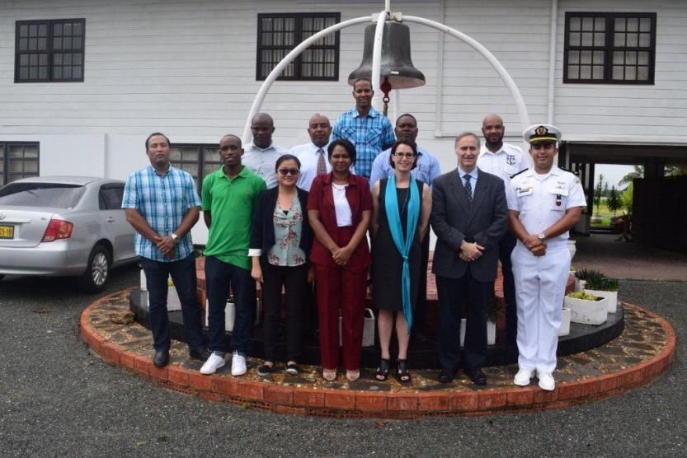

Slide 10
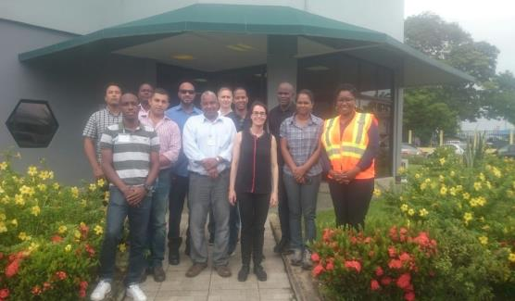
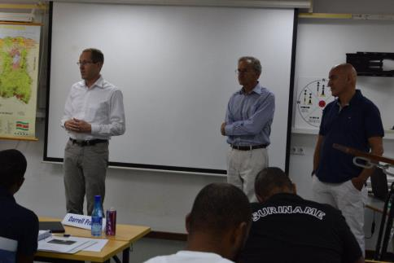
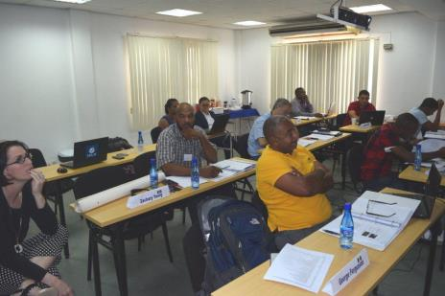
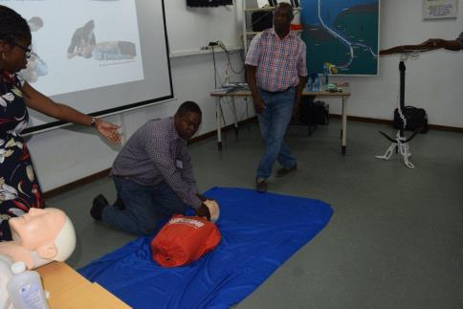

Slide 11
Competence of the Aids to navigation manager
The Level 1 Aids to Navigation Manager Course is based on IALA Recommendation E-141. After having demonstrated the required level of competence by passing all the modular examinations and other assessments required , the participants will be awarded an IALA Aids to Navigation Level 1 Certificate.
This will permit successful students to operate as a manager with an Aids to Navigation service provider approved by the Competent Authority within their Country.
Aids to Navigation managers and engineers are responsible to the Competent Authority for providing an appropriate quantity and quality of Aids to Navigation services which as a minimum meets the obligations set out in the International Convention for the Safety of Life at Sea, Chapter V, Regulation 13 and other mandatory instruments issued by the International Maritime Organization.

Slide 12
Conclusion
The Suriname Aton Academy in cooperation with IALA W.W.A. will be contributing to an efficient global and regional network of Aids to Navigation services for the safety of navigation, through capacity building and the sharing of expertise.
Therefore The Level 1 Aids to Navigation Manager course will be delivered in 2018 .

Slide 13
Questions?

