Slide 1
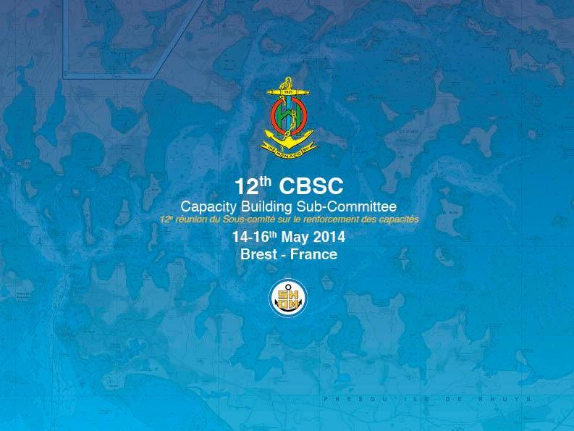
HydroMAOC study follow-up
06E - Definition study for a long term project
CBSC15 – Paramaribo (Surinam) – June 2017

Slide 2
HydroMAOC General approach
ANALYSIS
Archives
SWOT
Visits/Visites
HYDRO CAPABILITY DEFINITION
Education/Éducation
Equipment/Équipement
Empowerment/Émancipation
IMPLEMENTATION PROCESS
Roadmap/Feuille de route
Fundraising/Financement
Recommendations
REGIONAL CB PROGRAMME

Slide 3
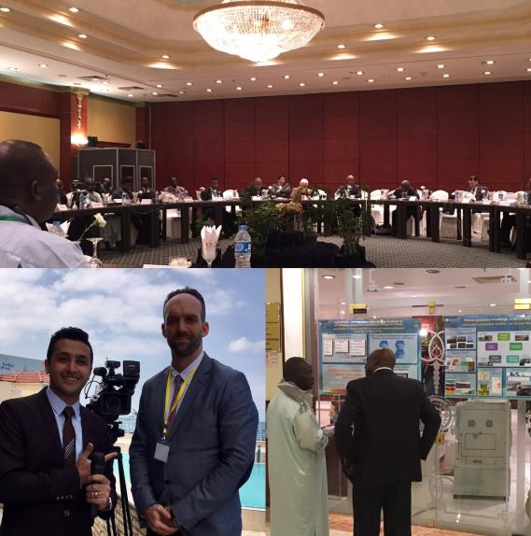
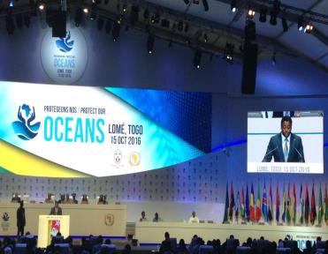
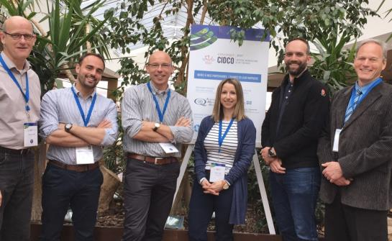
Promoting HydroMAOC’s ways forward…

Slide 4
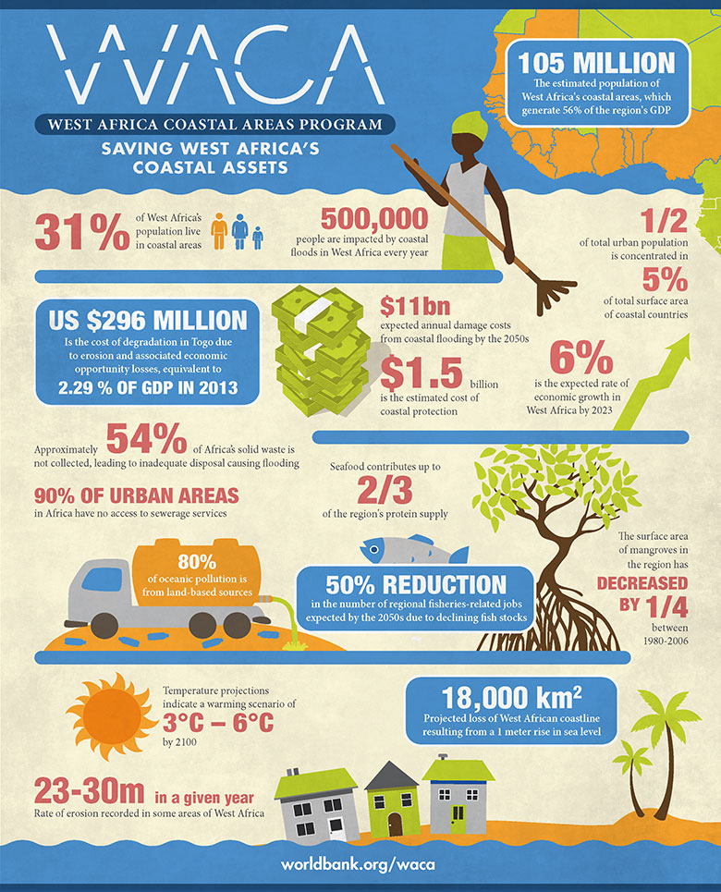

Slide 5
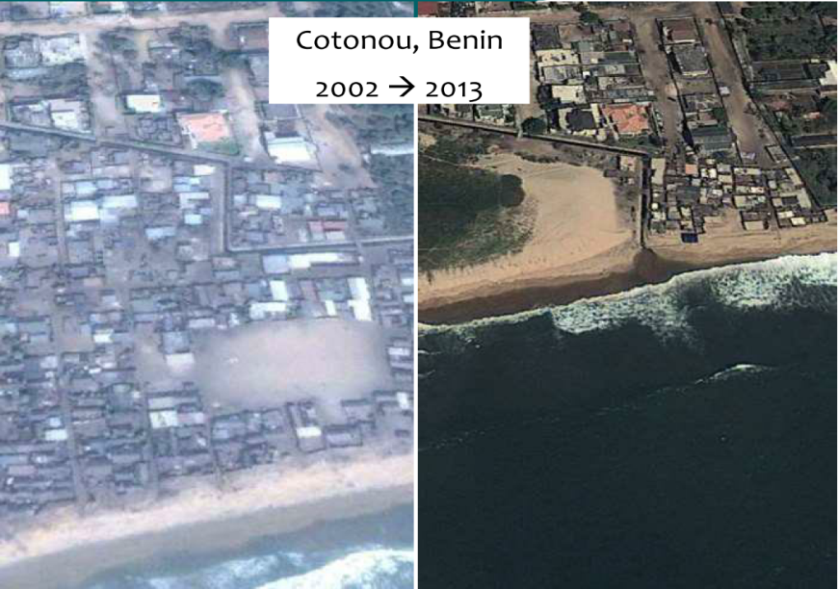
Coastal hazards: Erosion

Slide 6
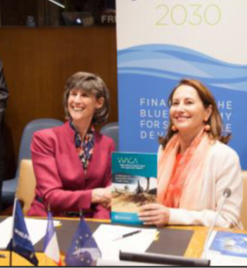
04/2016: MoU between France and the World Bank on ocean & Blue economy
02/2017: Convention between MEEM and Shom, IGN, Cerema, BRGM on cartography archives digitalization and skill transfer (800k€)
04/2017: FFEM project on coastal hazards (5M€)

Slide 7
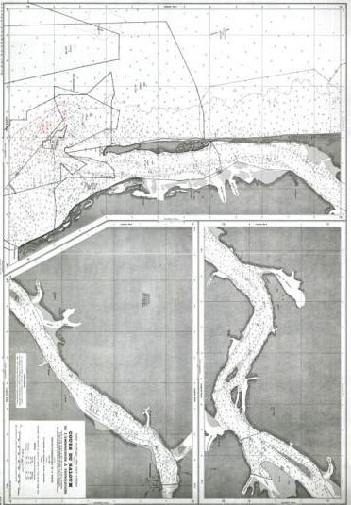
Project: Cartographic Archives
Funds: 800k€ (200k€)
Duration: 4 years
Targeted States:
Phase 1 = BJ, SG, TG (250 docs)
Phase 2 = MR, CI, GU (tbd)
Partners: Shom, IGN, Cerema, BRGM piloted by MTES.

Slide 8
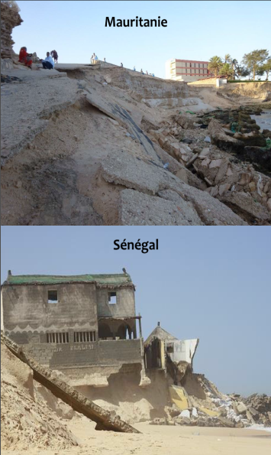
Project: Coastal hazards and adaptation
Funds: 5M€ (1.5M€)
Duration: 4 years
Targeted States:
Phase 1 = BJ, SG, TG
Phase 2 = WCA States (tbd)
Partners: Shom, Cerema,
piloted by CSE/MOLOA
➔ Sea level observation, shallow water bathymetry

Slide 9
What’s next?
Liaise with more funding agencies through targeted visits:
African Development Bank, West African Development Bank
KOICA and JICA
EU (DEVCO)
Maintain dialogue with the World Bank:
Within FR contribution to WACA programme
Within IHO initiatives (visit, WB event, …)
HydroMAOC follow-up submission to 2018 CBWP
Practice other ways of adressing the need to develop hydrographic capabilities in the region:
Use of business plan methodologies with targeted coastal States
Use of Morphological analysis to build up scenarios
Explore ways to develop mentoring and tutoring in WCA
Regional training center study submission to 2018 CBWP

Slide 10
The CBSC in invited to
Take note of that report
Identify ways to engage with funding organizations under the IHO flag

Slide 11
Questions?
Merci pour votre attention
Thank you for your attention

