Slide 1
Report of the Hydrographic Dictionary Working Group
#### Report - HD Structure - Outreach
Hydrographic Services and Standards Committee

Slide 2
Report (Principal activities and achievements)
HSSC9/39 HSSC approved the amendments to the HDWG TORs as proposed by the HDWG: Unique IHO Reference
IHO Sec. to upload the new HDWG TORs accordingly - completed
IHO Sec. to invite IHO Member States to appoint new active members to the HDWG – on going positive replies from Canada, Italy and Oman; China and Russian Federation still to be confirmed.

Slide 3
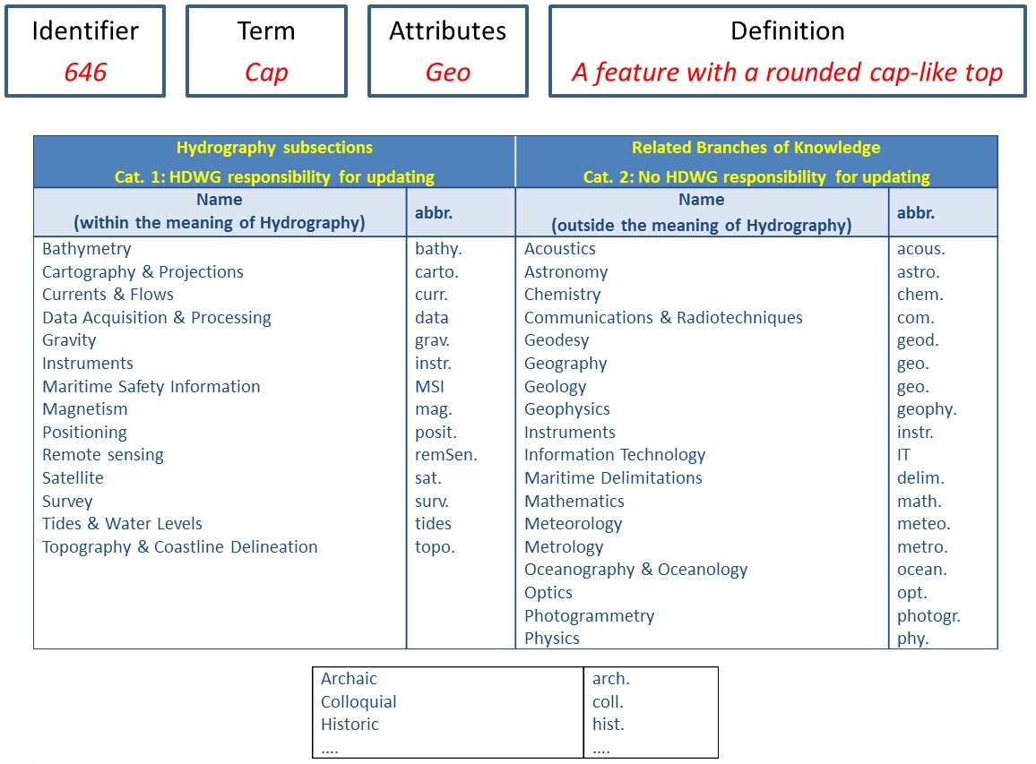
Outreach 1/4 Reminder: The HD structure
Four Categories of Terms:
IHO specific,
Borrowed,
Historical,
Irrelevant.

Slide 4
Outreach 2/4 : Producing an HD in several languages
Language branch | Speakers | HDWG Representative
English | 1.39 bn | Canada (bilingual expertise) – Italy (EU languages)
Chinese 中文 | 1.16 bn | China (and characters-based languages) TBC
Spanish | 661 m | Argentina
Arabian العربية | 442 m | Oman (and Arabian based languages)
Russian ру́сский язы́к | 267 m | Russia (and Slavonic-based languages) TBC
French | 229 m | Canada (bilingual expertise) – Italy (EU languages)
Portuguese | 229 m | Italy (EU)
HD responsibilities and work will be spread amongst RHCs.
Apart rare face-to-face meetings (at least once), HDWG Members shall work by correspondence and represent the WG within their RHCs.

Slide 5
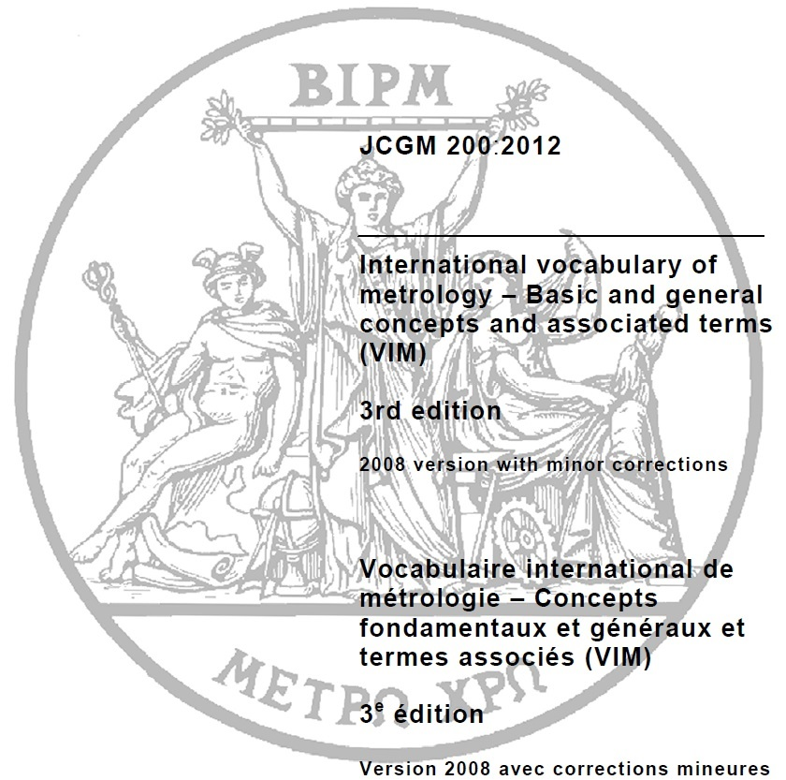
Outreach 3/4: Adding external sources
Originator | Source | New Terms
ABLOS | TALOS Glossary | 29
HSPT | International vocabulary of Metrology | 46
All WG Chairpersons are invited to submit their New Terms to the HDWG.

Slide 6
Outreach 4/4: HD expanding mechanism
All WG Chairs are invited to submit their New Terms to the HDWG.
HSSC-10, Rostock-Warnemünde, Germany, 14 -17 May 2018

Slide 7
Work plan
Work Item |  | Start | End | Obs
Review all terms currently included in S-32 for their relevance in accordance with the S-32 Business Rules and propose which definitions should be removed from S-32 | 1. Terms a – d 2. Terms e – l 3. Terms m – r 3. Terms s – z | 2018 2018 2018 2018 | 2019 2019 2020 2020 | HDWG and IHO Secretariat (Capt Aste, PN)
Develop structure and database application to support the on-line dictionary |  | 2017 | 2018 | Tony Pharaoh (IHO Secretariat)
Add the New Terms suggested by TALOS and HSPT Chairs |  | 2018 | 2018 | HDWG
Start translating Arabic Terms |  | 2018 |  | Sultanate of Oman
Confirm China and Russia support |  | 2018 |  | IHO Secretariat And HDWG Chair
International Hydrographic Organization Organisation Hydrographique Internationale

Slide 8
Action requested of HSSC
The HSSC is invited to:
note this report and presentation;
appoint the HDWG to continue its work under the current ToRs and Business Rules. This will require minimum WG support
approve the work plan; and
invite member states to appoint new WG members and guarantee their effective participation to the HDWG workplan and future meetings.

Slide 9
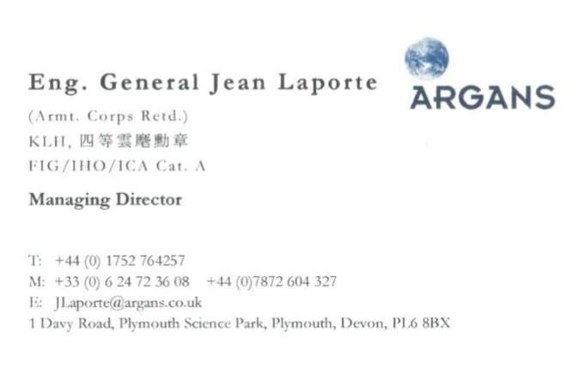
Hydrographic Services and Standards Committee

Slide 10
Hydrographic Services and Standards Committee
Report of the Hydrographic Dictionary Working Group
#### Report - HD Structure - Outreach
Any questions?

