Slide 1
Report of the S-100WG
Hydrographic Services and Standards Committee

Slide 2
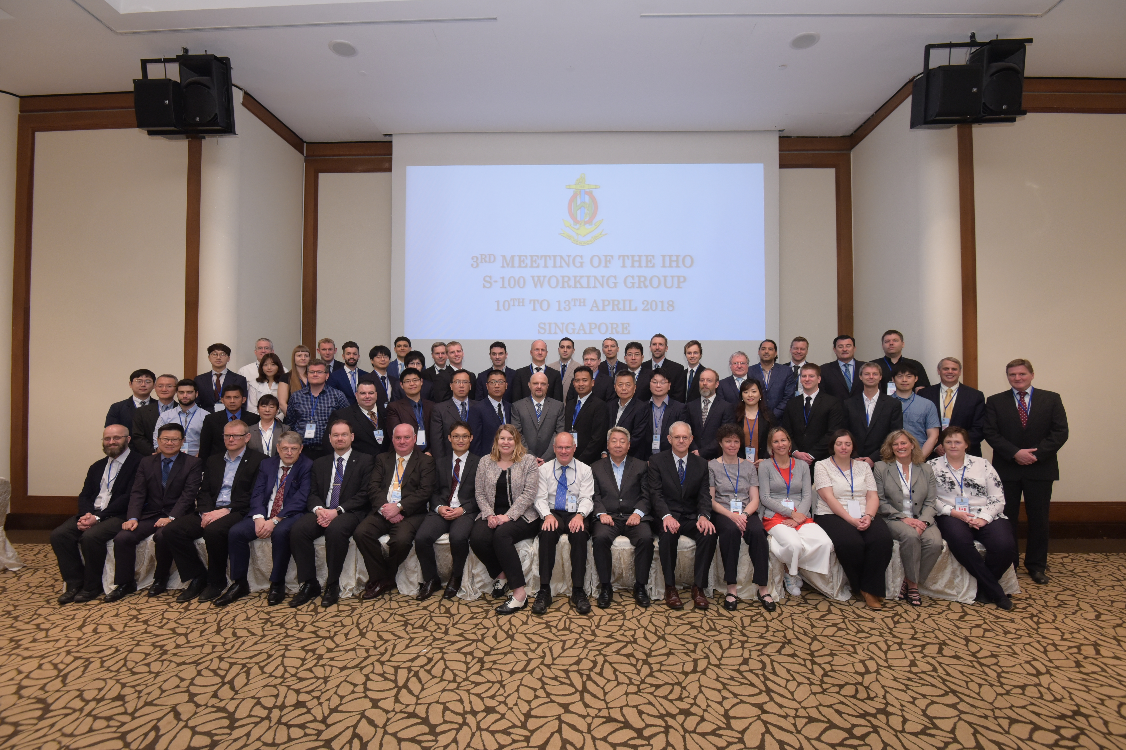
Activities and achievements
Membership
  23 member states, 15+ industry members
Meetings
  April 2018, Singapore
    60+ delegates
Election
  Chair – Julia Powell (USA)
  Vice Chair – Yong Baek (ROK)

Slide 3
Activities and achievements
S-100 Edition 4.0.0
S-100 Product Specification Guidebook
S-98 Interoperability Specification
Product Specification Development
S-100 Test Bed Development

Slide 4
S-100 Edition 4.0.0
Over 16 proposals were considered over a two and a half year period
Major Extensions include
  Online Communication Extension requested by IALA
  Scripting language support – requested by OEMs
  Lua Portrayal support – requested by OEMs
  Inclusion of bSpline Spatial – requested by WMO
  Data Protection

Slide 5
S-100 Edition 4.0.0
Major Corrections include
  Discovery Metadata – alignment across all product specifications
  HDF5 Harmonization
  Feature Catalogue
Clarifications
  GML – ease of use for system implementation

Slide 6
Compliance to TR 2/2007
S-100 is a framework
Product Specification’s are tied to specific editions of S-100
  No Impacts to existing product specifications that are tied to Edition 3.0.0

Slide 7
S-100 Edition 4.0.0 – Path to Publication
2018 Quarter 2 – consolidate approved proposals into a committee draft
2018 Quarter 3 – comment period open for Member States and Stakeholders (only for those parts that have changed)
2018 Quarter 3 – Utilize the Test Strategy Meeting to resolve any outstanding issues
2018 Quarter 4 – S-100 Edition 4.0.0 is published
  Target December 2018

Slide 8
HSSC is requested:
HSSC10 endorse the path to publication for Edition 4.0.0 of S-100

Slide 9
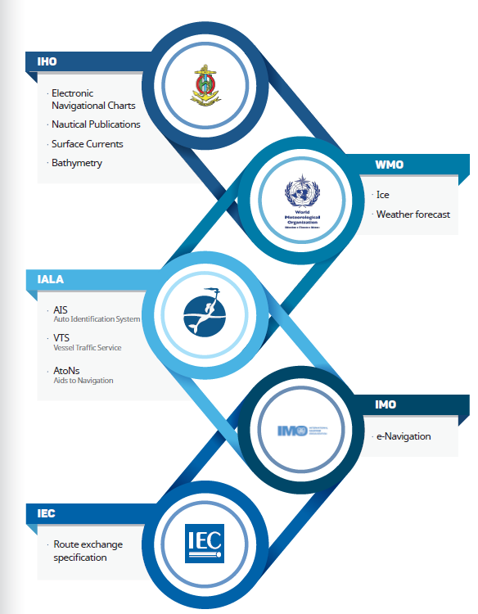
S-100 Product Specification Guidebook
S-100 is a framework for increased standardization
  Difficult to decipher
  Over 400 pages
  14 parts and counting

Slide 10
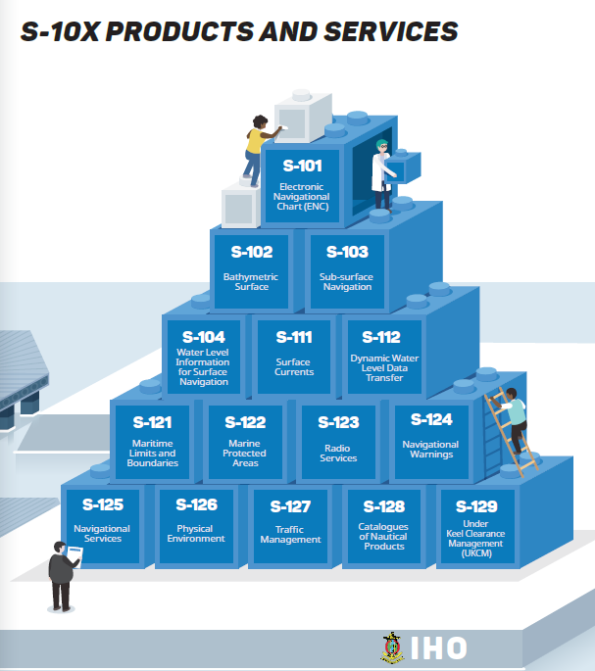
Background
Need for additional guidance for developers of product specifications
Ensures specification harmonization

Slide 11
Guidance Document
Two Parts
  Content – defines the general content within S-100 utilizing plain language (mostly)
  Execution – prescribes the general flow that should be followed to build a S-100 conforming product specification
S100WG agreed to include the DQWG data quality checklist within this document

Slide 12
HSSC is requested
Endorse the S-100 Product Specification Guidebook and include it within the S-100 work plan
Assign a S-Number to the product specification guidebook

Slide 13
S-100 Interoperability Specification
New Name – Same objective
  S-98 Specification for Data Product Interoperability in S-100 Navigation Systems
Specification No. | Title
S-101 | Electronic Navigational Chart (ENC) / Cartes électroniques de navigation
S-102 | Bathymetric Surface / Surface bathymétrique
S-104 | Water Level Information for Surface Navigation / Information de hauteur d’eau pour la navigation de surface
S-111 | Surface currents / Courants de surface
S-122 | Marine Protected Areas / Aires marines protégées
S-124 | Navigational warnings / Avertissements de navigation
S-411 | Sea Ice (WMO-IOC Joint Technical Commission for Oceanography and Marine Meteorology [JCOMM]) Glace de mer (Commission technique mixte OMM-COI pour l’océanographie et la météorologie marine [JCOMM])
S-412 | Met-ocean forecasts (JCOMM) Prévisions météo-océanographiques (JCOMM)

Slide 14
Path to publication of S-98 edition 1.0.0
December 2017 – S-98 sent to the S-100 stakeholder community for comments
  Denmark
  NIPWG
    France
    Sweden
    USA – NGA
Majority of the comments are editorial in nature – some were substantive that need to be addressed

Slide 15
Path to publication - Recommendations
Q2 2018 -Incorporate the editorial changes into a revised draft
Q2 2018 -Create a red-line for any substantive comments
Q3 2018 Review redline at the S-100 Test Strategy Meeting
  Address the need for a strong set of functional principles for S-98 as an executive summary of the document
Q3 2018 – Send S-98 for a second and final round of comments
Q1 2019 – S-100 finalizes S-98 for HSSC endorsement
Q2 2019 – HSSC11 Endorses S-98
Q3 2019 – S-98 Edition 1.0.0 is published

Slide 16
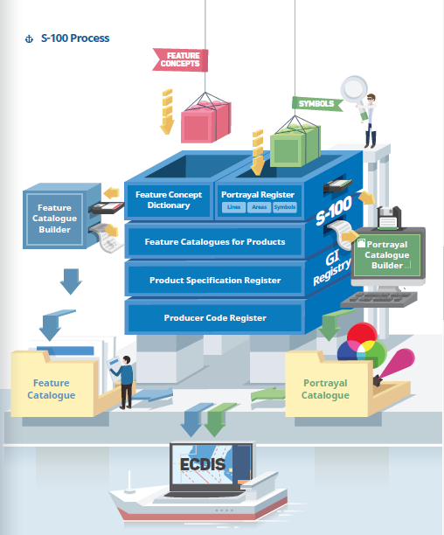
S-100 Infrastructure
Essential Framework for developing product specifications
Maintained by KHOA on behalf of the IHO
Will be updated to S-100 Edition 4.0.0

Slide 17
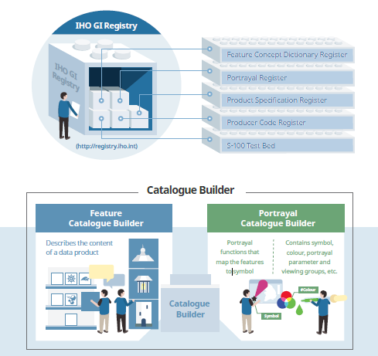
S-100 Infrastructure
S-100 Portrayal Catalogue Builder
  IHO contract to establish the database structure and a web-based front end
ROK developed a standalone PCB application that utilizes the IHO database structure
S100WG endorsed the use of the ROK PCB application for use in building of S-100 compliant product Specifications

Slide 18
Use of IHO special project funds
HSSC9 approved funds for
  Building S-101 Portrayal Catalogue
  Updating the PCB
New developments
  ROK will handle the PCB – but requested consultation hours for specialized portrayal knowledge
  Cost effective solution as the IHO will no longer be responsible for the software development of the PCB

Slide 19
Principal activities and achievements
Review the S-100 Master Plan Annually (D.1)
  Simplified the master plan
  Key Items
    S-100 in general
    S-100 Infrastructure
    S-100 Product Specifications (timelines)
    Test Bed
    Interoperability
    Interaction with non-IHO stakeholders
    S-100 and Type approval of ECDIS

Slide 20
S-129 UKC
Development and Testing
SR
MS Vote
S-129 Released for Implementation
S-128 Catalog of Catalogs
Development (TBD)
S-127 Sea Traffic Management
Development (TBD)
S-124 Nav Warnings
Development and Testing
SR
MS Vote
S-124 Released for Implementation
S-123 Radio Services
Development and Testing
SR
MS Vote
S-123 Released for Implementation
C=Council
A = Assembly
SR = Stakeholder Review
MS = IHO Member State
S-122 MPAs
Development and Testing
SR
MS Vote
S-122 Released for Implementation
S-121 - MLB
Development and Testing
SR
MS Vote
S-121 Released for Implementation
S-111 Surface Currents
Development and Testing
SR
MS Vote
S-111 Released for Implementation
S-104 Water Levels
Development and Testing
SR
MS Vote
S-104 Released for Implementation
S-102 Bathy
Development and Testing
SR
MS Vote
S-102 Released
S-101 ENC
Development and Testing
SR
MS
S-101 Released for Implementation and Transition
2017
2019
2020
2018
A2
C2
HSSC11
C3
C4
HSSC10
HSSC12
S-100 Edition 4.0.0

Slide 21
HSSC is requested
Endorse the simplified S-100 master plan
Endorse the notional S-100 Timeline for Product Specifications and include it in the HSSC report to the Council

Slide 22
S-101 – the way to publication

Slide 23
Principal activities and achievements
S-101 Component | Current Status | Comment
Main Document | Baseline – May 2018 | Major concepts have been baselined Any new changes will require a proposal which will be held for Edition 2.0.0 NOAA and ESRI continue to support the S-57 to S-101 convertor
Data Classification and Encoding Guide | Baseline – May 2018
8211 Annex | Baseline – May 2018
Feature Catalogue | Baseline – May 2018 | Feature Catalogue created to reflect May 2018 DCEG baseline
Portrayal Catalogue | Partial Baseline – May 2018 | Lua is the preferred approach for S-101 portrayal SPAWAR has developed a set of LUA rules for the existing S-52 rules that still apply Work is continuing to improve portrayal post edition 1.0.0
Encryption | In Progress | Industry Members and the RENCs have drafted the initial part for encryption to be included in S-100 which will feed S-101
Validation Checks | In Progress | Denmark has taken the lead to develop the S-101 Validation Checks
Alerts and Indications | Not Started
Full Test Data Sets | Not Started

Slide 24
Next Steps - 2018
April –
  Send out S-101 for a final round of comments
  Build out the S-101 Portrayal Catalogue using the IHO’s Portrayal Catalogue Builder
June –
  Hold a project team meeting (June 19-20, Monaco)
    Adjudicate any comments
    Face to face meeting for Validation and how new features/attributes should be portrayed
    Shake out any large technical issues
    Note: S-101 will utilize the Lua portrayal mechanism rather than XSLT
      Will require an update to the PCB
      S-100 will require an update to accommodate this methodology
July – August
  Finalize documentation
  Update S-57 to S-101 convertor
August – November
  IHO distributes S-101 for Member State Vote
December
  Publish edition 1.0.0 of S-101
  Needs to be published in conjunction with Edition 4.0.0 of S-100

Slide 25
Path forward for S-101 Edition 1.0.0 and beyond
Components | Edition 1.0.0 (2018) | Edition 2.0.0 (2020) | Edition 3.0.0 (2022)
Main Documentation | ü | ü | ü
Feature Catalogue | ü | ü | ü
Portrayal Catalogue | Partial | ü | ü
Validation | Partial | ü | ü
Data Classification and Encoding Guide | ü | ü | ü
Encoding Format | ü | ü | ü
Encryption |  | ü | ü
Alerts and Indications |  | ü | ü
Full Test Data Sets for Type approval |  | Partial | ü
Notes | Portrayal will be limited to S-52 rules translated to LUA | Edition 2.0.0 refines all the additional rules | Operational Edition

Slide 26
S-101 and TR 2/2007
Aggressive Timeline
Undergone multiple stakeholder reviews
Integral part of the S-100 Test Bed
Impact Study Requirement?
  Everyone is waiting on edition 1.0.0 to start implementing
How to handle the correction process between edition 1.0.0 and 2.0.0
  Ask that the S-100 WG be allowed to approve minor editions
  Follow a more agile approach to development

Slide 27
HSSC is requested:
Agree to the publication timeline of S-101 Edition 1.0.0
Agree that the S-100 WG can approve minor editions for S-101 until Edition 2.0.0 goes before HSSC

Slide 28
Progress on the S-100 Test bed
Currently two major test beds
  ROK
  SPAWAR
Iterative Process
  Feeds into refinement of S-100 and associated product specifcations
  Testing Interoperability concepts

Slide 29
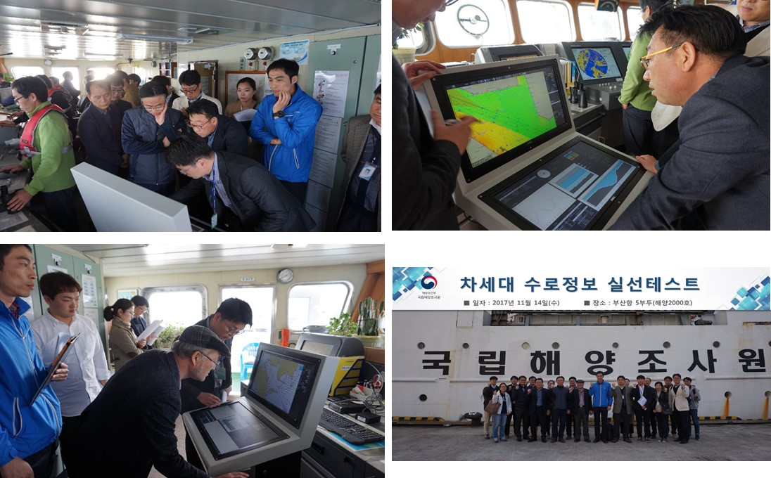
S-100 Sea Trial
Video Clip

Slide 30
S-102
Progress so far
  Incorporation of different coordinate reference systems
  Tile size and tiling schemes
  Gridding methodology
  Portrayal color ramps
  US Navy is developing a Bathymetric Attributed Grid to S-102 Convertor
  Alignment with S-100 Edition 4.0.0 HDF5

Slide 31
S-102 – Path to Publication
April 2018 – Meeting held to resolve any outstanding issues
June 2018 – Consolidated S-102 sent out for stakeholder review
June 2018 – Finalize S-102 convertor script and make available to IHO stakeholder community
September 2018 – Consolidate stakeholder feedback
December 2018 – Publish S-102 Edition 2.0.0

Slide 32
S-102 and TR 2/2007
Impact study conducted in 2016 that supported the update to S-102
Finland, Sweden, Norway and Primar have started to develop test data sets
US Navy is creating a convertor to continue to support the S-102 test bed
S-102 has undergone numerous rounds of stakeholder review and input

Slide 33
HSSC is requested
Endorse the publication of S-102 Edition 2.0.0 with a target date of December 2018

Slide 34
S-121 Project Team

Slide 35
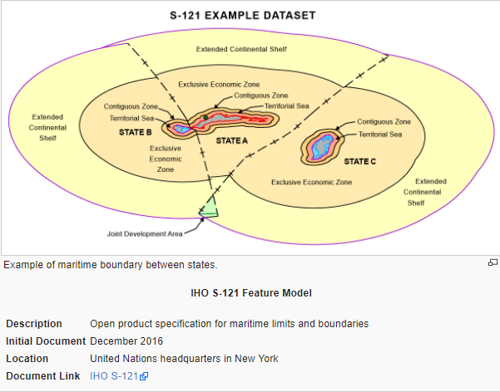
S-121 – Maritime Limits and Boundaries
Progress on Edition 1.0.0
  Draft Standard
  Established the Feature Model
  Encoding Guidance
Establish a MLB domain in the IHO Registry
OGC Pilot
  Development of GIS implementations
  Legal dissemination format
  GML based exchange

Slide 36
S-121 – Path to Publication
June 2018 – S-121 will under go a wider stakeholder review
Fall 2018 – adjudication of comments
December 2018 – project team meeting to finalize any outstanding issues
December 2018 – Publication of S-121 Edition 1.0.0?
Note: S-121 communicates official representations of maritime limits and boundaries to the international community

Slide 37
HSSC is requested
Endorse the publication timeline for S-121 Edition 1.0.0 – noting that it still has to undergo a wider stakeholder review
Endorse the establishment of an Maritime Limits and Boundaries Domain within the Feature Concept Dictionary

Slide 38
S-129 Under Keel Clearance Management
Continue to develop the data model
  Depiction of no-go areas based on UKC calculations
Exploring testing through OMCs Dynamic Under Keel Clearance API and under the STM project in Europe
Finalize the draft specification in September 2018
On track for submission to HSSC11

Slide 39
Action requested of HSSC:
Establish a UKCM domain in the S100 Feature Concept Dictionary

Slide 40
Liaison Activities
WMO
  S-412 is making good progress
IALA
  Incorporated IALA proposals on Online Communications
  Established an mrn.iho domain
IEC
  Provided a compliance checklist for product specifications developers if they would like their product to be used in an ECDIS
  Agreed to include in the S-100 Developers Guidebook

Slide 41
Problems or Outstanding Issues
Moving HSSC from November to May has shortened many planned activities
  Timed for full submission for a November HSSC meeting
Jan
Nov
Feb
Mar
April
May
June
July
Aug
Sep
Oct
Dec
2018
6 Months
New HSSC Date
Former HSSC Date

Slide 42
Problems or outstanding issues
Many of the “asks” take a bit of faith
  Requesting HSSC to approve notional publication timelines without a complete submission
  Utilize an HSSC Letter for a more formal approval in the fall when the specifications have undergone their final reviews

Slide 43
Sign of Progress
S-101
S-102 e2
S-111
S-121
2012
2013
2014
2015
2016
2017
2018
2019
2011
2010
S-102
S-122
S-123
S-129
Edition
1.0.0
Edition
2.0.0
Edition
3.0.0
Edition
4.0.0

Slide 44
S-100 Dependencies
S-100 Edition 3.0.0
  S-122 Marine Protected Areas
  S-123 Radio Services
S-100 Edition 4.0.0
  S-101 Electronic Navigational Chart
  S-102 High Resolution Bathymetry (ed 2.0.0)
  S-111 Surface Currents
  S-121 Maritime Limits and Boundaries

Slide 45
S-100 Working Group Priorities to the Council
Priority 1
  Publication of S-101 Edition 1.0.0 (end of 2018)
Priority 2
  Publication of S-100 Edition 4.0.0 (end of 2018)
Priority 3
  Continued development of the S-98 Interoperability Specification (2019)

Slide 46
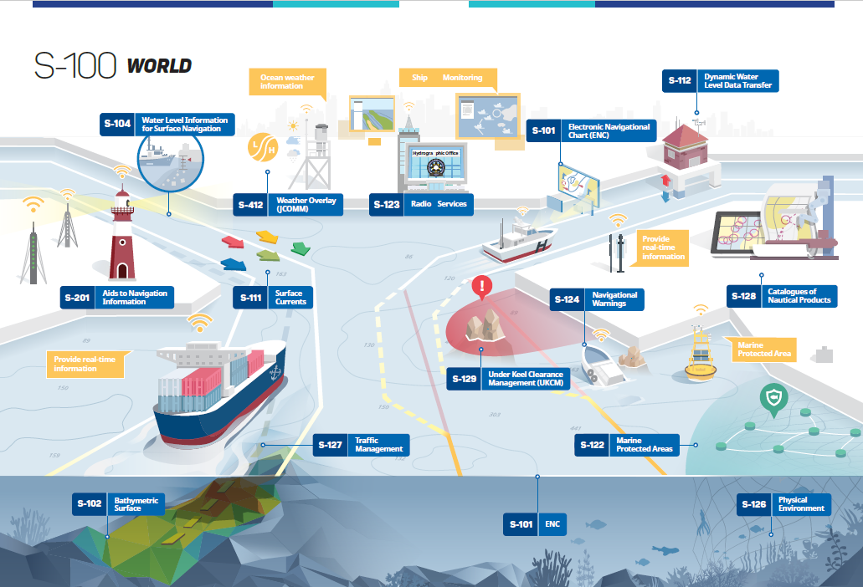

Slide 47
Action requested of HSSC
The HSSC is invited to
  note this report and approve the continuance of the Work Plan.
Approve the actions requested with in this report

Slide 48
Actions Requested of HSSC
HSSC10 endorse the path to publication for Edition 4.0.0 of S-100
  target of an IHO CL for approval in October 2018
Endorse the S-100 Product Specification Guidebook and include it within the S-100 work plan
Assign an S-Number to the Product Specification Guidebook
Endorse the simplified S-100 master plan
Endorse the notional S-100 Timeline for Product Specifications and include it in the HSSC report to the Council

Slide 49
Actions Requested of HSSC
Agree to the publication timeline of S-101 Edition 1.0.0
  target of an IHO CL for approval in October 2018
Agree that the S-100 WG can approve minor editions for S-101 until Edition 2.0.0 goes before HSSC
Endorse the publication of S-102 Edition 2.0.0 with a target date of December 2018
  target of an IHO CL for approval in October 2018

Slide 50
Actions requested of HSSC
Establish a UKCM domain in the S100 Feature Concept Dictionary
Endorse the publication timeline for S-121 Edition 1.0.0 – noting that it still has to undergo a wider stakeholder review
  target of an IHO CL for approval in October 2018
Endorse the establishment of an Maritime Limits and Boundaries Domain within the Feature Concept Dictionary

