Slide 1
EMODnet High Resolution Seabed Mapping
IENWG – 27/09/2017 – Paris & Brest, France
Schmitt Thierry
SHOM, thierry.schmitt@shom.fr

Slide 2
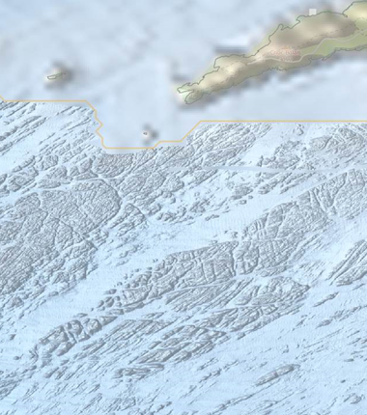
Global objectives
Common method to access data from surveys
Multi-resolution Digital Terrain Model of the seabed
Standard coastline and baseline data
Web portal allowing easy access of the data and data products
Interoperability (INSPIRE) and with organisations from outside EU
Support to users and to the overall EMODnet community (secretariat, other themes)
3rd phase. Initiated in 2009.

Slide 3
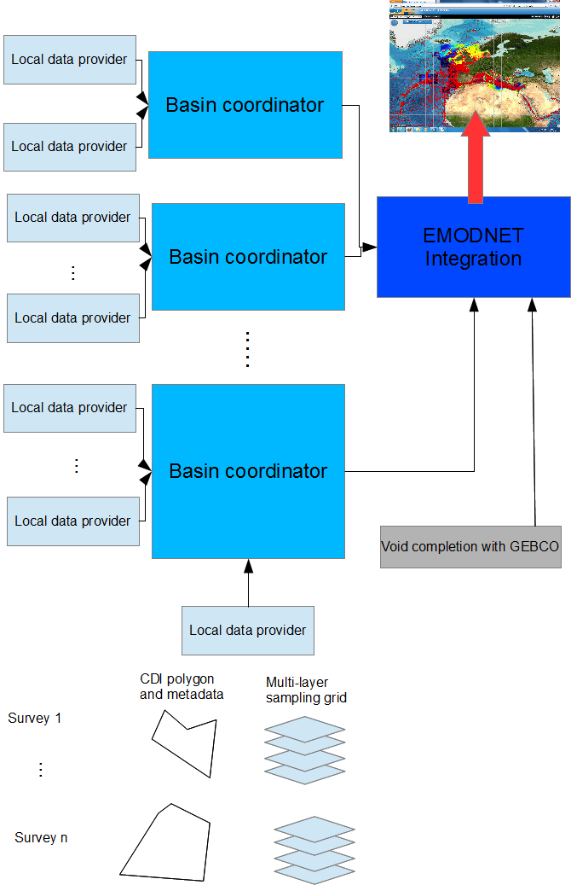
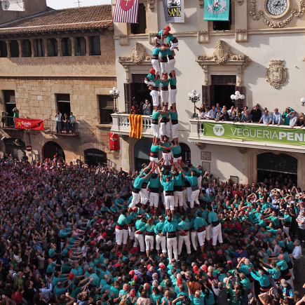
EMODNet bathymetry spirit: distributed roles
Unified method and tools for data and metadata production
Distributed role, from the local data provider, to the integration to the portal
Distributed infrastructure (opposite to a central portal)
Data diffusion is managed at the data provider level, with respect to his own data policy.

Slide 4
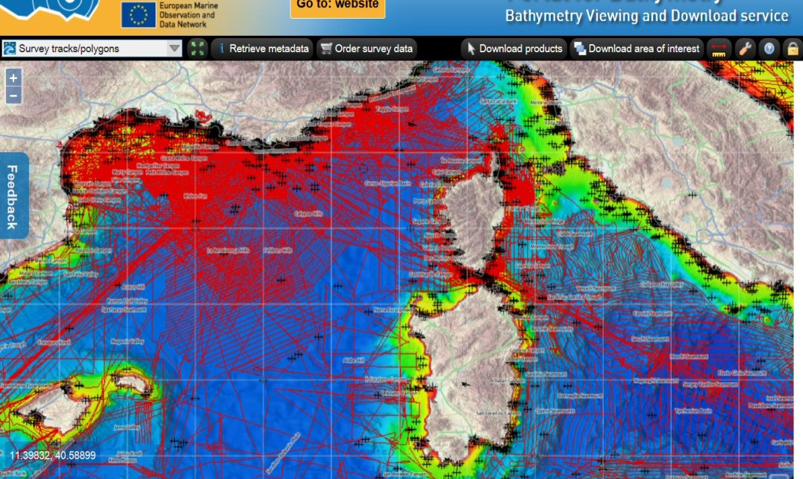
Existing Emodnet Bathymetry
Ongoing since 2009, with one release at 500m, 250m (current version)
Portal allows access and download of the DTM product
Portals allows discovery of source data and connection with the data owner

Slide 5
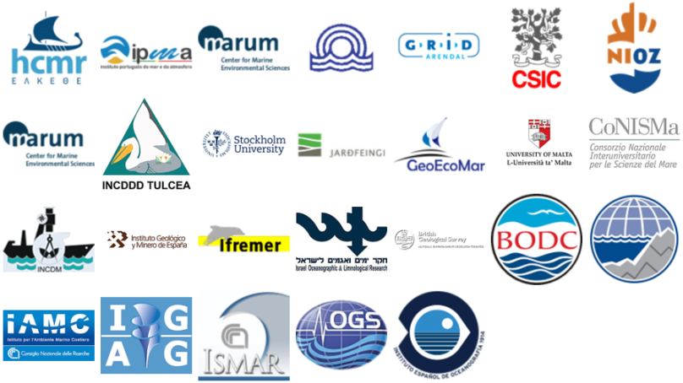
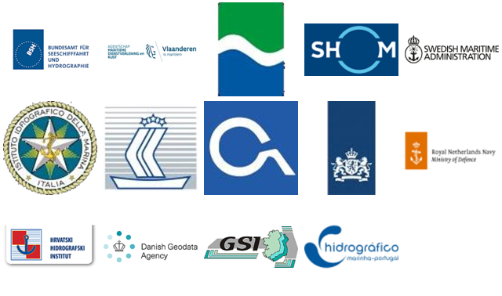
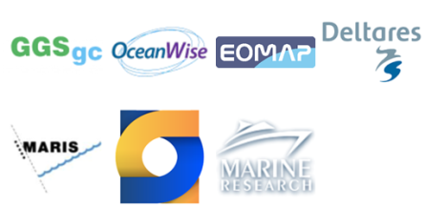
EMODNET -3 Consortium
41 collaborating organisations
Kick-off meeting held end of March 2017

Slide 6
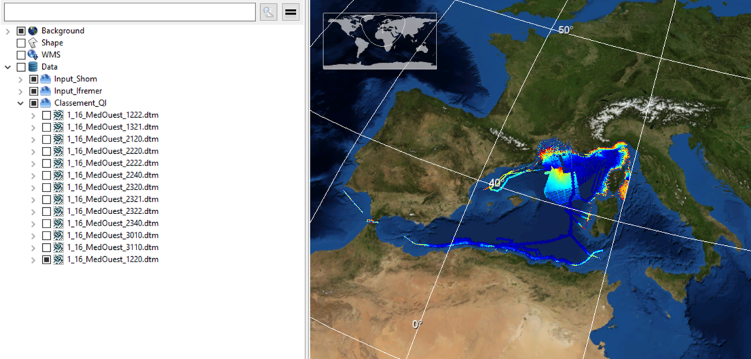
Data and metadata collection Processing and DTM production
Definition of a new quality indicator based on:
Age of dataset
Horizontal and vertical precision
Purpose of the survey
Implemented within data production tools (CDI and CPRD catalogues)
Globe processing software upgraded
All data providers are now preparing and populating updated and new metadata and associated datasets

Slide 7
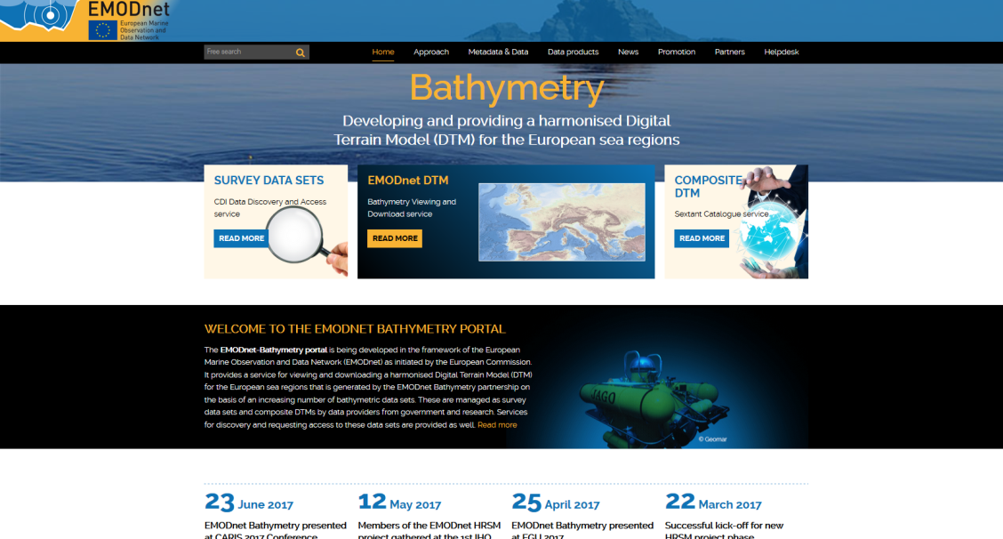
Technical development, portal, tools and services
New modern EMODnet Bathymetry web portal with responsive design implemented
WM(T)S, WFS services running and used for collaborations with NOAA for example
Preparation and review of the set-up for the Virtual Research Environment developments at the DATARMOR computing facilities

Slide 8
Outreach and international collaborations
Since Jan. 2017:
Emodnet bathymetry referenced in 19 peer reviewed papers and 4 book chapters since
8 Conferences (EUG, AGU, CARIS conference, Inmartech, ODIP workshop, EMODNET Geology Kick-off, IHO General assembly, … )
4 Inserts or papers in technical and generalist papers, website
“Workshop on Global Reference grid System” at the initiative of the JRC
Ongoing discussion to:
include Emodnet-Bathy DTM in GE
Collaborate with IHO/GEBCO (Seabed 2030)
Converge with the AtlantOS project

Slide 9
Future actions (6 months)
Gather and populate metadata and pre-process source data
Generate regional basin DTMs
End of first year reporting
Coastal interaction between DTM and tidal levels to generate coastlines
Annual EMODnet HRSM meeting to be held in Heraklion, October 25th and 26th.

