Slide 1
South West Pacific Hydrographic Commission (SWPHC)
Report to IRCC 10 Goa, India – 4 June 2018
Commodore Fiona Freeman, RAN Chair SWPHC Hydrographer of Australia

Slide 2
Commission Membership
Members | Australia (Chair), Fiji (Vice Chair), France, New Zealand (CB Coordinator), Papua New Guinea, Tonga, United Kingdom, United States of America, Vanuatu
Associate Members | Cook Islands, Indonesia, Kiribati, Niue, Palau, Samoa, Solomon Islands
Intergovernmental Observer Organizations | IALA, IMO, GEBCO, Pacific Community (SPC)
Observers | Nauru, New Caledonia, Tuvalu
IHO Representatives | Director Abri Kampfer, Assistant Director Alberto Costa Neves

Slide 3
Meetings, Working Groups and Actions
The 15th SWPHC Meeting held in Nadi, Fiji on 21-22 February 2018 was attended by 39 participants - representing all 9 Member States of the Commission, 6 Associate Members, 2 Observer States, international/regional organisations, industry and the IHO.
Since the last SWPHC meeting, there have been a number of teleconferences and correspondence activities to review the CB Work Plan and to consider CB bids.
The next meeting will be held in Niue in February 2019.
Status of IRCC9 Actions
– refer to full report for status of IRCC actions relevant to SWPHC.

Slide 4
Capacity Building Activities
Activities completed since the last IRCC
IHO CB Activities (CBWP)
Technical Workshop on Implementing Hydrographic Governance (2018 CBWP P-05)
- Aimed to assist PICTs in development and strengthening of hydrographic capacity to meet their
international obligations under SOLAS and to support economic growth and protection of the
marine environment.
- Attended by 29 participants from the PCAs and the PICTs. Presenters from Australia,
New Zealand, United Kingdom, IHO, IALA and The Pacific Community (SPC).
Activities postponed/cancelled
IHO CB Activities (2017 CBWP)
SW Pacific Region Industry Survey Project (CBWP- P-09) – cancelled.
MBES Training in Fiji (CBWP- P-10) – carried forward to 2018.
Solomon Islands Nautical Cartographer Development (CBWP - P-25) – cancelled.

Slide 5
Capacity Building Activities
Activities planned for 2018
IHO CB Activities (2018 CBWP)
Technical Implementation Visit - Samoa (CBWP A-04).
Technical Implementation Visit - Niue (CBWP A-05).
(Follow-up of the Technical Assessment & Advice Visits carried out in 2016. The visits are to ensure that Samoa and Niue fulfil their SOLAS V obligations (V/4 & V/9), by providing support to implement the recommendations of the technical visits.)
MBES Training in Fiji (CBWP P-P32) - planned for October 2018.
MSI Regional Workshop (CBWP P-11) - planned to be held in NZ in late 2018.

Slide 6
Capacity Building Activities
Major Support Activities
UK Commonwealth Marine Economies (CME) Programme
CME Programme aims to support the sustainable growth of Commonwealth Small Island Developing States (SIDS) within the Caribbean, Pacific and Indian Ocean regions.
Part of the Programme includes providing surveys, charting and capacity building in the SWPHC. Surveys of critical areas in Nukualofa, Tonga conducted and a number of activities are underway in the region (Vanuatu, Tuvalu and Fiji).
NZ Pacific Regional Navigation Initiative (PRNI)
Progress continues in the PRNI with increasing data discovery, risk assessment, capacity building, mitigation measures and partnerships.
Samoa: Hydrographic risk assessment; MSI training; Bilateral Arrangement signed.
Tonga, Niue, Tokelau, Cook Islands: Satellite Derived Bathymetry (SDB) produced
Airborne Laser Bathymetry (ALB) planned in Tonga and Niue this year.
MBES in Tonga using an Unmanned Surface Vessel (Oct-Nov 2018).
Nine ENCs and six charts of Tonga and Samoa produced using data held by SPC.
PNG Maritime and Waterways Safety Project
As part of this ADB project surveys were conducted in Papua New Guinea ports and coastal areas. The data will be used for updating relevant charts.

Slide 7
Capacity Building Activities
Achievements
Considerable progress in hydrographic activities in the region since the last meeting.
Surveys and Charting
Fiji has conducted new surveys and published charts. Plans to expand the hydrographic service to include support of data management and oceanographic operations.
Vanuatu has obtained Cabinet approval for survey of 10 priority areas.
Tonga, Cook Islands, Samoa, Niue, Tokelau: Various activities carried out under NZ PRNI.
United States of America plans to conduct surveys and charting in the region. Recently six ENCs were produced covering the waters surrounding the Palau Islands.
Australia became PCA for Solomon Islands in August 2017.
IHO and SWPHC membership
Vanuatu became an IHO Member in 2017 and a full Member of the SWPHC.
Solomon Islands is in the process of becoming an IHO Member.
Cook Islands, Kiribati, Samoa and Tuvalu indicated their intention to join the IHO.
Indonesia became an Associate Member of the SWPHC.

Slide 8
Capacity Building Activities
Achievements
Governance
Vanuatu established a National Hydrographic Committee and plans to build a new Hydrographic Survey Unit within the Lands and Survey Department.
Kiribati has appointed a National Coordinator for MSI and plans are underway to establish Hydrographic Services.
Samoa established a National Hydrographic Committee. Plans to appoint a National Coordinator for MSI and to establish a National Hydrographic Authority.
Niue plans to establish a National Hydrographic Authority and a National Coordination Committee.

Slide 9
Capacity Building Activities
Challenges
Capacity of the Capacity Builders
Support from the PCAs for CB activities in the SWPHC is under constant strain as the balance is maintained against other national priorities and resource management.
Increased support from the IHO Secretariat is critical to the ongoing success of the IHO CBWP, not only merely for implementing the CBWP but also for its effectiveness, governance and due diligence to MS. The recent recruitment of an additional staff member to support CB Assistant Director at the IHO Secretariat will assist with administrative work associated with this activity.

Slide 10
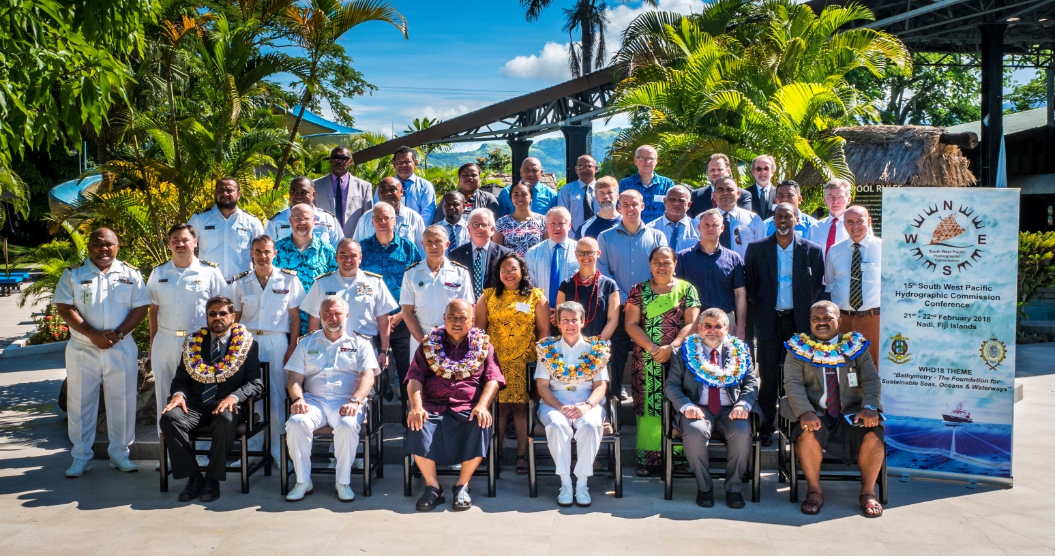
Actions required from IRCC
IRCC members are invited to:
note this report
note the value and effectiveness of preceding SWPHC meetings with a CB related workshop
15th SWPHC Meeting - Nadi, Fiji, 21-22 February 2018

Slide 11
