Slide 1
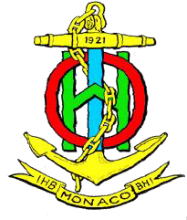
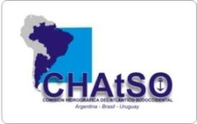
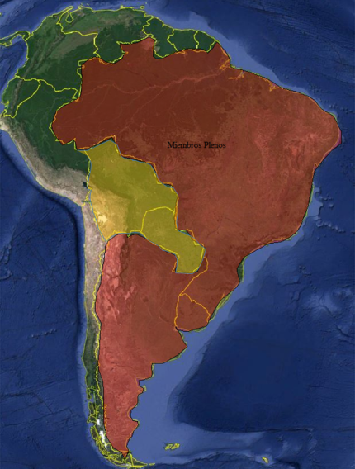
10 ^{th} MEETING OF THE IHO INTER-REGIONAL COORDINATING COMMITTEE
IHO-IRCC 10
Goa India, 4-6 June 2018
South West Atlantic Hydrographic Commission (SWAtHC) Report
In 2006, Argentine, Brazil and Uruguay signed the cooperation agreement that result in the South West Atlantic Hydrographic Commission (SWAtHC). Main achievements have been the development of a regional Cartographic Plan, establishment of a Planning Commission to coordinate INT Charts and ENC production and the acceptance of Bolivia and Paraguay as Observer and Associate Members.

Slide 2
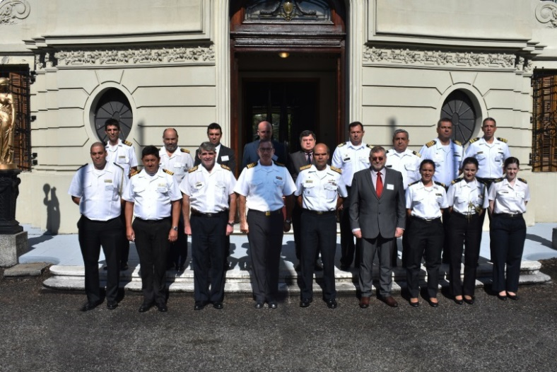
10 ^{th} MEETING OF THE IHO INTER-REGIONAL COORDINATING COMMITTEE
IHO-IRCC 10
Goa India, 4-6 June 2018
Chair: Captain Pablo TABAREZ (Uruguay)
Vice-Chair: Commodore Valentin Alejandro SANZ RODRIGUEZ (Argentina)
Full Members: Argentina, Brazil and Uruguay.
Associate members: Paraguay.
Observers: Bolivia (presenting membership request as associate member)
Last Meeting: 12 SWAtHC took place at Service Oceanographic Hydrogaphic and Meteorological of Uruguayan Navy (SOHMA), Montevideo Uruguay (5-6 April, 2018)
Next meeting: will be held in Mar del Plata Argentina 2019
Photo at SOHMA

Slide 3
10 ^{th} MEETING OF THE IHO INTER-REGIONAL COORDINATING COMMITTEE
IHO-IRCC 10
Goa India, 4-6 June 2018
South West Atlantic Hydrographic Commission (SWAtHC) Report Key achievements
A contingency plan was celebrated between NAVAREA V (Brazil) and NAVAREA VI (Argentina) to ensure that broadcast and monitoring Maritime Safety Information (MSI) are not interrupted in case of failure of one of these systems.
SWAtHC created a Geoportal with spatial data with ENCs published by the Member States, whose the main propose is to facilitate the work of harmonization of boundaries and risk assessment.
The full members has approved the request of The Servicio Nacional De Hidrografía Naval de Bolivia, and start the procedure of adhesion to became as an Associate Member of SWAtHC. That Service should address this to its national authorities

Slide 4
10 ^{th} MEETING OF THE IHO INTER-REGIONAL COORDINATING COMMITTEE
IHO-IRCC 10
Goa India, 4-6 June 2018
South West Atlantic Hydrographic Commission (SWAtHC) Report
Capacity Building
Activities Completed on 2017
CBWP P-16 Bathymetry training course using RTK technology (DHN-Brasil)
CBWP P-22 Digital Photogrammetry with satellite images (SHN-Argentina)
CBWP P-27 Data Management Workshop (SOHMA-Uruguay)
CBWP P-21 Workshop offshore surveys (geophysical analysis and identification
of seamounts) .SEPRHC

Slide 5
10 ^{th} MEETING OF THE IHO INTER-REGIONAL COORDINATING COMMITTEE
IHO-IRCC 10
Goa India, 4-6 June 2018
Main items under consideration:
SWAtHC INT Chart scheme has a total of 47 charts. From these, 34 charts (73.9%) have already been published.
Country | INT Charts Scheme | INT Charts available | %
ARGENTINA | 11 | 3 | 27%
BRASIL | 32 | 31 | 96%
URUGUAY | 1 | 0 | 0%
ARG/UY | 2 | 0 | 0%
TOTAL | 46 | 34 | 73.9%

Slide 6
10 ^{th} MEETING OF THE IHO INTER-REGIONAL COORDINATING COMMITTEE
IHO-IRCC 10
Goa India, 4-6 June 2018
Main items under consideration:
SWAtHC ENC scheme has a total of 233 cells. From these, 192 cells (82 %) have already been released.
Country | Cells Scheme | Cells Available | %
BRASIL | 122 | 107 | 87%
ARGENTINA | 65 | 58 | 89%
URUGUAY | 46 | 27 | 55%
TOTAL | 233 | 192 | 82%
The end result is that the region has no significant overlaps, no unassessed CATZOCs and gaps are being addressed.

Slide 7
10 ^{th} MEETING OF THE IHO INTER-REGIONAL COORDINATING COMMITTEE
IHO-IRCC 10
Goa India, 4-6 June 2018
South West Atlantic Hydrographic Commission (SWAtHC) Report
Conclusions
SWAtHC is committed to carrying out forward hydrographic, cartographic and capacity building activities in a straight alignment with IHO objectives and goals. In addition, SWAtHC join efforts to coordinate nautical charts and ENCs production, harmonizing boundaries.
Action Required of IRCC9 : refer to full report for status of IRCC actions relevant to SWAtHC Chair

