Slide 1
Report of the Marine Spatial Data Infrastructures Working Group (MSDIWG) to IRCC10

Slide 2
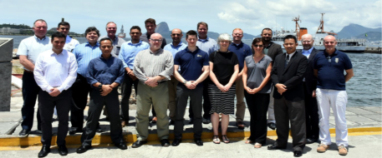
Principal activities and achievements
The MSDIWG9 meeting of took place in Niteroi (Rio de Janeiro), 30 January – 1 February 2018. The MSDIWG meeting was preceded firstly on 29 January by a MSDI Open Forum and after the MSDIWG9 meeting on the 2 February 2018 an OGC Marine Domain WG was arranged.

Slide 3
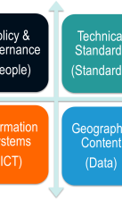
Principal activities and achievements
MSDIWG9 topics:
Information on MSDI implementation from MSDIWG members
IHO strategic plan and establishing a draft IHO MSDI vision 2025/2030
MSDI e-learning
Improving the availability of bathymetric data Worldwide
UN-GGIM
The MSDIWG to focus on security
Update of C 17
The IHO/OGC conceptual study
Spatial Data Quality
S-100
Cooperation with the International Cable Protection Committee
Cooperation with OGC
Revision of the MSDIWG Work Plan
The four basic components of MSDI

Slide 4
Principal activities and achievements
Next Planned Meeting:
MSDIWG10
The IHO/MSDIWG will hold a three day-long MSDIWG10 meeting, a MSDI Open Forum and an OGC Marine Domain
WG meeting in 2019 in Busan, Republic of Korea, on 4 to 8 March 2019.
MSDI Open Forum
The IHO/MSDIWG will continue to facilitate a MSDI Open Forum which would allow non-MSDIWG stakeholders (e.g. RHC MS, government, academia, industry, funding bodies and NGOs) to attend to see what the MSDIWG and the commercial partners can offer. Attendees at the Open Forum would then be encouraged to stay on for the MSDIWG10 meeting. This approach is being developed in consultation with the hosts.
Logistics and meeting details will be available at:
https://www.iho.int/srv1/index.php?option=com_content&view=article&id=483&Itemid=370&lang=en

Slide 5
Principal activities and achievements
A | Communication and dissemination
B | Operational - Data sharing and management
C | Policies and governances – RHC. (Ensure that MSDI is a standing agenda item for RHCs’ meetings (IHO Res 2/1997, as amended, refers))
D | Standards (OGC and HSSC)
E | Innovation – Future perspectives (2021 - 2023)
F | Training and education
G | Maintain and extend the publication IHO MSDI C-17 (IHO Task 3.9.2.1 refers)
H | Conduct annual meetings of MSDIWG, arranged back to back with 1-day MSDI Open Forum (IHO Task 3.9.1 refers)

Slide 6

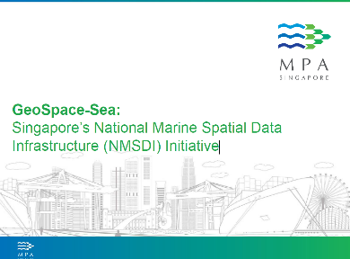
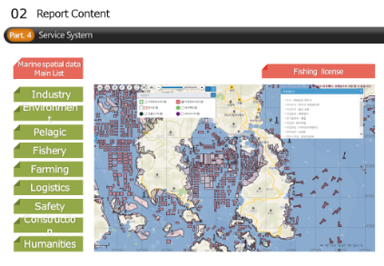
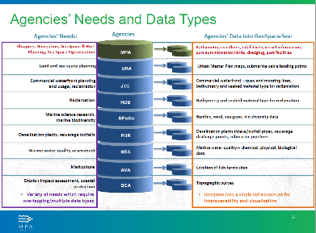
Principal activities and achievements
Information on MSDI implementation from MSDIWG members

Slide 7
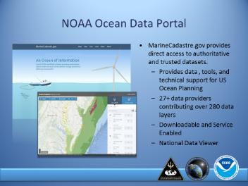
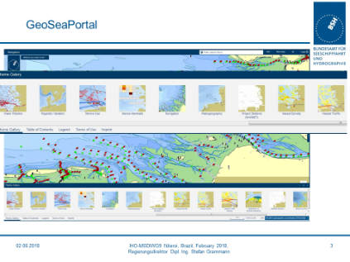
Principal activities and achievements
Information on MSDI implementation from MSDIWG members

Slide 8
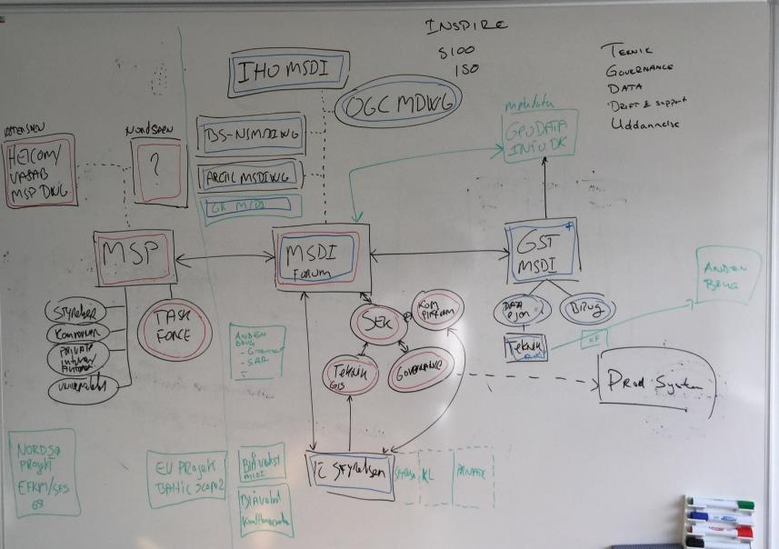
Principal activities and achievements
The Danish
MSDI landscape

Slide 9
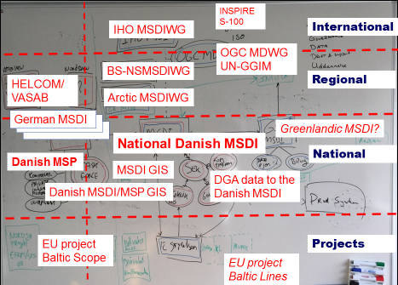
Principal activities and achievements
The Danish
MSDI landscape

Slide 10
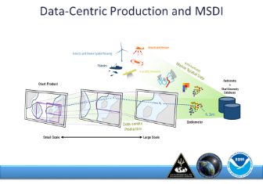
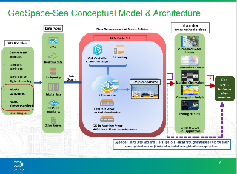
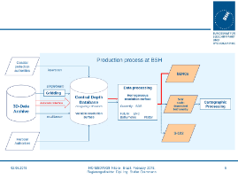
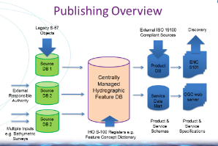
Principal activities and achievements
Data-Centric
Information on MSDI implementation
from MSDIWG members

Slide 11
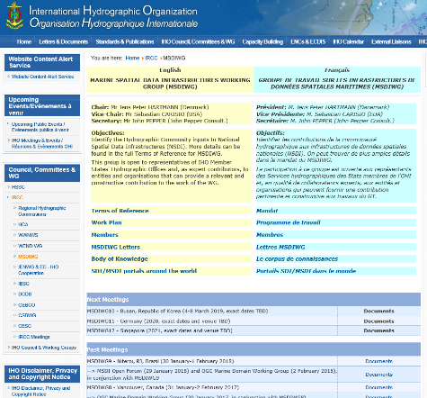
Principal activities and achievements
MSDI Case Study Summary Information Sheet

Slide 12

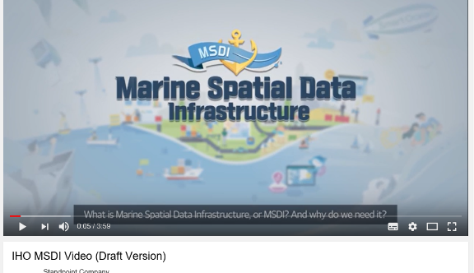
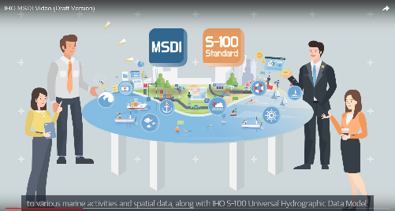
Principal activities and achievements
Communication and dissemination

Slide 13
Security and Integrity
Security
  Unauthorised use (e.g stealing a car, downloading a pirate movie)
  To demonstrate “authorised use” some form of “permission” is required.
Integrity
  Who sent me this? Is it complete?
  Different from “is it correct?”
Different concepts.
In MSDI often integrity has a higher priority than security.
Why? Because often MSDI is built with the express purpose of promulgating data so most (not all) use is “authorised”
The conclusion we came to was the issue is “integrity” which relies on two things, knowing who a piece of data came from and the knowledge that it has not changed in its journey to the end user. This is also dealt with by IHO S-63 in the form of its digital signatures.

Slide 14
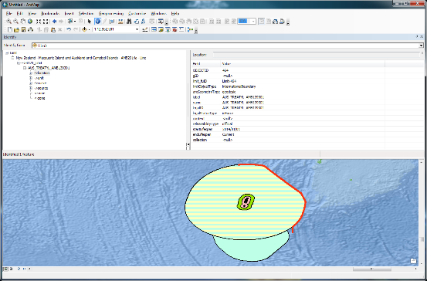
Security and Integrity - The issue within the MSDI community
Where are the risks?
Much MSDI data relates to boundaries, administrative, legal, cadastral etc.
Impact of incorrect reproduction or attribution can be very large.
Is there a ready-made solution?
Ongoing need to consider this issue
Consider existing mechanisms
  Stream based may not be suitable for “data centric” models
  IHO S-63 relies on a specific end user system
  Other standards exist but may need adaptation
  All require a “trust network” to define identitiy.
Consider that one of the fundamental datasets recently under consideration are UNCLOS maritime limits and boundaries. These datasets are simple, by comparison with the complex geospatial data which make up ENC but their economic and political weight are enormous and the impact of their incorrect reproduction through an MSDI environment is of concern.
UNCLOS official limits and boundaries are often promulgated alongside other official boundaries such as marine protected areas, fishing zones and many others which define rights and responsibilities as part of a harmonised marine cadastral system.
The challenge, technically, is to provide means and mechanisms to protect the data integrity and assure the end user of the provenance of the data they are receiving.
Notes:
Example Treaty Limit
Red is treaty

Slide 15
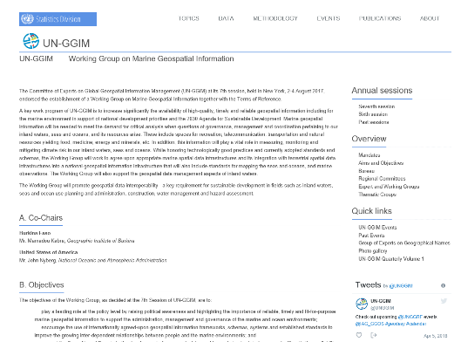
UN-GGIM - Working Group on Marine Geospatial Information
http://ggim.un.org/UNGGIM-wg8/

Slide 16
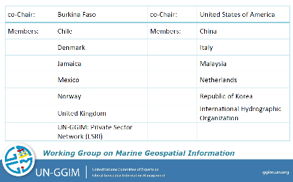
UN-GGIM - Working Group on Marine Geospatial Information

Slide 17
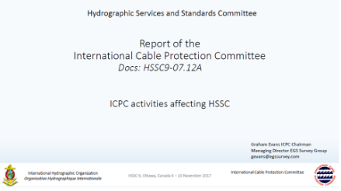

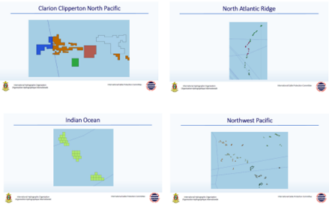
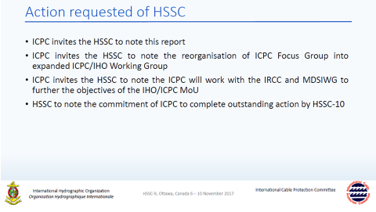
Cooperation with the International Cable Protection Committee

Slide 18
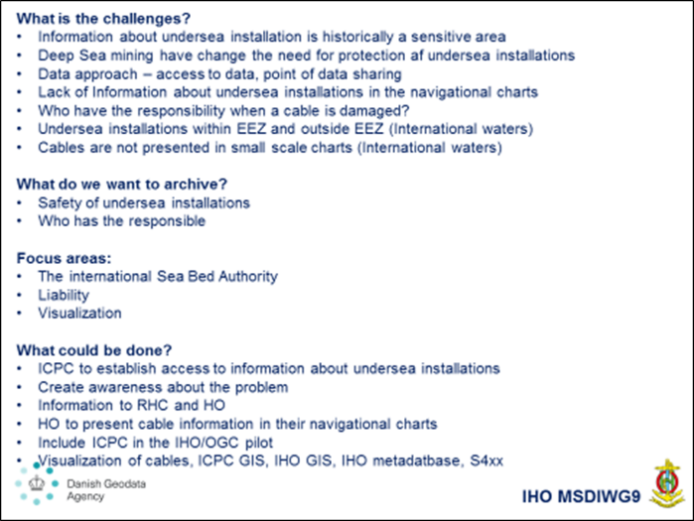
Cooperation with the International Cable Protection Committee

Slide 19
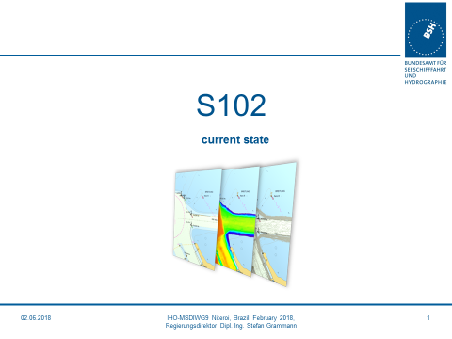
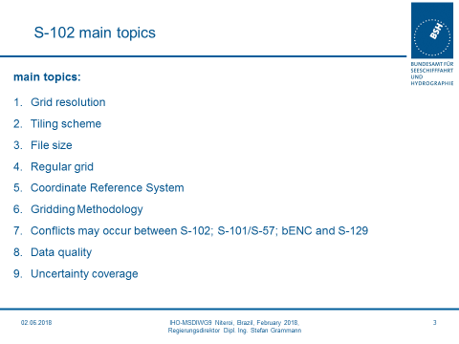
S-102 from a MSDI perspective

Slide 20
IHO MSDIWG Vision Statement (DRAFT)
The IHO MSDIWG vision is to enable open, accessible, and interoperable Marine Spatial data and information.
The broader use of MSDI will be able to connect people and systems.
This will create value, marine knowledge, and enhance decisions for the benefit of society, at any level of development, and sustain the environment.

Slide 21
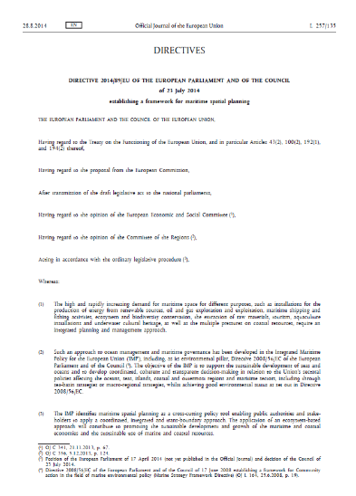
Future work program – Marine Spatial Planning - MSP
Maritime spatial planning
Article 6
Minimum requirements for maritime spatial planning
Member States shall establish procedural steps to contribute to the objectives listed in Article 5, taking into account relevant activities and uses in marine waters:
(e) Organise the use of the best available
data in accordance with Article 10.
(f) Ensure trans-boundary cooperation
between Member States in accordance
with Article 12.
(g) Promote cooperation with third countries
in accordance with Article 13.

Slide 22
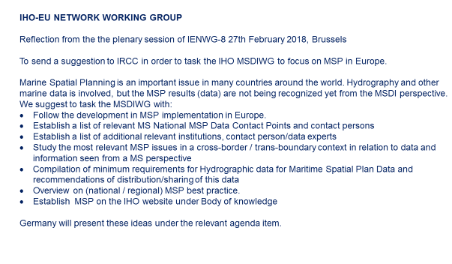
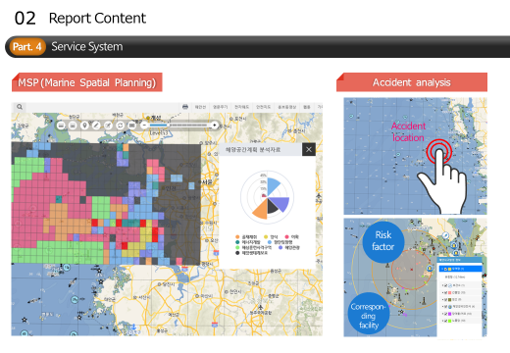
Future work program - Marine Spatial Planning - MSP
To focus on Maritime Spatial Planning from an international perspective?

Slide 23

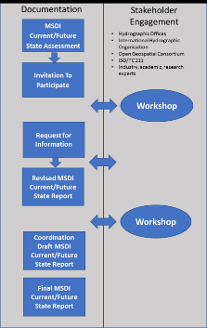
Future work program
Investigate the possibilities to establish an IHO
Metadata platform for Hydrographic data?
Establish a MSDI e-learning platform
IHO OGC MSDI Concept
Development Study (CDS)

Slide 24
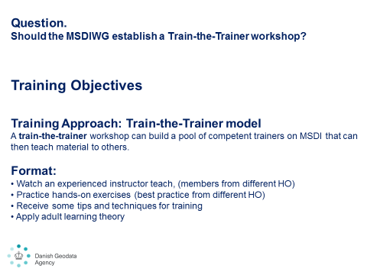
Future work program
Investigate the need and possibilities to use
S-58 and S-64 from a MSDI approach.
Establish a Train-the-Trainer workshop/training.

Slide 25
Action requested of IRCC
The IRCC10 is invited to:
note the report
approve the work programme
discuss how the MSDIWG should deal with
marine Spatial Planning in the future
discuss any item with relevance to SDI/MSDI
and to take appropriate actions.

Slide 26
End of the report from the Marine Spatial Data Infrastructures Working Group
(IHO MSDIWG)

