Slide 1
Work Programme No. 3 Reference Doc: A.1/WP3/01
Baltic Sea Hydrographic Commission
(BSHC)

Slide 2
Baltic Sea Hydrographic Commission
(BSHC)
Chair : Mr Mindaugas Cesnauskis (Lithuania)
Vice–Chair: Dr Mathias Jonas (Germany)
Members: Denmark, Estonia, Finland, Germany, Latvia, Poland, Russian Federation, Sweden
Associate Members: Lithuania
Observers: United Kingdom

Slide 3
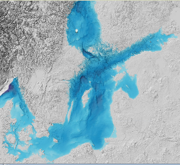
BSHC Key Achievements of Interest for IRCC
Commonly coordinated and monitored Re-survey
Practical outcome: FAMOS project
Provision of the joint Baltic Sea Bathymetric Database
Implementation of a Harmonized Chart Datum
Parallel processing of all ENC and paper chart issues
Collaboration with NSHC in Marine Spatial Data Infrastructure affairs
BSHC Information and GIS services are publicly available under www.bshc.pro
Active participation in the IHO-EU Network Working Group
Notes:
The cooperation within the BSHC is very productive. Several projects have led to joint databases and results provided in the web. The outreach of the hydrographic work in the region and beyond has improved even further.
Member states have continued to contribute extensively to the work of the IHO and have been active participants of various working groups.
There has been substantial cooperation between commission member states and other European States and the EU on information sharing and shared projects.

Slide 4
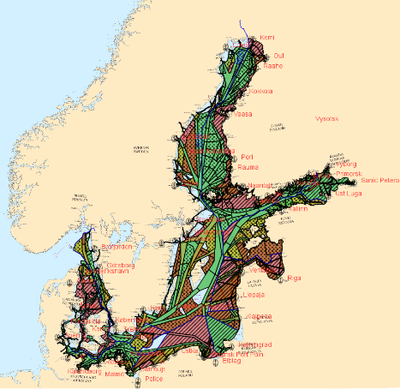
Difficulties encountered and challenges yet to be addressed
none, except:
Lithuania as Associate Member is not a member of the IHO. Since Lithuania is currently holding BSHC chair, IHO related activities are therefore effectively processed by the Vice Chair (Germany).

Slide 5
Actions required of the Assembly
The Assembly is invited to take note of be means of this report that:
The cooperation within the BSHC is very productive. Several projects have led to joint databases and results provided on the web. The outreach of the hydrographic work in the region and beyond has improved even further.
Member States continue to contribute extensively to the work of the IHO and have been active participants of working groups.
There has been substantial cooperation between the commission’s Member States and other European States and the EU on information sharing and shared projects.

Slide 6
www.iho.int

