Slide 1
Regional Hydrographic Commission Report to IRCC9
SAIHC
Presented by Vice Chair Rear Admiral Tim Lowe

Slide 2
SOUTHERN AFRICA & ISLANDS HYDROGRAPHIC COMMISION (SAIHC)
Chair: Captain Abri Kampfer (SA)
Vice Chair: Rear Admiral Tim Lowe (UK)
Members: France, Mauritius, Mozambique, Norway, Republic of South Africa, UK.
Associate Members: Angola, Comores, Kenya, Madagascar, Malawi, Namibia, Portugal, Seychelles, Tanzania.
Observers: Brazil and United States of America

Slide 3
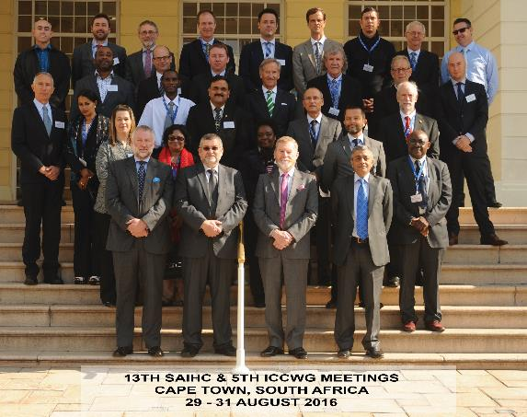
Last Meeting - 13th SAIHC Conference, Cape Town, South Africa: 30 - 31 August 2016

Slide 4
Industry Participation

Slide 5
Difficulties & Challenges
Participation of Associate Members
INT Charts
Capacity Building

Slide 6
Capacity Building
2016 Phase 1 Skills training course
2017 MSI training course

Slide 7
Conclusion
Statutes
Disaster Response
ICCWG

Slide 8
Actions Required of IRCC9
IRCC is invited to note this report.
Thankyou

