Slide 1
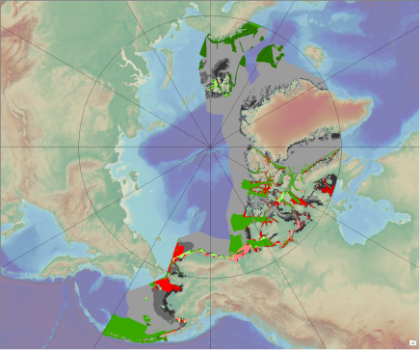
Arctic Regional Hydrographic Commission (ARHC)
Arctic Regional Hydrographic Commission (ARHC)
ARHC report to IRCC9
Paramaribo, Suriname, 12-14 June 2017
Presentation to IRRC9

Slide 2
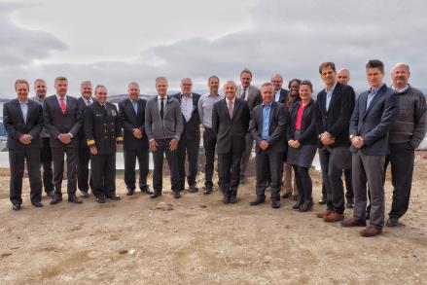
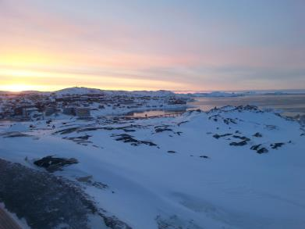
Arctic Regional Hydrographic Commission (ARHC)
Meetings:
Since last IRCC8 meeting there has been two ARHC meetings:
- 6th Conference – Iqaluit, Nunavut, Canada (3 and 6 October 2016)
- Special ARHC meeting – Monaco (26 April 2017)
Next meeting will be in Ilulissat in Greenland, 22-24 August 2017.

Slide 3
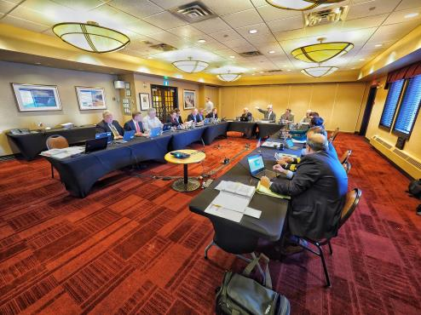
Arctic Regional Hydrographic Commission (ARHC)
Current ARHC Working Groups:
a) ARHC Strategic Planning Working Group (SPWG) [Dormant ]
b) ARHC Operations and Technologies Working Group (OTWG)
Arctic International Charting Coordination Working Group (AICCWG)
Arctic Regional Marine Spatial Data Infrastructure Working Group (ARMSDIWG)

Slide 4
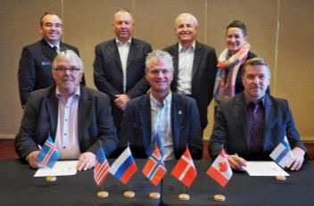
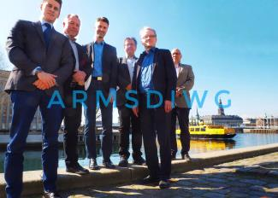
Arctic Regional Hydrographic Commission (ARHC)
Agenda Items:
The main subjects dealt with during the reporting period were the following:
Operational and Technical Working Group with an emphasis on Hydrographic Risk Assessment in the Arctic.
Arctic International Charting Coordination Working Group
Established Arctic Regional Marine Spatial Data Infrastructure Working Group
Establishing an Arctic Voyage Planning Guide for mariners
Investigate potential of remote sensing and satellite-derived bathymetry (SDB)
Investigate potential of crowd-sourced bathymetry for use within the Arctic community
MIO-services

Slide 5
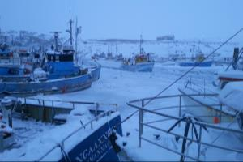
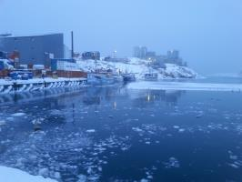
Arctic Regional Hydrographic Commission (ARHC)
Conclusions:
ARCH has positioned itself as the Regional Hydrographic Commission that deals with regional hydrographic and charting issues in the Arctic
ARHC engages across the Arctic community to communicate the hydrographic and charting data situation
ARHC has made great strides to improve our understanding of the hydrographic data environment and communicate this situation to a broad community of users.
Establish an Arctic Regional Marine Spatial Data Infrastructure Working Group (ARMSDIWG)

Slide 6
Arctic Regional Hydrographic Commission (ARHC)
Actions required from the IRCC9:
The IRCC9 is invited to:
a) take note of the ARHC report
b) discuss the challenges with MIO’s and to take actions as deemed appropriate.

