Slide 1
IRCC9 Input from HSSC8
Reference Doc: IRCC9-09A
Notes:
GB: use larger font size to facilitate reading from the back of the auditorium

Slide 2
The eighth meeting of the Hydrographic Services and Standards Committee (HSSC) took place from 14 to 18 November 2016 at the IHO Secretariat in Monaco.
The meeting was attended by 74 representatives from 22 Member States, nine international organizations accredited as observers and the IHO Secretariat.
The IRCC Chair reported on the main outcome of the IRCC-8 meeting that were of interest for the HSSC.
Increasing developments of S-57-based products and charts for the non-SOLAS market and encouraged IHO Member States to share their experience on this matter.
Notes:
GB:
Use larger font size
Add a bullet point « actions required »

Slide 3
The HSSC decided to disband the Data Protection Scheme Working Group (DPSWG) and:
to transfer to the S-100WG the development of the protection scheme (component equivalent to S-63 -IHO Data Protection Scheme) of S-100 based-products;
to task the ENC Standards Maintenance WG for the maintenance and monitoring of the existing S-63 standard.
Notes:
Know the earth – show the world – understand the world

Slide 4
The Committee established a Project Team on the Standards for Hydrographic Surveys (HS PT)
to conduct a comprehensive review of IHO Publication S-44 - IHO Standards for Hydrographic Surveys in order to develop and propose recommendations on the way forward, with the possible creation of a hydrographic surveys working group in the future (see IHO CL 26/2017).
Notes:
GB:
Use larger font size
Add a bullet point « actions required »

Slide 5
Issues of interest to the IRCC
Ecological Marine Units
In relation with the development of S-122 - Marine Protected Areas, the Committee noted the concept of Ecological Marine Units being developed through a public-private partnership led by Esri and the US Geological Survey (USGS) and invited the MSDIWG to consider further the concept.
Notes:
GB:
Use larger font size
Add a bullet point « actions required »

Slide 6
Issues of interest to the IRCC
Data Quality
HSSC noted that a major source of discontent from mariners in relation with ENC quality indicators was caused by the fact that many HOs were not populating CATZOC (Category Zone of Confidence) values in the ENCs.
HSSC invites the IRCC to remind IHO Member States of the importance of populating ENCs with assessed CATZOC values (1 to 5), noting that the concept of CATZOC values will remain valid for future S-101 ENCs.
Notes:
GB:
Use larger font size
Add a bullet point « actions required »

Slide 7
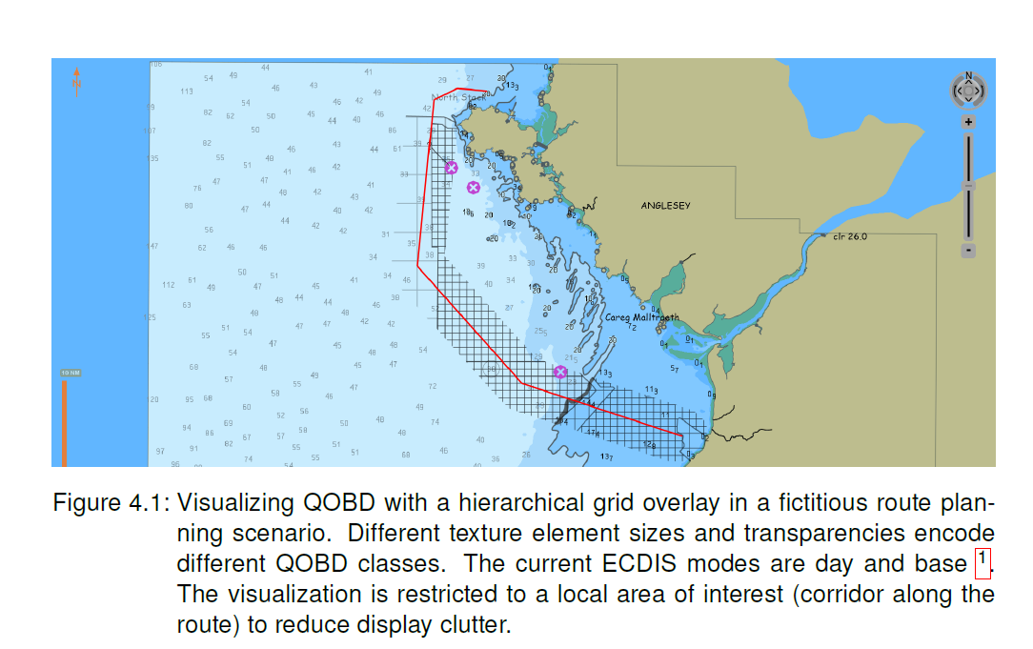
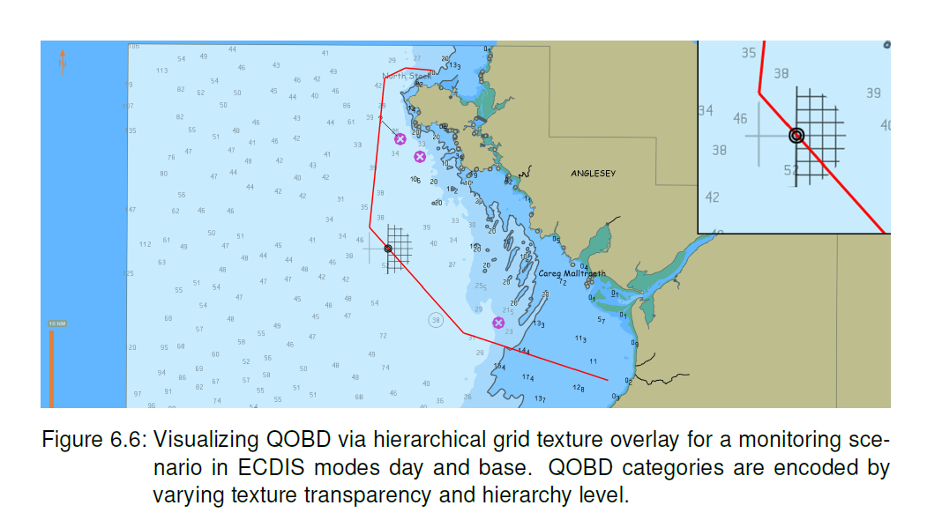
Issues of interest to the IRCC
Data Quality vizualisation
Notes:
GB:
Use larger font size
Add a bullet point « actions required »

Slide 8
Issues of interest to the IRCC
S-124 - Navigational Warnings
France reported on the activities of the S-124 Correspondence Group (CG) on Navigational Warnings.
The Committee noted the report and reiterated its views that S-124 is not intended to become an interim solution for providing “equivalent” T&Ps in ENC updates.
Notes:
GB:
Use larger font size
Add a bullet point « actions required »

Slide 9
Issues of interest to the IRCC
Undersea Feature Names
HSSC endorsed the TORs of the Undersea Feature Name (UFN) Project Team submitted by the Sub-Committee on UFN (SCUFN) and included liaison with this Project Team on its work to incorporate UFN into the S-100 framework.
T&P for ENCs
NCWG is tasked to prepare a single educative IHO authoritative document addressing the issue of “equivalent”T&Ps for ENCs, in view of its distribution to HOs, Port State Control authorities and mariners
Notes:
GB:
Use larger font size
Add a bullet point « actions required »

Slide 10
Cooperation with the IHO Stakeholders
OGC on the development of the Discrete Global Grid Systems (DGGS),
CIRM on the development and assessment of a comprehensive, non-generic e-navigation training programme,
ISO/TC211 19100 series of standards and specifications underpins S-100.
Notes:
GB:
Use larger font size
Add a bullet point « actions required »

Slide 11
Action requested from IRCC
To take note of the report
To adress IRCC items of relevance for HSSC and to collaborate with HSSC to progress in common
Notes:
GB:
Use larger font size
Add a bullet point « actions required »

Slide 12
www.iho.int

