Slide 1
Brief on
Nautical Information Provision Working Group work
NCWG4 The Hague
Presented by Mr. Yves Guillam (on behalf of NIPWG)

Slide 2
Activities and achievements
Development of NPUB Scope
Development of S-100 based data model
Development of NPUB Product Specs
Contributions to IMO e-Navigation
Maintaining M-3 parts relevant for NPUBS
Maintaining various IHO Standards
  S-12 List of Lights
  S-49 Mariners‘ Routeing Guide
Notes:
Since 1999, the group has developed and maintained a scope of nautical publication content. Based on the initial scope, development of a data model based on S57 was started.
S-100 has had significant impacts on the data model as it now allows the option to extend the set of features by information objects and complex attributes. These new types offer greater flexibility of the model.
The working group is heavily engaged in NPUB Product Specification development. That included the cooperation with the contractors during the development process of S-122 (Marine Protected Areas), S-123 (Radio Services), S-127 (Traffic Management) and the work on S-128 (Catalogue of Nautical Products).
Other product specifications under NIPWG remit have been deleveloped to a certain level of maturity but are on hold based on HSSC decision.
The WG is engaged in e-navigation discussions and coordinates the IHO work in that regard.
A permanent work item is to check the significance of IHO Resolutions M-3 relevant for Nautical Publications and to suggest amendments if considered necessary.
The group is responsible for maintaining certain IHO Standards.

Slide 3
NPUB ProdSpecs Status
Product specs |  |  | Overall Working Status
S-122 Marine Protected Areas |  |  | Member State Approval
S-123 Radio Services |  |  | Member State Approval
S-125 Navigational Service |  |  | On hold
S-126 Physical Environment |  |  | On hold
S-127 Marine Traffic Management |  |  | Under contract, in progress
S-128 Catalogue of Nautical Information |  |  | Under contract, in progress
S-1xx Marine Services |  |  | Planned
S-1xx Digital Mariner ‘s Routeing Guide |  |  | Planned
S-1xx Harbour Infrastructure |  |  | Planned
S-1xx (Social/Political) |  |  | Planned
Notes:
NIPWG contracted out the completion of S-122 (MPA) and S-123 (Radio Services). The product specifications were delivered in time and are in the Member State approval process.
Considering the outcome of an impact study for both product specifications, it can be said that most HOs are not ready for the production of S-122 or S-123 data sets. Reasons are missing production tools, missing administrative orders by their administration of a lack of knowledge on S-100 environment.
The US and Germany are planning to release S-122 data sets for their waters withing the next 6 months.
The S-125 and S-126 developments are on hold based on HSSC decision.
In parallel, the S-125 Sub-Team investigated gaps between S-101 (ENC), S-125 (Navigational Services) and S-201 (IALA AtoN) . The current position is to seek the widest possible data model harmonisation between S-101 and S-201. The decision to resume the S-125 development should be based on results of this harmonisation work.
The work on S-125 raises a principle question of whether the IHO should provide comprehensive AtoN information in parallel with S-201 or if the AtoN information provision should belong entirly to IALA. That is the introduction of the conceptual data model.
The S-126 Sub-Team is doing small work and investigates the level of details to be provided depends on user needs. The answer on the question of the intended use of this product specification is under consideration.
S-127 can be considered as the remaining Product Specification which fits and complements nicely with the S-122 (MPA) and S-123 (Radio Services) by providing digitized and interoperable information to support bridge operations during a voyage, as well as related activities such as voyage planning. The functions to be supported include route monitoring, route planning, and reporting functions.
S-127 will complement S-101 (ENC), S-102 (Bathymetric Surface), S-122 (Marine Protected Areas), and S-123 (Radio Services) with information about routeing, pilotage, ship reporting (including requirements, times, and locations for reports), and vessel traffic services.
S-127 completes the set of three product specifcations which, together with S-101 (ENC), could potentially convince stakeholders to replace S-57 ECDIS by S-100 ECDIS. They provide the demanded value for the end users.
The intended release date is by the end of 2019, that means, in one year’s time.
All other product specifications are planned and the development starting date cannot be determined yet.

Slide 4
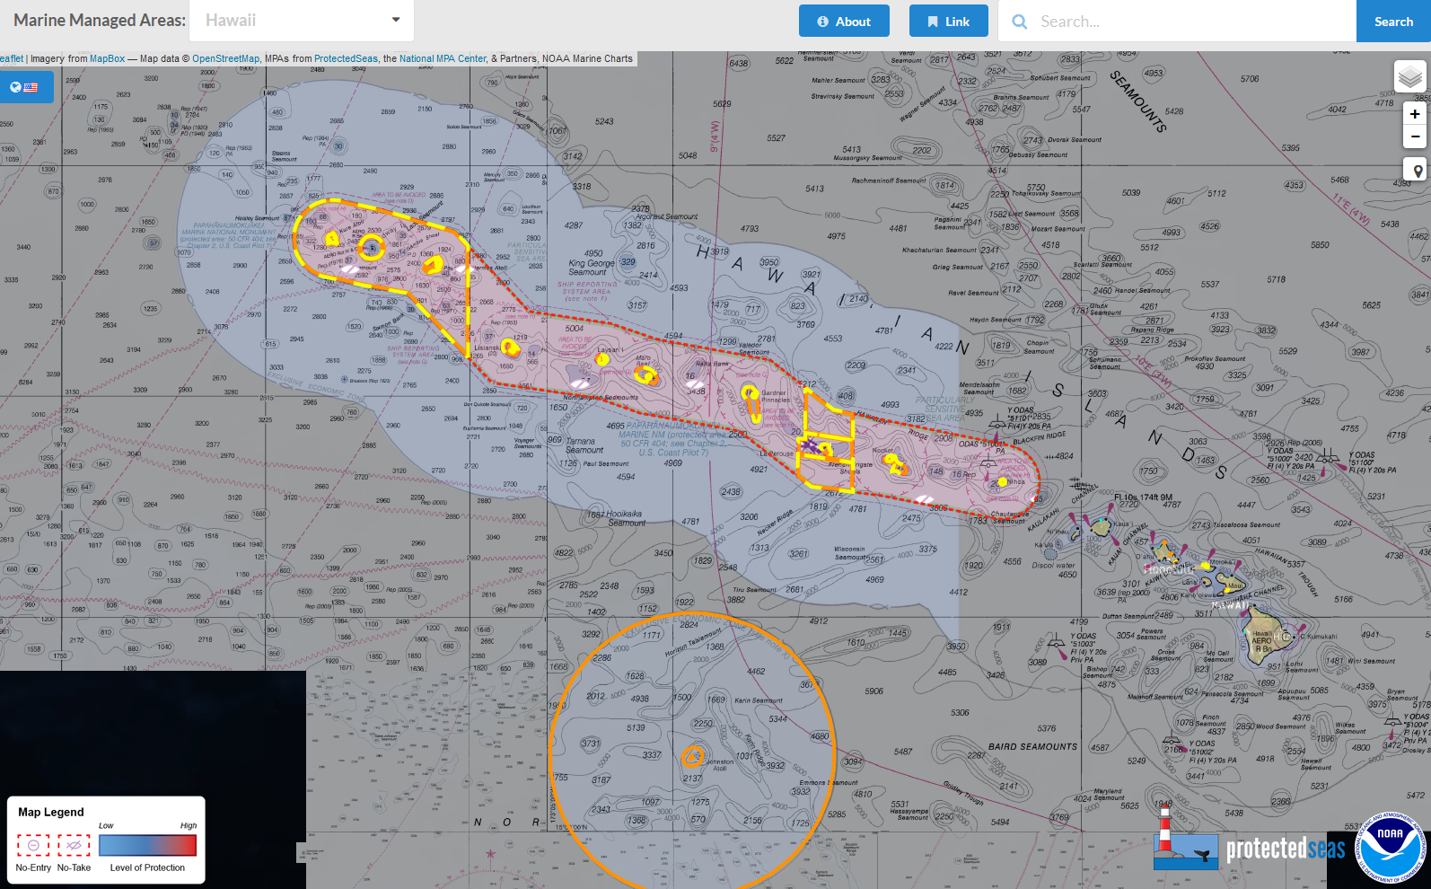
Interoperability issues between S-122 (Marine Protected Area) and S-121(Limits and Boundaries)
Notes:
Antrophocene Institute, which is an associated technical expert company, is planning to conduct tests to detect interoperability issues between S-121 (Maritime Limits and Bounderies) and S-122 (Marine Protected Areas).
Results are expected at the earliest in January 2019.

Slide 5
XML harmonisation of NtM Chart corrections
Improve and anticipate information exchange between HOs
Pool HOs IT competence
XML functions
  Easy to implement in production systems
  Act as an adapter between different NtM information provision
NIPWG wiki act as discussion basis
Notes:
NIPWG5 discussed the potential benefits which a harmonised provision of chart correction might have.
Some Hydrographic Offices mentioned that they have plans to provide chart correction in XML and that first releases are scheduled for the end of this year.
It was recognised that pooling the IT competence and that a common XML structur for chart corrections can improve that information exchange between HOs.
The NIPWG wiki contains an appropriate section for XML data exchange and the upload of XML-files has been enabled.

Slide 6
IHO/ HSSC and IMO e-Navigation
Marine Services combined to a Maritime Service Portfolio
  maritime service No.5 (Maritime Safety Information Service (MSI)) WWNWS-CG
  maritime service No.11 (Nautical Chart Service) NCWG, ENCWG MISSING
  maritime service No.12 (Nautical Publications Service) NIPWG
  maritime service No.15 (Real-time hydrographic and environmental information Service) TWCWG
Display of information received via communication equipment (postponed)
Participation in IMO/IHO Harmonization Group on Data Modelling (HGDM)
  Involved IHO WG/CG encouraged to use the template draft to submit Maritime Services description
Notes:
E-Nav of IMO provides the fundamental basis on which maritime services can be established.
As agreed by NCSR5, a set of Maritime Services can be combined to a Martime Service Portfolio. That is in-line with the IHO strategy to support an Maritime Service Portfolio „Hydrographic Services“. So far, following Maritime Services are in IHO‘s remit:
No.5 (Maritime Safety Information Service (MSI)) WWNWS-CG
No.11 (Nautical Chart Service) NCWG, ENCWG, has not been provided yet
No.12 (Nautical Publications Service) NIPWG
No.15 (Real-time hydrographic and environmental information Service) TWCWG
The work on the guideline on „Display of information received via communication equipment“ has been postponed due to overdue papers which should serve as backbone of this guideline. Until these papers have been adopted by IMO, the guideline remains at an iterim status.

Slide 7
Thank you for your attention.

