Slide 1
Product Specifications Compared
NIPWG 6
30 January 2019
Raphael Malyankar

Slide 2
Introduction
General information in many S-100-based product specifications has a lot in common, not just in the NIPWG domain(s) but also with S-101 and other vector products.
SNPWG and later NIPWG intentionally defined the NPUB information concepts top-down, trying to make features and attributes which are generally applicable (and, therefore, harmonize NPUB data models from the beginning).
NPUB domain products also attempt harmonization with S-101.
Other data products also have aspects in common.
But the product specifications are written as if they were completely independent data products!

Slide 3
Overview
The paper contains a quick high-level analysis of current and discussed NIPWG product specifications from four perspectives.
… and asks what happens when there are N S-100-based product specifications active, where N > (say) 5.
How are the specifications to be managed?
  Specifications meaning the documents and artifacts.

Slide 4
General characteristics
General purpose
Transfer mode
Specific usage
Update mechanism
Spatial representation
S-126 MPE
S-122 MPA
S-123 MRS
S-128 CTLG
S-127 MTM

Slide 5
Data models
Information classes
Feature classes
Information Associations
Feature Associations
Meta-features – Data Coverage, Quality of Non-bathymetric data
Abstract hierarchy of feature and information classes
Whole-cell information
Fuzzy areas
S-126 MPE
S-122 MPA
S-123 MRS
S-128 CTLG
S-127 MTM

Slide 6
Data sources, data mapping, data conversion
Data sources – general (publications)
Data sources (domain-specific databases)
Data conversion from domain-specific sources
Data mapping from publications
  For example – technique for mapping regulations in sailing directions to NIPWG information types
Data conversion from ENC databases
S-122 MPA
S-126 MPE
S-123 MRS
S-128 CTLG
S-127 MTM

Slide 7
Product specification documentary content
Most general information – conventions, maintenance, etc.
Specific description, name, number, etc.
General encoding rules, for example:
  How to encode text and pictures.
  Masking
Specific descriptions of features and tgheir mandatory attributes
Tables for information types and meta-features
Tables for widely-used attributes – e.g., feature name, date ranges, text content.
Tables for domain-specific features.
Nearly all data quality (for similar uses)
S-126 MPE
S-122 MPA
S-123 MRS
S-128 CTLG
S-127 MTM

Slide 8
General Characteristics
General purpose
Transfer mode
Specific usage - often
Update mechanism
Spatial representation
Specific usage – sometimes
Transfer mode – for some products
Update method - maybe
Notes:
Work on Edition 1.0.0 of S-127 was done before S-101 1.0.0 was finalized and a final comparison is necessary.

Slide 9
Data models
Information classes
Feature classes
Information Associations
Feature Associations
Meta-features – Data Coverage, Quality of Non-bathymetric data
Abstract hierarchy of feature and information classes
Whole-cell information
Fuzzy areas
Feature classes (except meta-features)
Information types – some(?)
Feature associations
Notes:
Work on Edition 1.0.0 of S-127 was done before S-101 1.0.0 was finalized and a final comparison is necessary.

Slide 10
Sources and mapping
Data sources – general (publications)
Data sources (domain-specific databases)
Data conversion from domain-specific sources
Data mapping from publications
  For example – technique for mapping regulations in sailing directions to NIPWG information types
Data conversion from ENC databases
Data sources (domain-specific databases)
Data conversion from domain-specific sources

Slide 11
Product specification content (mainly DCEG and Main document)
Most general information – conventions, maintenance, etc.
Specific description, name, number, etc.
General encoding rules, for example:
  How to encode text and pictures.
  Masking
Specific descriptions of features and tgheir mandatory attributes
Tables for information types and meta-features
Tables for widely-used attributes – e.g., feature name, date ranges, text content.
Tables for domain-specific features.
Nearly all data quality (for similar uses)
Specific description, name, number, etc.
Specific lists of features and their mandatory attributes in preliminary sections.
Tables for domain-specific features

Slide 12
Conclusion
Many product specifications in NIPWG domains can be expected to have much in common.
How important is it to keep common material harmonized?
At what point should any harmonization attempt be made – Editions 2.0, earlier, or later?
What should be the method to achieve harmonization?
  Informal or formal re-use of content – project teams are either informally encouraged or required to copy common material and portions of application schemas from earlier product specifications.
  Common content base – e.g., prepare a base of common content, manage it outside of any particular product specification, and require it to be reused by project teams.
What restructuring of product specification components is needed, if any?
How would any restructuring or re-use interact with versioning of product specifications?
  Manage clarifications (to common material) differently from revisions and new editions.
  Treat general rules differently from object types
What are the criteria for sharing material?
  Overlapping application schemas, purpose and use of product, etc.

Slide 13
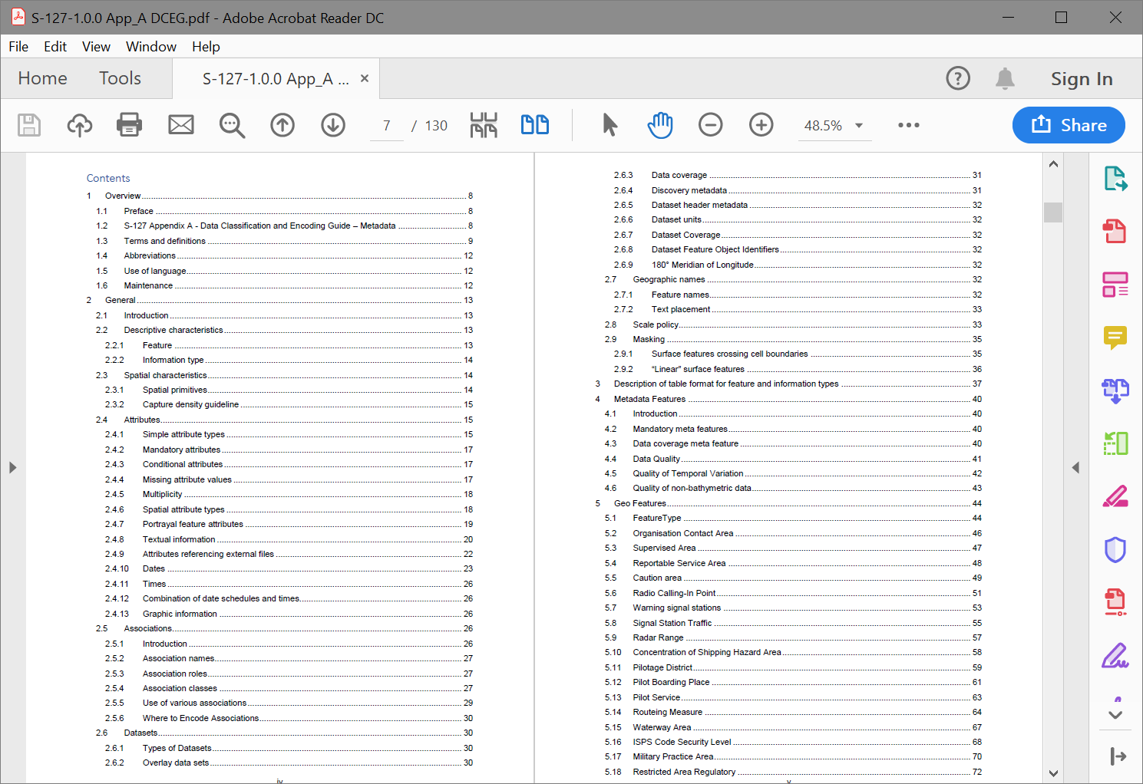
DCEG

Slide 14
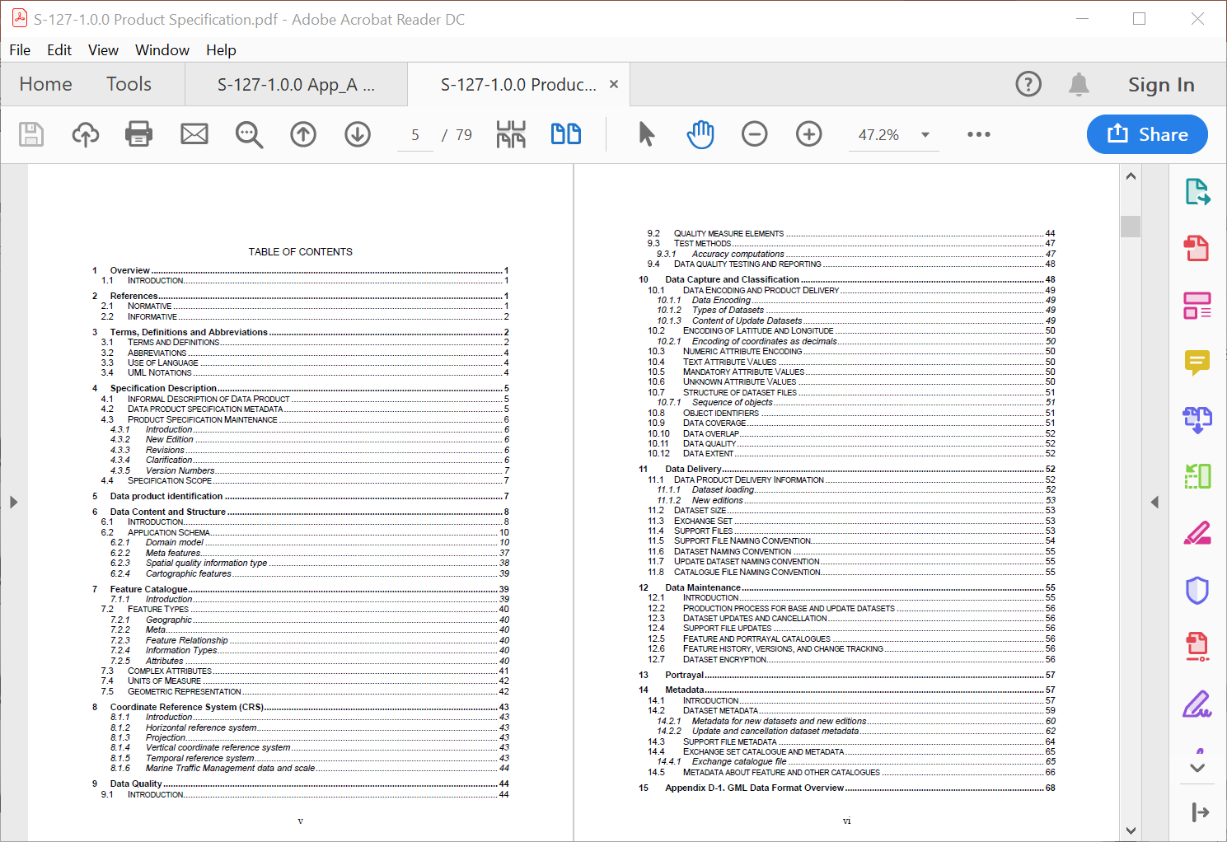
Overview

