Slide 1
WENDWG7 Washington 2017
4.1 Overlapping issues ENC Coverage
Report on global ENC Coverage
Nigel Sutton - UK & NSHC Representative

Slide 2
WENDWG7 Washington 2017
ENC Coverage for 2016:
Bands 1 & 2 = 100%
Band 3 = 93%
Bands 4, 5 & 6 = 98%

Slide 3
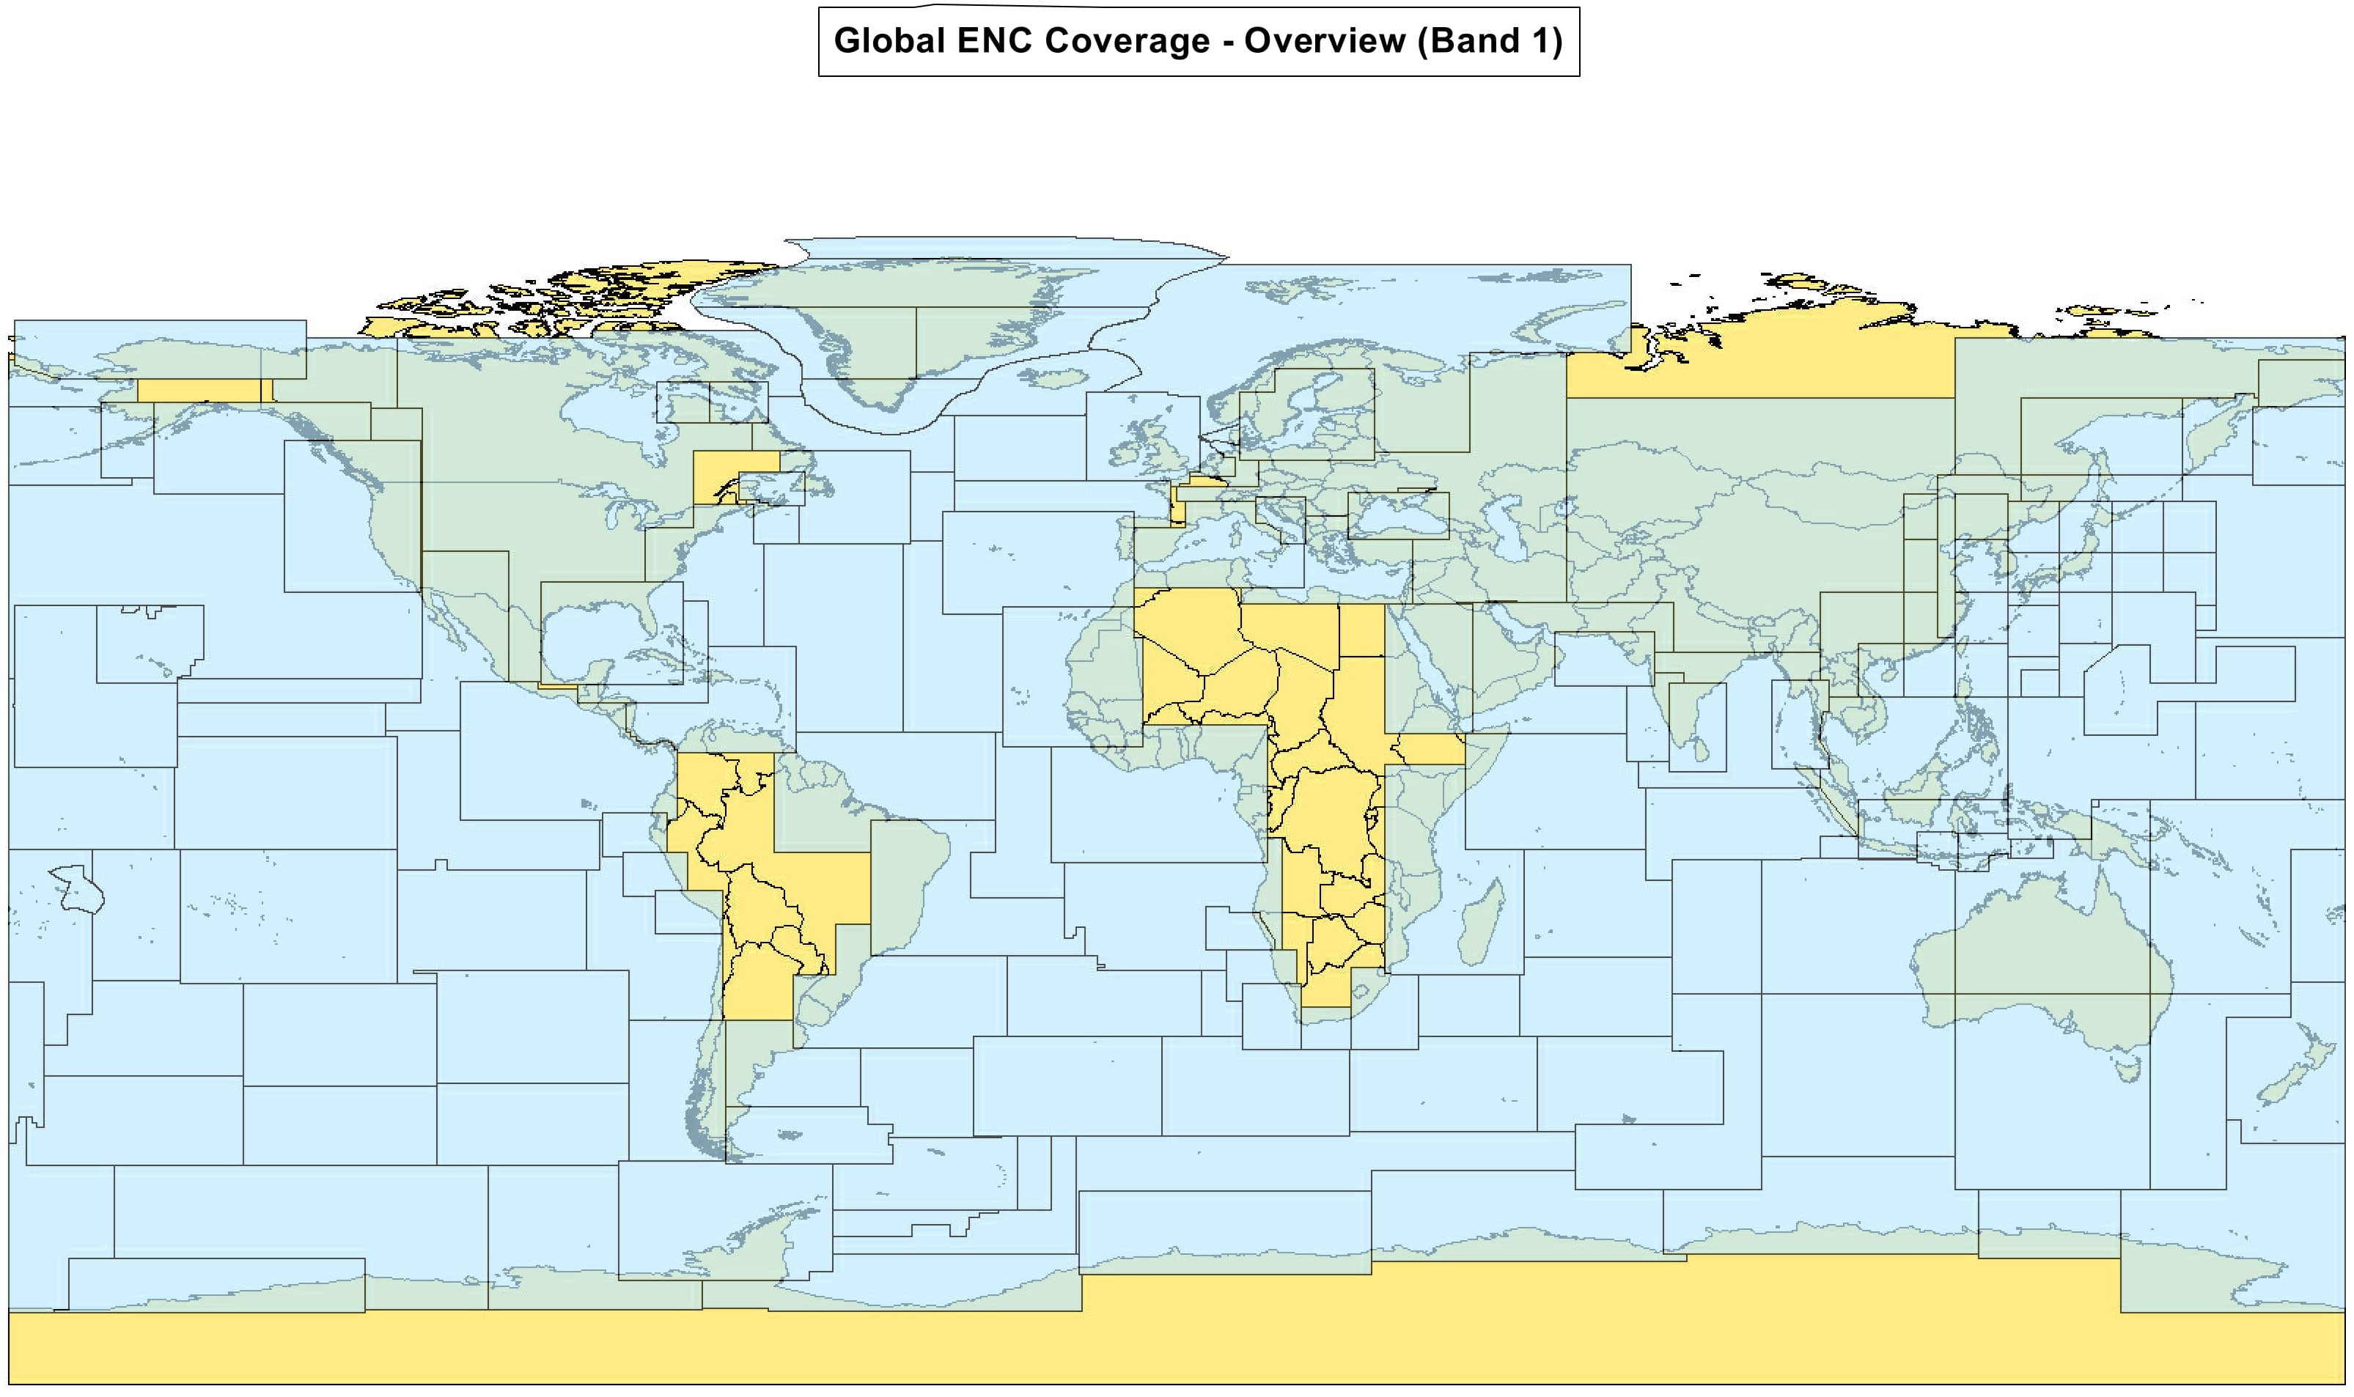
WENDWG7 Washington 2017
ENC Coverage for 2016:

Slide 4
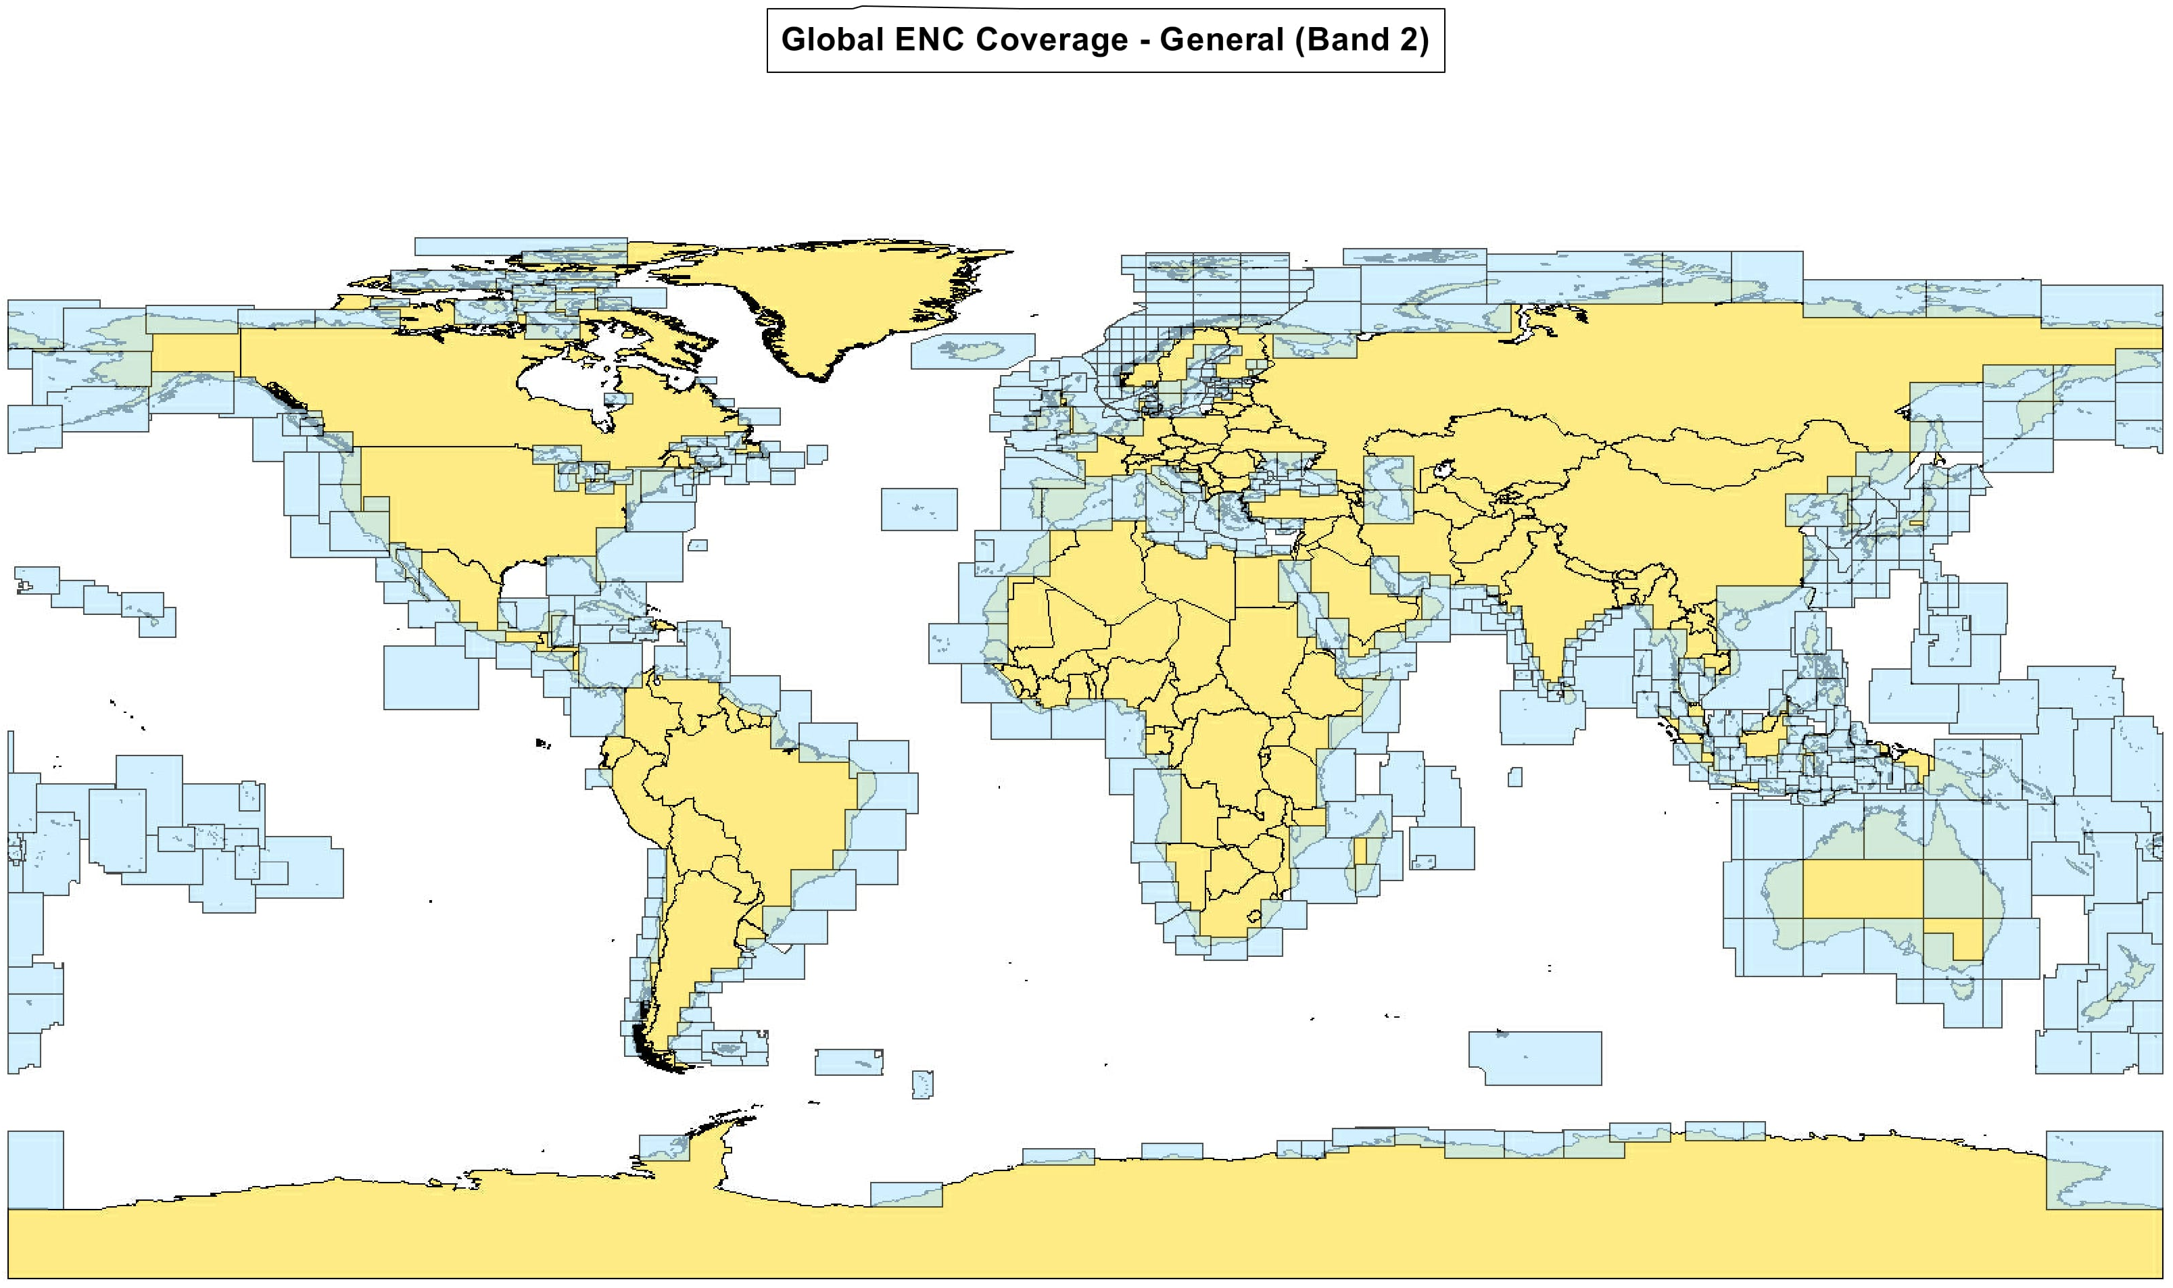
WENDWG7 Washington 2017
ENC Coverage for 2016:

Slide 5
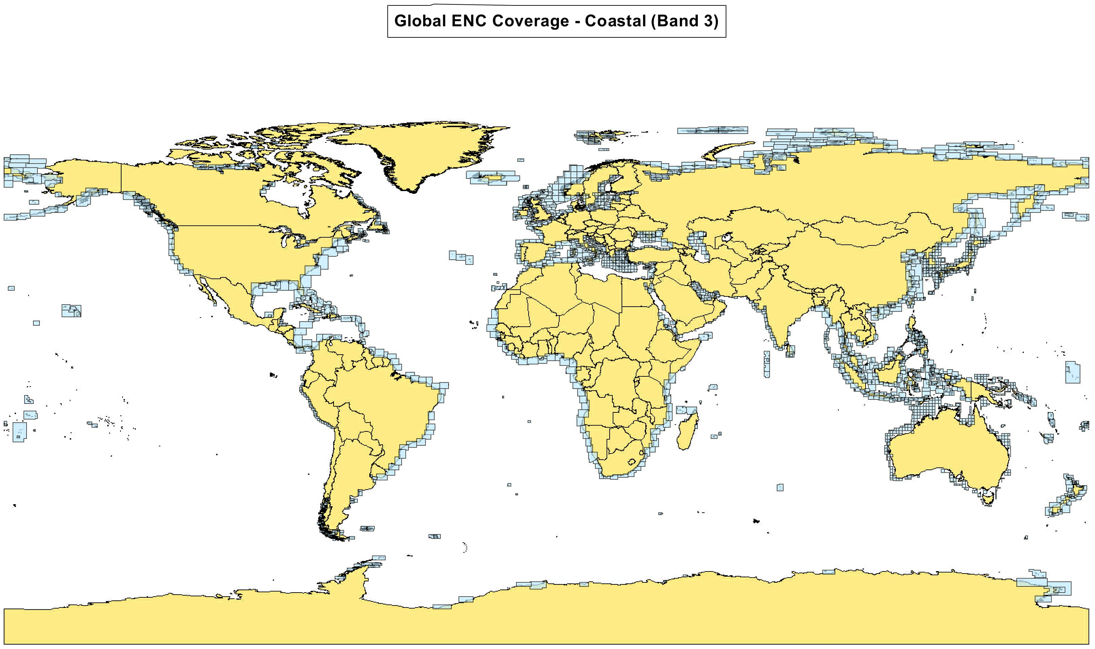
WENDWG7 Washington 2017
ENC Coverage for 2016:

Slide 6
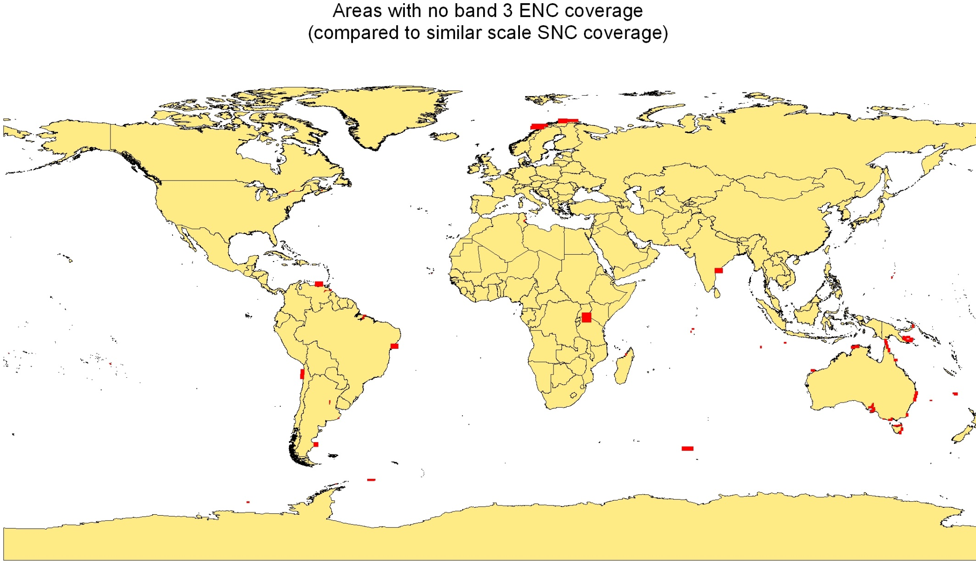
WENDWG7 Washington 2017
ENC Coverage for 2016:

Slide 7
WENDWG7 Washington 2017
Number of overlaps for 2016
are similar to the
number of overlaps for
2015

Slide 8
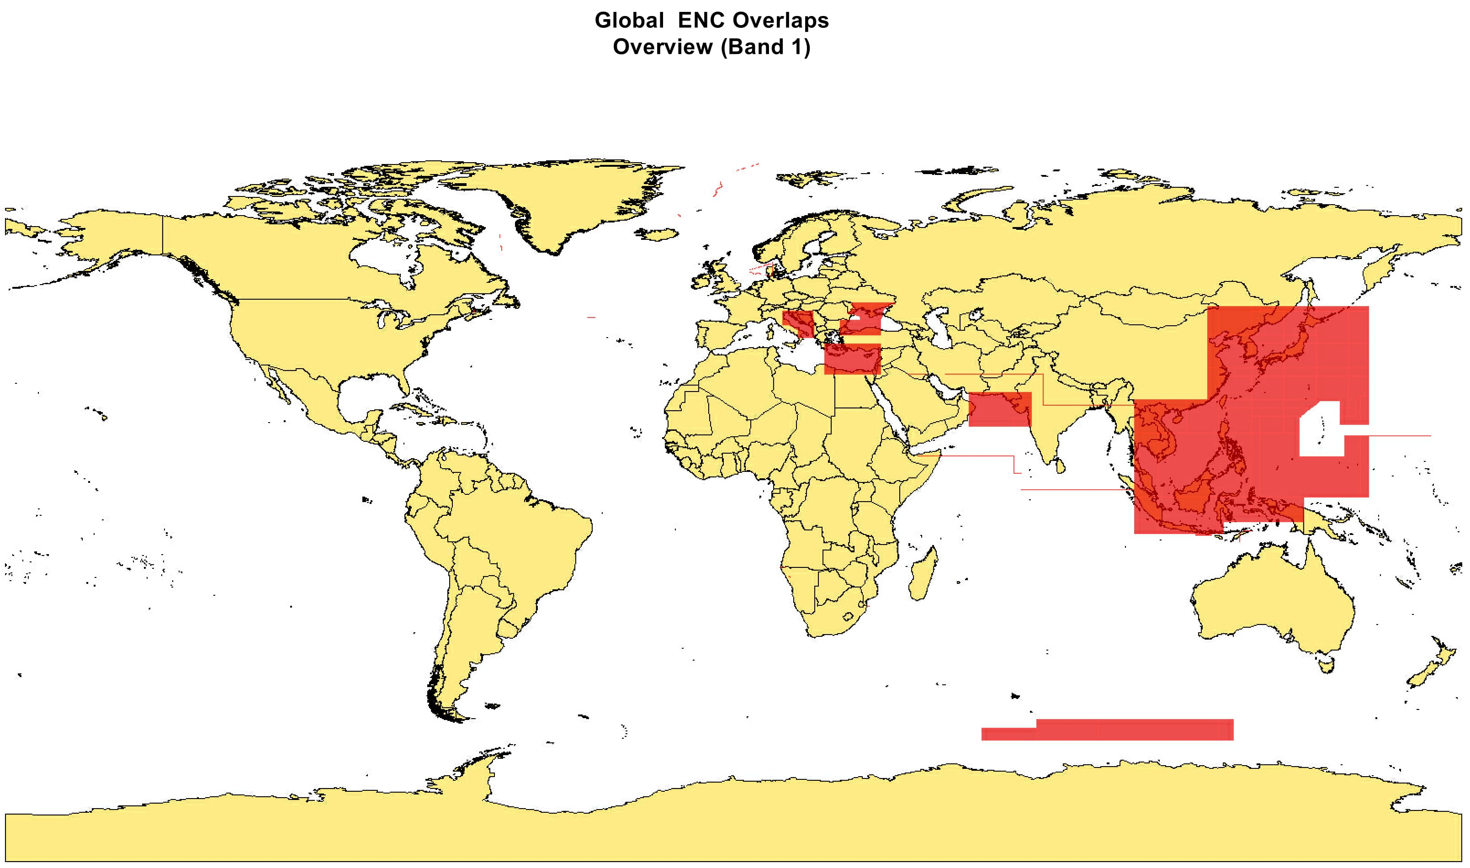
WENDWG7 Washington 2017
ENC Coverage for 2016:

Slide 9
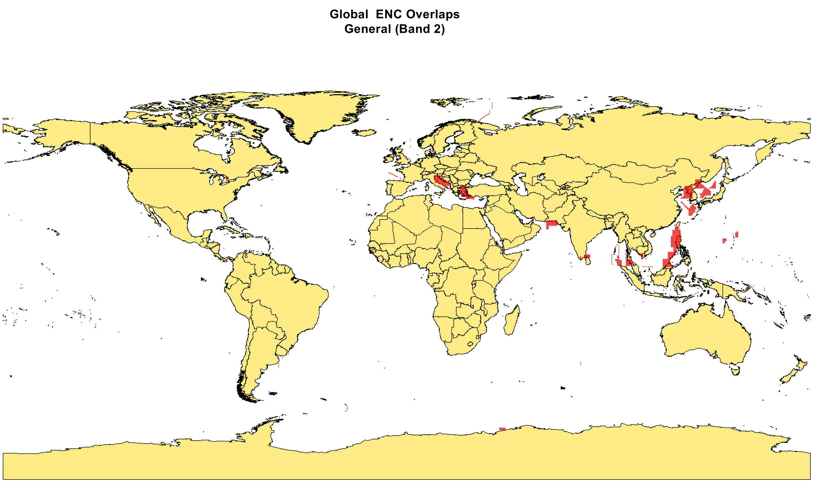
WENDWG7 Washington 2017
ENC Coverage for 2016:

Slide 10
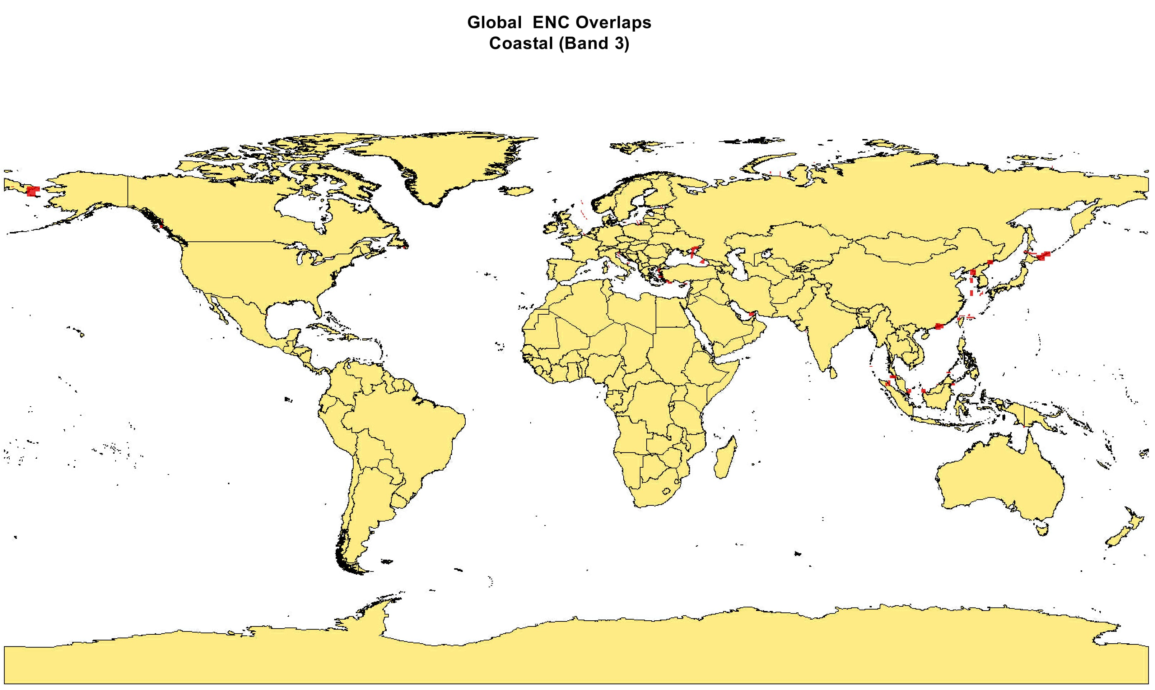
WENDWG7 Washington 2017
ENC Coverage for 2016:

Slide 11
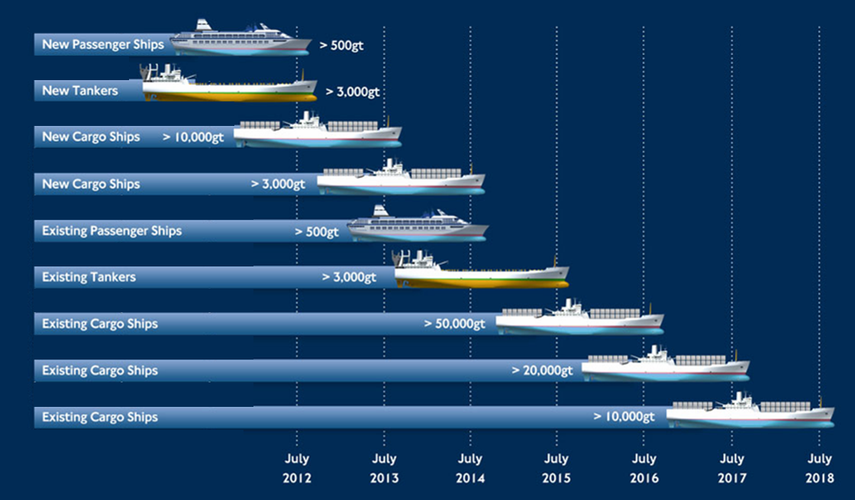
WENDWG7 Washington 2017
18th IHC Work Programme 2012-17
ENC Coverage for 2016:
1st Assembly Work Programme 2017-20

Slide 12
WENDWG7 Washington 2017
Global ENC overlaps by
RHCs
from 2012 to 2016

Slide 13
WENDWG7 Washington 2017
List of Ports and Moorings Database (US NGA Pub 150) comparison with AVCS ENC Coverage for 2016

Slide 14
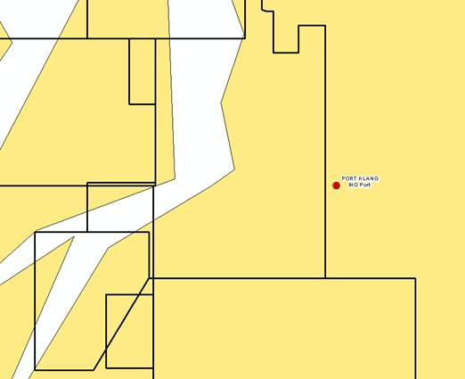
WENDWG7 Washington 2017
Some ports are listed by city/town centre location rather than port location

Slide 15
WENDWG7 Washington 2017
Summary:
ENC Coverage is increasing year by year
Key ports and moorings are included on ENCs
ENC overlaps have reduced substantially since 2012
Some regions have reduced ENC overlaps more than others

Slide 16
WENDWG7 Washington 2017
Recommendation:
The WEND WG to circulate the Global ENC overlaps table by RHCs from 2012 to 2016 to Chairs of RHC’s for discussion

