Slide 1
Report of the representative of the Baltic Sea Hydrographic Commission (BSHC) on the implementation of ENC Schemes in Region E
Jarmo Mäkinen Finland
WORLDWIDE ENC DATABASE WORKING GROUP (WENDWG)

Slide 2
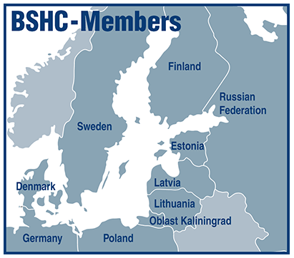
Region E- Baltic Sea- Background
Members: Denmark, Estonia, Finland, Germany, Latvia, Poland, Russian Federation, Sweden
Associate Member: Lithuania

Slide 3
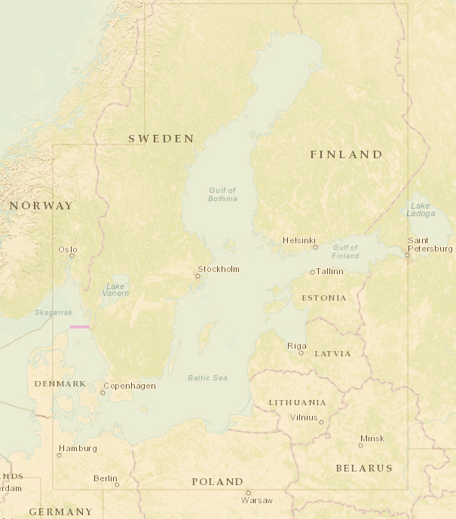
Status of the ENC Scheme UB1 (Overview)in the Region E
1 Overview – produced by Germany (agreed in BSHC)

Slide 4
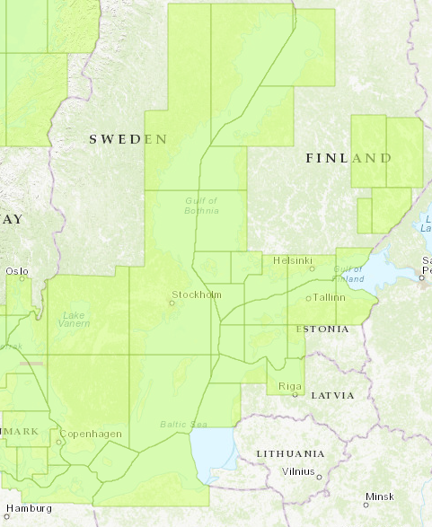
Status of the ENC Scheme UB2 (General) in the Region E

Slide 5
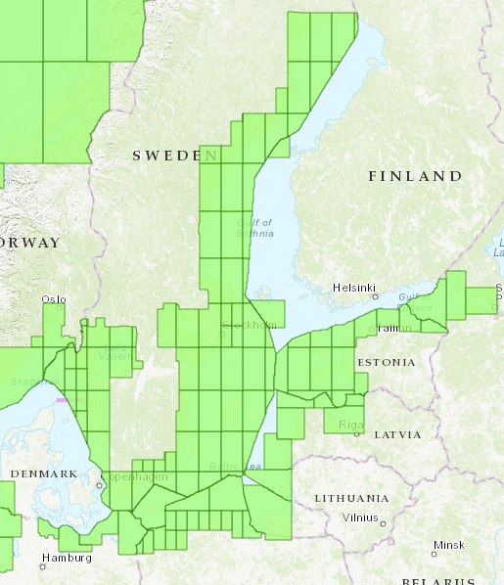
Status of the ENC Scheme UB3 (Coastal) in the Region E
Denmark is preparing the release of 8 new ENC cells in Usage Band 3 in 2018, to harmonize data with Sweden.
Finland will also extend coastal coverage in future

Slide 6
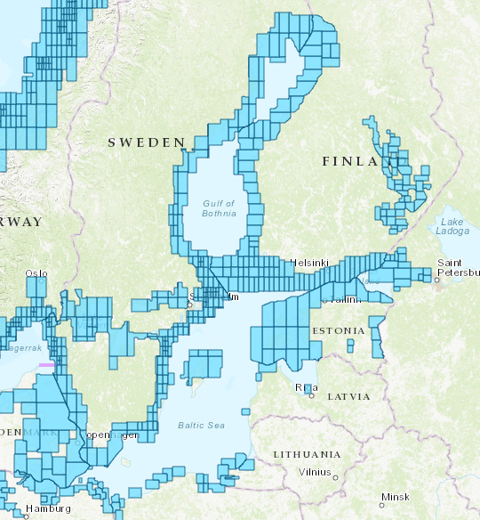
Status of the ENC Scheme UB4 (Approach) in the Region E
Estonia has released new approach cells from the inland waters
Poland is planning to extend its approach coverage to cover the whole coastline
Latvia is planning to extend approach coverrage, starting 2019

Slide 7
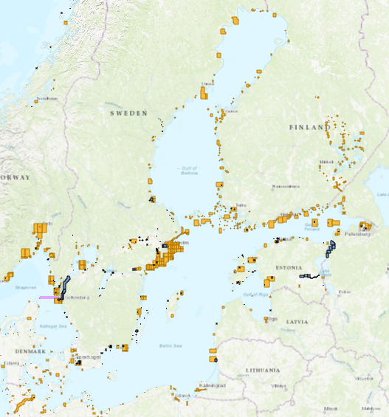
Status of the ENC Scheme UB5+ UB6 (Harbour, Perth ) in the Region E
Denmark is planning to release many new harbor cells within a couple of years.

Slide 8
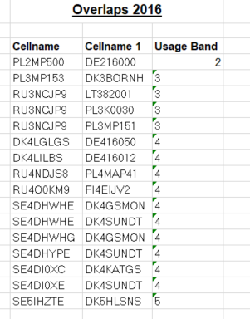
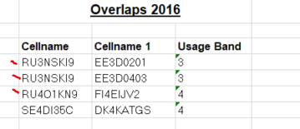
Existence of overlapping ENCs that may have a possible impact on safe navigation
Report delivered to Member States , presented in BSHC and discussed in BSICCWG (Baltic Sea Chart Coordinating WG) in November 2017
Many of overlaps have not seen as a risk in a navigational point of view
Member states work to solve overlaps
Reported every year in BSHC
Some of Baltic Sea overlaps are under NHC, in overlaps exel-file

Slide 9
Existence of overlapping ENCs that may have a possible impact on safe navigation
IC-ENC overlapping data policy report was presented in BSHC (Sept 2017) and discussed in BSICCWG (Nov 2017).
Medium level risk (Overall Severity of Risk) case was highlighted. Process to solve it is going on between DE and DK.
The benefits of this kind of reporting were discussed in BSICCWG. Some members reminded, that both RENCs have these kinds of tools and the member countries can themselves check these issues. Countries themselves are responsible for the data and decide whether it is a risk or not.

Slide 10
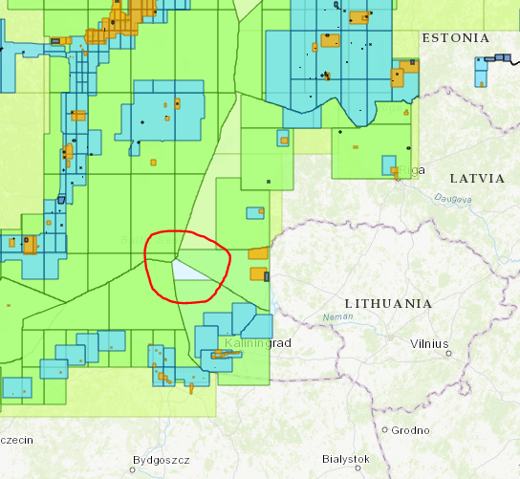
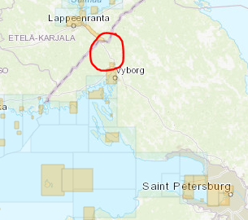
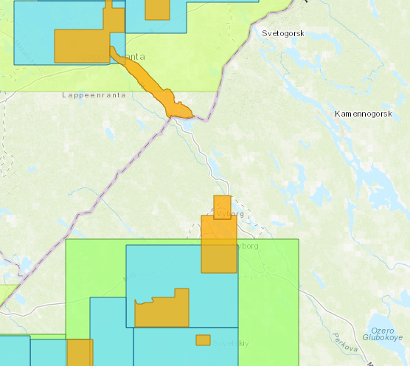
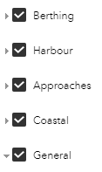
Coverage issues, gaps and risk assessment analysis
Gaps in coverage;
Kaliningrad/Lithuanian waters (UB2) -discussions with Russia and Lithuania
One small port not covered by harbour cell
Saimaa Canal, rental area- New ENC (UB5)in the process (RU)

Slide 11
Problems or outstanding issues, Recommendations
Many member States have kept ENC coverage unchanged for years and lets neighboring countries cut or extend their coverage to match the border.
Agreed in BSICCWG, that member states will inform Chart Coordinator of new cells and major changes in coverage
Project for changing compilation scales of approach cells is continues in Estonia.
Baltic Sea ENC harmonisation recommendations were reviewed in last BSICCWG.
New features in INToGIS project (development Phase II) have seen very helpful for analysing ENC coverage.
Reporting status of overlaps and gaps is a permanent agenda item in BSHC and BSICCWG meetings.

Slide 12
Actions requested of WENDWG/IRCC
WENDWG is invited to note the report from BSHC

