Slide 1
WORLDWIDE ENC DATABASE WORKING GROUP
SAIHC REGION H
Report to WENDWG8

Slide 2
SAIHC Approved ENC Scheme
Good progress being made
S11 style format used for ENC catalogue
Includes all published ENC details
Planned ENCs added as they are schemed
PDF booklet format available
Graphics show scheming of cells by band and country
Produced using ARC GIS
Notes:
Details as per slide.

Slide 3

Cell details are listed in an accompanying table in the familiar S11 format
Planned ENCs are shown in red
Notes:
Details as per slide.

Slide 4
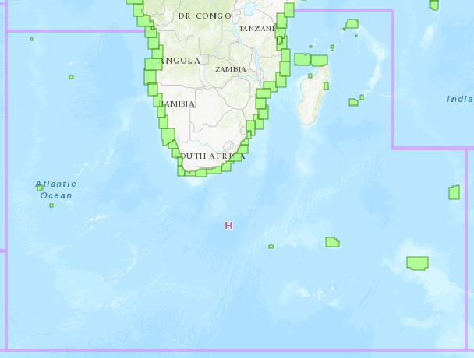
Status of the ENC Scheme in Region H
UB 3 ENC COVERAGE (Coastal)
Notes:
Current status of SAIHC Region H Coastal ENC scheme for usage band 3 extracted from IHO online ENC Catalogue. The IHO online ENC catalogue provides for details of UB4 and UB5 as well as schemed ENCs for the region.

Slide 5
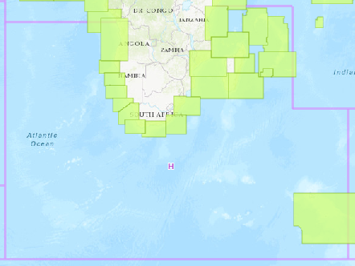
Status of the ENC Scheme in Region H
UB 2 ENC COVERAGE (General)
Notes:
Current status of SAIHC Region H General ENC scheme for usage band 2 extracted from IHO online ENC Catalogue.

Slide 6
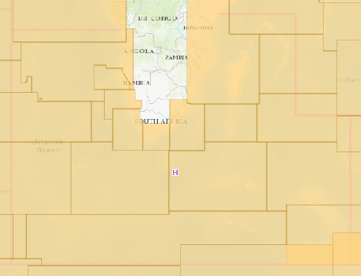
Status of the ENC Scheme in Region H
UB 1 ENC COVERAGE (Overview)
Notes:
Current status of SAIHC region H Overview ENC scheme for usage band 1 extracted from IHO online ENC Catalogue.

Slide 7
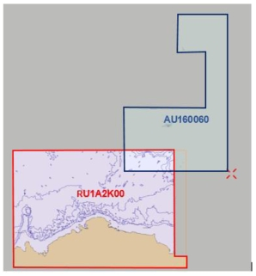

Existence of overlapping ENCs that may have a possible impact on safe navigation
Overlap of ENCs exist in UB1 between Russia and Australia (related to WENDWG action).
Overlap to be resolved under coordination of the ICC-Coordinator Region H, in conjunction with WEND Chair.
Letter sent to RU and AU requesting proposed action in resolving the overlap
Notes:
Overlap of ENCs exist in UB1 between Russia and Australia related to actions arising from the SAIHC 6th ICCWG minutes of the meeting.
The ICCWG Chair confirmed that this is related to a WENDWG Action with the overlap between Russia and Australia to be resolved. The ICC-Coordinator has drafted a letter informing the two countries on behalf of SAIHC to resolve the ENC overlap, in conjunction with the WEND Chair.

Slide 8
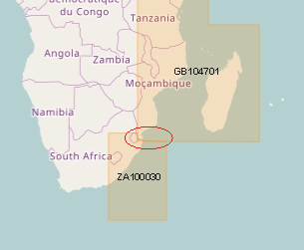
Existence of overlapping ENCs that may have a possible impact on safe navigation…..cont.
Overlap of ENCs exist in UB1 between ZA and the UK as indicated in the IC-ENC Overlap report (2018) and PRIMAR OVERLAP CHECKER.
- Overlap resolution in progress.
Notes:
An overlap of ENCs exist in UB1 between ZA and the UK as reported in the IC-ENC Overlap report (2018) and PRIMAR Overlap Checker.
The overlap is in deep water with reasonable consistency where the overall severity of risk is small. The extent of the overlap is 38km x 750m. The HO is in the process of resolving this overlap.

Slide 9
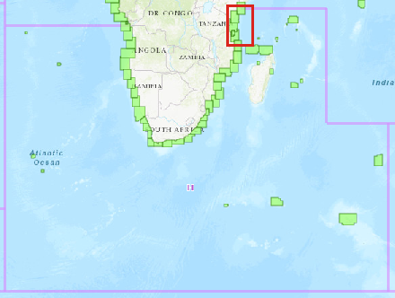
Coverage issues, gaps and risk assessment analysis
Creation of ENC schemes - ICCWG Coordinator for Region H to define ENC scheme initially from Mozambique to northern limit of SAIHC Region H related to IRCC Action item. Works in progress.
Notes:
Action item no 7 arising from the SAIHC 6th ICCWG minutes of the meeting.
Noting actions from IRCC concerning the creation of ENC Schemes, the SAIHC ICCWG Chair is to define an ENC scheme initially from Mozambique to northern limit of SAIHC.
ICC Co-ordinator for Region H to contact SAIHC members to determine possible future port developments and to also develop larger scale usage band ENC schema as appropriate. The area marked in red is presently the main area of focus and a works in progress.

Slide 10
Problems or outstanding issues, Recommendations
Representation by SAIHC at WENDWG not always possible due to varying internal challenges. Correspondence and participation by email if attendance not possible.
SAIHC is in full support for the development of the trial ENC scheme (INT paper chart schema equivalent) and in the process of defining minimum meta data required to support the development.
Notes:
Representation by SAIHC at WENDWG not always possible due to varying internal challenges. Correspondence and participation by email if attendance is not possible.
SAIHC is in full support for the development of the trial ENC scheme (INT paper chart schema equivalent) and in the process of defining minimum meta data required to support the development.

