Slide 1
The Nippon Foundation-GEBCO Seabed 2030 Project
2nd IHO Council
11th October 2018
Presented by: Dr Graham Allen
Acting Seabed 2030 Director
Member of GEBCO Guiding Committee ,
Co-author of Seabed 2030 Business Plan and Roadmap
Day job is
Chief Information Officer (CIO)
National Oceanography Centre, UK
Notes:
- Collaborative project: NF - GEBCO
Satinder – foundational, end of september

Slide 2
GEBCO is
‘… an open ended joint project of IHO - IOC managed by the GEBCO Guiding Committee (GGC)’
‘ The General Bathymetric Chart of the Ocean’
‘… largely a voluntary community of international collaborating community of scientists and hydrographers with the support of their parent organizations.’
‘…aiming to provide the most authoritative, publicly-available bathymetric data sets of the world’s oceans.’

Slide 3
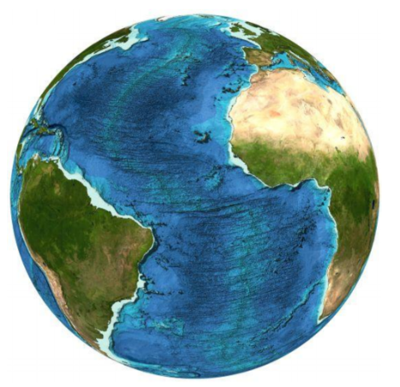
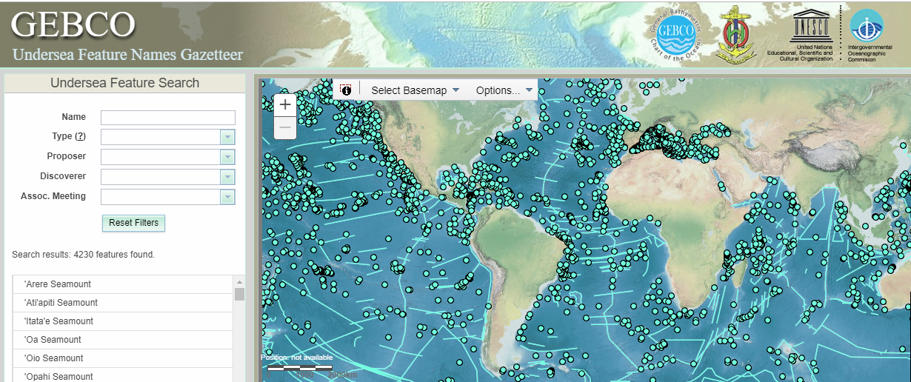
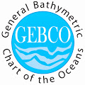
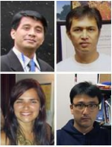
GEBCO outputs
2. GEBCO
Undersea Feature Names Gazetteer
1. GEBCO Grid
SCRUM =
Sub-committee on Regional Undersea Mapping
SCUFN = Sub-committee on Undersea Feature Names
TSCOM =
Technical Sub-committee on Ocean Mapping
Postgraduate Certificate in Ocean Bathymetry, University of New Hampshire, USA
3. Next generation of scientists and hydrographers in ocean bathymetry

Slide 4
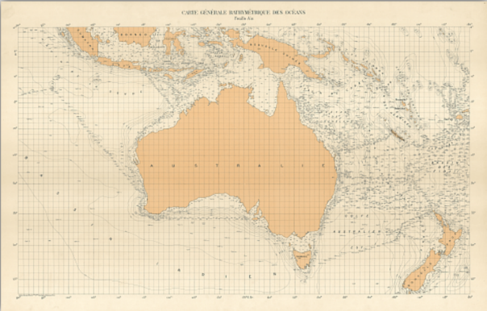
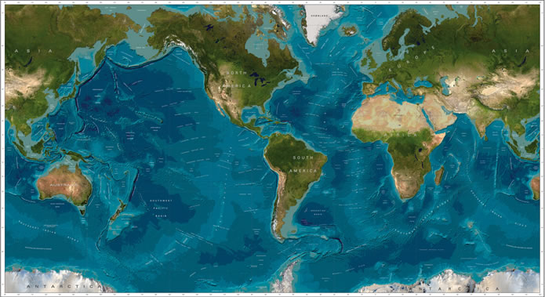
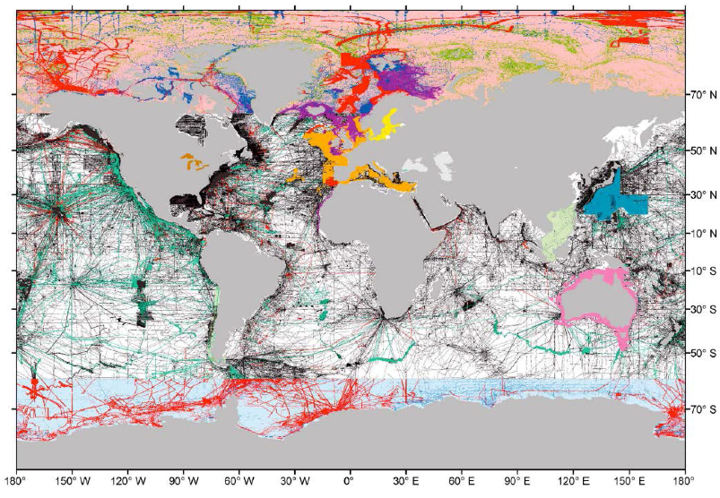
GEBCO - the most authoritative, publicly-available world ocean map
1903
2014
GEBCO Grid today
30 arc-second grid
Notes:
Journalistic license: 23% of the worlds mapped

Slide 5
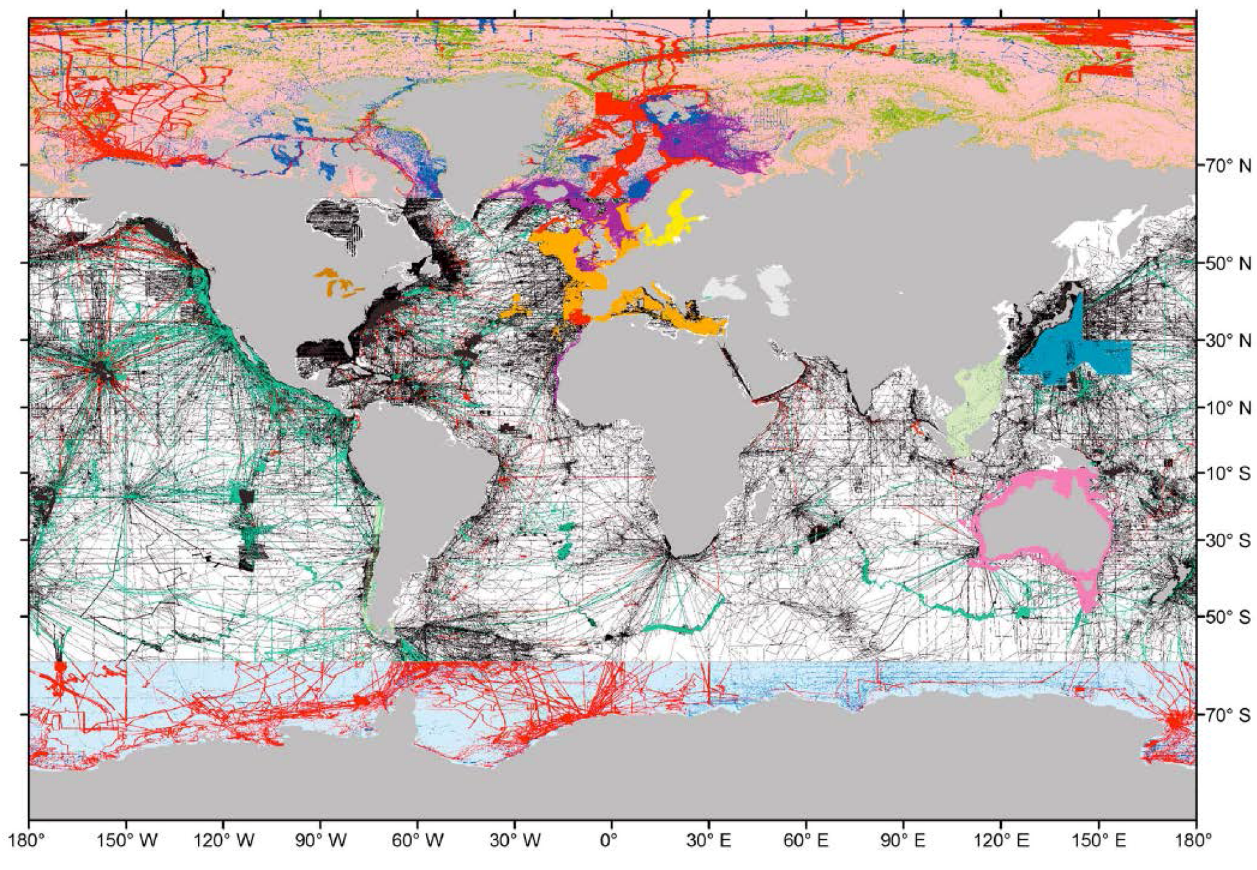
GEBCO - the most authoritative, publicly-available world ocean map

Slide 6
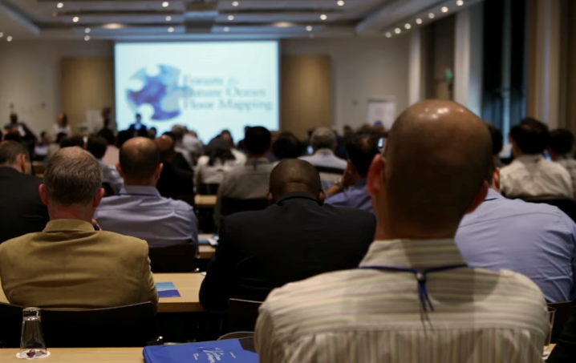
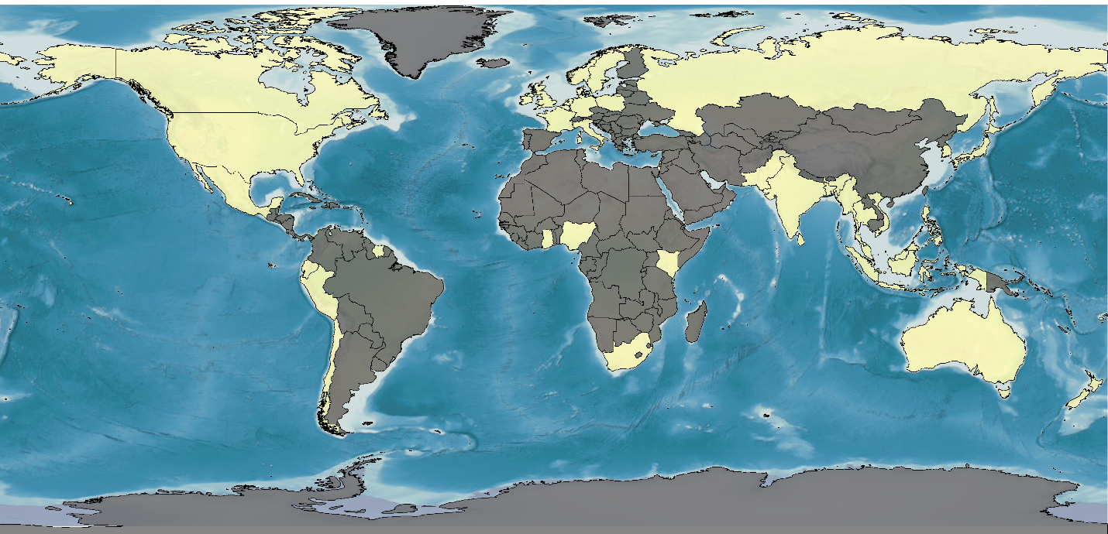
Forum for Future Ocean Floor Mapping – June 2016
> 160 Participants
45 Countries
Academia, Government, Industry
Developed Seabed 2030 Roadmap

Slide 7
NF – GEBCO Seabed 2030
Collaborative project
Nippon Foundation and
GEBCO
Mr Sasakawa, Chairman of the Nippon Foundation proposed
‘…to map 100% of the topography of the World Ocean by 2030’
Complete the GEBCO Grid at high resolution by 2030

Slide 8
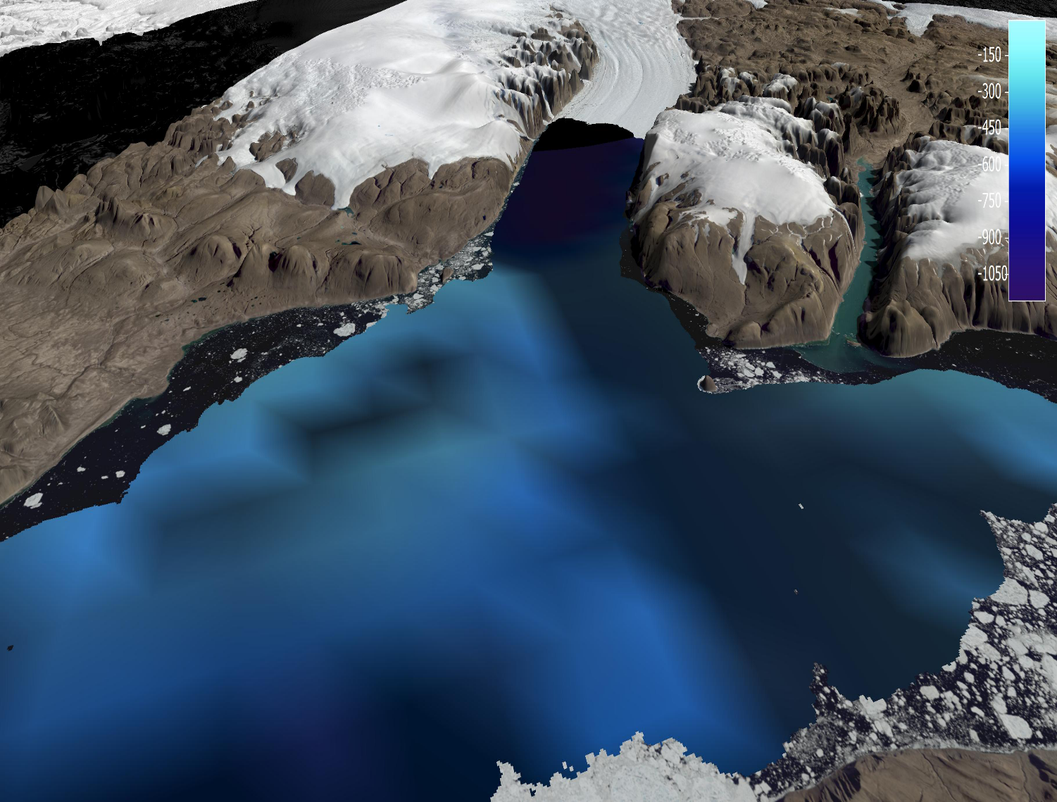
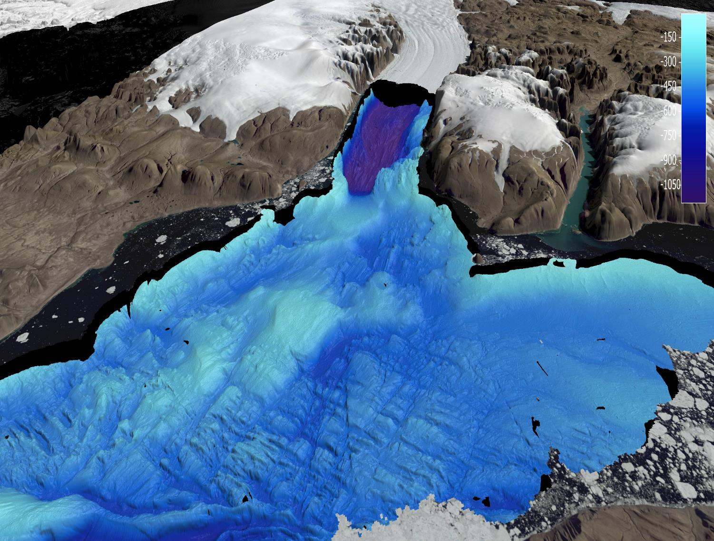
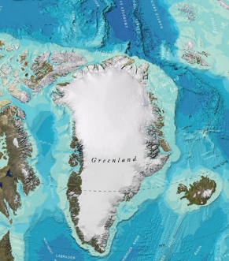
GEBCO - the most authoritative, publicly-available world ocean map
From……
To

Slide 9
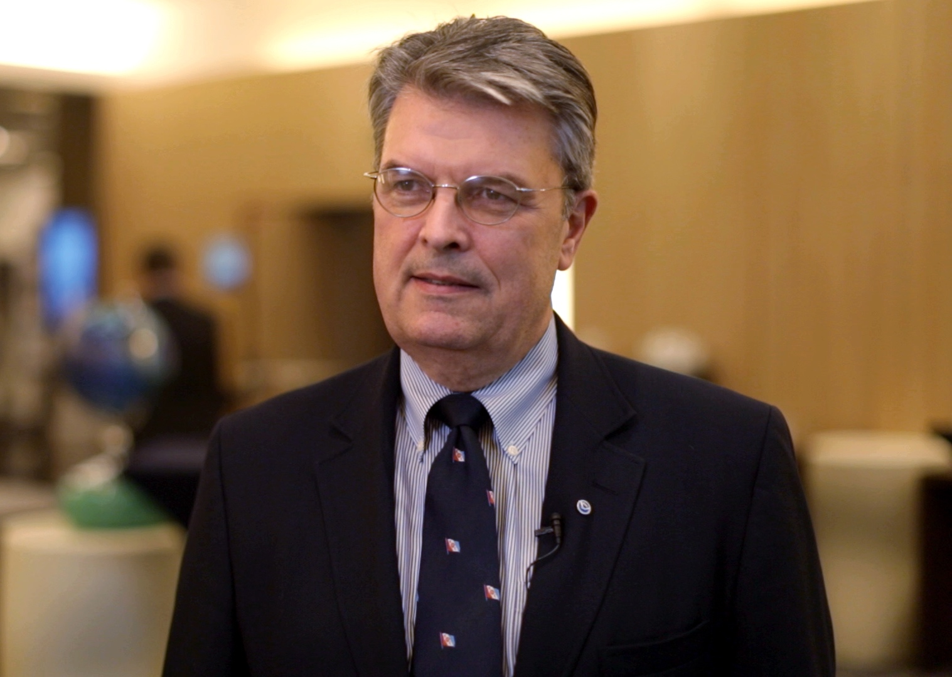
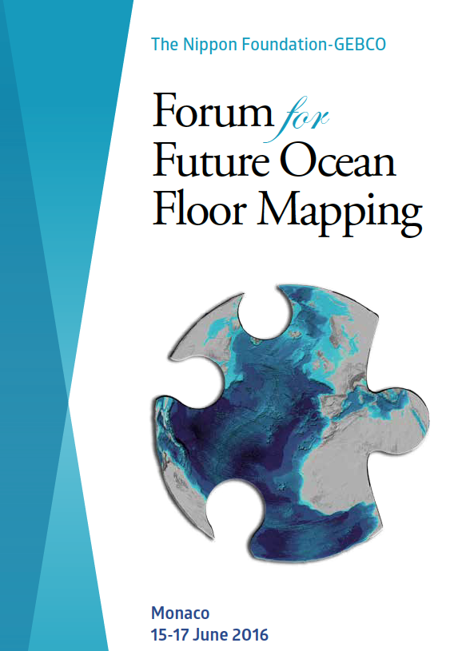
Forum for Future Ocean Floor Mapping
“Mapping the ocean is not something that any one enterprise is going to do. No commercial company is going to do it alone. No nation is going to do it alone. It’s going to take a global community….”
Craig McLean
Assistant Administrator, Oceanic and Atmospheric Research,
National Oceanic and Atmospheric Administration

Slide 10
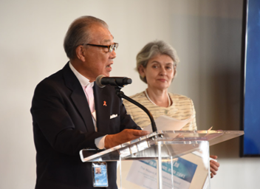
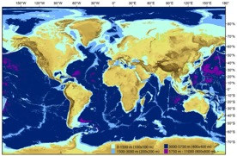
Seabed 2030 complete the GEBCO Grid
Mr Sasakawa, Chairman of the Nippon Foundation proposed ‘…to map 100% of the topography of the World Ocean by 2030’
June 2016
Nippon Foundation - GEBCO Seabed 2030 Project
announced
June 2017
Mr Sasakawa – 1 of 8 IOC-UNESCO “Champions of Global Ocean Science”
Project Operational
SDG-14
2030 100% of ocean mapped
1st February 2018
Today = 222 days
Notes:
GGC delegated Establishment team to establish Seabed 2030
Martin Jakobsson (vice chair GGC), Robin Falconer (ex chair GGC), Graham Allen [Shin Tani (chair GGC)]

Slide 11
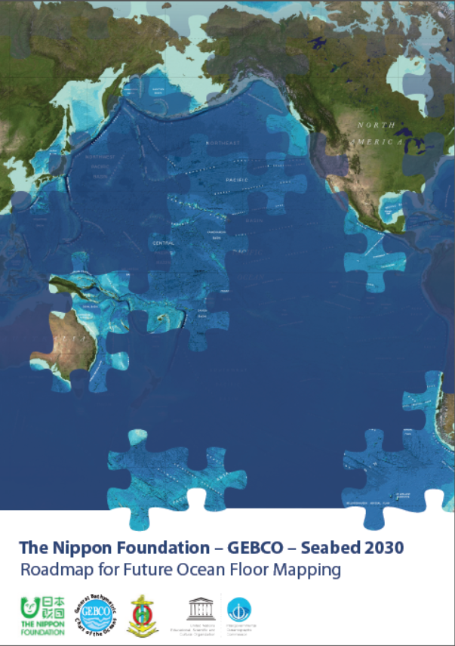
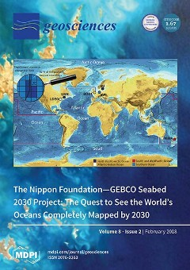
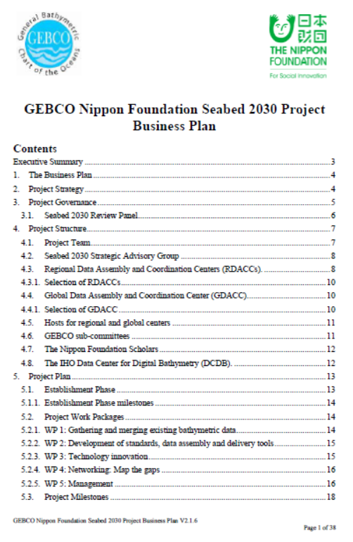
Key Documents
Roadmap
https://seabed2030.gebco.net/
Technical paper
https://seabed2030.gebco.net/
10 year Business Plan
doi:10.3390/geosciences8020063

Slide 12
Seabed 2030 Phases
X + Y + Z = 100%
GEBCO Grid
Now
Data NOT in
Grid
‘Map the Gaps’

Slide 13
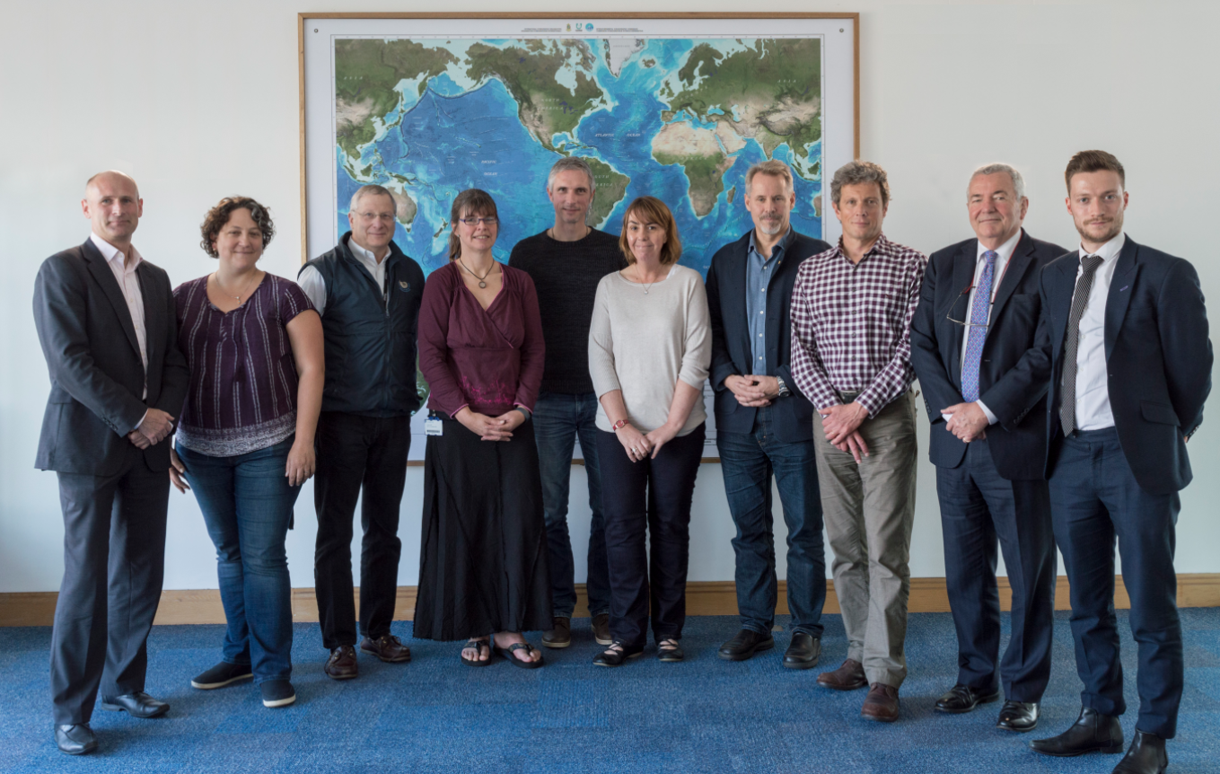
Seabed 2030
Vision into Action
Illustration: Marine Dep. Malaysia
Operational since1st February 2018
From left to right: Graham Allen (Establishment Team), Vicki Ferrini (Regional Centre Lead), Larry Mayer (Regional Center co-Lead), Helen Snaith Global Center Lead, Boris Dorschel (Regional Center Lead), Pauline Weatherall, Digital Atlas Manager, Martin Jakobsson (Regional Center co-Lead), Geoffroy Lamarche (Regional Center Lead), Patrick Orr & Henry Gilliver (Communcations)
New mapping technologies
Notes:
222 days old

Slide 14
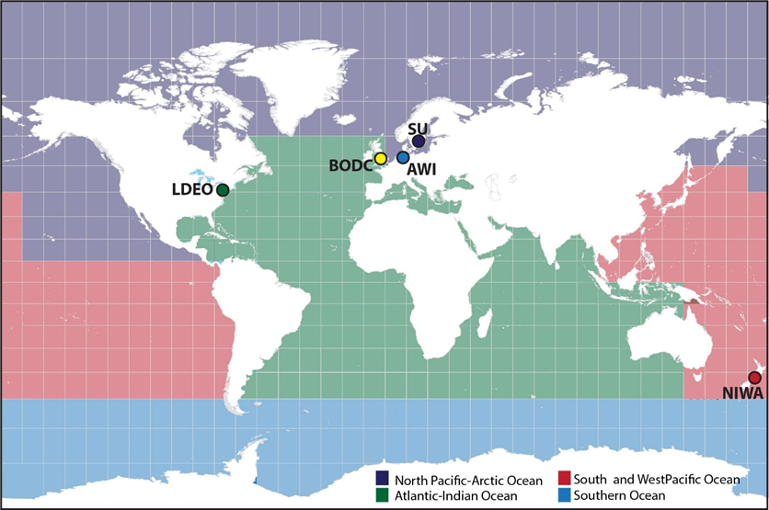
Nippon Foundation GEBCO Seabed 2030 Regional & Global Centers
North Pacific-Arctic Ocean Regional Centre:
Stockholm University (SU)/University of New Hampshire (UNH)
shared center
Global Center:
National Oceanography Centre (NOC)
NOC
UNH
CU
South and West Pacific Ocean Regional Center: The National Institute of Water and Atmospheric Research (NIWA)
Atlantic and Indian oceans Regional Center:
Columbia University (CU)
Southern Ocean Regional Center:
Alfred Wegener Institute of Polar and Marine Research (AWI)
Notes:
Expand SCRUM – centralized/once a year into continuous 4 centers

Slide 15
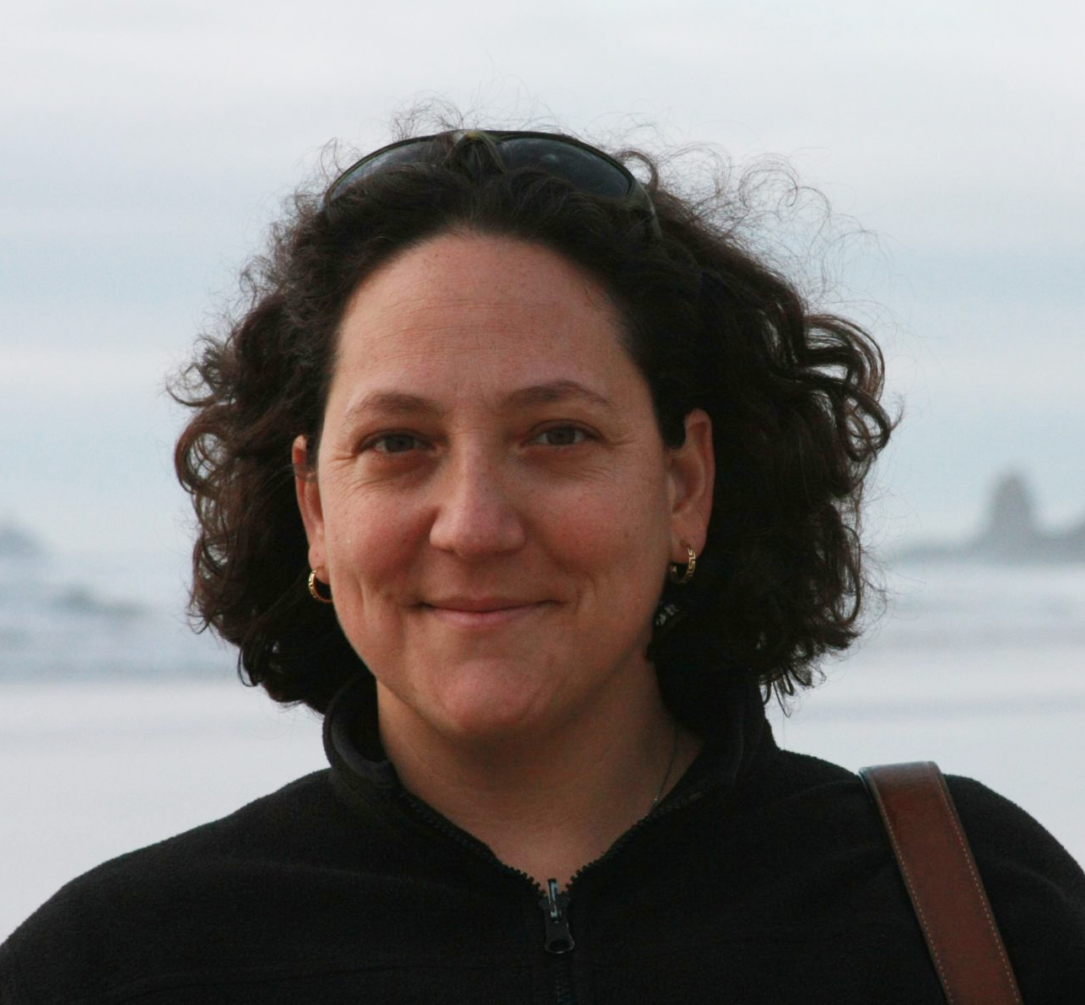
Southern Ocean
Atlantic and Indian Oceans
Dr. Boris Dorschel
Dr. Vicki Ferrini
SCRUM chair

Slide 16
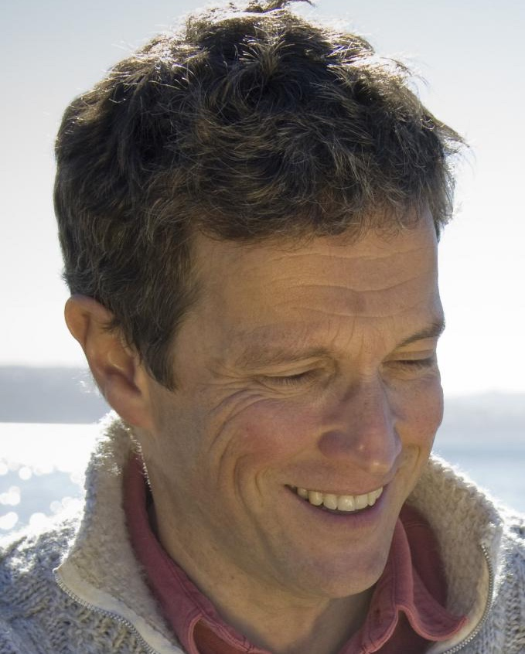
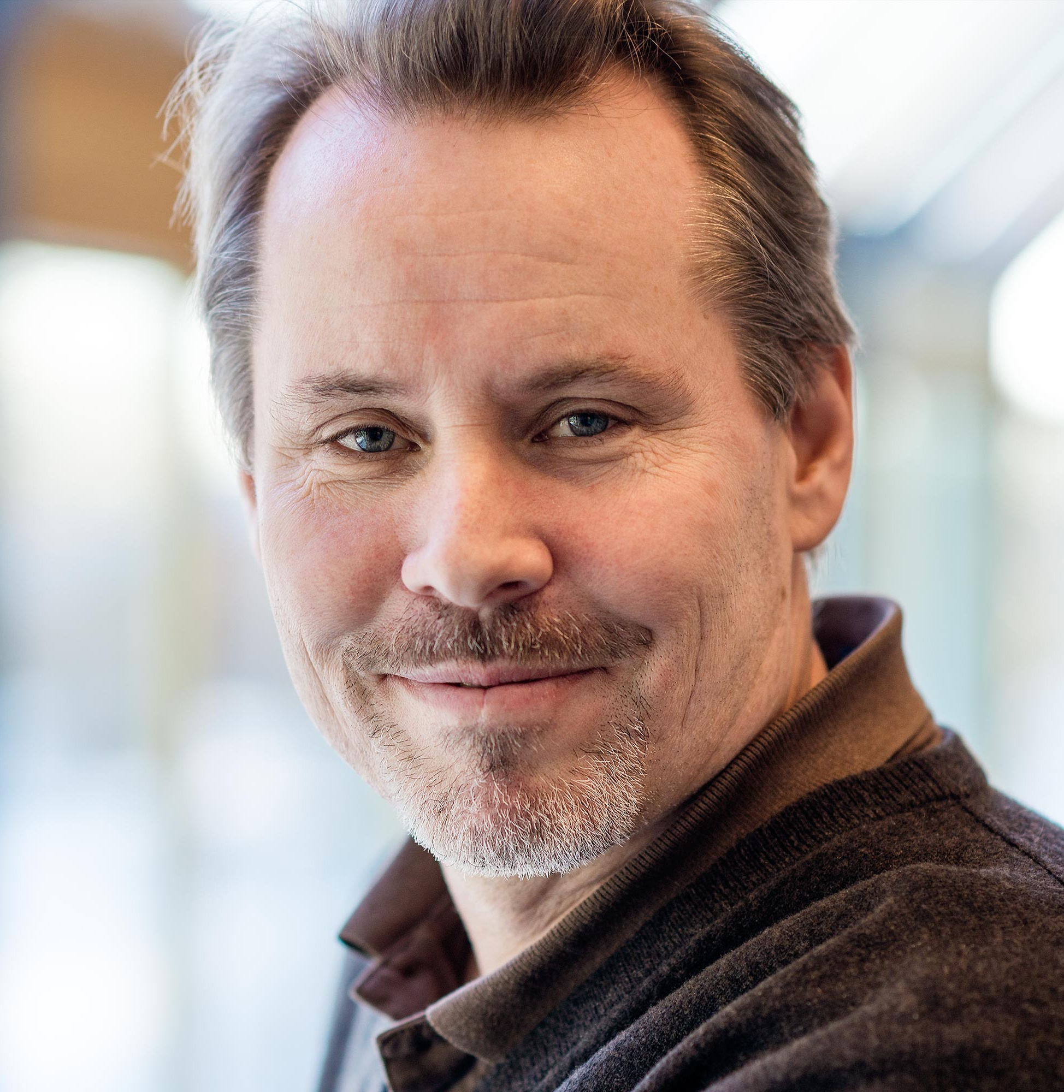
South and West Pacific Ocean
Arctic and Northern Pacific Oceans
Dr. Geoffroy Lamarche
Dr. Martin Jakobsson
Vice-chair GGC
Dr. Larry Mayer

Slide 17
Seabed 2030 Centers
Global Center
Dr. Helen Snaith
Pauline Weatherall
SCRUM vice-chair

Slide 18
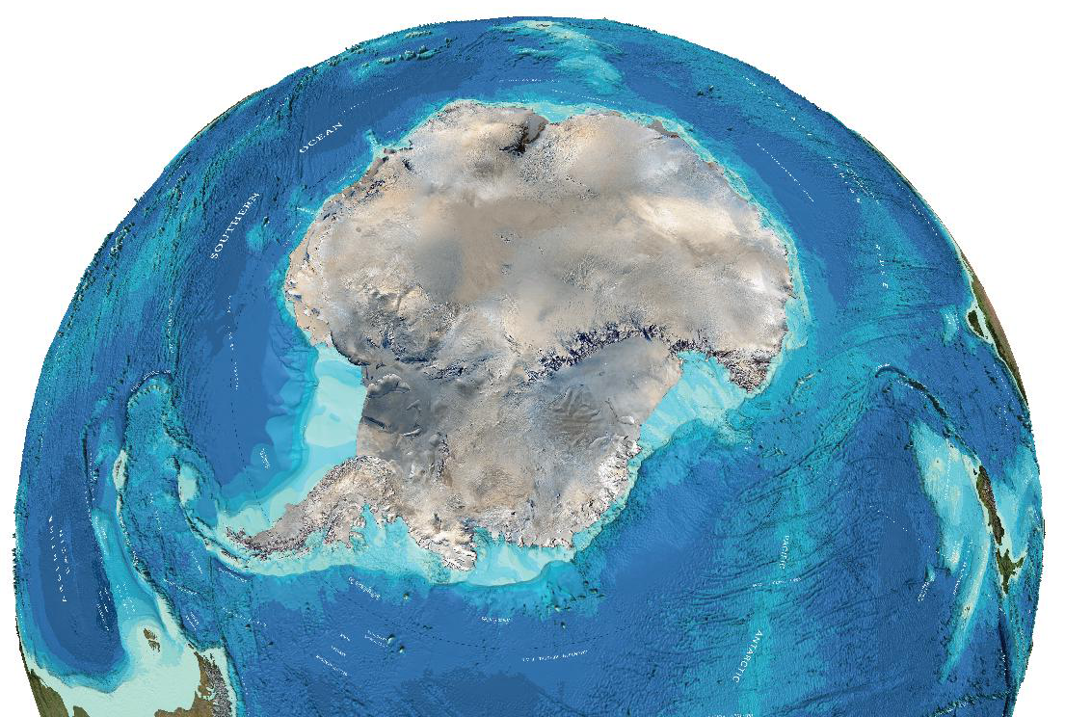
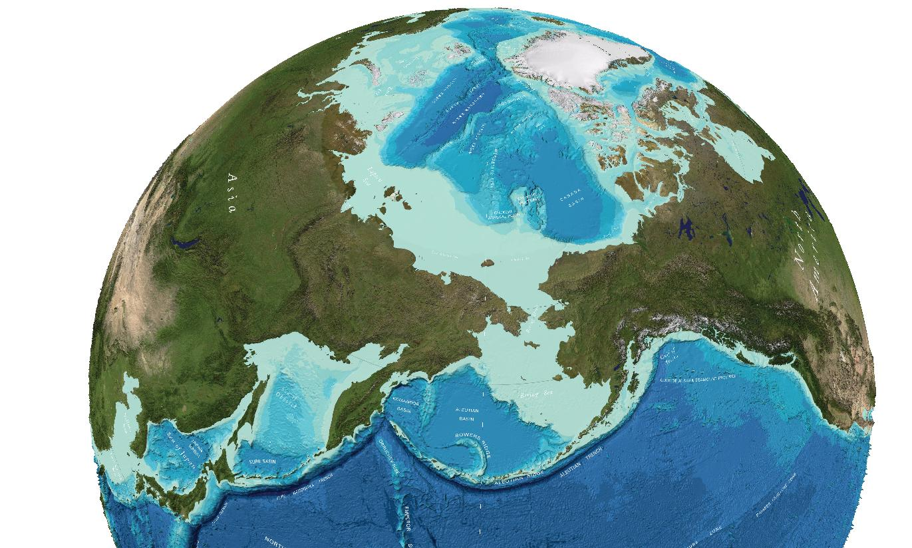
Strategic organization
based on experience
The Seabed 2030 project organization originates from the concept of a “Regional Mapping Project” and GEBCO’s structure within its parent organizations the International Hydrographic Organization (IHO) and Intergovernmental Oceanographic Commission of UNESCO (IOC)
International Bathymetric Chart of the Southern Ocean (IBCSO)
International Bathymetric Chart of the Arctic Ocean (IBCAO)

Slide 19
Seabed 2030 Governance
Review Panel
SCRUM =
Sub-committee on Regional Undersea Mapping
GEBCO Guiding
Committee
SCRUM
SCUFN
TSCOM =
Technical Sub-committee on Ocean Mapping
TSCOM
Project Team
Director + Center leads
SCUFN = Sub-committee on Undersea Feature Names
Manages the project
Reports to GGC

Slide 20
Seabed 2030 Operations
GEBCO Guiding
Committee
SCRUM
SCUFN
TSCOM
Advisory
Group
Project Team
Director + Center leads
N Pacific & Arctic Ocean
Atlantic & Indian Ocean
Global
Center
Southern Ocean
South & West Pacific

Slide 21
Seabed 2030 Operations
Regional communities
Technical
SCRUM
TSCOM
Director + Center leads
Project Team
N Pacific & Arctic Ocean
Atlantic & Indian Ocean
Global
Center
Southern Ocean
South & West Pacific

Slide 22
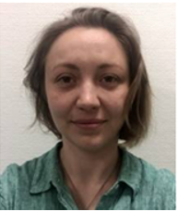
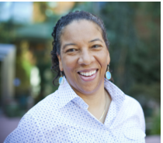
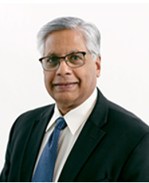
Seabed 2030 Strategic Advisory Group
Advisory
Group
Bjorn Jalving
Executive VP,
Konsberg Maritime
Yulia Zarayskaya
NF-GEBCO Alumni
Team Lead XPrize
Dawn Wright
Chief Scientist, ESRI
Dr. Kilaparti Ramakrishna
Head of Strategy, Green Climate Fund

Slide 23
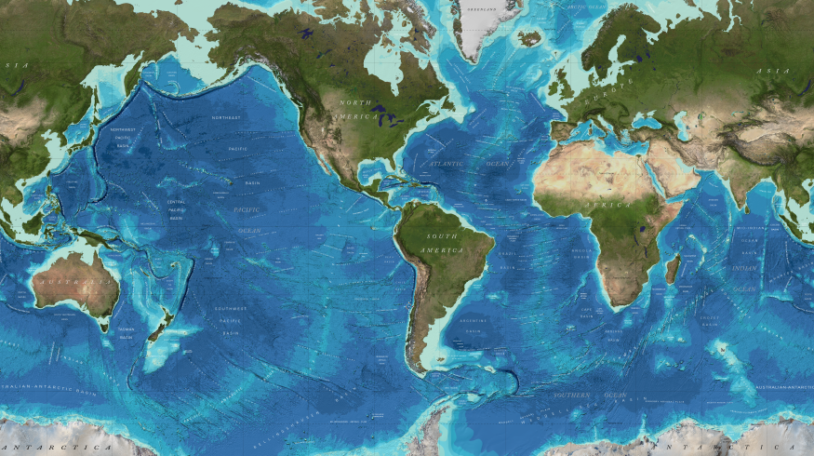
Completeness of GEBCO 2014 Grid
If the World Ocean is divided into 1x1 km blocks (grid cells), about 82 % of them do not have depth values. (Based on GEBCO 2014 grid)
18 % complete
1 km
Target resolution of
New HIGH RESOLUTION
GEBCO Grid?
Notes:
GRID 18% complete
NOT 18% of world ocean mapped
Media reported 100 m – everywhere!

Slide 24
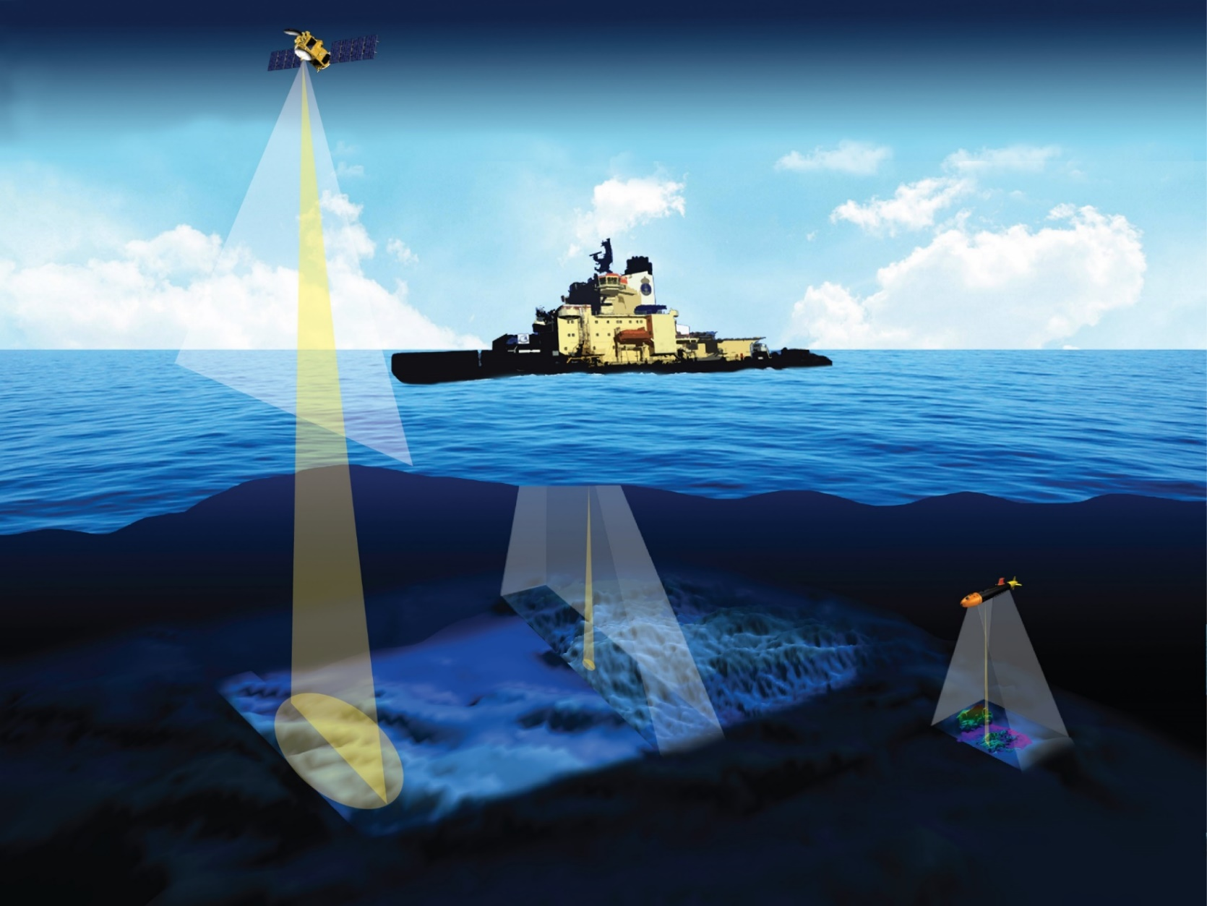
Seabed 2030
Mapping resolution
(1°x1° deep-water multibeam)
Horizontal resolution: ∼60 m
Swath width: 14-17 km
(1°x1° high-res multibeam)
Horizontal resolution: < 5 m
Swath width: <500 m
Horisontal resolution: ∼1 km
10.3390/geosciences8020063
Notes:
Mainstream mapping technology

Slide 25
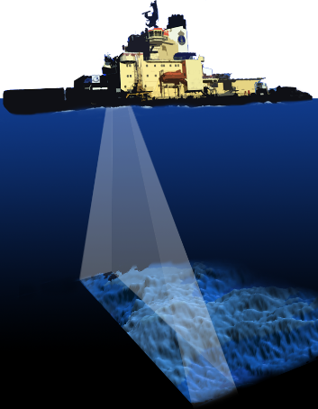
Mapping with surface vessel,
deep water multibeam
(12 kHz 2°x 2°, 60 ° from nadir)
World Ocean area
“Resolution”
“Coverage”
∼Foot print
∼Swath width
9.7 %
0
35
2000
500
Today’s surface
technology
2.0 %
70
4000
1000
4.4 %
140
8000
2000
8.6 %
209
12000
3000
22.2 %
279
16000
4000
31.8 %
349
20000
5000
19.9 %
Depth (m)
419
24000
6000
1.0 %
489
28000
7000
0.1 %
Assumed 4 x water depth
559
32000
8000
<0.1 %
Assumed 2°x2°
628
36000
9000
698
40000
10000
10.3390/geosciences8020063
768
44000
11000

Slide 26
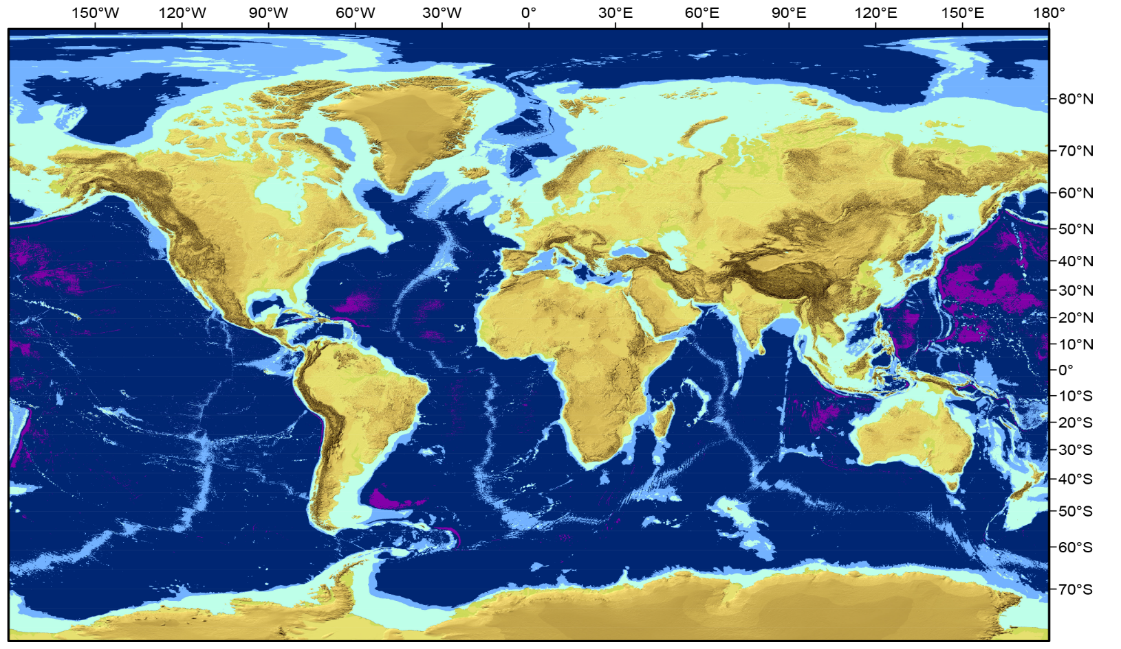
Target GEBCO Grid Variable Resolution
100x100 m
200x200 m
400x400 m
800x800 m
Depth Range | Resolution | % of ocean
0–1500 m | 100 × 100 m | 13.7
1500–3000 m | 200 × 200 m | 11
3000–5750 m | 400 × 400 m | 72.6
5750–11,000 m | 800 × 800 m | 2.7
Depth-dependent,
variable resolution

Slide 27
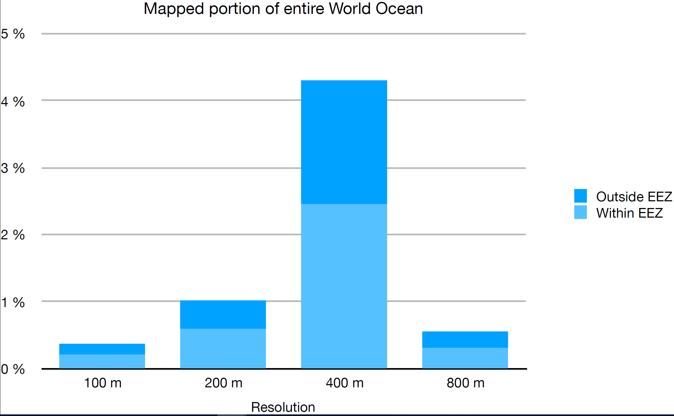
How complete is the variable res GEBCO Grid?
4.3 %
Depth Range | Resolution | % of ocean
0–1500 m | 100 × 100 m | 13.7
1500–3000 m | 200 × 200 m | 11
3000–5750 m | 400 × 400 m | 72.6
5750–11,000 m | 800 × 800 m | 2.7
1.8 %
Grid 6.2 % complete
1.0 %
2.5 %
0.4 %
0.4 %
0.5 %
6.2 + Y + Z = 100%
0.2 %
0.6 %
0.2 %
0.2 %
0.3 %
Grid + data + gaps = 100%
0–1500
1500–3000
3000–5750
5750-11000
Depth Range (m)
Notes:
- GEBCO 2014 Grid = 18% complete

Slide 28
How to complete the GEBCO Grid?
Coordinate and inspire mapping ex
Global ocean mapping community
Vast amounts of data collected but yet NOT available for the GEBCO Grid (Y)
Build on SCRUM as GEBCO regional mapping model
Build on TSCOM for technical advances
Technology innovation
Human capacity development
Illustration: Marine Dep. Malaysia
Facilitate crowd sourced data
New mapping technologies

Slide 29
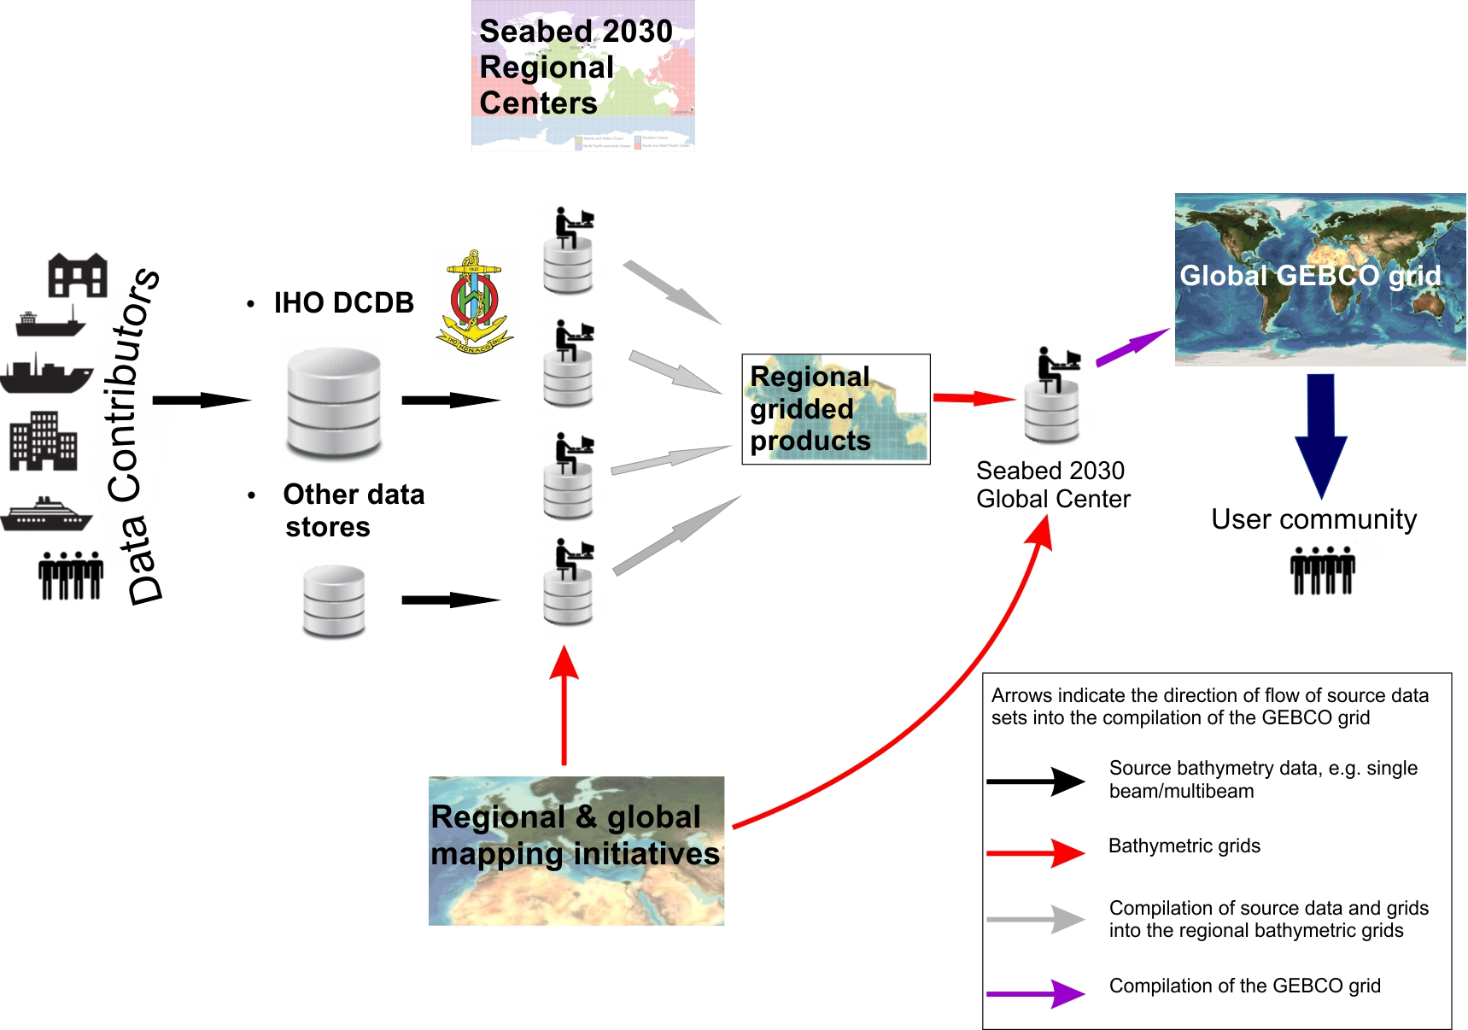
Nippon Foundation – GEBCO Seabed 2030 Project
Preferred data flow

Slide 30
Nippon Foundation – GEBCO Seabed 2030 Project
Other supported data flows
If Data Contributors submit data to Regional or Global Centers:
Data Contributors will be asked to commit to 1 of 3 data access protocols:
Public data access (preferred)
Data forwarded to IHO-DCDB for archive and public access
Restricted data access
Data forwarded to IHO-DCDB for archive and restricted access
Private data access
Data not forwarded to IHO-DCDB, archived at Seabed 2030 Center
Usage restricted to only inclusion in GEBCO Products;
no distribution of data

Slide 31
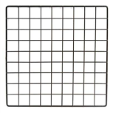
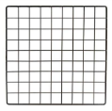
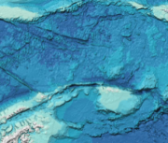
Data Flow - detailed
Data flow - archival
Grids
Data flow - grid
Grids
Grid flow
Regional Grid
Seabed 2030
Global Center
Regional Center
BODC
3
4
4
<Private>
GEBCO Grid
3
4
1
?
<Public>
1
<Restricted>
Data
2
Data
IHO DCDB
2
Data

Slide 32
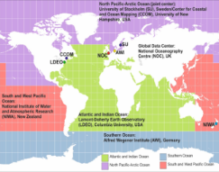
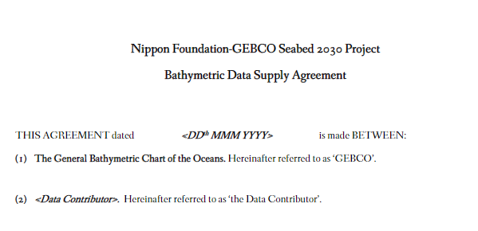
Data Flow - detailed
Global Centre
Create GEBCO Grid from
Integrating trans-regional grids
Integrating Seabed 2030 Grids
Send data to Regional Centres
Archive data:
At IHO-DCDB or
At BODC
Integrate
trans-regional grids
GEBCO Grid
2. Integrate Seabed 2030
regional grids
Data flow - archival
Data flow - grid
Seabed 2030
Global Center
BODC
3
Grid flow
<Private>
?
4
<Public>
Data supply Agreement
<Restricted>
3
IHO DCDB
3. Data submissions

Slide 33
Seabed 2030 Strategy
Evolution of SCRUM + TSCOM
Source grids and data - Community
Identify contributors
Build relationships
Solicit contributions
Integrate into regional Grid - Technical
Agree data protocols/formats
Ingest data
Build gridding system
Send Grid to Global Centre
Send data to IHO-DCDB for archive
SCRUM
TSCOM

Slide 34
Next steps
SCRUM
Focus on Y = existing data not in GEBCO (Y)
X + Y = ‘mapped’
Regional Centers:
Engage with data contributors
Create regional editorial boards
Reach out to IHO Regional Hydrographic Commissions
GGC/SCRUM meeting in November 2018
TSCOM
Seabed 2030 Project Team establish technical systems
GGC/TSCOM meeting in November 2018

Slide 35
Nippon Foundation GEBCO Seabed 2030 Upcoming events
8th to 10th Oct 2018 Seabed 2030 – Arctic, Antarctic & North Pacific Mapping Meeting, Stockholm Uni, Sweden 30th Oct to 1st Nov 2018 Seabed 2030 – Atlantic and Indian Oceans Regional Center Meeting, Lamont Doherty Earth Observatory, Columbia Uni, USA 12th to 16th Nov, 2018 GEBCO TSCOM/SCRUM and GGC Meeting, Canberra, Australia
UNH

Slide 36
Call to Action
Support data availability at Seabed 2030 target resolution
Facilitate legal availability at Seabed 2030 target resolution
Engage with Regional Centers or Global Center
Support & promote GEBCO activities & products

Slide 37
Questions…
The Nippon Foundation-GEBCO Seabed 2030 Project
Thank you.
GEBCO operates under the joint auspices of the International Hydrographic Organization (IHO) and UNESCO’s Intergovernmental Oceanographic Commission (IOC)
The Nippon Foundation acts as a Social Innovation hub, creating new frameworks and bringing about change, to lay the foundation for a society in which “all people support one another.”
seabed2030.gebco.net
@seabed2030

Slide 38
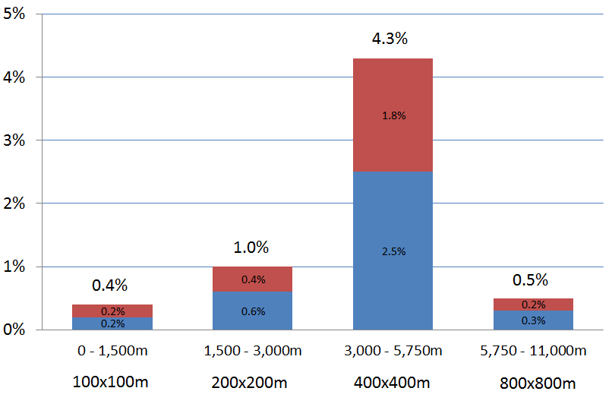
How complete is the variable res GEBCO Grid?
Grid 6.2 % complete
Depth Range | Resolution | % of ocean
0–1500 m | 100 × 100 m | 13.7
1500–3000 m | 200 × 200 m | 11
3000–5750 m | 400 × 400 m | 72.6
5750–11,000 m | 800 × 800 m | 2.7

