Slide 1

Arctic Regional Marine Spatial Data Infrastructures Working Group (ARMSDIWG)
Report to ARHC7
▪ ▪ ▪
International Hydrographic Organization (IHO)
Arctic Regional Hydrographic Commission (ARHC)
Sebastian Carisio
Chair ARMSDIWG

Slide 2





Data-Centric Production and MSDI
Search and Rescue
Industry and Marine Spatial Planning
Fisheries
(standardized)
Marine Spatial Data
Scientific Research
Chart Product
Bathymetry
+
Chart Geometry
Databases
4₁
4₁
4₁
4.1m
Data-centric
Production
Bathymetry
Small Scale Large Scale
Slide – S. Carisio, Working Towards a Marine Spatial Data Infrastructure (MSDI) in the Arctic, July 2017
Approved for public release, 17-281.

Slide 3
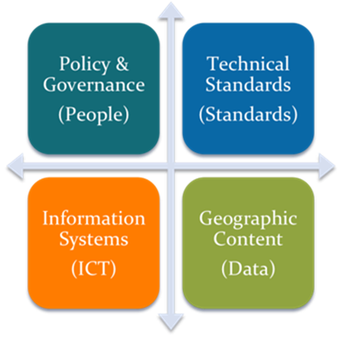
ARMSDIWG (ɑrmz - dē - wɪg)
ARHC 5 Action: Denmark and U.S. to propose a regional approach to MSDI
  Arctic Regional MSDIWG
  Arctic Voyage Planning Guide (AVPG)
Established ARMSDIWG at ARHC 6.
Currently represented nations:
  Canada
  Denmark
  Finland
  Iceland
  Norway
  United States (Chair)
Arctic Regional MSDI
Image Credit - (DRAFT) IHO Publication C-17, Spatial Data Infrastructures: “The Marine Dimension” - Guidance for Hydrographic Offices, Ed 2.0, April 2016

Slide 4
ARMSDIWG Functions
Identify and assess the statuses of individual MS MSDI implementation.
Consider MSDI policies in related international projects and cooperate specifically with the Arctic SDI.
Analyze how maritime authorities can contribute their spatial information and the necessary updates, so information can easily be collated with other information to a current overall picture for the region.
Focus on how ARHC in the future can benefit from a regional approach.
Slide Information - https://www.iho.int/mtg_docs/rhc/ArHC/ArHC_Misc/ToR_ARMSDIWG.pdf

Slide 5
ARMSDIWG Functions
Monitor the development of SDI (specifically the Arctic SDI) that could be relevant for the region.
Monitor the development of relevant and applicable OGC standards and activities through association with the OGC Marine DWG.
To present a yearly report to the ARHC at their meeting. This report should include a description on the current status, recommendations on how to proceed with the MSDI implementation, and if deemed necessary, an action plan with specified time schedule for future ARMSDI actions.
The ARMSDIWG should inform relevant Regional Hydrographic Commissions (RHCs) with the aim to coordinate within the other regions as far as possible.
ARMSDIWG Terms of Reference can be accessed from the IHO ARHC page or directly at:
  https://www.iho.int/mtg_docs/rhc/ArHC/ArHC_Misc/ToR_ARMSDIWG.pdf
Slide Information - https://www.iho.int/mtg_docs/rhc/ArHC/ArHC_Misc/ToR_ARMSDIWG.pdf

Slide 6
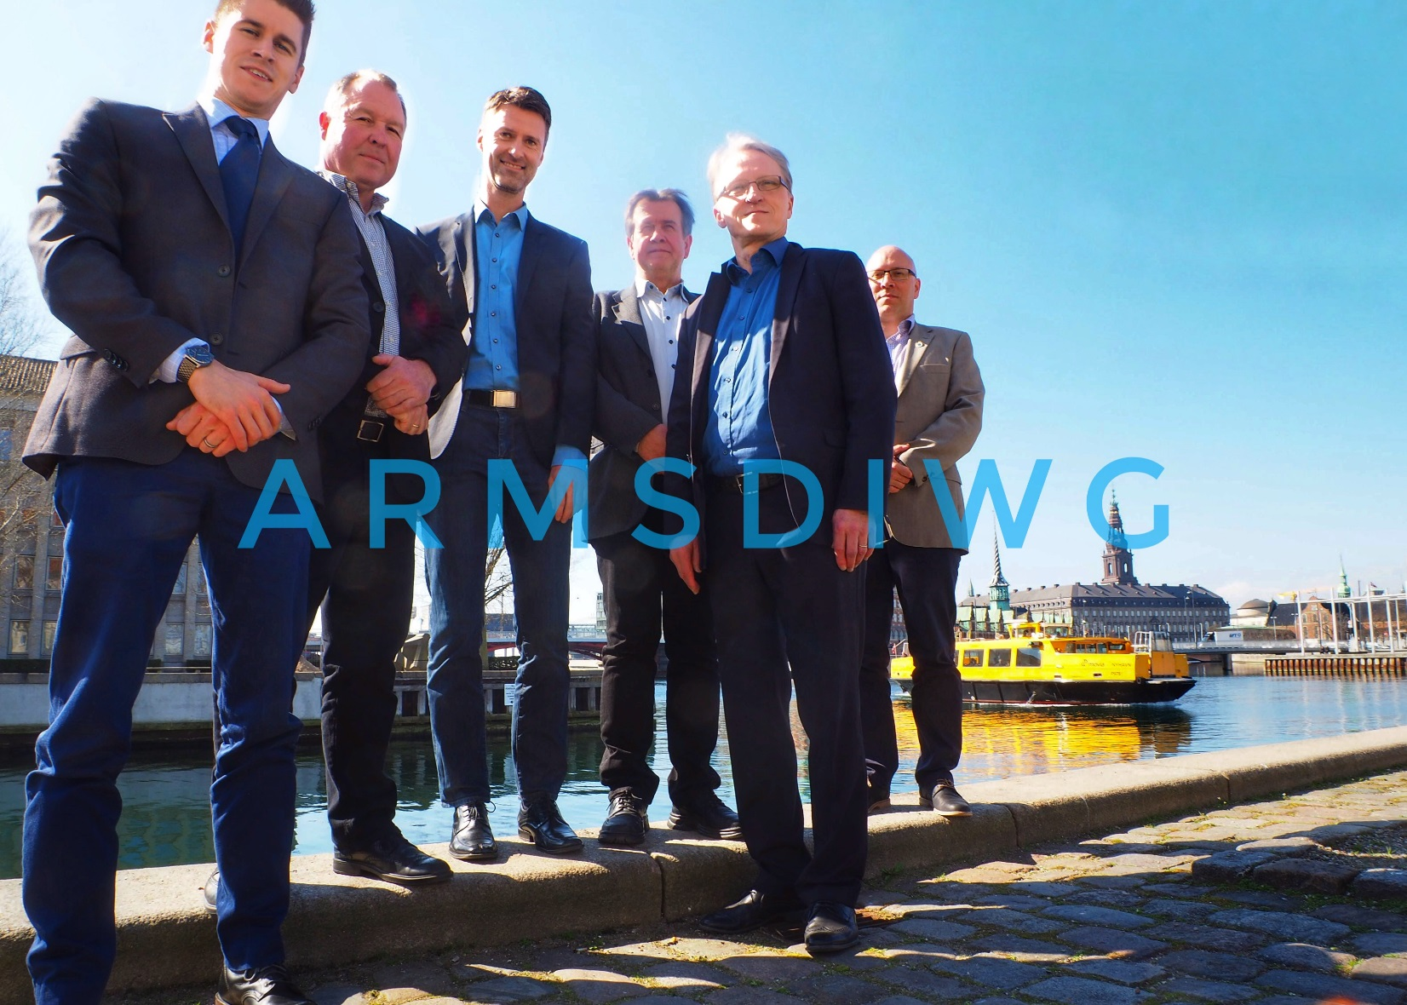
ARMSDIWG1
Copenhagen, Denmark
  04 - 05 April 2017
Meeting participants
  Canada
  Denmark
  Finland
  Norway
  United States
Day 1
  National Presentations
  Pan-Arctic Bathymetry
Day 2
  MSDI approach to AVPG
  Related Arctic spatial data activities
  ARMSDIWG/Arctic SDI preparation
  Evaluation, Actions, Work Plan

Slide 7
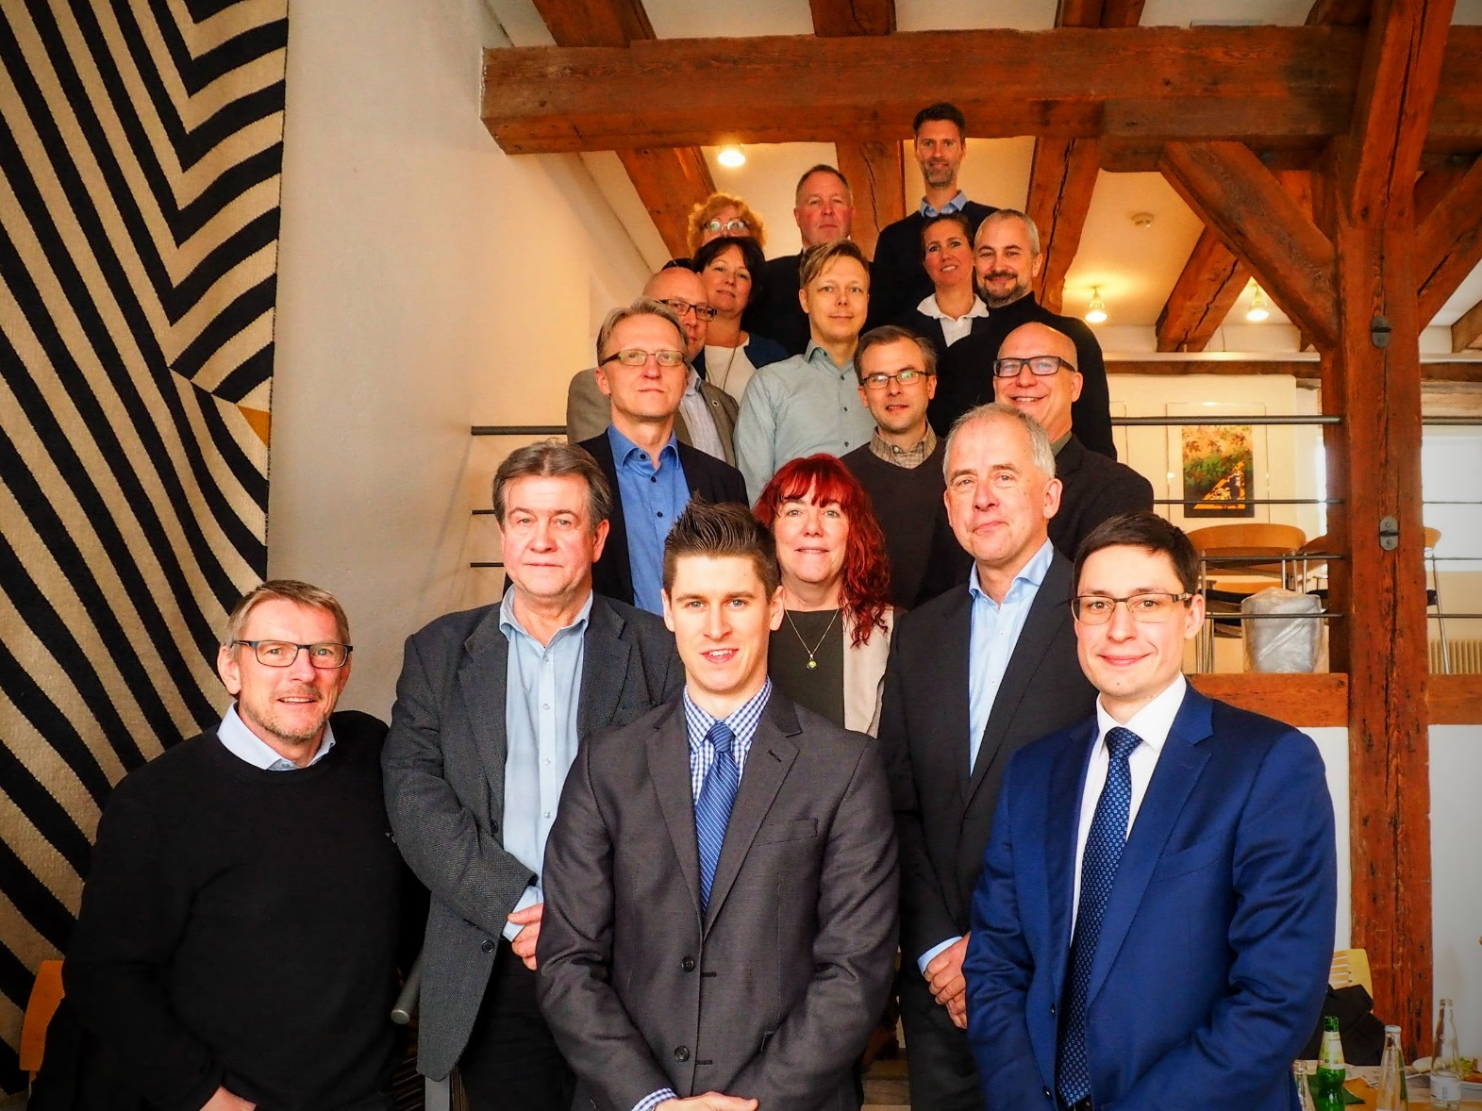
Joint Meeting of the Arctic SDI and the ARMSDIWG
Copenhagen, Denmark
  06 April 2017
Overview of Arctic SDI
Overview of ARMSDIWG
Discussion of Opportunities
  Identify major datasets for between domains (land/sea)
  Coordinated outreach
  Joint architecture
  Spatial data pilots w/ stakeholders
  Arctic SDI milestone: contact with Marine domain
  Organization
    File sharing, web presence, joint meetings, etc.
  Possible OGC Arctic DWG
Note: Extreme alignment of orgs.

Slide 8
ARMSDIWG Outreach & Awareness
In-person presentations at conferences and meetings within first year of existence.
Reaching 300+ individuals with several events including online additional attendees.
  Ocean Innovation 2016, OCT 2016 – Iqaluit, NU, Canada
  BS-NSMSDIWG5, DEC 2016 – Rostock, Germany
  MSDIWG8, FEB 2017 – Vancouver, BC, Canada
  U.S. HYDRO 2017, MAR 2017 – Galveston, TX, USA
  103rd OGC Technical Committee Meeting, JUN 2017 – St. John’s, NL, Canada
  International Cartographic Conference 2017, JUL 2017 – Washington, DC, USA
  NOAA Open House on Nautical Cartography, JUL 2017 – Silver Spring, MD, USA
  7th Symposium on the Impacts of an Ice-Diminishing Arctic on Naval and Maritime Operations, JUL 2017 – Washington, DC, USA

Slide 9
ARMSDIWG Recent Actions
Prepare a white paper on Arctic MSDI for the next Arctic Council meeting.
  COMPLETE
Draft a consolidated work plan (using IHO template), to be reviewed at the ARHC extraordinary meeting.
  COMPLETE
First, in-person ARMSDIWG Meeting in Copenhagen, Denmark combined with Arctic SDI Meeting.
  COMPLETE
  Continued meetings, joint presentations/white paper, joint online web presence (e.g., marine.arctic-sdi.org), etc.
MSDI Reporting Template
  Based on reporting criteria in 2015 CHS-developed MSDI questionnaire/survey.
MSDI approach to the Arctic Voyage Planning Guide (AVPG).
  Canada will lead (Norway, Denmark, C/ARMSDIWG to support) a concept paper/implementation plan for AVPG that builds on previous AVPG framework with a MSDI perspective.
C/ARMSDIWG to investigate the idea of a pan-Arctic bathymetric database for ARHC 7.
  ARMSDIWG1 – determined many initiatives like this already exist.
  Focus on best practices for cross-community bathymetric sharing.

Slide 10
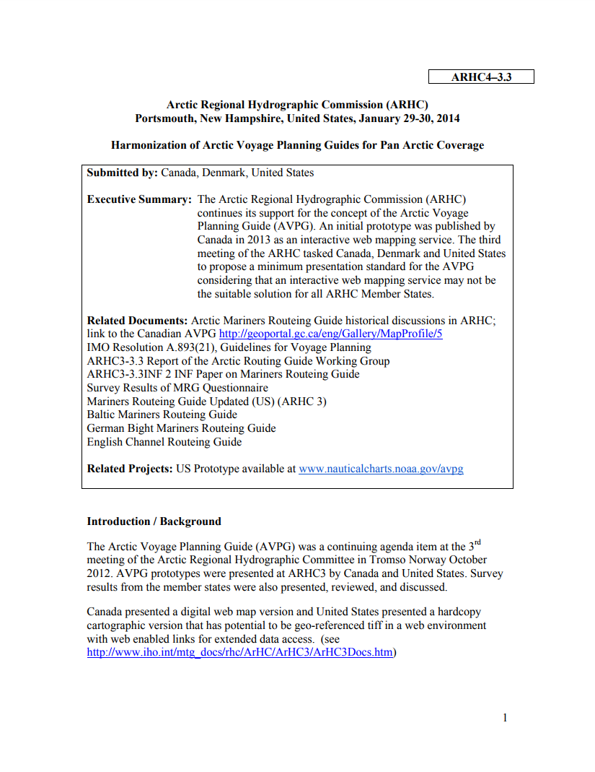
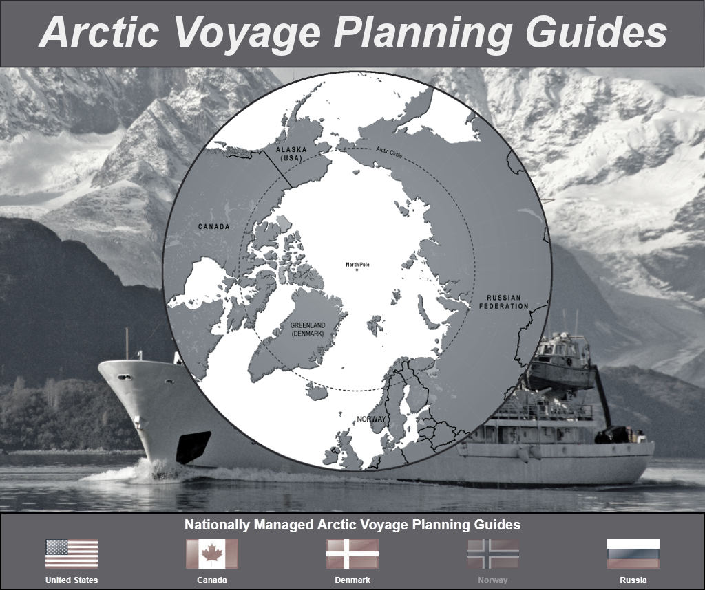
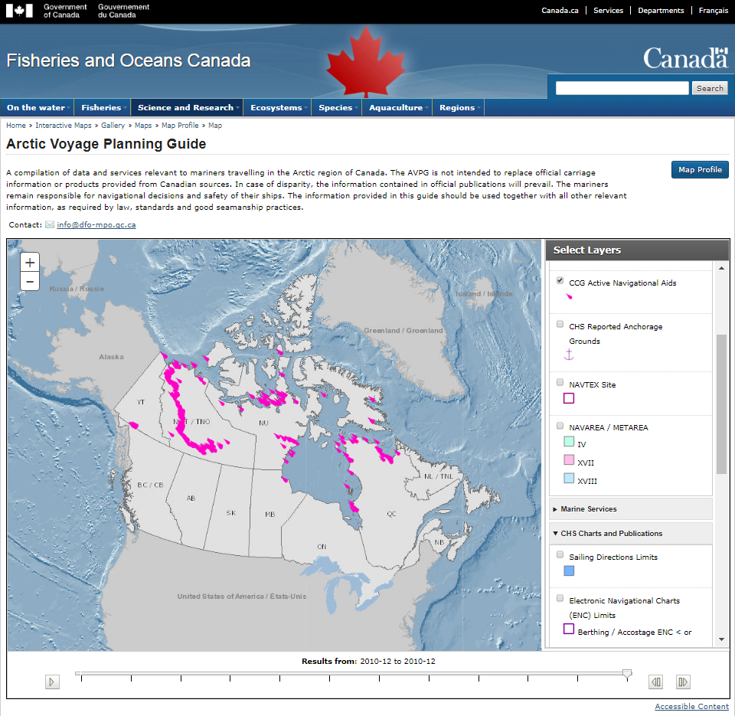
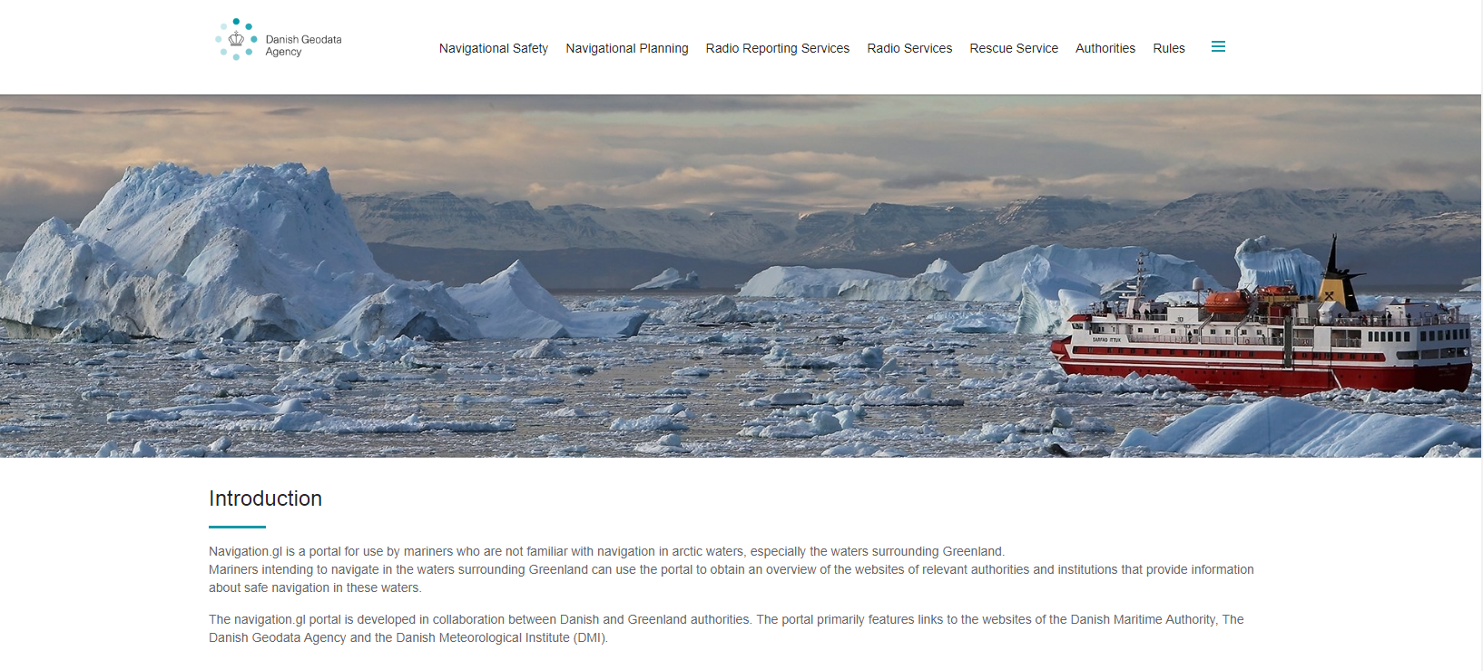
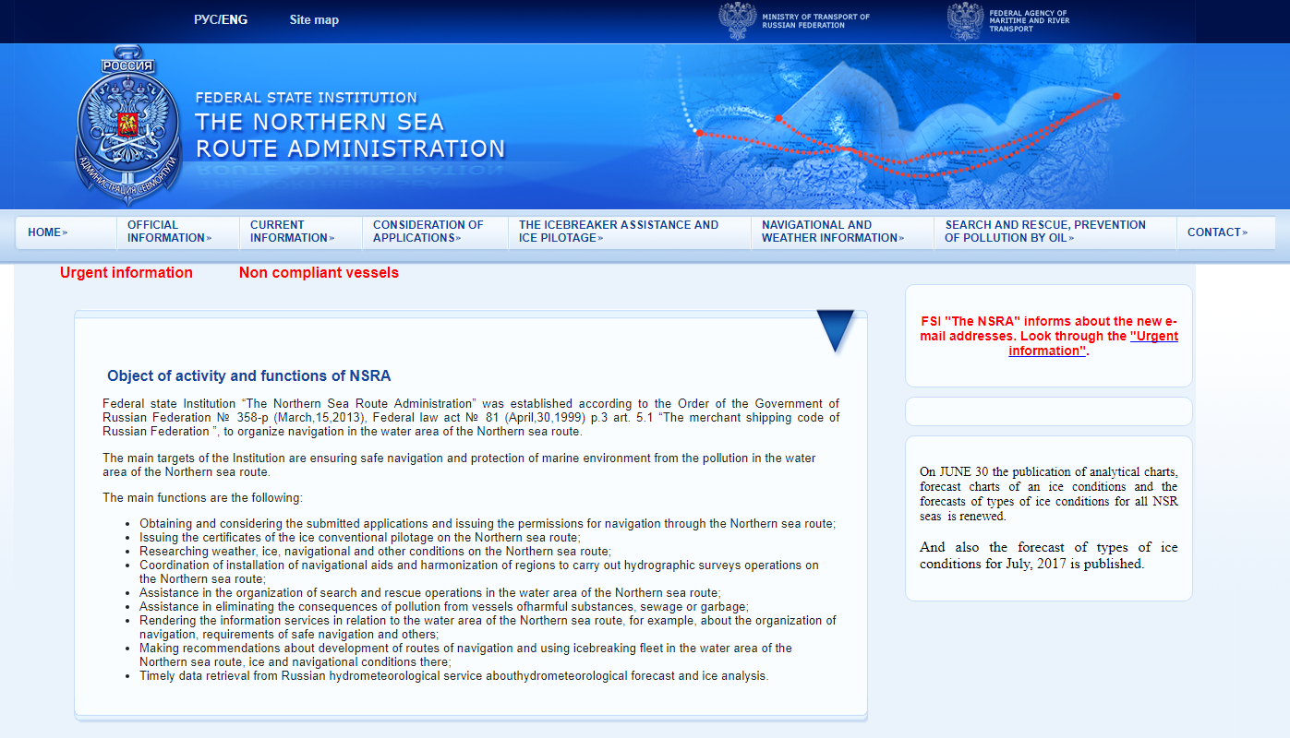
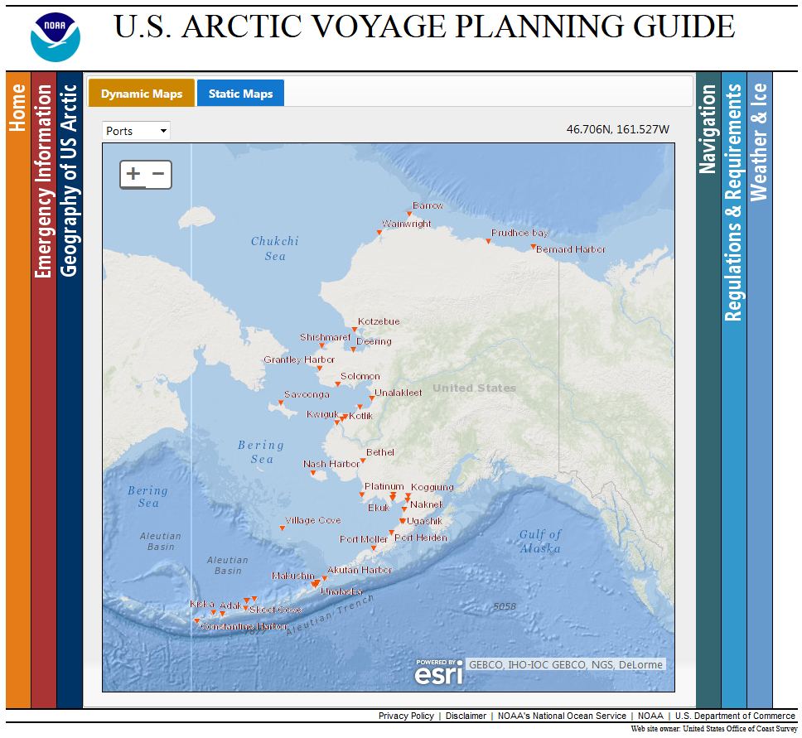
ARHC4-3.3 Harmonization of Arctic Voyage Planning Guide for Pan Arctic Coverage – pivoting from this document, but with a MSDI approach.
Current AVPG Portals
Image Credits - https://www.nauticalcharts.noaa.gov/avpg/
- http://www.nauticalcharts.noaa.gov/avpg/guide.htm
- http://geoportail-geoportal.gc.ca/eng/Gallery/mapprofile/5
- http://eng.navigation.gl/
- http://asmp.morflot.ru/en/celi_funktsii/

Slide 11
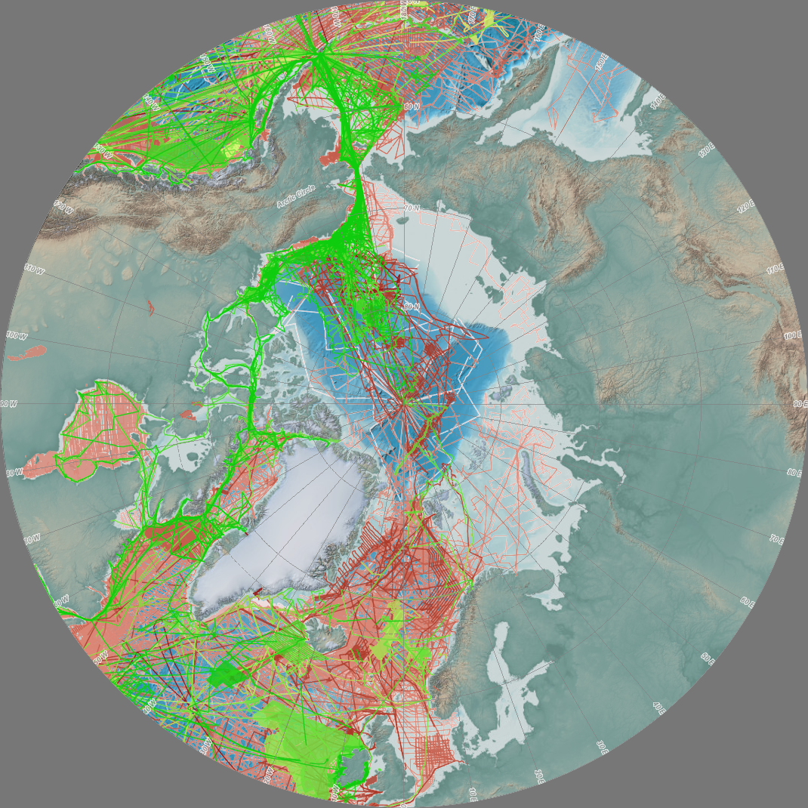
The IHO DCDB is hosted by the U.S. National Oceanographic and Atmospheric Administration (NOAA) on behalf of the IHO Member States.
■ Multibeam Bathymetric Surveys
■ Single-Beam (Trackline) Bathymetric Surveys
Image Credit - https://maps.ngdc.noaa.gov/viewers/bathymetry/

Slide 12
For more information: www.iho.int
IHO Contact: info@iho.int

