Slide 1
National Report by Japan
IHO Hydrographic Commission on Antarctica (HCA)

Slide 2
Survey and charting progress in Antarctica since HCA-14 (June 2016)
New charts produced (INT, national, ENC)
Areas Surveyed
Data Provision

Slide 3
New charts produced (ENC)
June 2016
“Approach” ENCs based on INT9047, Cell size：30´
Cell No.：JP40P0TS, Area：69-30S - 69-00S 39-00E - 39-30E
Cell No.：JP40P0TU, Area：69-30S - 69-00S 39-30E - 40-00E
Cell No.：JP40PKES, Area：69-00S - 68-30S 39-00E - 39-30E
Cell No.：JP40PKEU, Area：69-00S - 68-30S 39-30E - 40-00E
Aug 2016
“General Navigation” ENCs based on INT9045 , Cell size：4°
Cell No.：JP20ODCG, Area：70-00S - 66-00S 36-00E - 40-00E
“Coastal Navigation” ENCs based on INT9046 , Cell size：1°
Cell No.：JP30ODCO, Area：70-00S - 69-00S 38-00E - 39-00E
Cell No.：JP30ODCS, Area：70-00S - 69-00S 39-00E - 40-00E
Cell No.：JP30PKEO, Area：69-00S - 68-00S 38-00E - 39-00E
Cell No.：JP30PKES, Area：69-00S - 68-00S 39-00E - 40-00E
“Harbour” ENCs based on INT9047 Plan , Cell size：15´
Cell No.：JP50PAME, Area 69-15S - 69-00S 39-30E - 39-45E
Cell No.：JP50PKEU, Area 69-00S - 68-45S 39-30E - 39-45E

Slide 4
New charts produced (INT and national paper charts)
July 2016
INT9046 (published as national paper charts “W3941”)
Title ONGUL ISLANDS TO SKARVSNES
Area：68-52S, 69-28S, 38-47E and 39-55E Scale 1:100,000

Slide 5
Areas Surveyed
Due to damage of multibeam sonar of Japanese icebreaker “Shirase”, Japan has not been able to conduct hydrographic surveys in Antarctic region since 2014.
JHOD has made efforts to ensure budget to repair the multibeam sonar in cooperation with the ministry* which is in charge of Antarctic projects.
*Ministry of Education, Culture, Sports, Science and Technology
The multibeam sonar would be repaired in 2019 hopefully.

Slide 6
Planned Activities 2018-19
new charts
No plans at this stage
new surveys
No plans in 2018
Red rectangles in the right figure during Dec. 2019-Mar. 2020.
64 deg S
Lützow-holm bay
：Planned survey
(Dec. 2019-Mar. 2020)
70 deg S
32 deg E
56 deg E

Slide 7
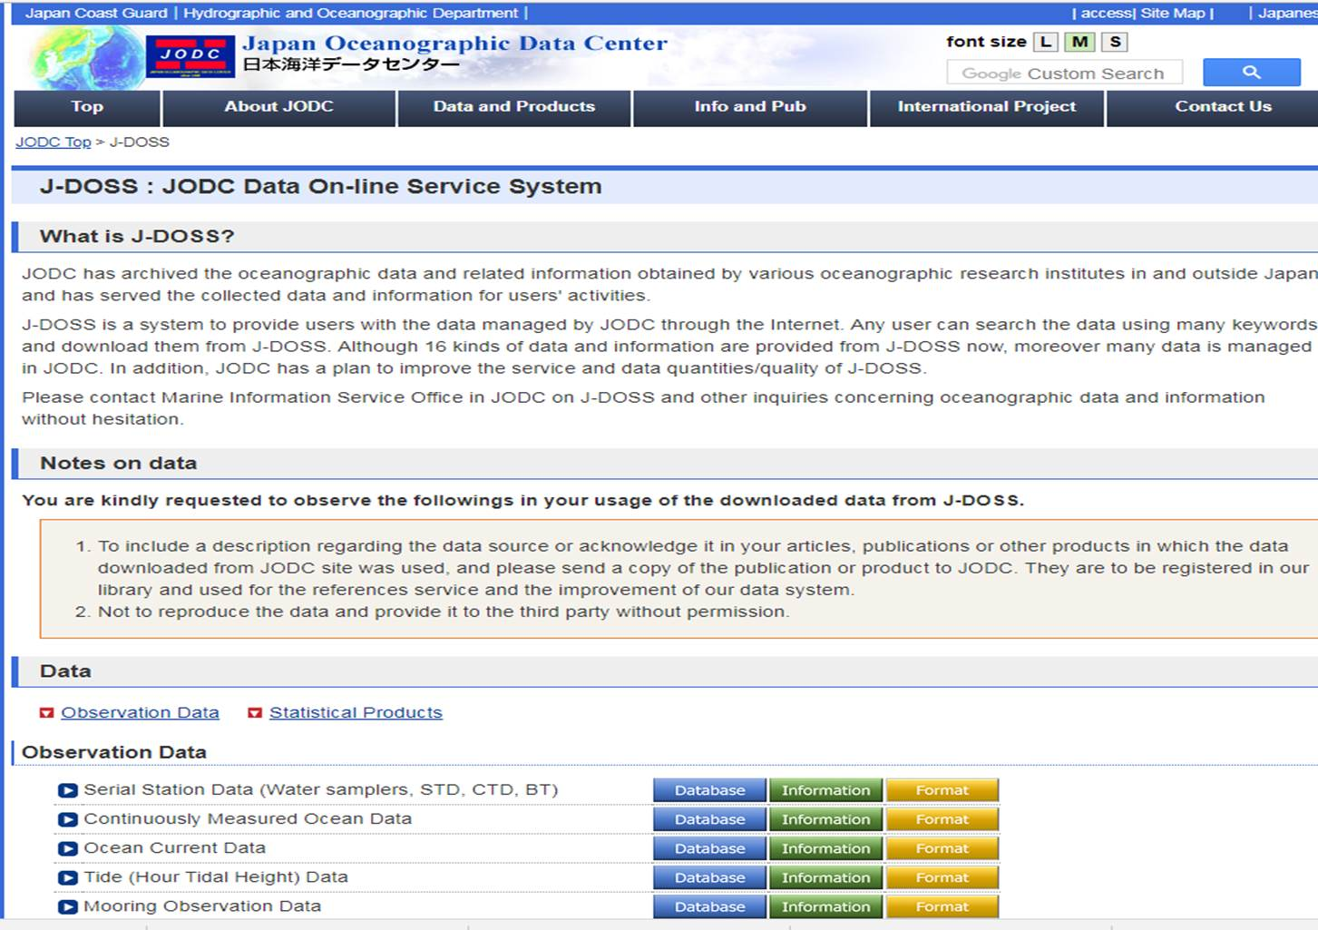
Data provision
Japan has developed online system to provide oceanographic and bathymetric data. http://www.jodc.go.jp/jodcweb/JDOSS/index.html
Marine data such as bathymetry, tide, salinity, DO and temperature in Antarctica can be downloaded.
--- > The data will also contribute to GEBCO Seabed2030.
Bathymetry
http://jdoss1.jodc.go.jp/vpage2017/JAREdepth.html
Tide at “Showa” station of Japan
http://jdoss1.jodc.go.jp/vpage/tide.html
Salinity, DO and Temperature
http://jdoss1.jodc.go.jp/vpage/scalar.html

