Slide 1
17th MACHC Conference
Agenda item 2.2
IRCC 8 report

Slide 2
Content
MACHC report to IRRC8
IBSC
IRCC8 Action list
IRCC8 Work plan

Slide 3
MACHC report to IRRC8
Summary
Progresses made on the membership
Importance of Spanish within the MACHC
Procedure for selection of MS for the IHO council
MICC achievements, including NOAA Port Analysis
First Risk assessment meeting, plus follow on activities.
MEIP, work on future viability (incl ENC online viewer).
CB Committee active with a structured plan

Slide 4
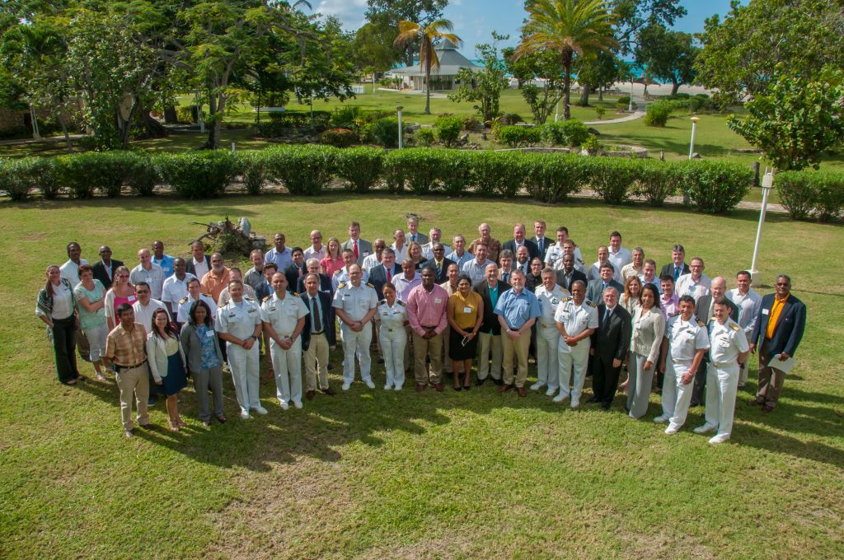
MACHC report to IRRC8
16th MACHC- St John’s, Antigua and Barbuda
12 of 13 MS
Interna-tional organisa-tions
7 of
13 AMS
Regional organisa-tions
6 Obser-ver nations
Industry
During Conference some 80 participants

Slide 5
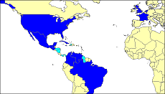
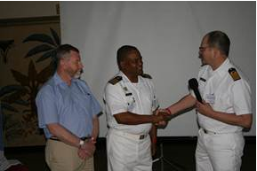
MACHC report to IRRC8
Memberschip
Dominican Republic Associate Member

Slide 6
MACHC report to IRRC8
Spanish within the MACHC
Conclusions
IOT advance aims of MACHC the use of the Spanish language, wherever possible, would be beneficial.
Focus on working language, not official IHO-language.
inclusiveness ⬄ budgetary constraints
Amended Statutes for Spanish:
Continuous interpretation at meetings to and from Spanish being provided

Slide 7
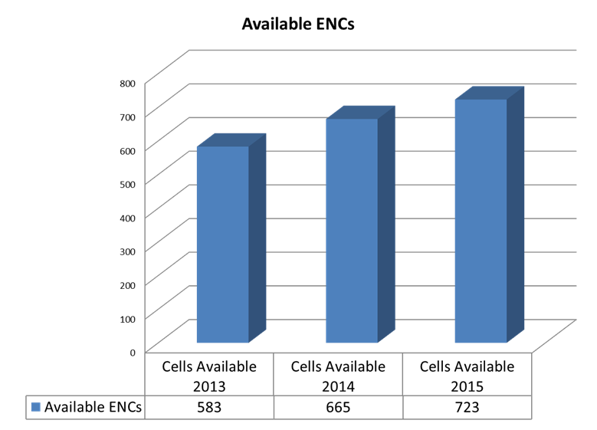
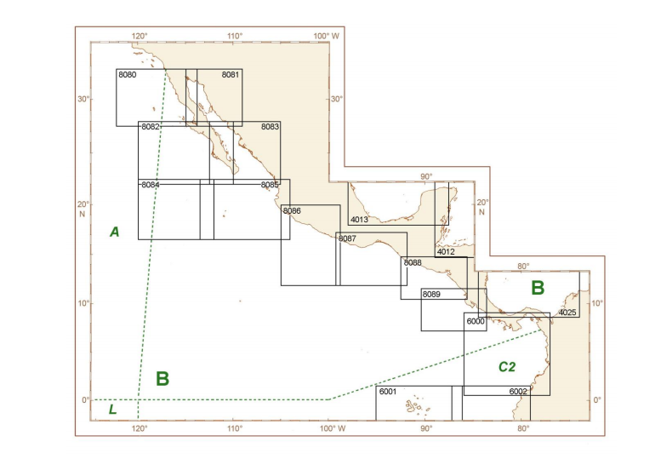
MACHC report to IRRC8
MACH Integrated Charting Committee (MICC)
S-11 update published
STEADY PROGRESS
47 new ENC’s

Slide 8
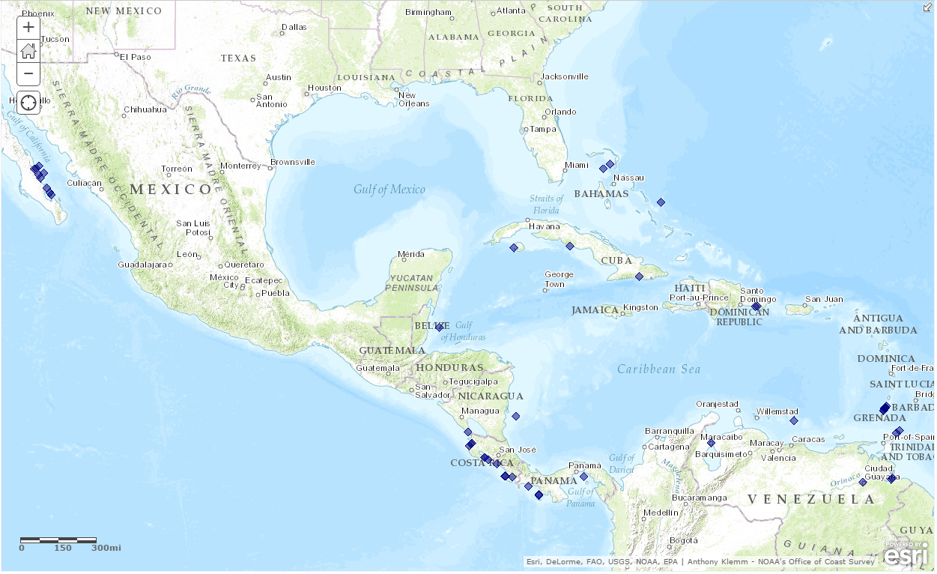
48 out of the 373 world-wide Cruise Ship Ports/ Anchorages not covered by Band 4, 5, or 6 ENCs are located in the MACHC
MACHC report to IRRC8
NOAA Port Analysis Evaluation – Gaps
Three have already been covered by new large scale ENCs

Slide 9
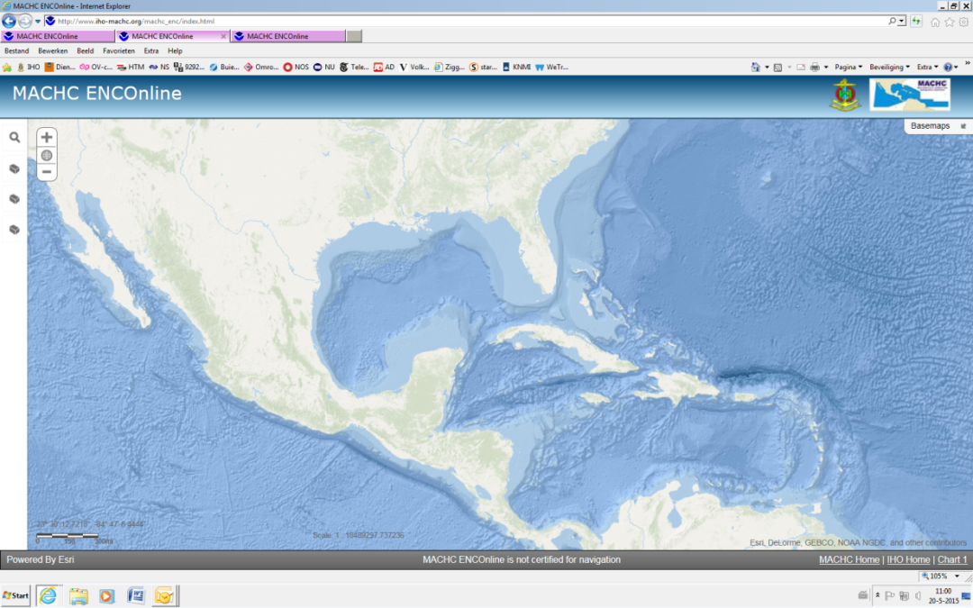
MACHC report to IRRC8
Marine Economic Infrastructure Programme (MEIP) WG
ENC Online viewer (WMS)
Remove password?
Yes. Showcase to spark interest IOT for data be used in other initiatives.
No. Chart data is a commodity that merits a return on investment.
CATALYST
IOT maintain momentum, NOAA offered to host two versions of the viewer: one under password and one without

Slide 10
MACHC report to IRRC8
Capacity Building Committee
MSI & Hydro Governance Workshop
SDB Workshop
MSDI Workshop for Spanish Speakers
Seminar on Raising Awareness of Hydrography
MACHC
CB plan 2013-2017
2017
4 Proposed
ACTIVITIES
2014
4 Completed
2015
6 Completed
2016
4 Funded

Slide 11
MACHC report to IRRC8
Capacity Building Committee: challenges
Need for more courses in Spanish.
Complications in managing and coordinating MACHC CB activities in combination with a growing number of regional initiatives, e.g. FOCHIAMECA, OECS, PAIGH, US support to Haiti etc.

Slide 12
IBSC
Standards of Competence for Hydrographic Surveyors
JPN HO: separate Cat. A syllabus for Hydrographic Surveyors that already hold a Cat. B certification.
No, but:
If Cat B before Cat A: submitting institute must demonstrate that total combined training is at Cat A level.
“IBSC to clarify the course duration timeframes indicated in S-5A, S-5B, S-8A and S-8B (minimum versus recommendations).

Slide 13
IRRC8 Action list
Annexes to MACHC letter 17/2016
A. Filtered Decision List.
Affect the MACHC region
Of immediate interest to its Members.
B. Filtered Action List
Relate to the MACHC region.
Added Column with proposed MACHC way ahead.
Basis for discussion during agenda item 2.2

Slide 14
IRRC8 Action list
IRCC 8 Actions translated in MACHC Actions (1)
IRCC8 | ACTION (AGENDA ITEM) | RESP | DEADLINE | MACHC actions to be taken
6 | Encourage the attendance of Member States and Observers at WWNWS-SC meetings (7b) | RHC Chair | Permanent | Adopt as continuous MACHC action item.
7 | Raise awareness of the impact of e-navigation on the provision of MSI in the respective regions and to highlight the use of the Joint Manual on MSI to ensure correct terminology and formats are used in MSI messages (7b) | RHC Chair | Permanent | Adopt as continuous MACHC action item. Will be addressed during agenda item 2.4
8 | Encourage closer engagement of the National MSI Coordinators of Member States with the relevant NAVAREA Coordinator (7b) | RHC Chair | Permanent | Adopt as continuous MACHC action item.
9 | Encourage closer coordination between NAVAREA and Capacity Building Coordinators in planning and student selection for the CB MSI training courses (7b) | RHC Chair | Permanent | Closed. Already in scope of work of CB Coordinator.
13 | Work to reduce overlaps by applying the WEND Principles in defining approve ENC schemes (7d) | RHC Chair | Permanent | Completed. The work is integral to the remit of the MICC with escalation possibility to the MACHC meeting if required.

Slide 15
IRRC8 Action list
IRCC 8 Actions translated in MACHC Actions (2)
IRCC8 | ACTION (AGENDA ITEM) | RESP | DEADLINE | MACHC actions to be taken
21 | Invite Member States to provide following information in the National Reports to RHC meetings: the status of MSDI; plans for involvement in MSDI; and challenges facing the HO (7e) | RHC Chair | Permanent | Already part of national report format para 9 : “MSDI-progress”. Adopt as action for chair to improve National report format into an Annex of the Statutes. See NL report as example
30 | Invite Member States to provide scanned version of any of the missing sheets, that that they may have in their archives, to the IHB for inclusion in the online digital archive (7i) | RHC Chair | 31 Aug 2016 | Adopt as open action MACHC action item and report back during 17th MACHC meeting if any such sheets can be made available.

Slide 16
IRRC8 Action list
IRCC 8 Actions translated in MACHC Actions (2)
IRCC8 | ACTION (AGENDA ITEM) | RESP | DEADLINE | MACHC actions to be taken
31 | In coordination with Member States, to be attentive to opportunities to raise awareness on the role of hydrography and the importance of improving mankind’s knowledge of the seas and oceans in support of the sustainable development goals, disaster risk reduction and the integrity of the oceans (8) | RHC Chair | Permanent. | Adopt as continuous MACHC action item
32 | Invite Member States to send updated information to the Secretariat with respect to IHO Publications C-55 and P-5.annually including reports of "no changes") | RHC chair | 31 Jul 2016 | Continuous MACHC action 14.1.30 applies. Needs to be re-written accordingly.
37 | Send to the IHB a copy of their regulations regarding the designation of Member States to occupy the seats on the IHO Council allocated to their Commission (12) | RHC Chairs | 23 Jan 2017. | Completed. Procedures approved at MACHC 16 and revised Statutes uploaded on IHO-site.

Slide 17
IRRC8 Workplan
IRCC 8 Workplan translated in MACHC Actions
IRCC8 | ACTION (AGENDA ITEM) | RESP | DEADLINE | MACHC actions to be taken
9/2016 | Provide the IRCC Chair with progress reports on the relevant tasks in the IHO 2016 Work Programme | RHC Chair | Jan 2017 | Continuous. Yearly report, Chairs MACHC WG’s and MS to collate updates on the various topics of work programs 1, 2 and 3. Chair MACHC to coordinate overall.
10/2016 | Provide to the IRCC Chair the estimated values of SPIs and agreed WPIs as of 31 December 2016 and target values for 31 December 2017, complemented by the comments on the difficulties encountered and suggestions for a way forward | RHC Chair | Jan 2017 | Continuous. Yearly report. Chairs of MACHC WG and MS to collate updates on WPI en SPI as indicators. Chair MACHC to coordinate overall.

