Slide 1
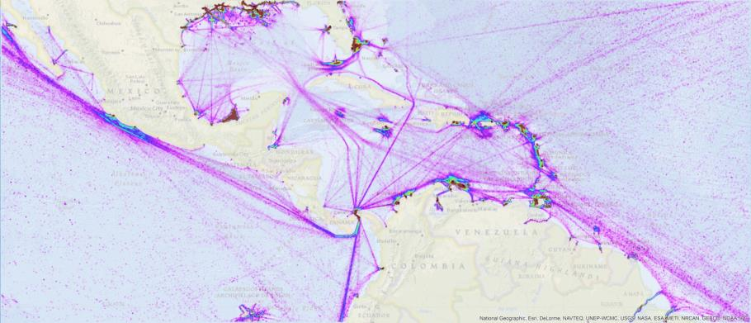
MesoAmerican and Caribbean Sea Hydrographic Commission
Integrated Charting Committee

Slide 2
Work Procedures
Quarterly calls hosted by NOAA.
  Thank you for participation!
Continued to use an evolving GIS planning tool to guide discussions
Need improved phone/voice system
Notes:
This past year, from Colombia, Alex Ferrero, Gustavo Guitierrez, Olga Bonfante and Dagoberto David joined the MICC. Dagoberto David had been a participant several years ago and has recently rejoined the group. Additionally Victor Emilio Aluija Urgell from Cuba, Pierre-Yves Le Moigne from France, Leendert Dorst from the Netherlands, Bernice Mahabier from Suriname, Paul Barrett, Claire Bunyan and Jane Jones from the United Kingdom, Jesse Friedmann from the United States and D. A. Rojas from Venezuela joined in the deliberations of the MICC.
Quarterly calls with webex and GIS

Slide 3
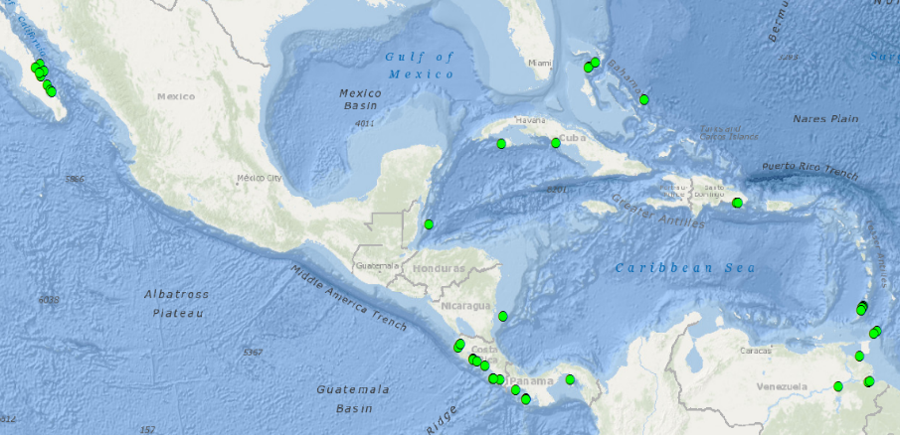
Port Analysis Evaluation – Gaps
46 out of the 373 world-wide Cruise Ship Ports/Anchorages not covered by Band 4, 5, or 6 ENCs are located in the MACHC

Slide 4
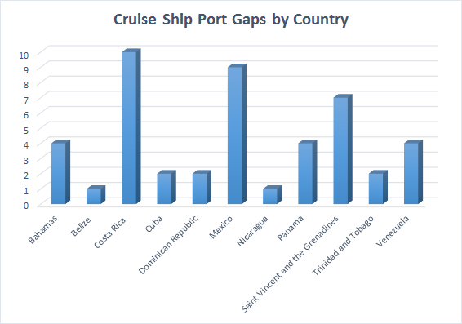

Slide 5

Port Analysis Evaluation – Gaps
Good News
Two more Cruise Ship Ports/Anchorages identified in Summer 2015 have already been covered by new large scale ENCs since the last analysis:
* Portulano El Gran Roque, VZ500309
* Bahia de Santiago de Cuba, CU511905
Mexico and Cuba have reported plans to
fill many identified gaps

Slide 6
MACHC ENC Availability
2016 Summary

Slide 7
MACHC ENCs Available

Slide 8
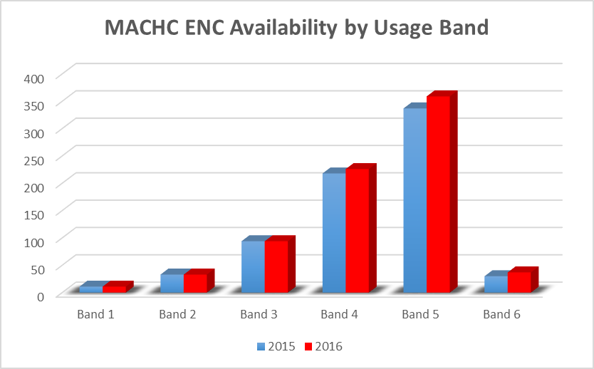

Slide 9
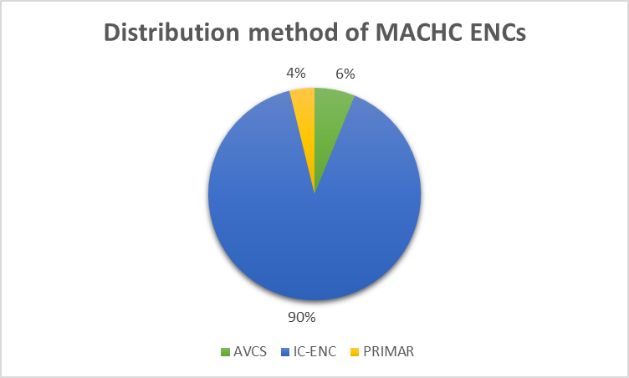

Slide 10
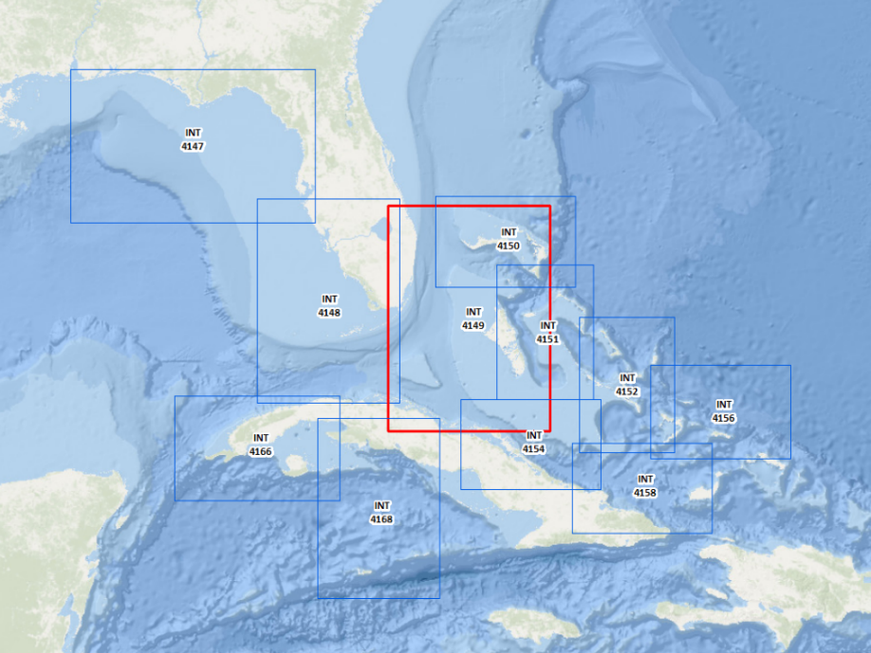
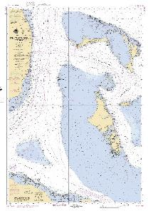
New US/Cuba/UK INT Chart 4149

Slide 11
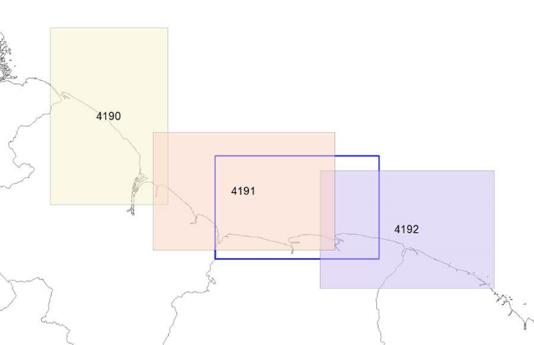
INT Chart 4191
New proposed limits for Chart 4191

Slide 12

INT Chart Coordinator
Please Endorse:
Paulo Matos

Slide 13
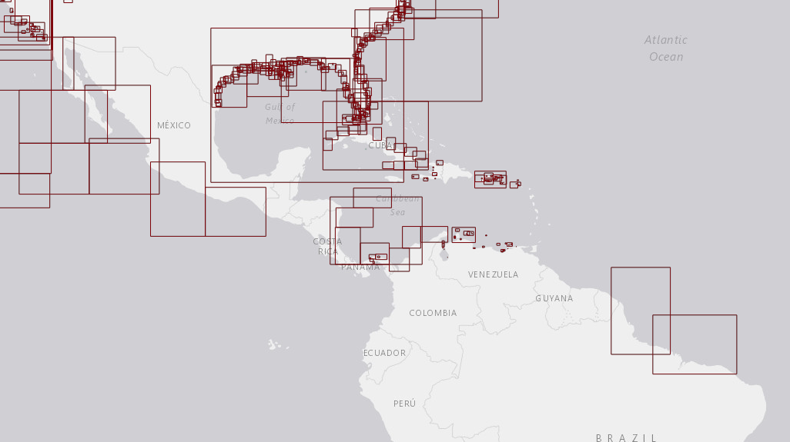
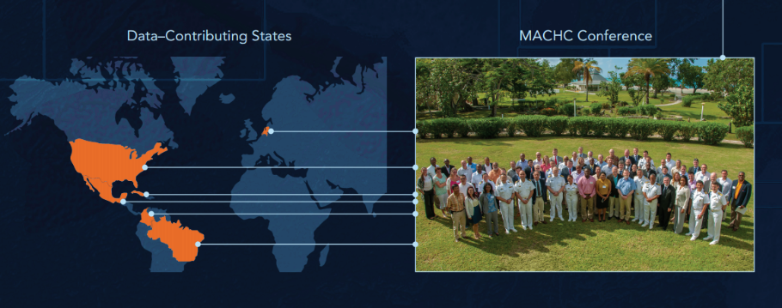
MACHC ENC Online

Slide 14
MACHC ENC Online Usage

Slide 15
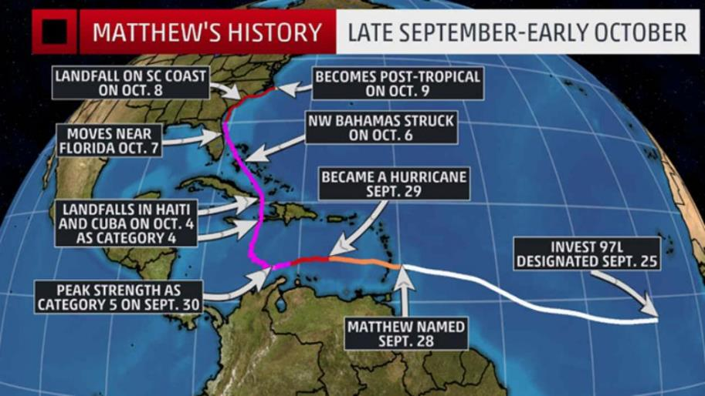
MACHC ENC Online Usage

Slide 16
Work Plan

Slide 17
WEND
“to advise IRCC [ RHCs ] and to assist in facilitating a world-wide consistent level of high-quality, updated official ENCs through integrated services that support chart carriage requirements of SOLAS Chapter V, and the requirements of the IMO Performance Standards for ECDIS.”
WEND Principles (IHO Resolution 1/1997)
Guidelines for the Implementation of the WEND Principles

Slide 18
Main Issues
Overlapping ENCs
RENC Harmonization and ENC Distribution
ENC Coverage (Risk Assessment)
Full Implementation of the WEND Principles
Admiralty Information Overlays (T&Ps, …)
WENDWG6/06: RHCs to define and adopt ENC Schemes (as it is done for INT Charts Schemes) and provide basic metadata to the IHB and IHB to consider including a layer of “Approved” ENC Schemes to the IHO ENC Catalogue or as an extension of the INT Web Chart Catalogue.

Slide 19
IRCC 8
IRCC8/13: RHCs to reduce overlaps by applying the WEND Principles in defining approved ENC schemes
IRCC8/14: WENDWG to draft an IHO Resolution to address the overlapping issues and report to the IRCC
Decision IRCC8/14: …on Marine Information Overlays, T&Ps ---- ARHC 6-21
Notes:
IRCC 8/14 to endorse the recommended actions from WENDWG concerning Marine Information Overlays (MIOs) as follows: 1. Taking into account the report of WENDWG6 concerning the situation where a Marine Information Overlay (MIO) is used to assist in drawing attention to any differences between a published paper chart and the corresponding ENC or to assist in displaying T&P notices for an ENC recommends: a. All parties concerned with producing the respective MIO, paper chart and ENC should agree on the promulgation of the MIO for the relevant sea area concerned. b. In such circumstances, and mindful of serving the best interests of the mariner, those producers of the MIO and related paper chart and/or ENC should work together bilaterally. c. Production of the MIO should be carried out in close cooperation of producers of both the paper chart and the ENC IRCC8 Report Annex C d. The MIO should utilize the same T&Ps source as the producer of the ENC. 2. In parallel there is a need to raise awareness of T&P NM updates for ENCs, and HSSC is encouraged to include within its work plan for the ENCWG the delivery of an improved solution for T&P updates in future S-101 based ECDIS. In the interim period possibilities of S-124 should be considered 15 7d to note that further progress on delivering global ENC coverage
ARHC 6-21 c/ARHC to recommend to IRCC that the IRCC decision regarding MIOs be reported to the 1st IHO Assembly.

Slide 20
www.iho.int > WENDWG > WENDWG Repository
The US-Canada Case Study
Risk Assessment Methodologies
ENC Data Flow Producers→RENCs→Distributors
ENC Coverage for Cruise Ships in Med

Slide 21
Action requested of MACHC
→ MACHC Members to review WENDWG documents and instruct your MACHC Representative prior to WENDWG-7 (31 Jan. – 2 Feb, Washington DC, US) – proposals due Jan. 9
→ MACHC INT Chart / ENC Coordinator for Region B to define an ENC Scheme for UB1, UB2, UB3, in liaison with INT Chart and ENC Producers
→ MACHC Rep. to report to the WENDWG Chair/Sec. on ENC coverage issues (gaps, overlaps, inconsistencies) vs maritime shipping routes, user requirements (in preparation of the IHO report to NCSR – Action WENDWG6/12)
  → Take any other action as considered appropriate

Slide 22
Requests to the MACHC
Approve the Work Plan
Approve the addition of cruise ship ports to the list of ENC gaps
Re - Approve Paulo Matos for INT Charts
Encourage MACHC ENC Online participation
Note the WEND Report and provide feedback

Slide 23
Thank You
Thank You

