Slide 1
ST. Vincent and the Grenadines
Country report.
Kemron Beache, Maritime Administration

Slide 2
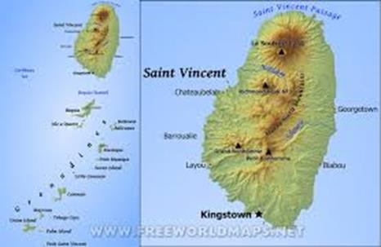
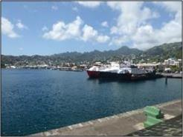
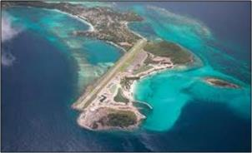
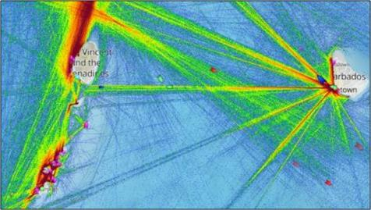

Slide 3
Commonwealth Marine Economies Program: Hand over of data and training to commence 4th and 5th of December 2017.
Delivery of other Maritime Spatial Data under the CME program.
Potential engagement of Oceanwise for creation of elevation maps.

Slide 4
Technical Mission from IALA: creation of an AToN register, and up dating of Charts by removal of aids no longer being used.
VIMSAS Audit: failure to NAVAREA to report on aids to navigation that were no longer in use.
Weak areas were identified:
These area related to the policy structure that exists between the Maritime Administration and the Port Authority. The Maritime Administration has the legislative responsibility, however resources, and fee collection with the Port Authority.

Slide 5
Goals:
Maritime spatial planning: development of Mooring Zones and Conservation Areas.
Implementation of an Ocean Governance Policy, to coordinates all activities and agencies with responsibility of the seas of St. Vincent and the Grenadines. In this would be underpinned by the availability and use of information
Human resources development:
Aids to Navigation Manager
Hydrographers
Development of a Deepwater Port.
Work with OCES members to eventually produce our own charts.

