Slide 1
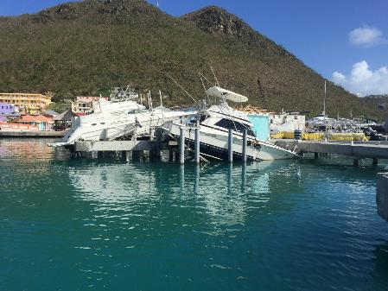
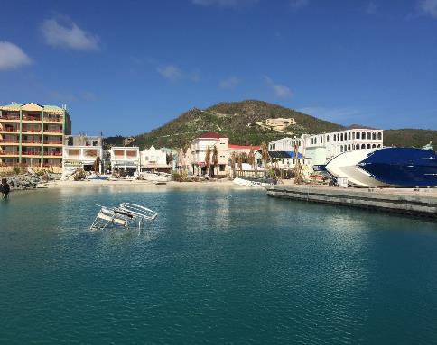
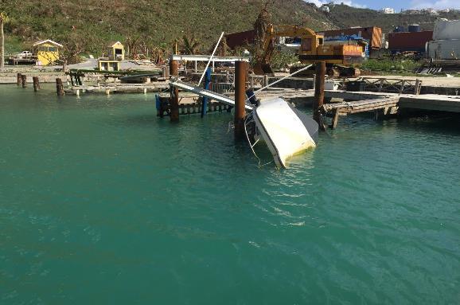
Disaster response to IRMA
Hydrographic mission
Sint Maarten 2017

Slide 2
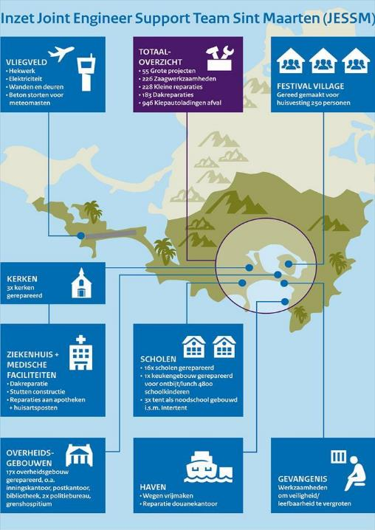
Relief activities
AIRFIELD
Fences
Roofs & doors
Electricity
Placing antenna’s
TOTAL SCORE
55 big projects
226 reconstructions
228 small repairs
183 roof repairs
946 truckloads debris
Multinational Carribean Coordination Cell (MNCCC) in Curaçao
NL, FR, UK
Air and sea transport
900.000 Kg goods
HNLMS Karel Doorman, Zeeland and Pelikaan
1.000.000 Kg materiel
NH90 Helikopter
48 patients Dominica
1000 Servicemen deployed
Prepared to receive
250 persons
CHURCES
3 churches
repaired
HOSPITAL +
MEDICAL
FACILITIES
Roofs
Support constructions
Pharmacy repairs
SCHOOLS
REPAIRED 16 SCHOOLS
DINING FACILITY 4800 CHILDREN
3 EMERGENCIES SCHOOLS (Tents)
GOVERMENT
BUILDINGS
17 REPAIRS: POST OFF. LIBRARY, POLICE STATIONS ETC
PRISON
SAFETY
HARBOR
FREE SHIPPING
REPAIRS CUSTOM OFFICE

Slide 3
Hydrographic mission Sint Maarten 2017
Survey operations in support of humanitarian relief operations after hurricane Irma.
Main objective: accessibility of port of Philipsburg Sint Maarten,
but….. as required
Hydrographic capacity:
Two qualified hydrographic officers (driver/operator)
RHIB equipped with integrated multi beam system, SSS, SV profiler. Use of Ellipsoid Referenced Surveying (ERS)

Slide 4
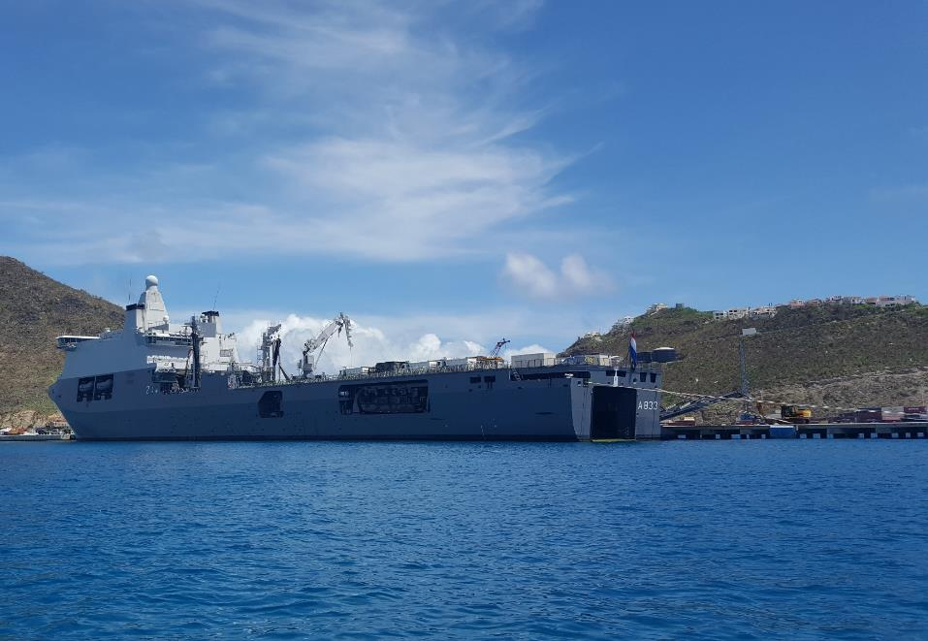
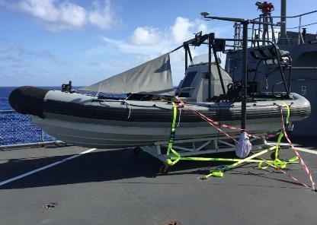
Platforms: HNLMS Karel Doorman & RHIB2000
Notes:
RHIB on board Zr. Ms. Karel Doorman Den Helder – Sint Maarten
On starboard side the survey pole, with MBES, integrated MRU and double GNSS antennas.

Slide 5
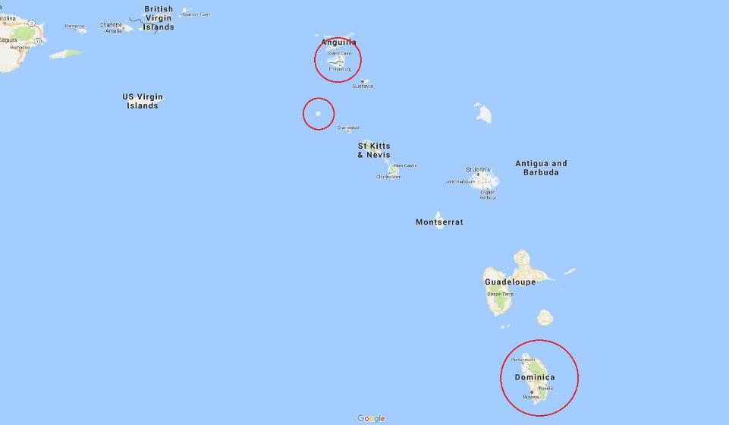
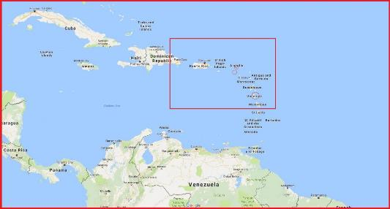
Surveys Leeward Islands
Surveyed ports
Groot Baai Philipsburg Sint Maarten
Simpson Baai Sint Maarten
Fort Baai Saba
Roseau Dominica
Notes:
All surveyed places in Caribean

Slide 6
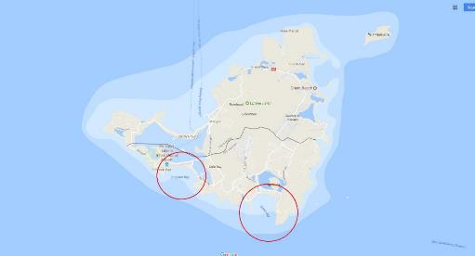
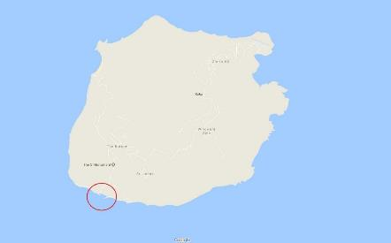
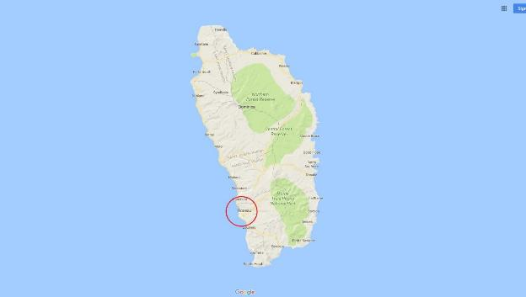
1) Sint Maarten
2) Saba
1) Groot baai &
Simpson Bay
2) Fort Baai
3) Roseau
3) Dominica
Notes:
Survey Locations on the Leeward Islands

Slide 7
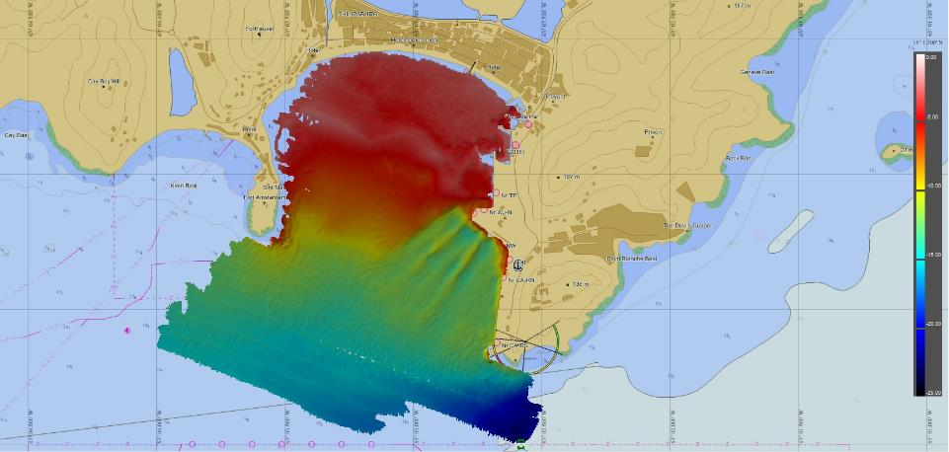
Sint Maarten Surveys
Groot Baai, Philipsburg approach, anchorage and quayside
Notes:
The approach to Groot Baai, Philipsburg, Sint Maarten with Dredged areas around Cruise Terminals, (3x8 hours survey time)

Slide 8
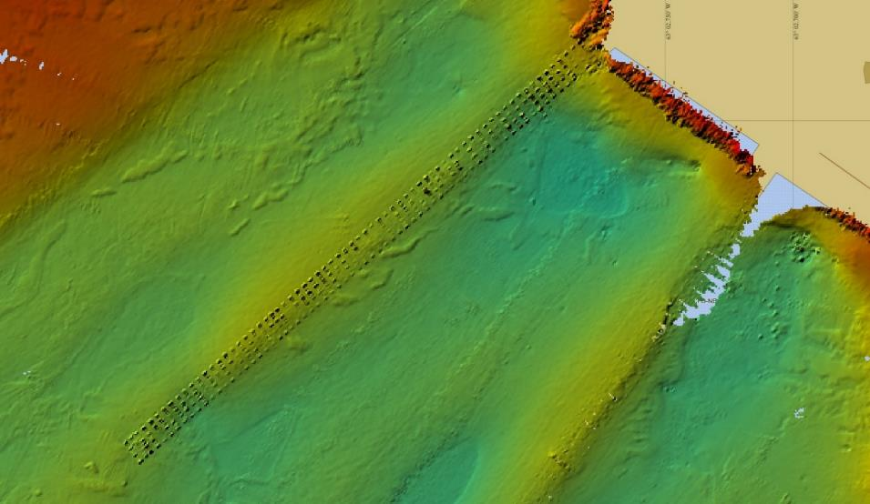
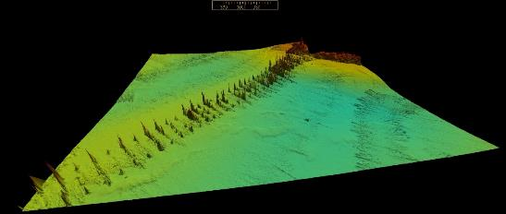
Jetty Surveys
Notes:
Detail of the quay, foundation poles visual, no other obstructions.

Slide 9
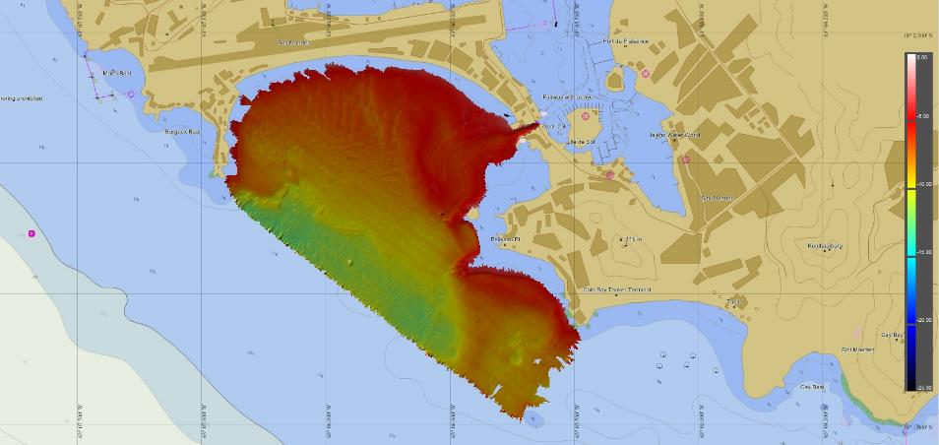
Sint Maarten Surveys
Simpson Bay, Philipsburg approach, anchorage and quayside
Notes:
The approach to Simpson Baai (8 hours to survey)

Slide 10
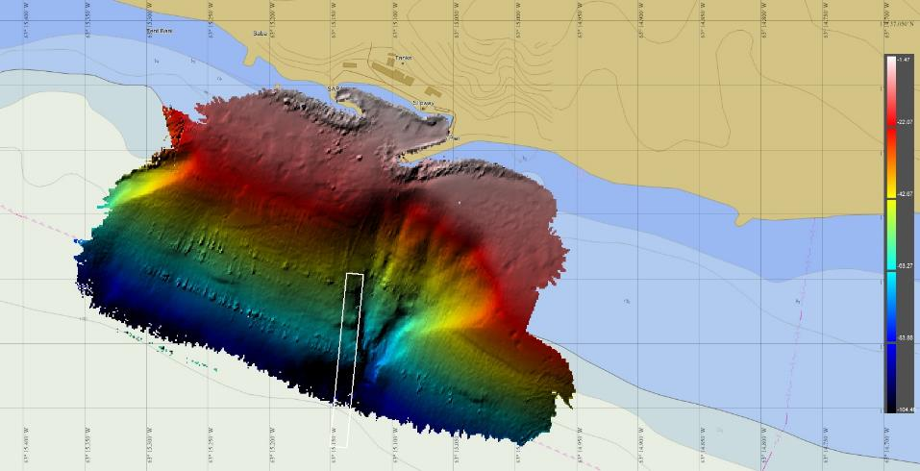
Saba Survey
Fort Baai (raw data) , approach, anchorage and quayside
Notes:
Fort Baai, Saba anchorage and very shallow water < 2 m around the quays. Foul ground around the piers due to Irma (stones). ONLY 1 hour survey time

Slide 11
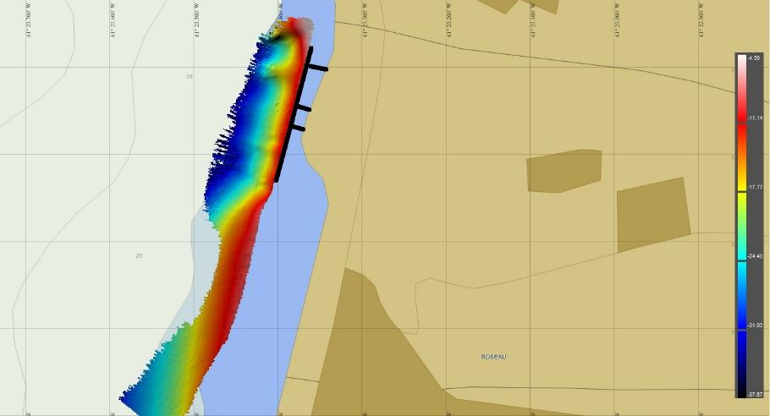
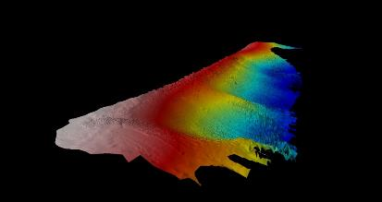
Dominica Survey
Roseau, quayside
Notes:
Jetty inspection (10min work, only 2 lines) Roseau, Dominca, save to moor for Karel Doorman
On the left the quay with a safe approach line
Left top a limiting danger line for a coral reef
3 hour survey

Slide 12
Survey results
Most frequently used system MBES.
SSS less used due to the expeditionary character.
ERS provided a stable height reference.
Coupling of ERS reference to chart datum via predicted tide
Good SV profile is vital for small vertical uncertainty
Bathymetry within special order standard

Slide 13
ARTICLE 3 b) : OF THE AIMS
MACHC Statutes
The Commission has a limited capacity for disaster response (IHO resolutions 1/2005).
The role of the Chair of the MACHC is that of a broker of hydrographic demand (from the affected countries) and supply (by countries offering assets).
The Chair cannot absorb Member States responsibilities for Diplomatic clearance needed to deploy those hydrographic assets.
CONCLUSION:
FROM NL PERSPECTIVE NO ADDITIONAL ISSUES

Slide 14
Strategic Framework on Geospatial Information and services for Disasters
UN-GGIM
Goal: informed decision making for DRM
Means: Geospatial information and services
Regional level: collaboration, plan and train, share data, regional geoportals, resource sharing, etc, etc.
Interesting: “To optimize the use of geospatial information products for the development of common operational pictures of disaster events…”
Relation with MACHC ENC viewer
Task MEIP Coordinator to investigate further use of viewer for DRM?

