Slide 1
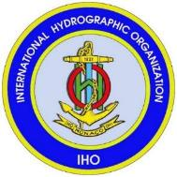
Meeting National Hydrographic Obligations
Alberto Costa Neves,
Assistant Director, IHO

Slide 2
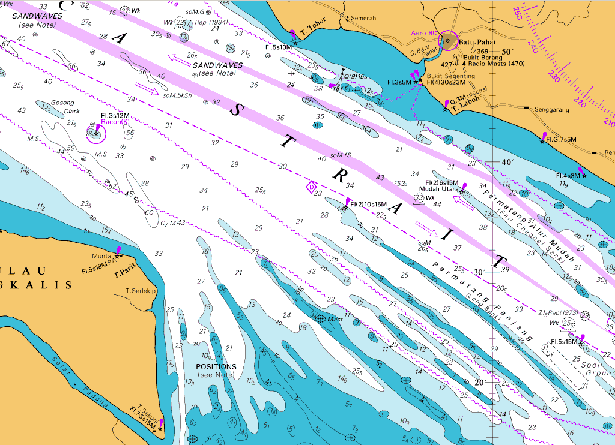
Who is responsible for Hydrography?
?

Slide 3
– Hydrographic Services –
International Obligations

Slide 4
Mariners’ Obligations
Convention on the Safety of Life at Sea (SOLAS) Chapter V
SOLAS V/19 – Carriage requirements for Nav equipment
…shall carry nautical charts and publications …
…issued officially by or on the authority of a Government, authorized Hydrographic Office or other relevant government institution ….
… [adhering to] IHO specifications and guidelines
SOLAS V/27 – Nautical charts and nautical publications
…adequate and up to date

Slide 5
Governmental Obligations
SOLAS V/9 – provision of hydrographic services
Contracting governments undertake to arrange to collect and compile hydrographic data, and to publish, disseminate and update all nautical information necessary for safe navigation;
Obtain uniformity in charts and nautical publications and to take into account whenever possible the relevant international resolutions and recommendations, adopted by the IHO; and
Co-ordinate activities and ensure global availability of hydrographic and nautical publications

Slide 6
Governmental Obligations
SOLAS V/4 – navigational warnings
…take all steps necessary to ensure that, when intelligence of any dangers is received from whatever reliable source, it shall be promptly brought to the knowledge of those concerned and communicated to other interested Governments

Slide 7
SOLAS Chapter 5 regulations 9 and 4
This means each State must ensure that :
hydrographic surveys are carried out
appropriate nautical charts and other nautical publications are available and up to date
Maritime Safety Information (MSI) is promulgated

Slide 8
SOLAS V/9, SOLAS V/4 (provision of hydrographic services and navigational warnings)
… are International Obligations under Treaty Law
… apply to ALL Contracting Governments

Slide 9
Other Governmental Obligations
UN Resolution A.53/32 - The Year of the Oceans ….. invites States to cooperate in carrying out hydrographic surveys and in providing nautical services for the purpose of ensuring safe navigation as well as to ensure the greatest uniformity in charts and nautical publications and to coordinate their activities so that hydrography and nautical information is available on a world-wide scale

Slide 10
UNCLOS 1982
Charts are required to support:
Establishing baselines
Delimiting Sea Areas - Territorial Sea, EEZ ,Continental Shelf , etc
Identifying traffic separation schemes
Identifying sea lanes transit and innocent passage routes
Deploying submarine cables and pipelines
Conducting drilling on the seafloor
Conduct of Marine Scientific Research

Slide 11
Meeting Governmental Obligations
SOLAS V/9 and V/4 can be satisfied:
directly via government
through bi-lateral cooperation with other States
using commercial support providers
in whole or in part
Overall responsibility and obligation to ensure that a national hydrographic service is provided remains with the Government

Slide 12
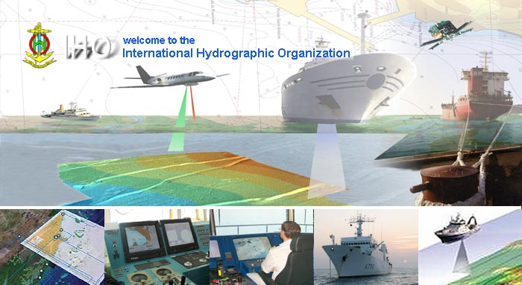
Questions?
www.iho.int

