Slide 1
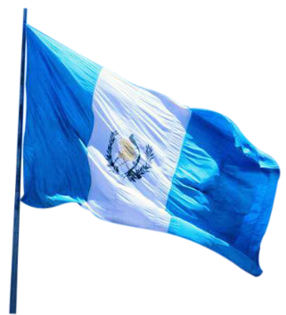
19th Meeting of the Meso America – Caribbean Sea Hydrographic Commission
National Report by
GUATEMALA
LT. Edwynn Alejandro Raxón Herrera
MSC. Maritime Affairs
Hydrographer Cat A

Slide 2
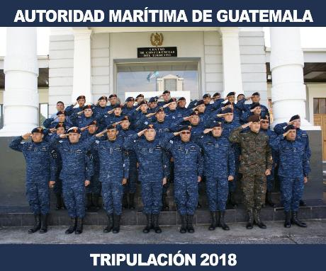
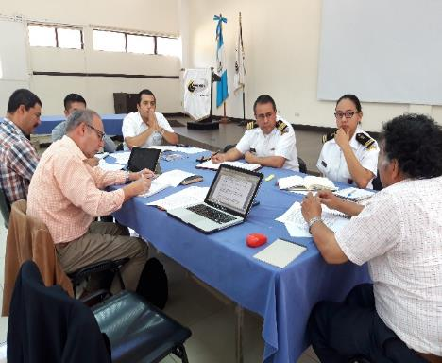
Hydrographic Office/Service:
General Directorate of Maritime Affairs and National Commission of Hydrography and Oceanography (CIIHO), National Commission on Maritime Administration (CONAMAR).

Slide 3
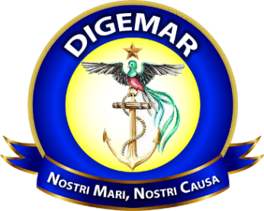
Mission
The DIGEMAR will be responsible for managing the functions of Flag State, Port State Control and Coastal State, through the planning, organization, coordination, development, implementation, monitoring of regulations, procedures and records related to the maritime safety and the prevention of pollution from ships, with the aim of contributing to national maritime development.

Slide 4
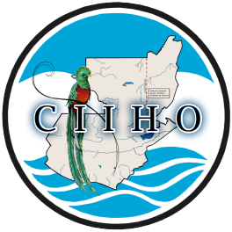
National Commission of Hydrography and Oceanography (CIIHO)
Created by Government Agreement 254-85
Formed by
Ministry of National Defense (Chairmanship)
Ministry of Communications (Ports and Meteorological Institute)
Ministry of Agriculture (Directorate of Fisheries)
National Geographic Institute (Land cartography)
Ministry of Foreign Affairs (Directorship of International Limits and Waters)
Ministry of Energy and Mines

Slide 5
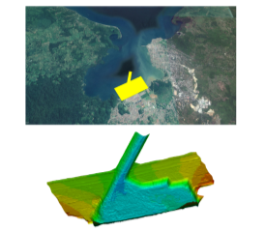
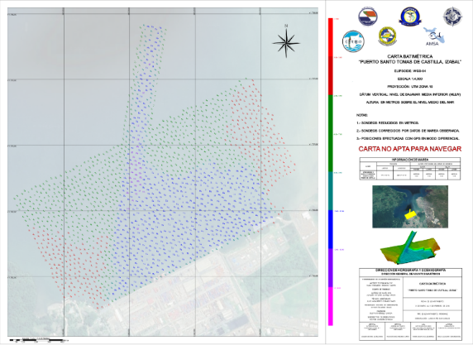
Surveys
EMPORNAC 60KM2 (Caribbean Sea, January 2018)

Slide 6
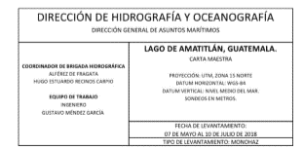
Amatitlán Lake
Amatitlan Lake is an area of interest for tourism and the preservation of aquatic ecosystems.
15.2 KM2
AMSA

Slide 7
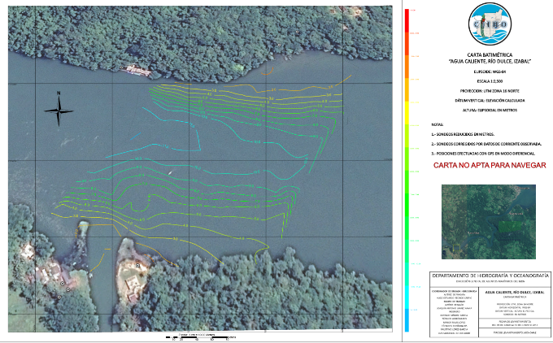
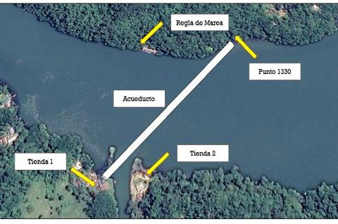
Livingston Izabal (Caribbean Sea)
Survey for the installation of a new aqueduct for freshwater between communities “Agua Caliente” 150 m2.

Slide 8
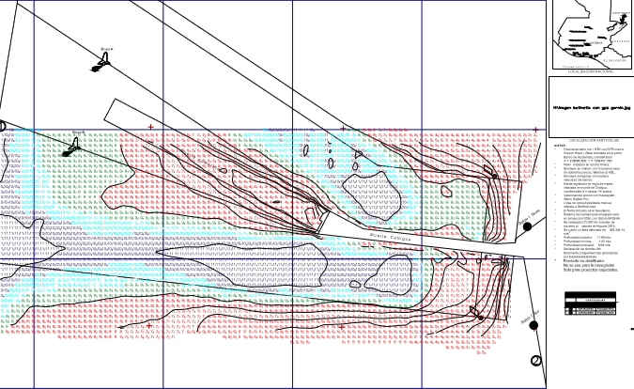
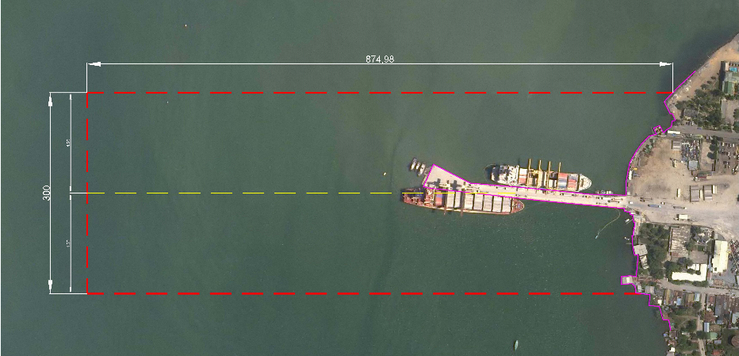
Puerto Barrios Port (Caribbean Sea)
262.4 KM2

Slide 10
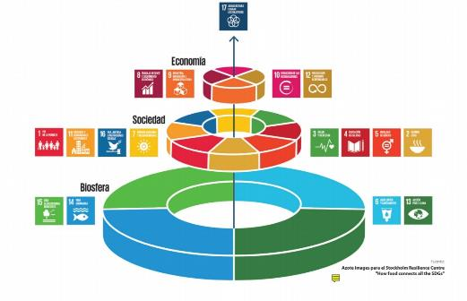
MPA AICHI targets, ODS, BWM and so on

Slide 11
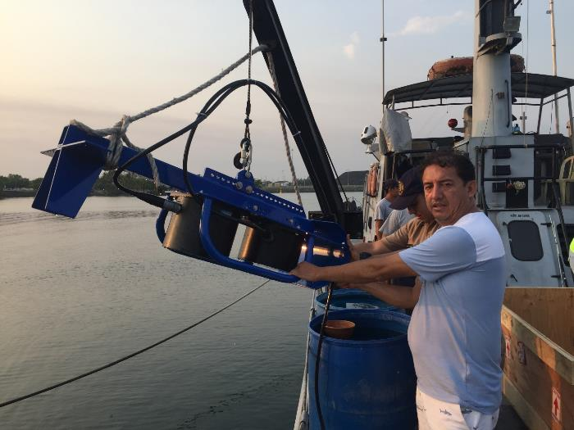
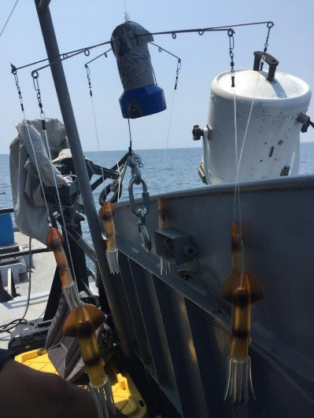
Oceanographic Characterization

Slide 12
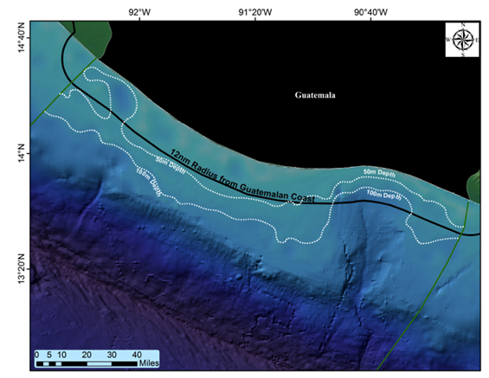
Oceanographic Campaign
MAGA/DIPESCA
Miami University
DIGEMAR
PNUD

Slide 13
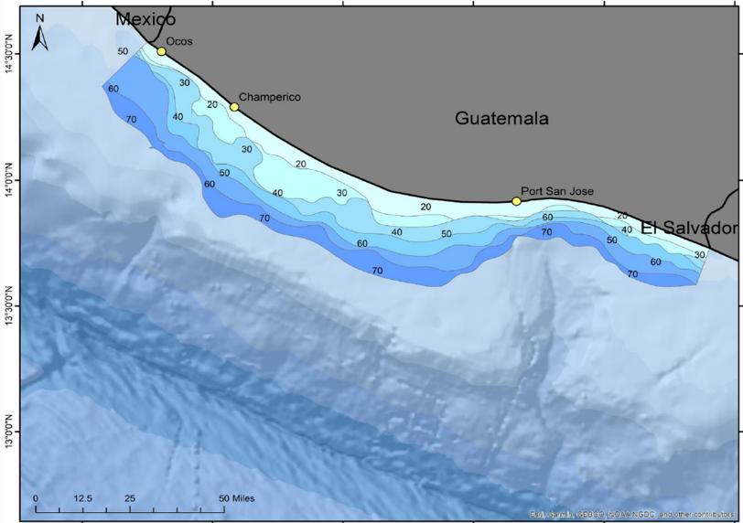
Pacific Ocean
5000 KM2
Post Processing

Slide 14
New charts and updates:
The US promulgated new charts and updates of Guatemalan Waters. However nobody sells the final product; consequently, the Directorship of Maritime Affairs is trying to sign the agreement with the United Kingdom Hydrographic Office (UKHO).

Slide 15
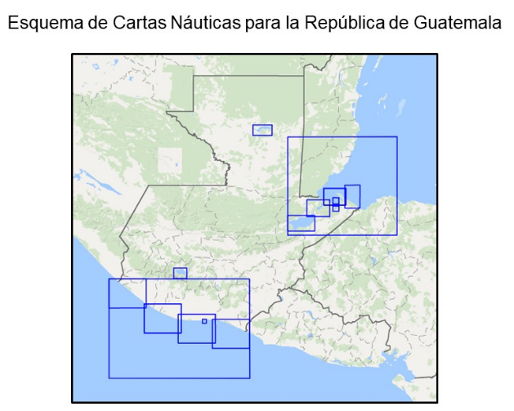
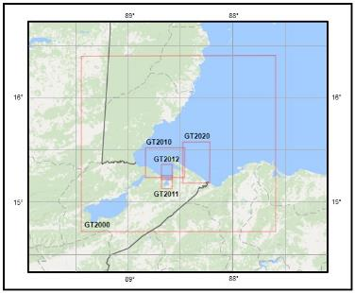
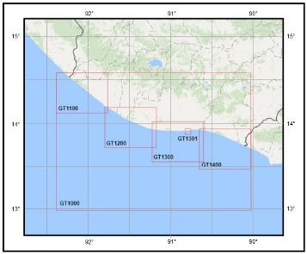
National Cartographic Plan

Slide 16
New publications and MSI
New publications
Not applicable.
MSI:
NGA (US) is the NAVAREA IV and XII coordinator within the IMO/IHO World-Wide Navigational Warning Service. (Including maritime areas of Guatemala). Consequently, the Directorship of Maritime Affairs has direct communication with this agency to share maritime safety information.
Guatemala has two officers trained in the MACHC CBP for the generation of MSI.

Slide 17
IHO PUBLICATION C-55
Status of hydrographic survey of all navigable waters, including internal waters, out to the limits of the EEZ: Survey coverage, where:
A = percentage which is adequately surveyed.
B = percentage which requires a re - survey at larger scale or to modern standards.
C = percentage which has never been systematically surveyed.
 | A | B | C
Depths < 200m | 10 | 60 | 30
Depths > 200m | 0 | 0 | 100
Not updated

Slide 18
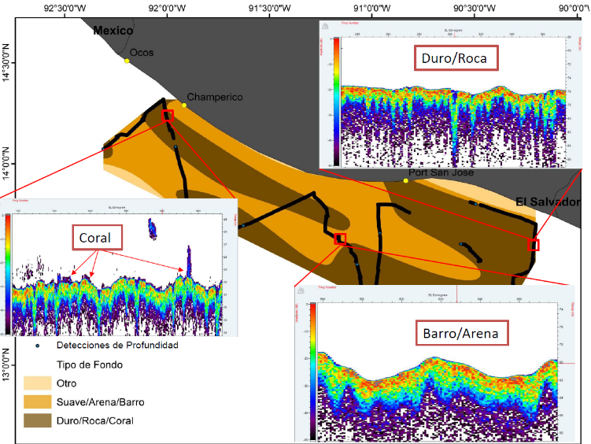
Oceanographic Activities
seafloor classification
CORAL
ROCK
SAND
MUD

Slide 19
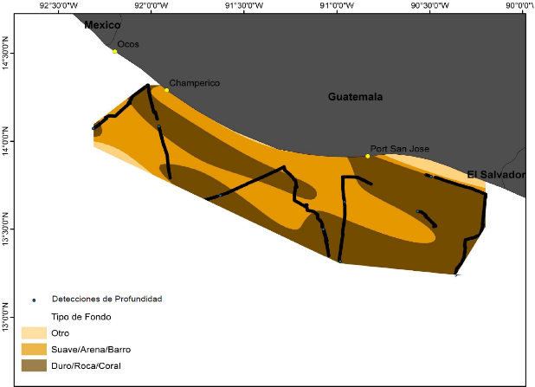
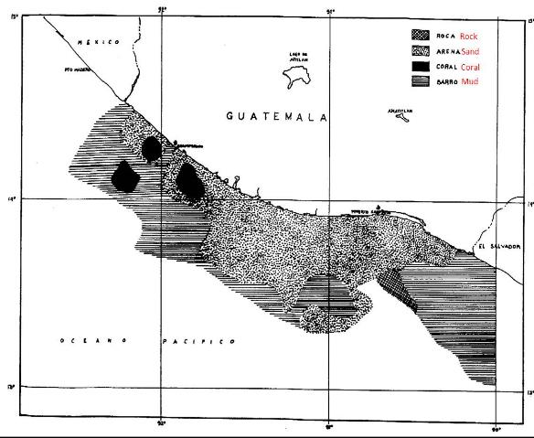
Comparación del tipo de fondo encontrado
en el crucero hidroacústico y un mapa
descriptivo del fondo marino
Fuente: Anexo 1 Manuel Ixquiac 1998

Slide 20
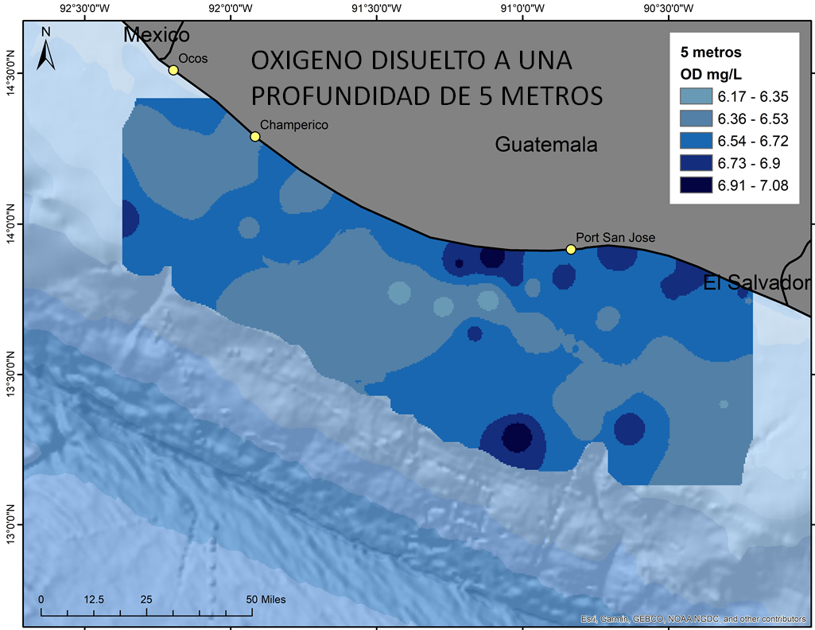

Slide 21
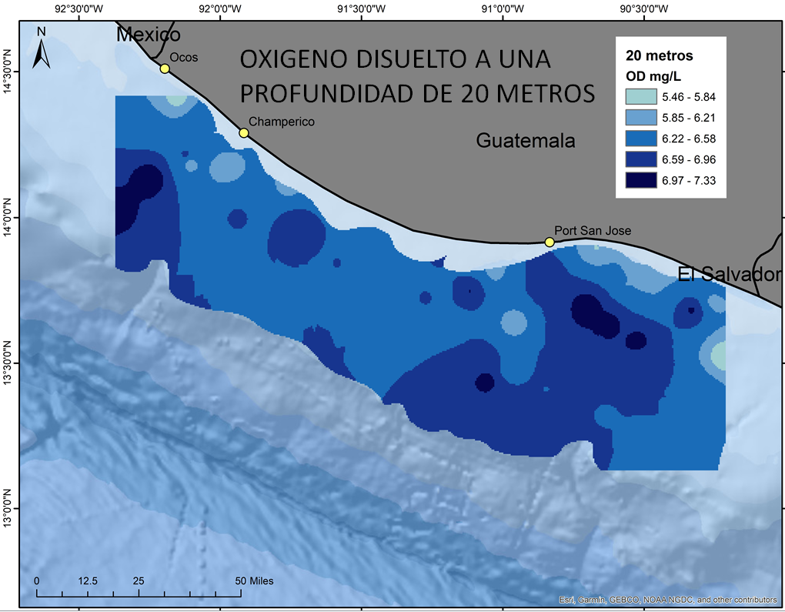

Slide 22
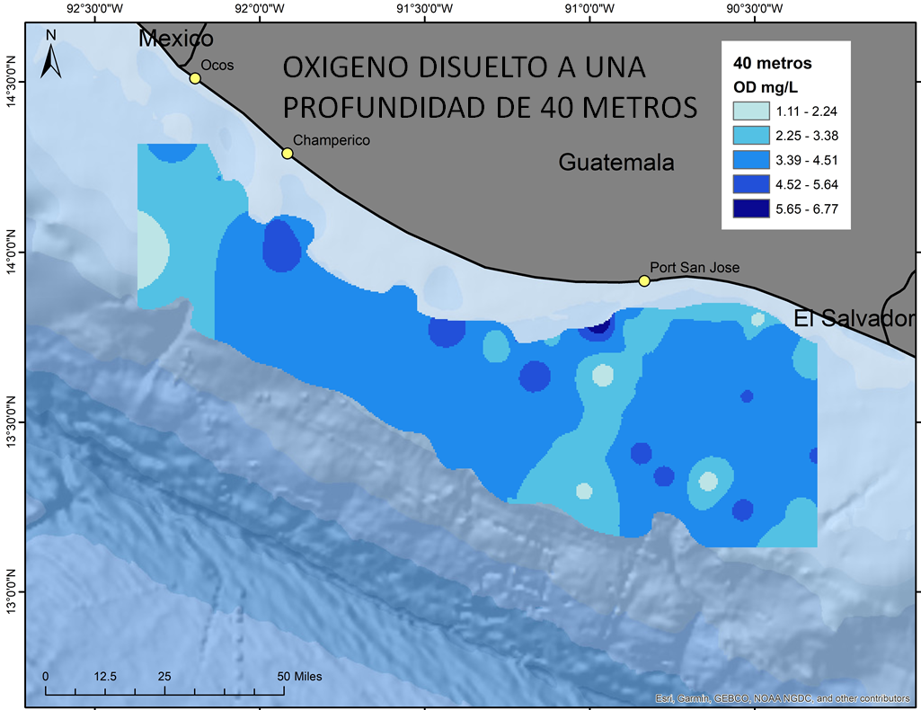

Slide 23
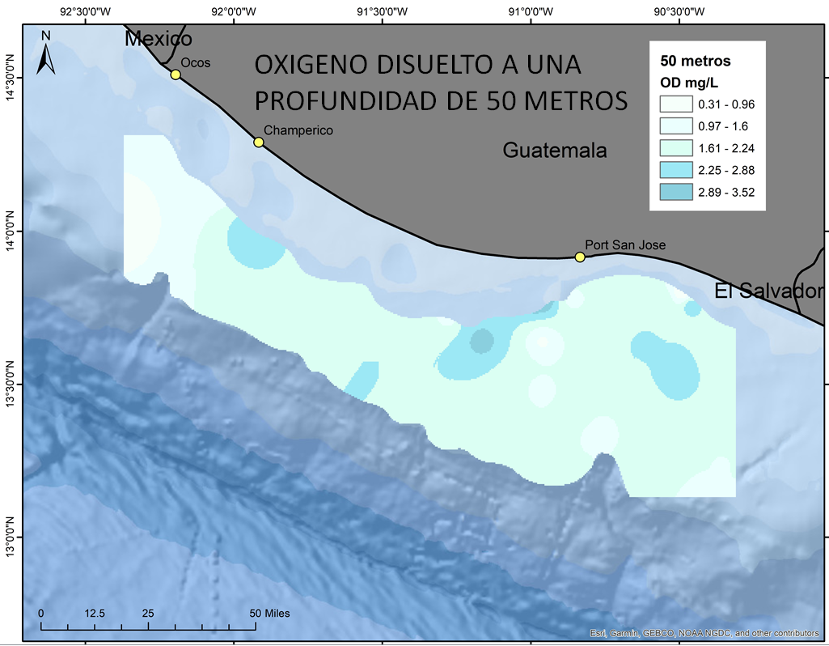

Slide 24
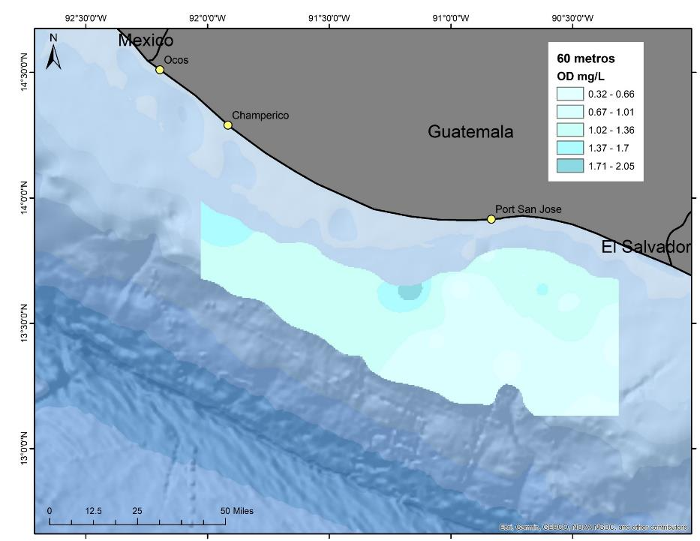
OXIGENO DISUELTO A UNA
PROFUNDIDAD DE 60 METROS

Slide 25
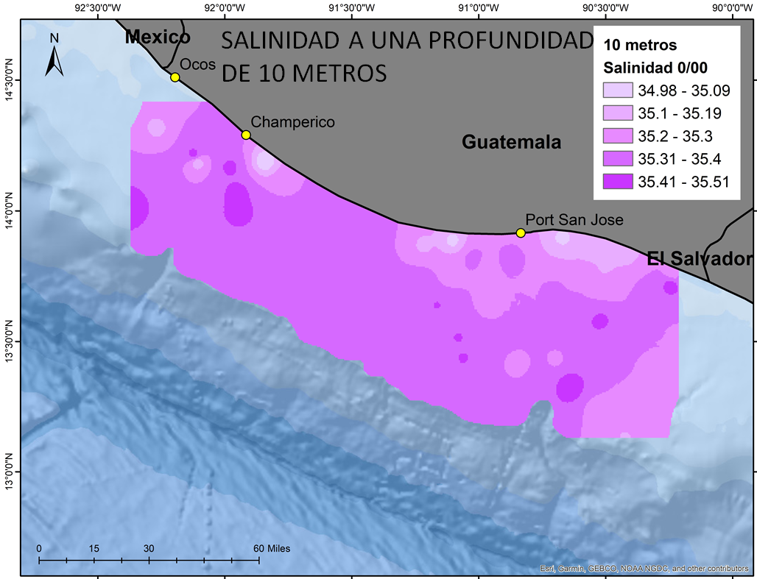

Slide 26
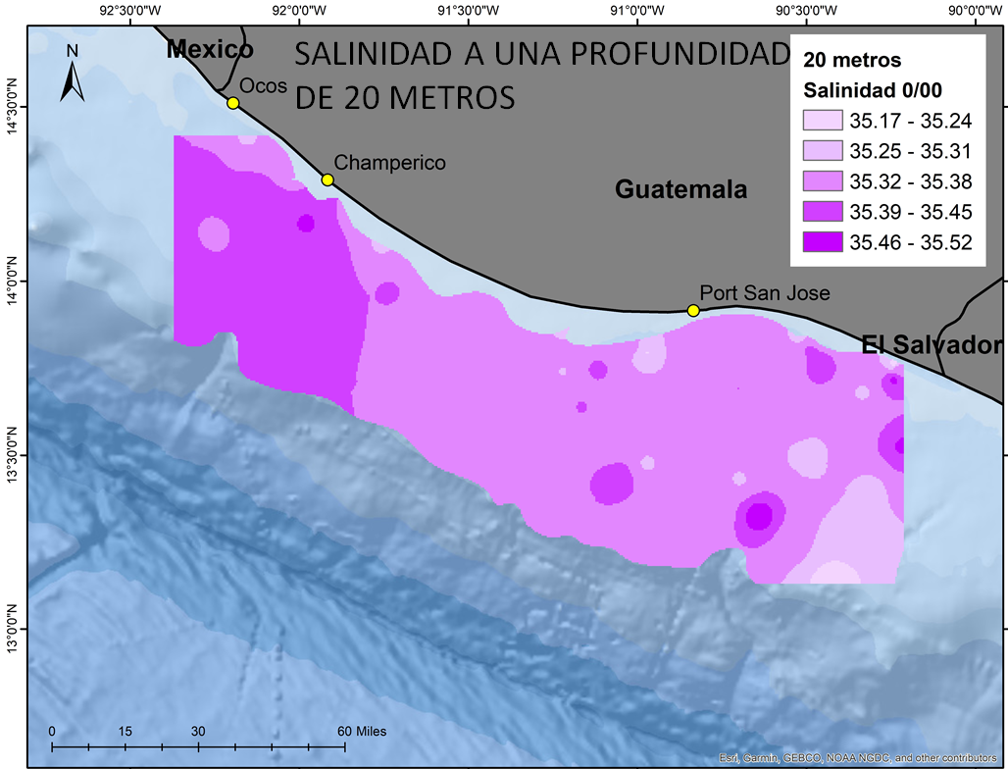

Slide 27
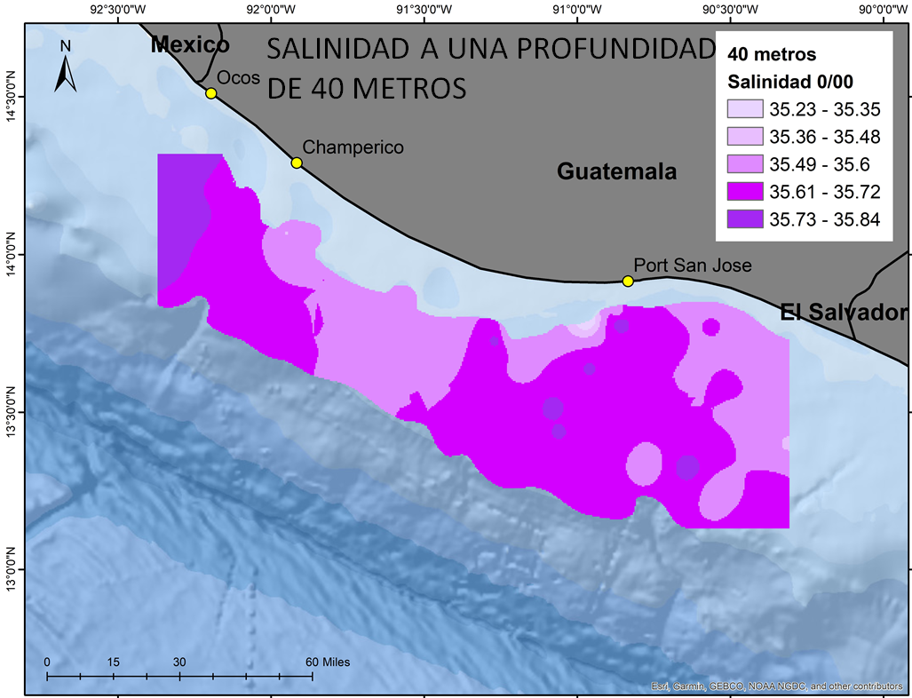

Slide 28
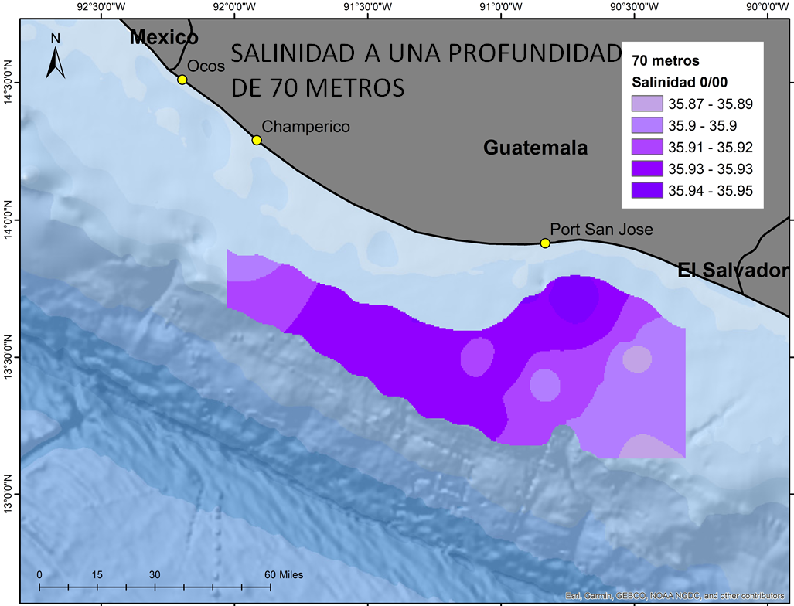

Slide 29
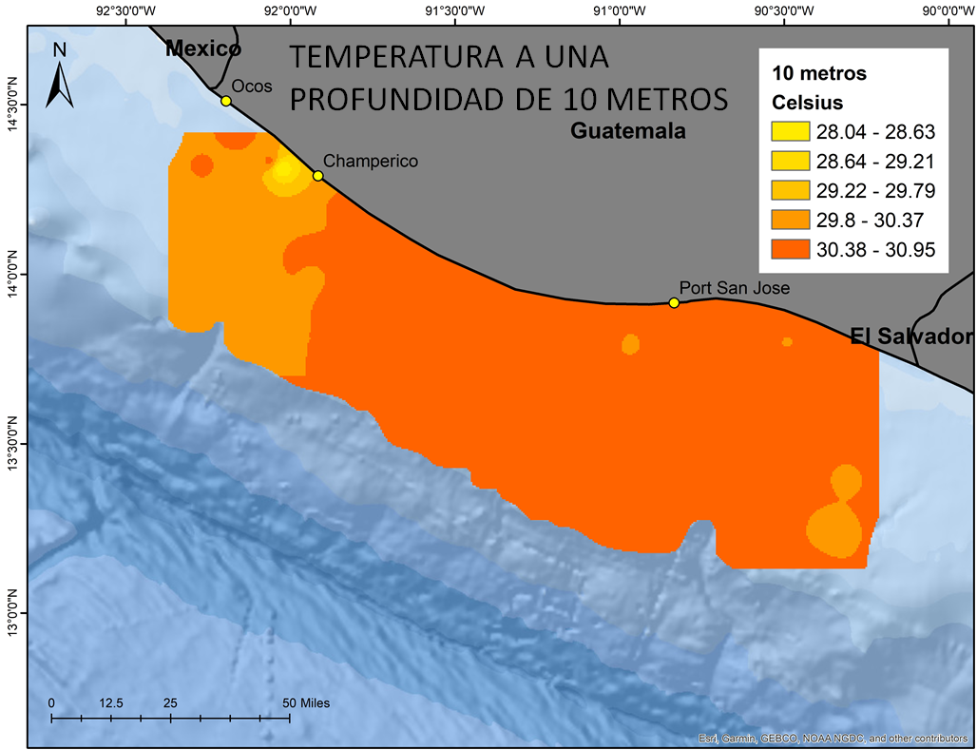

Slide 30
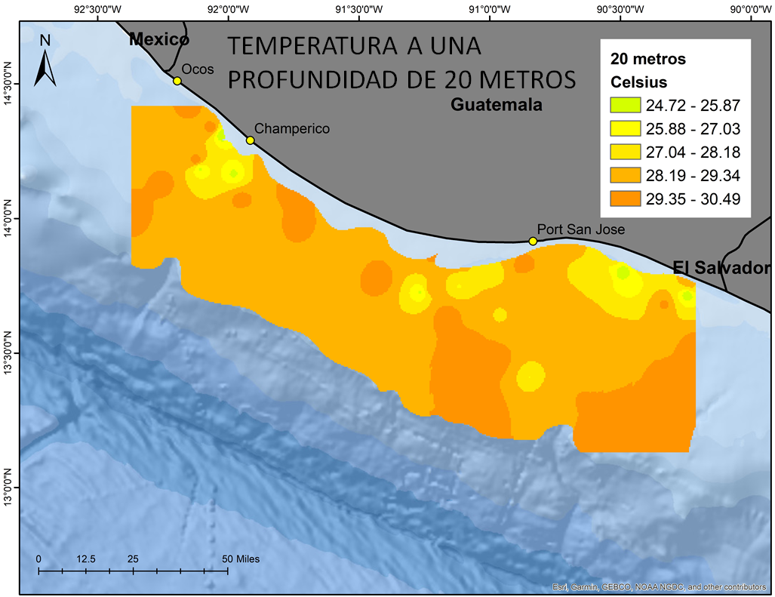

Slide 31
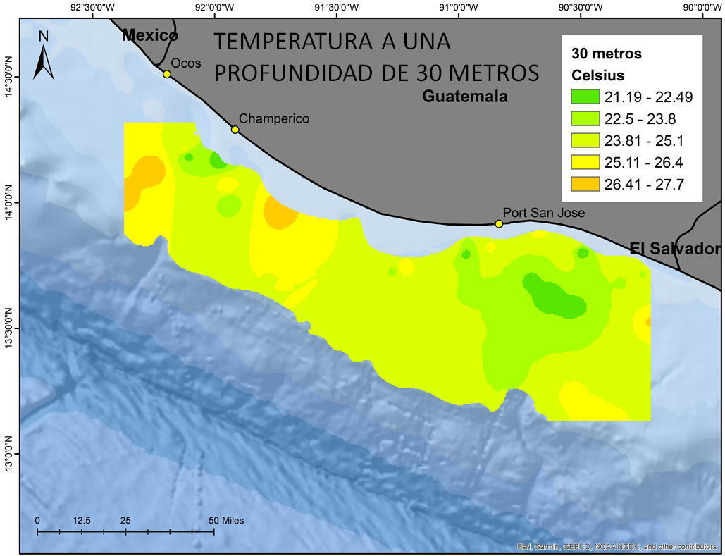

Slide 32
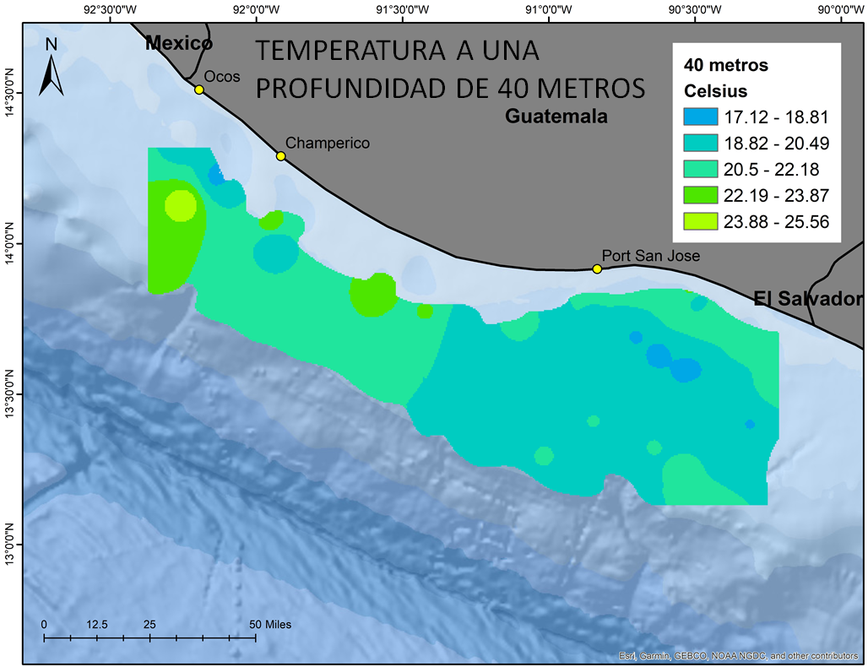

Slide 33
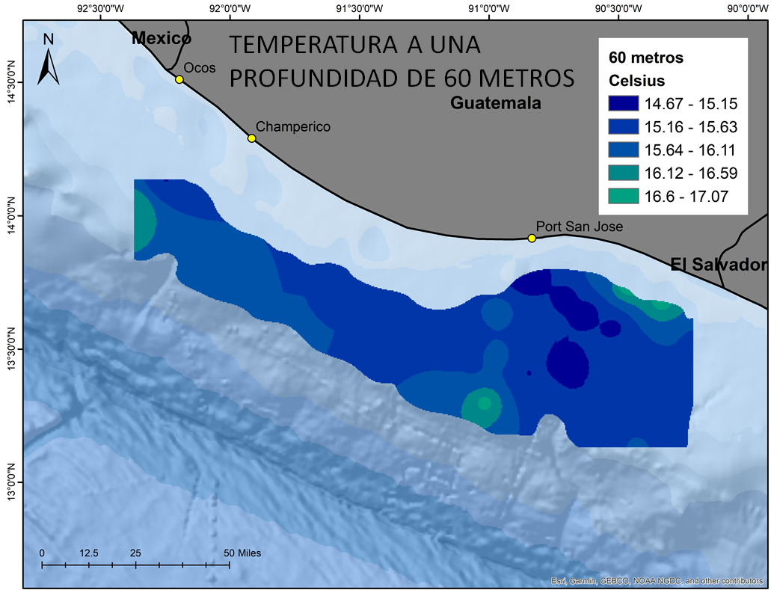

Slide 34
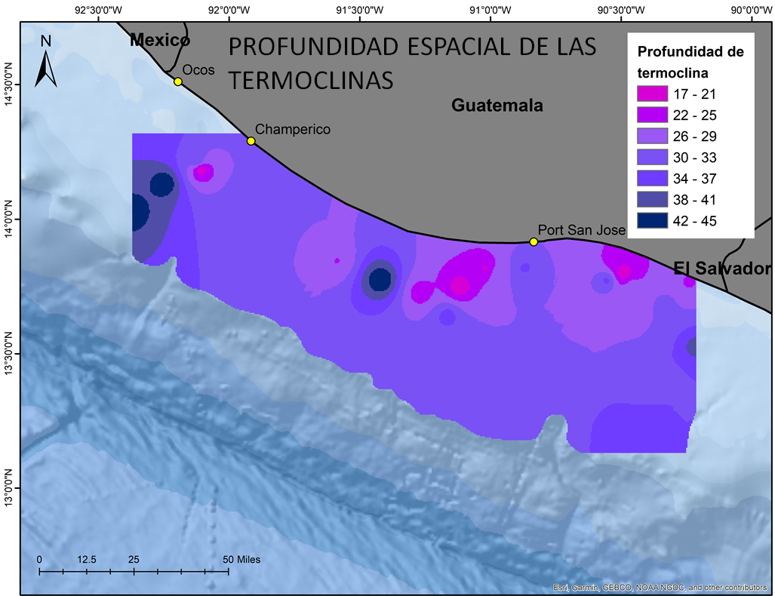

Slide 35
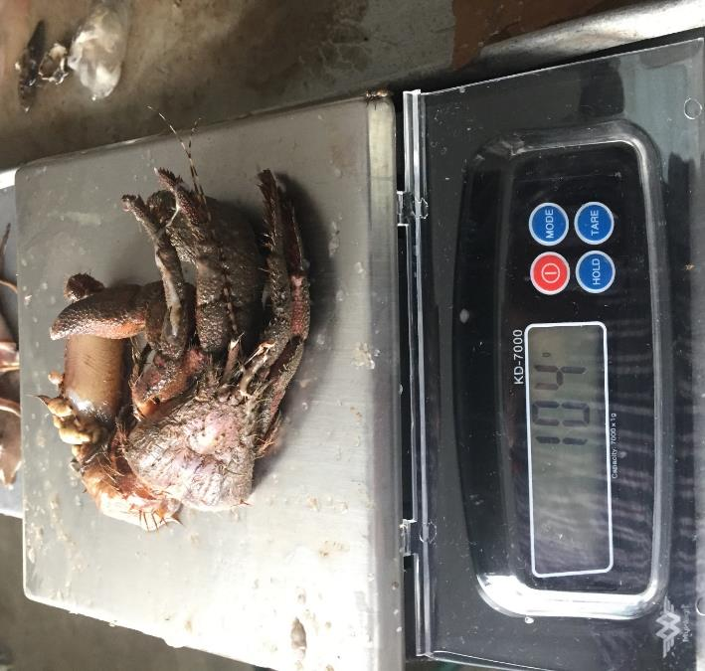
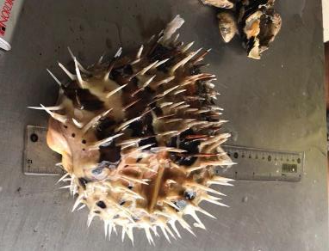
Sample processing
Especie
Talla
Peso
Sexo
Estadio gonadal

Slide 36
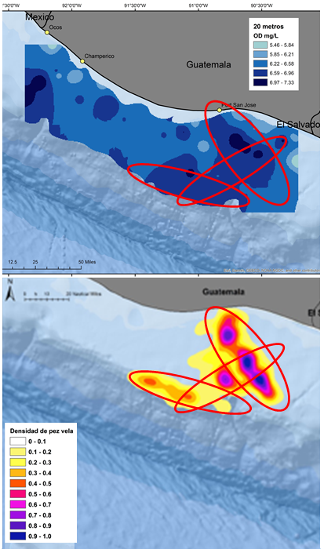
MAPA DE OXIGENO DISUELTO A
20 METROS DE PROFUNDIDAD
MAPA DE LA DISTRIBUCION
ESPACIAL DE LA ABUNDANCIA
RELATIVA DE PICUDOS EN LA
PESQUERIA DEPORTIVA

Slide 37
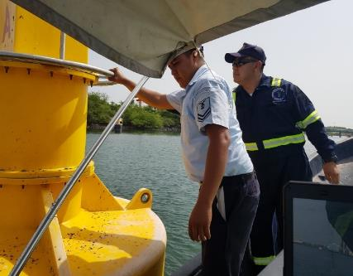
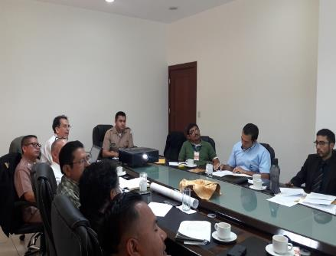
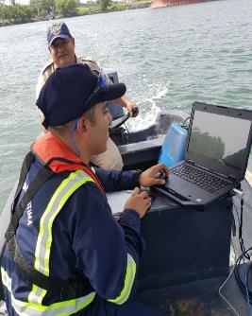
Inspection of ATONS
Working on the IALA report after technical visit
Ad hoc group for the creation of regulatory law

Slide 38
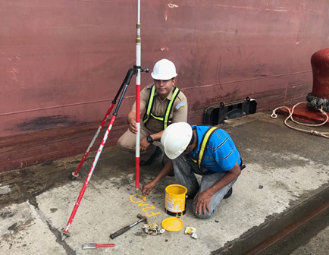
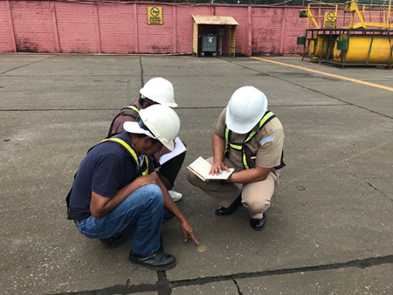
Geodesy
Information of Geodesic points

Slide 39
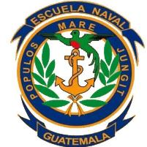
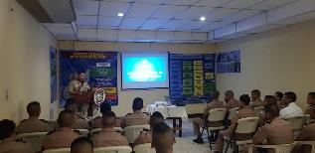
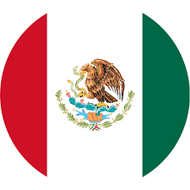
Capacity Building
106 in total
“Introduction to Hydrography" (Online and practical)
Navy (30),
Army (07),
Empresa Portuaria Quetzal (28),
Empresa Portuaria Santo Tomás de Castilla (14),
National Public and Private Institutions (23)
COCATRAM;
Maritime Conscious

Slide 40
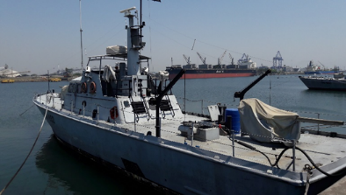
Conclusions:
Guatemala promotes research throughout the National Hydrographic and Oceanographic Commission, uniting human and material resources with the purpose of creating spatial data of the country. Moreover, other governmental institutions like universities and research institutions showed their interest in the work of the National Commission.
Need for Cartographers
A budget for research
Capacity building on MSDI.
Next Step: Marine Spatial Planning (old and new data)

