Slide 1
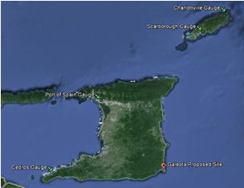
National Report of Trinidad and Tobago November 2018 MACHC 18
Hydrographic Unit
Land and Surveys Division
Ministry of Agriculture Land and Fisheries

Slide 2
Introduction- Hydrographic Unit
Obligations are:
Hydrographic Unit – provision of hydrographic data outside of port boundaries which include; water depths, tides, obstructions and currents.

Slide 3
Reorganization- Hydrographic Unit
Hydrographic Unit – Surveys and Mapping Division, Ministry of Agriculture Land and Fisheries(September 2015)
IHO- Member State
MACHC- Member State

Slide 4
Surveys
Coverage of new surveys
Since our last MACHC report, hydrographic surveys were conducted within the Gulf of Paria for the location of wrecks by the Hydrographic Unit. The Unit also conducted an AtoN exercise for the update of Nautical Charts.
New Technologies and/or equipment
Trinidad and Tobago is at the stage of procurement of a Multibeam echo sounder system, to allow the unit to conduct hydrographic surveys. We are currently conducting surveys with a Single Beam Echo Sounder (SBES).
New Ships
Trinidad and Tobago has recently re furbished a 28ft fiber glass vessel in order to conduct near shore surveys. We are also looking to purchase a larger vessel to conduct offshore surveys.

Slide 5
Charts and Publications
Charts
Charts for Trinidad and Tobago are produced by the United Kingdom Hydrographic Office (UKHO), under cooperative arrangements. MOA signed in November 2018
Publications
New Publications
Tidal prediction booklets are made available to the public by the Hydrographic Unit of Trinidad and Tobago.
The UKHO produces the sailing directions and list of lights for Trinidad and Tobago.

Slide 6
MSI
The Maritime Services Division of the Ministry of Transport is responsible for the dissemination of Trinidad and Tobago’s Maritime Safety Information (MSI).

Slide 7
Capacity Building
Training Received
One Member of the Hydrographic Unit participated in the IHO through the Nippon Foundation, Cat B cartography training course in 2013 conducted by the UKHO.
Training Required
There is a great need for members of staff of the Hydrographic Unit to be trained in both Cat B Hydrography and Cat A Hydrography.

Slide 8
C-55 Latest Update
There has been no change to the status of Trinidad and Tobago’s hydrographic coverage and the C-55 database reflects the currents status

Slide 9
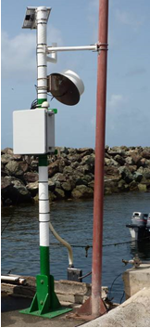
Oceanographic Activities
The Hydrographic unit currently operates two tidal gauges at; Port of Spain and Scarborough. We have also recently procured 3 additional radar sensors to improve the reliability of the gauges to be
deployed at locations below
No. | Tide Gauge | Latitude | Longitude
1 | Port of Spain | 10°38'48.00"N | 61°30'46.59"W
2 | Scarborough | 11°10'42.61"N | 60°44'6.69"W
3 | Cedros | 10° 5'35.74"N | 61°51'56.46"W
4 | Charlotteville | 11°19'24.67"N | 60°32'57.59"W

Slide 10
Conclusion
They Hydrographic Unit of Trinidad and Tobago continues to play a role in providing hydrographic data to facilitate safe navigation in the terrestrial waters of Trinidad and Tobago. We have made a great deal of progress within the last few years towards providing more comprehensive hydrographic data sets.

Slide 11
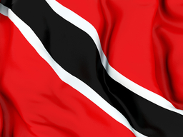
Questions?
Presented by:
Yashpal Singh
HydrographicunitTT@gmail.com
Trinidad and Tobago

