Slide 1
14th South West Pacific
Hydrographic Commission Conference
30 November – 2 December 2016
NOUMEA
National Report
New Zealand

Slide 2
14th South West Pacific Hydrographic Commission Conference
Overview
Our organisation and focus
Digital First / Data Centric
NZ Hydrography Risk Assessment
Pacific Regional Navigation Initiative (PRNI)
Challenges

Slide 3
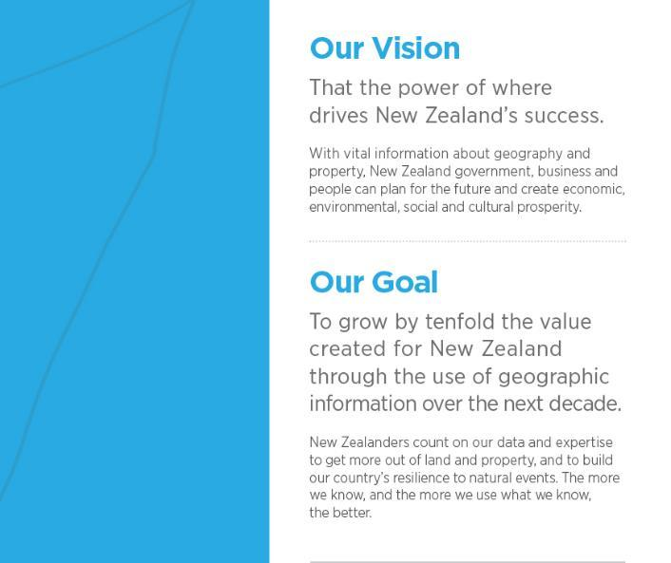
14th South West Pacific Hydrographic Commission Conference

Slide 4
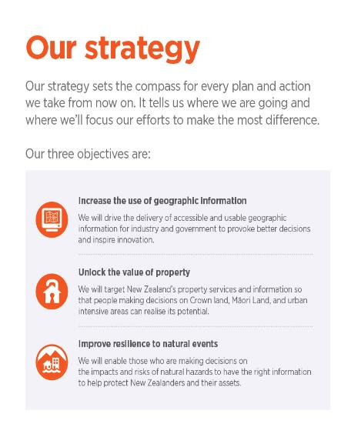
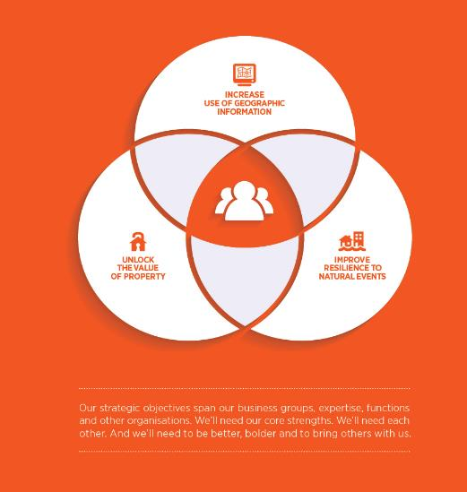
14th South West Pacific Hydrographic Commission Conference

Slide 5
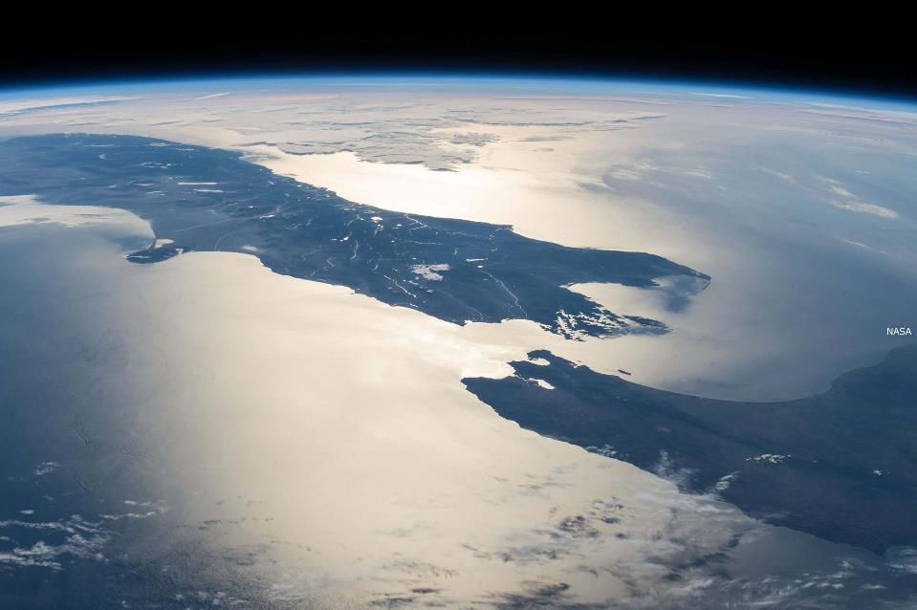
14th South West Pacific Hydrographic Commission Conference
_{Location System}
_{Location Information}
_{Property}
_{Rights}
_{Crown}
_{Property}
_{Corporate}
_{Open Government Data & SDI}
_{Business Development}
_{Policy & Frameworks}
Office of Surveyor General/Geographic
_{Board}
_{Registrar General of Land}
_{Office of the Valuer General}
_{Māori}
_{Land Service}
_{Geodetic}
_{Hydrography}
_{Data Services}
Business Innovation Group (BIG)
_{Topography and Addressing}
_{Property Rights Support}
_{Operations}
_{ASaTS}
_{Business with Maori}
_{Crown Property}
_{Legal Services}
_{Overseas Investment Office}
_{Commissioner of Crown Lands}
Business and Regulatory Assurance
_{Finance, Facilities,} _{Procurement}
_{Human Resources}
_{Information Technology}
Strategic Communications and Digital Services
_{Strategy and Performance}

Slide 6
14th South West Pacific Hydrographic Commission Conference
Technical Change Leader
Nautical Cartographers
x 6
Hydrographic Surveyors
x 2
Nautical Cartographers
Hydrographic Surveyors

Slide 7
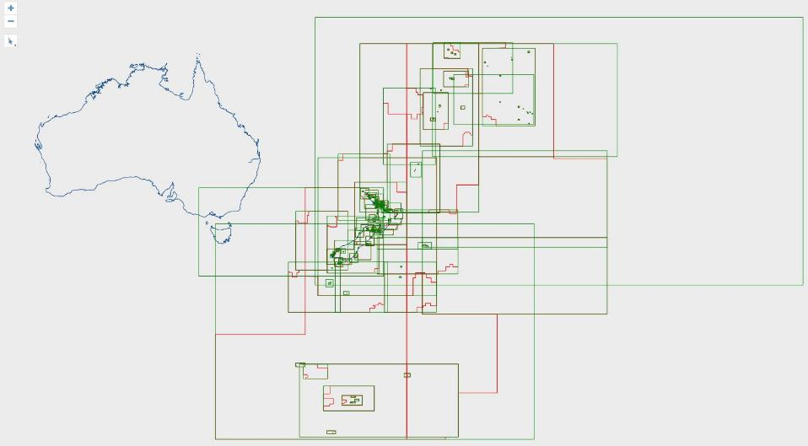
14th South West Pacific Hydrographic Commission Conference

Slide 8
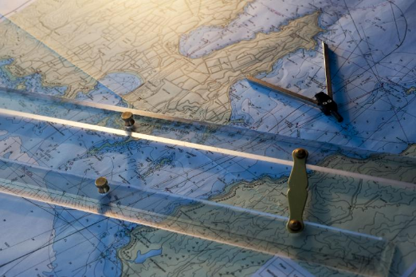
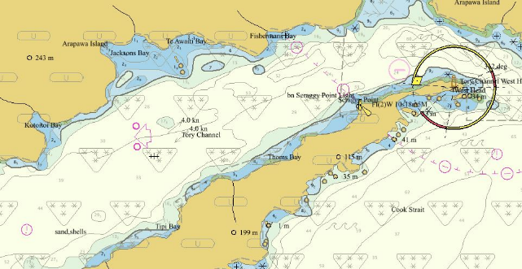
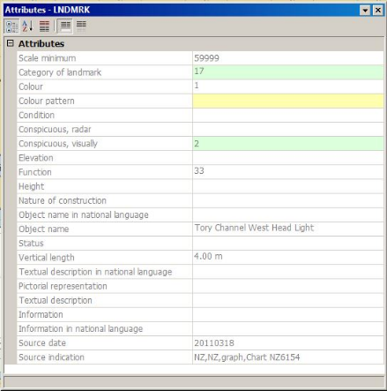
14th South West Pacific Hydrographic Commission Conference

Slide 9
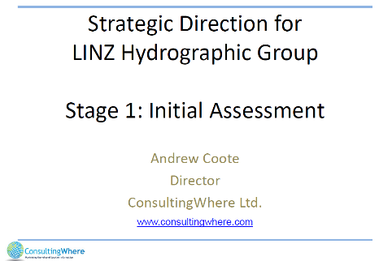
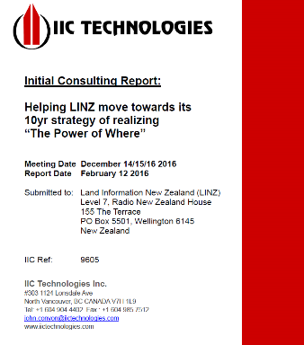
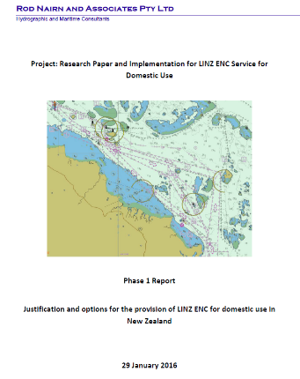
14th South West Pacific Hydrographic Commission Conference
Where’s the future?
…MSDI

Slide 10

14th South West Pacific Hydrographic Commission Conference
Digital First / Data Centric

Slide 11
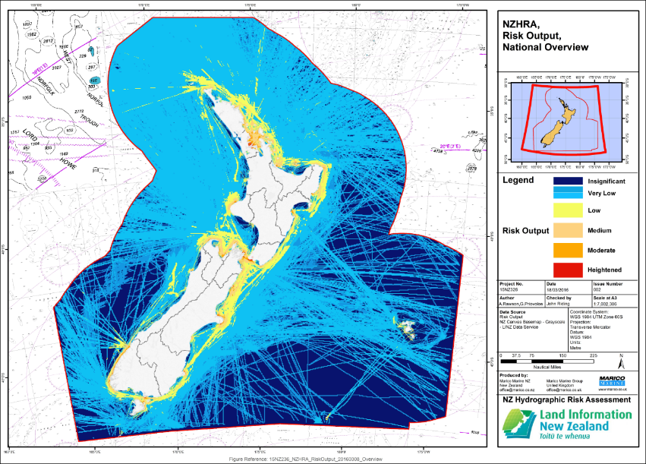
14th South West Pacific Hydrographic Commission Conference

Slide 12
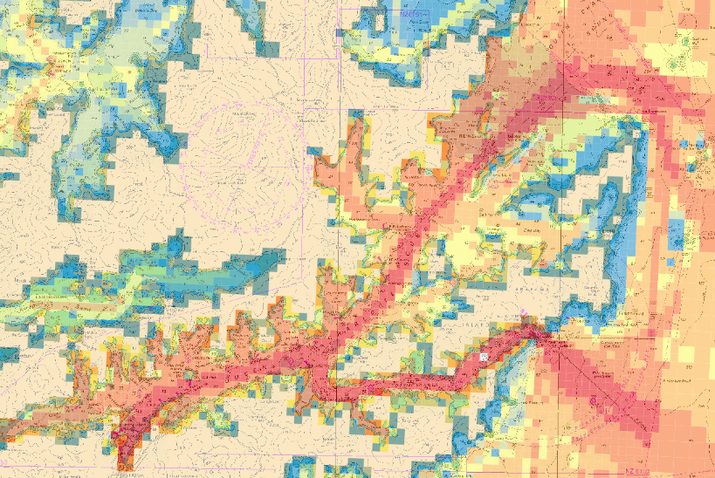
14th South West Pacific Hydrographic Commission Conference
Queen Charlotte Sound
Tory Channel

Slide 13
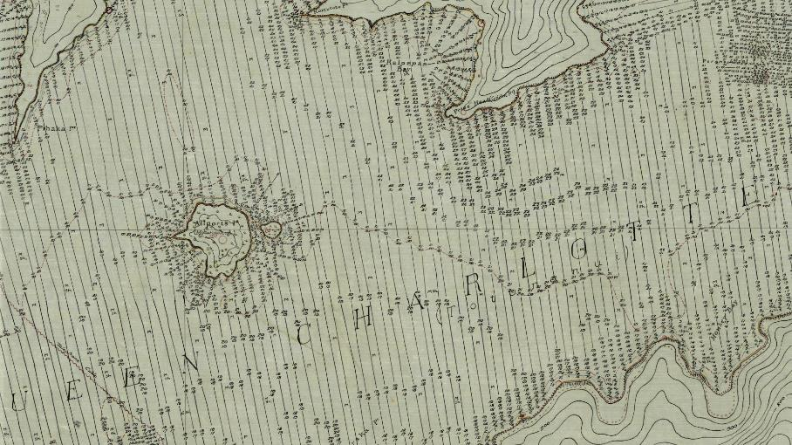
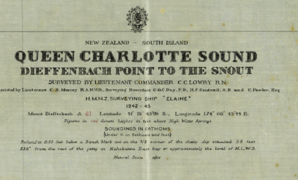
14th South West Pacific Hydrographic Commission Conference

Slide 14
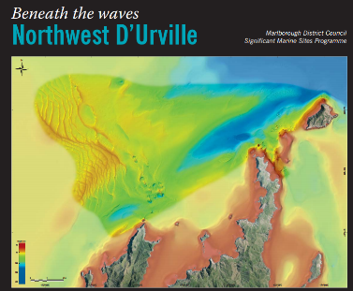
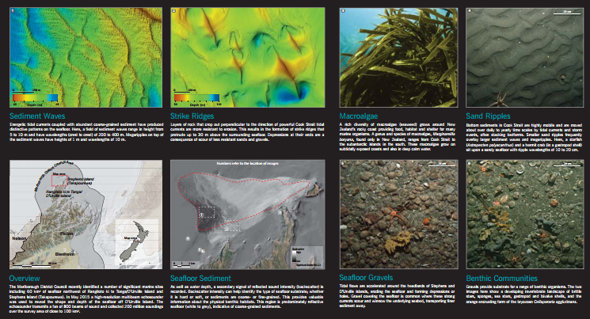
14th South West Pacific Hydrographic Commission Conference
Notes:
Ambitious Vision to map the entirety of the Marlborough Sounds, with the 2019 250yr anniversary approaching they were interested in starting in Queen Charlotte Sound

Slide 15
14th South West Pacific Hydrographic Commission Conference
Output 1:
Pacific-wide Data Discovery
Output 2:
Hydrographic Risk Assessment
SPC to search database to identify data with potential for use to improve quality of existing charts
SPC to work with PICs to release data to Primary Charting Authorities
LINZ to undertake risk assessments for Niue, Samoa & Tokelau
PRNI
LINZ: Cooks, Niue, Samoa, Tokelau, Tonga
SPC: Other PICs
Output 3:
Capability/Capacity Building
Output 5:
Pacific-wide Partnerships
LINZ to work with NZ 5 PICs on annual plans to increase capability following IHO framework
LINZ to assess NZ 5 PICs requirements for AtoN
SPC focus on other prioritised PICs to build capability and develop annual plans for improved legislation and AtoN
NZ to work with regional partners, development donors, PICs and private sector to develop partnerships for improving navigation safety
Output 4:
Mitigation Measures
LINZ to lead prioritising and project managing mitigation measures including AtoN, hydrographic surveys and chart modernisation

Slide 16
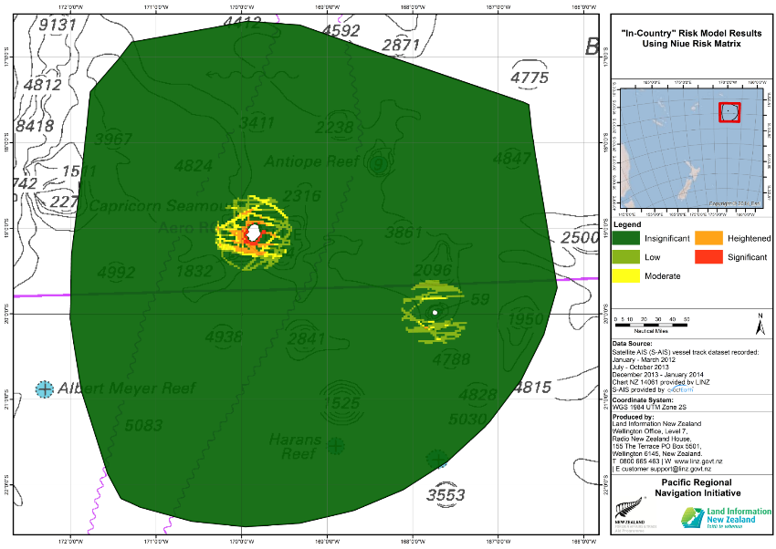
14th South West Pacific Hydrographic Commission Conference

Slide 17
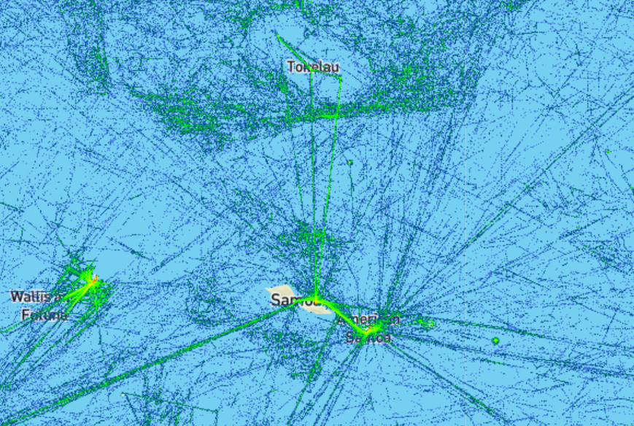
14th South West Pacific Hydrographic Commission Conference

Slide 18
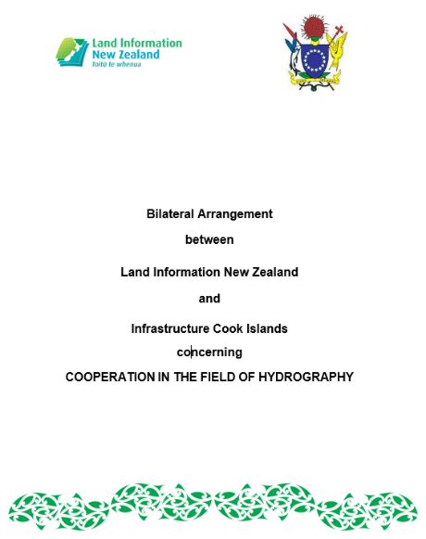
14th South West Pacific Hydrographic Commission Conference
Tonga
Niue
Samoa

Slide 19
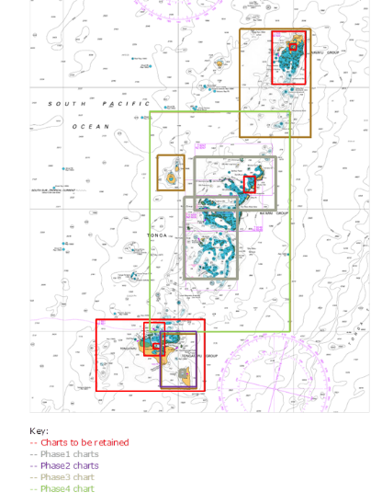
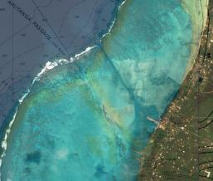
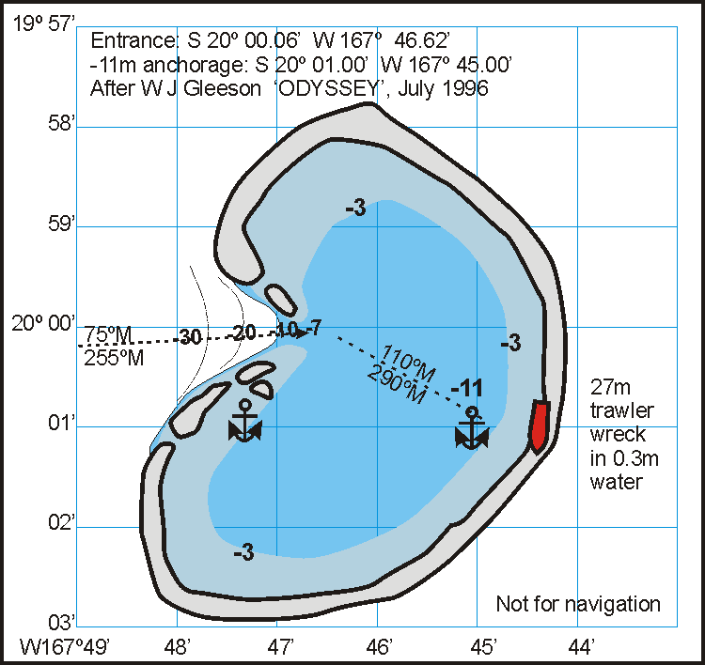
14th South West Pacific Hydrographic Commission Conference
Cook Islands
Niue

Slide 20
14th South West Pacific Hydrographic Commission Conference
Challenges
Small team, limited resources
Staff retention
Change is the norm
Diversifying – the digital environment
High density port ENCs
Responding to seismic events

Slide 21
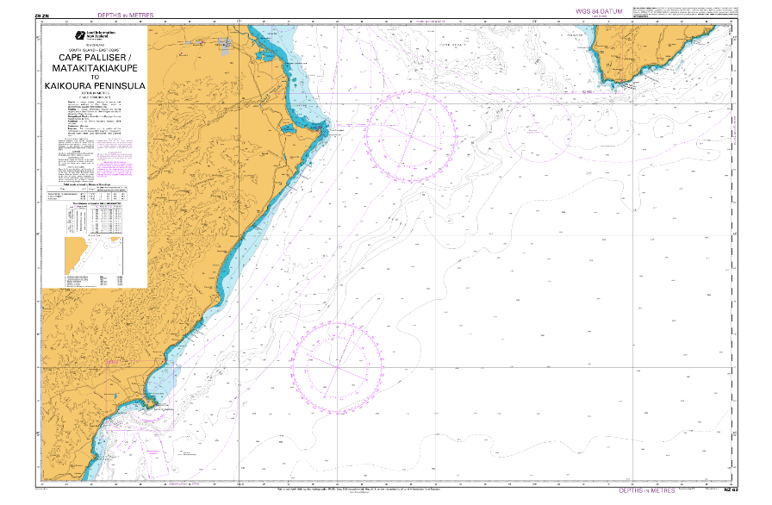
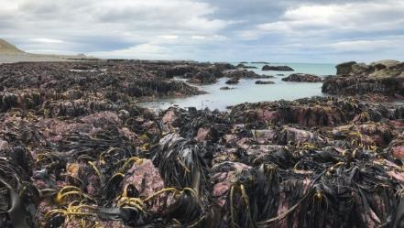
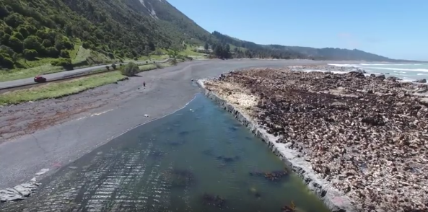
14th South West Pacific Hydrographic Commission Conference

Slide 22
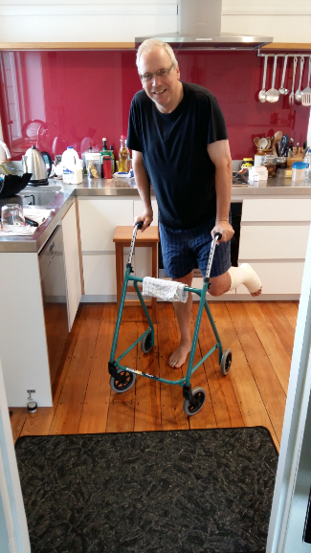
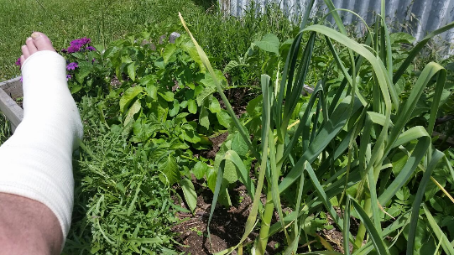
14th South West Pacific Hydrographic Commission Conference
…and finally…

Slide 23
14th South West Pacific
Hydrographic Commission Conference
30 November – 2 December 2016
NOUMEA
Thank You

