Slide 1
14th South West Pacific Hydrographic Commission Conference 30 November – 02 December Noumea, New Caledonia
https://assets.publishing.service.gov.uk/government/uploads/system/uploads/organisation/logo/51/UKHO-logo.png

Slide 2
Building on Success
UK activity 2015-16
Chart production
ENC Production
Publications
Capacity Building
Other activities
New Products

Slide 3
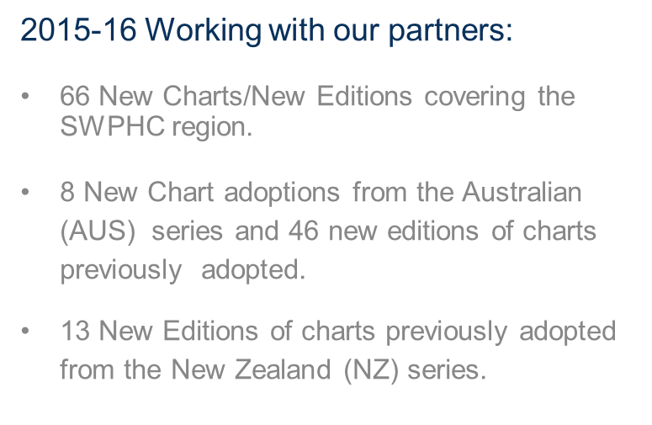
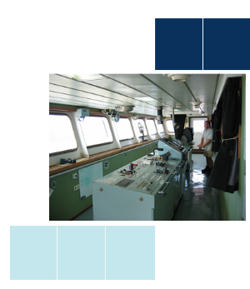
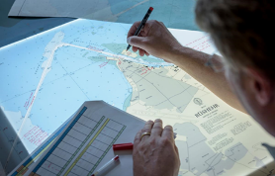
Paper Chart Production

Slide 4
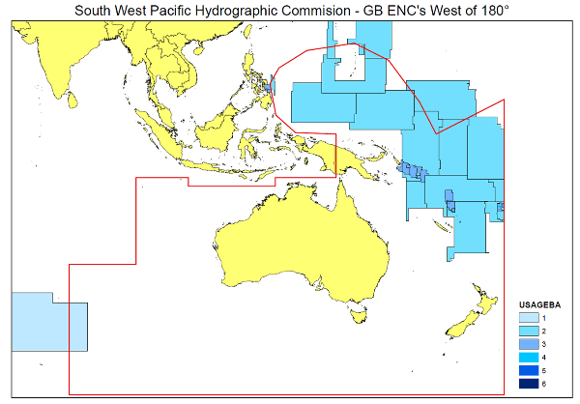
ENC Production
UK has published 114 ENC cells
SWPHC Region
Usage Band | GB ENCs
1 | 5
2 | 21
3 | 27
4 | 30
5 | 30
6 | 1
ENC Count | 114

Slide 5
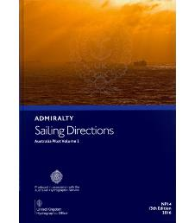
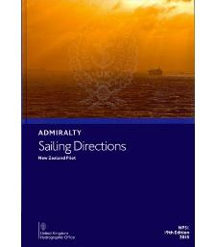
Publications and Products
New Editions published since last SWPHC:
NP 14 Australia Pilot Vol 2 2016
NP 15 Australia Pilot Vol 3 2015
NP 51 New Zealand Pilot 2015
New Editions to be published:
NP 60 Pacific Islands Pilot Vol 1 Feb 2017
NP 61 Pacific Islands Pilot Vol 2 Dec 2016
NP 13 Australia Pilot Vol 1 Apl 2017

Slide 7
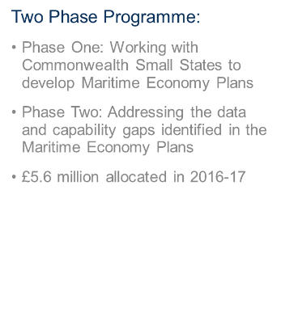

Slide 8
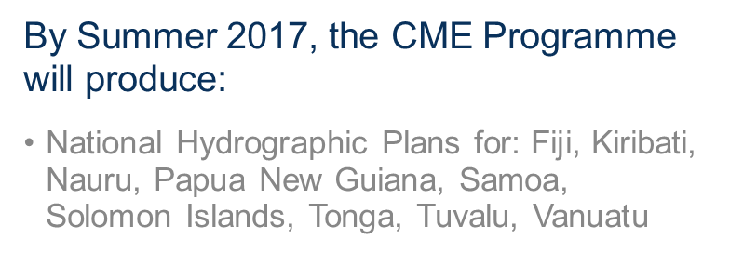
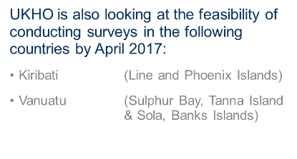

Slide 9
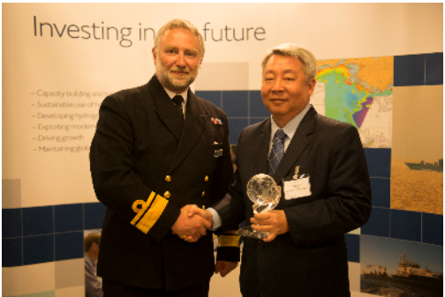
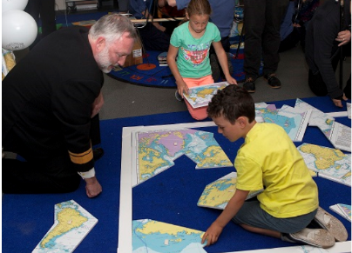
World hydrography Day
2016
“Hydrography- The key to well-managed seas and waterways”

