Slide 1
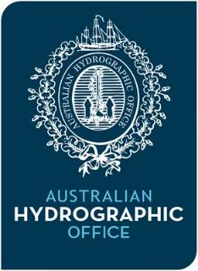
15th South West Pacific Hydrographic Commission Conference February 2018
Australian Report to SWPHC15

Slide 2
15th South West Pacific Hydrographic Commission Conference
Australian Hydrographic Office
Sits within Australian Geospatial Organisation
Defence White Paper 2016 indicates the future of Australia's hydrographic surveying capabilities will be ‘an efficient combination of commercial and military hydrographic and oceanographic surveying capabilities’ (SEA2400)

Slide 3
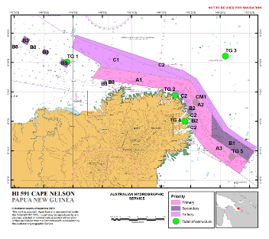
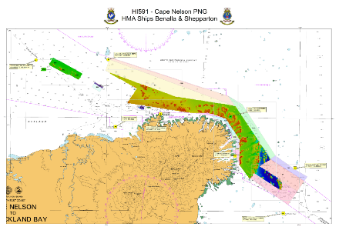
15th South West Pacific Hydrographic Commission Conference
Surveying
Hydroscheme 2017-2020 (www.hydro.gov.au)
Shepparton and Benalla surveyed Cape Nelson, PNG in early 2017
LADS, Leeuwin and Melville undertook surveys in Port Moresby, PNG in late 2017

Slide 4
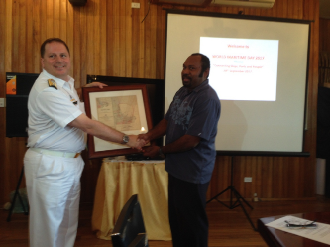
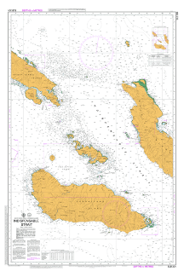
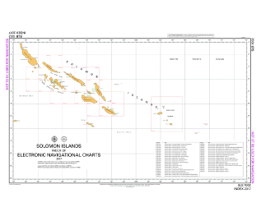
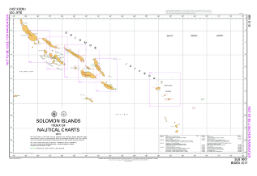
15th South West Pacific Hydrographic Commission Conference
Charting
Australia became PCA for Solomon Islands in August 2017
14 SLB Paper Charts
41 SB ENC
2 Index Charts
Paper Charts maintained in-house after 20 years of outsourcing

Slide 5
Capacity Building
Training
The last H2 course concluded in November 2017, there were 15 trainees:
10 Australian (RAN)
3 New Zealand (RNZN)
1 Indian Navy
1Fijian Defence Force

Slide 6
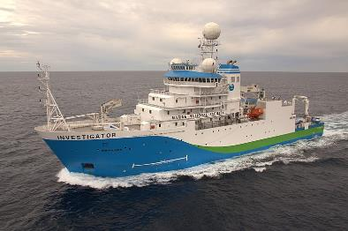
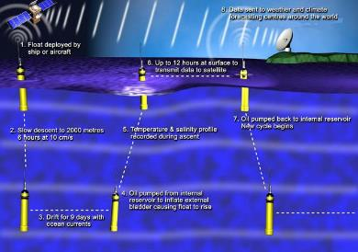
Engagement with CSIRO
AHO has engaged with Commonwealth Scientific and Industrial Research Organisation ship Research Vessel Investigator to undertake survey and science missions in waters around Australia
AHO continues to participate in the ARGO project with annual purchase of 5 floats some of which are deployed by Royal Australian Navy vessels outside major shipping lanes

Slide 7
Future
SEA2400
Solomon Islands Tide tables for 2019
Better scaled ENC for complex Port areas

