Slide 1
15th South West Pacific Hydrographic Commission Conference 21-22 February 2018 Nadi, Fiji
Pacific Regional Navigation Initiative
PRNI

Slide 2
15th South West Pacific Hydrographic Commission Conference
2015 - 5 year, $5 million programme of works
Partnership with MFAT, LINZ and SPC
Focus on navigation-related aspects of maritime safety
Builds on success on SWPRHP – risk assessments in Vanuatu, Tonga and Cook Islands
January 2018 – an additional $2.2 million secured
Programme continues to 2021

Slide 3
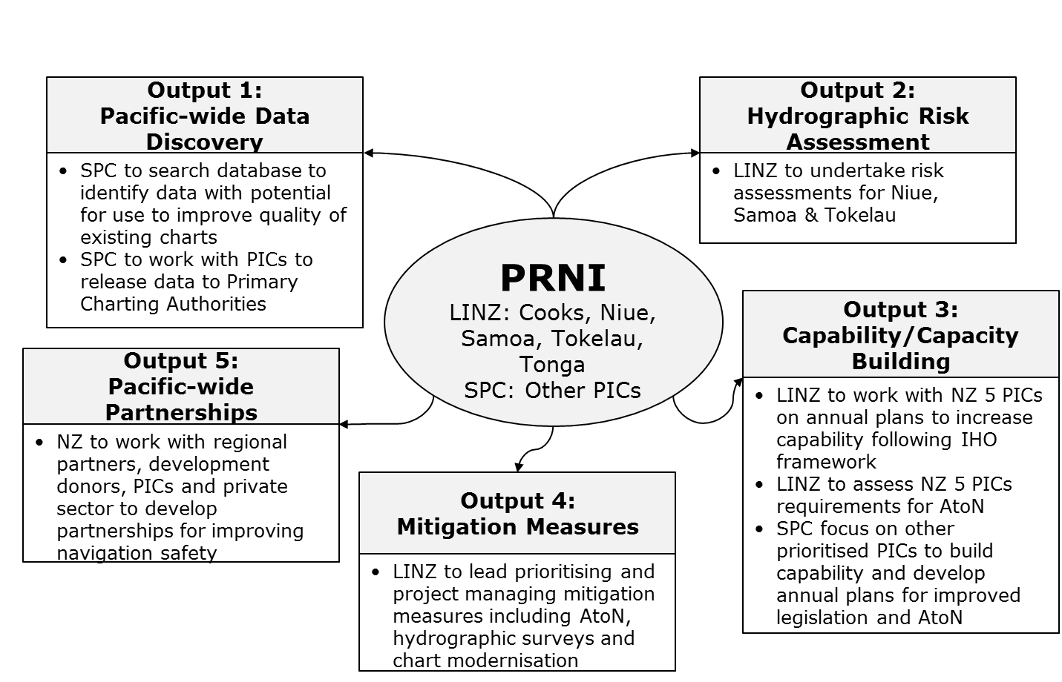
15th South West Pacific Hydrographic Commission Conference
Pacific Regional Navigation Initiative (PRNI)
Notes:
Capability / Capacity building component – to get to Phase 1
Includes in-country MSI training

Slide 4
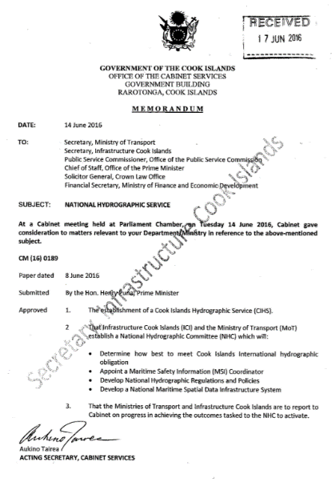
15th South West Pacific Hydrographic Commission Conference

Slide 5
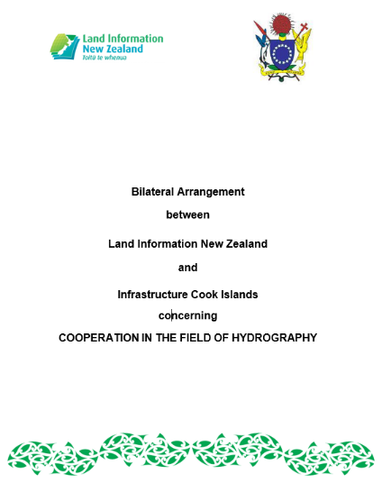
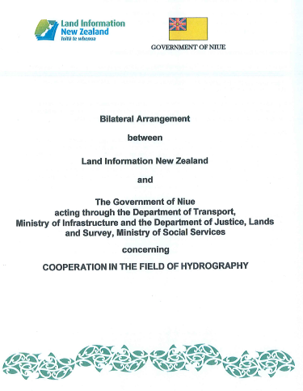
15th South West Pacific Hydrographic Commission Conference
Notes:
Includes data release – LINZ to PIC & visa versa

Slide 6
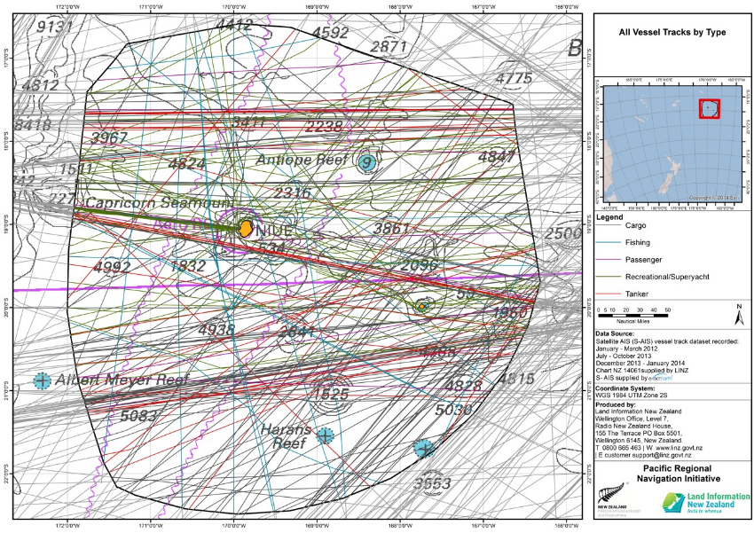
15th South West Pacific Hydrographic Commission Conference

Slide 7
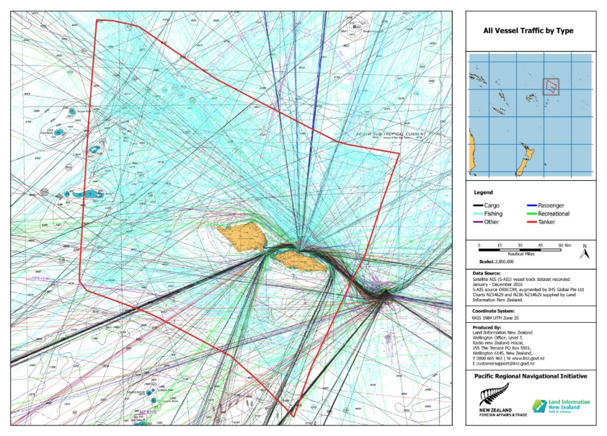
15th South West Pacific Hydrographic Commission Conference

Slide 8
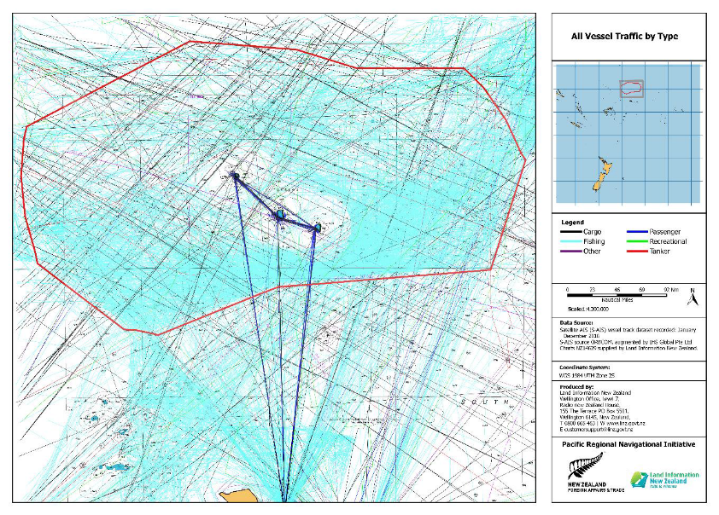
15th South West Pacific Hydrographic Commission Conference

Slide 9
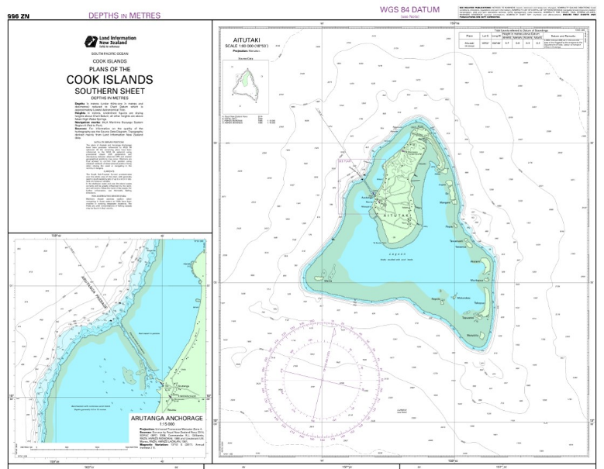
15th South West Pacific Hydrographic Commission Conference
Notes:
NE September 2017

Slide 10
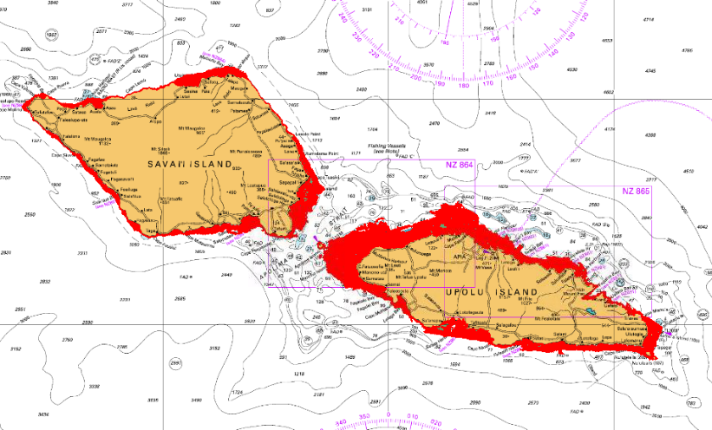
15th South West Pacific Hydrographic Commission Conference
Samoan 2015 LiDAR survey

Slide 11
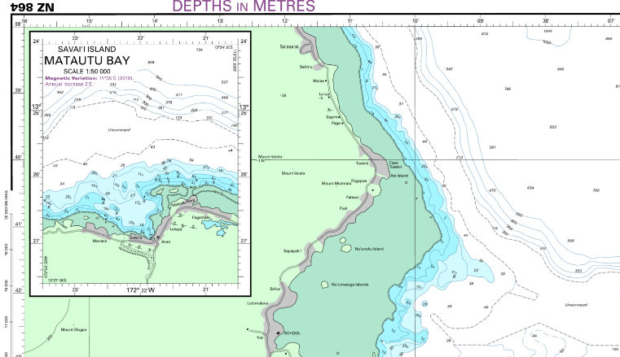
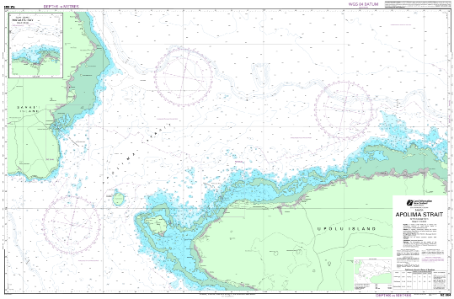
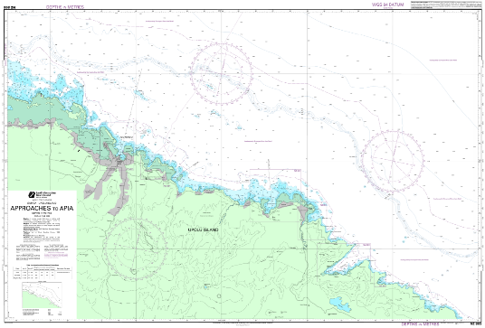
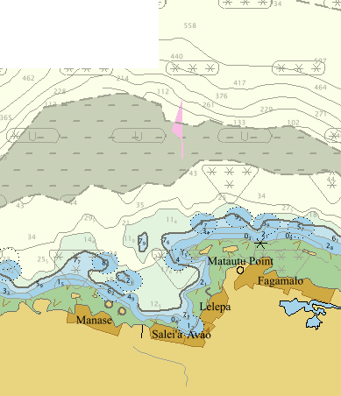
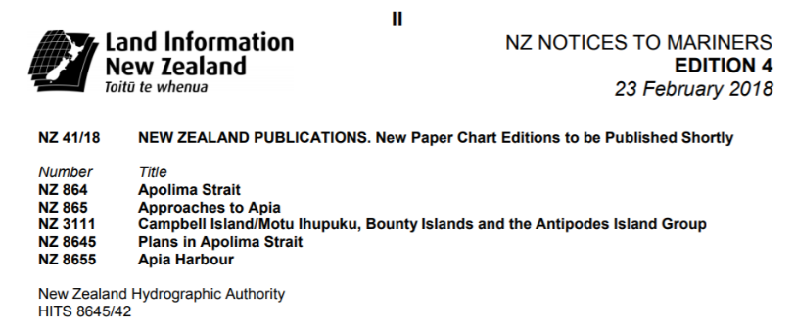
15th South West Pacific Hydrographic Commission Conference
Notes:
ENC cells published January 2018
Notification of paper charts to be released 9th March.

Slide 12
15th South West Pacific Hydrographic Commission Conference
Planned chart production schedule (SWP)
* New Charts will replace current fathoms/non-WGS84 charts, enabling production of large scale ENC for the first time.
Nation | Paper Charts |  | ENCs
 | New Edition | New Chart | New Edition | New Chart
Cook Islands | 3 (Jun 18) | - | 2 (Jun 17) 19 (Jun 18) | -
Niue | - | 1 (Mar 19) | 2 (May 18) | 1 (Mar 19)
Samoa | 4 (Feb 18) | 3 (Dec 19)* | 3 (Sep 17) 3 (Feb 18) | 7 (Dec 19)*
Tokelau | 1 (Mar 19) | - | 3 (Mar 19) | -
Tonga | 4 (Aug 19) | 6 (Aug 19)* | 5 (May 19)* | 7 (May 19)

Slide 13
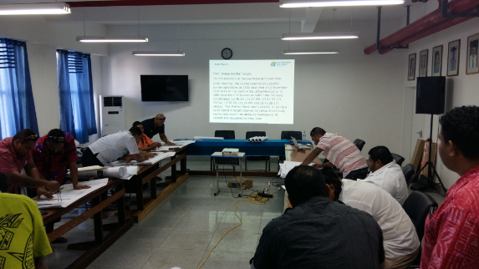
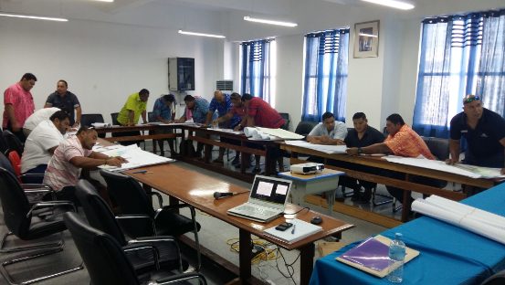
15th South West Pacific Hydrographic Commission Conference
Notes:
In-country MSI training
17 participants attended from MWTI, MNRE, MAF, MOP, SPA and NUS/SMT.
The training included practical exercises in assessing information and how best to disseminate the information – NAVAREA Coordinator & PCA

Slide 14
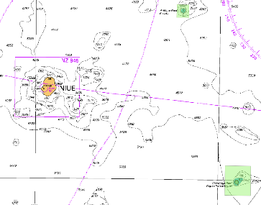
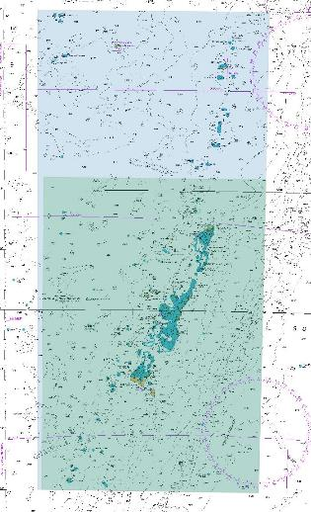
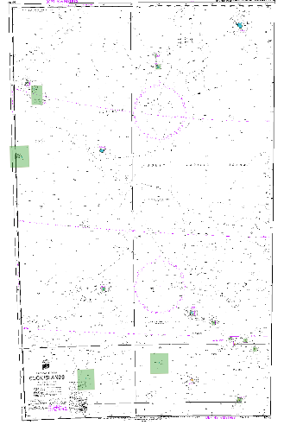
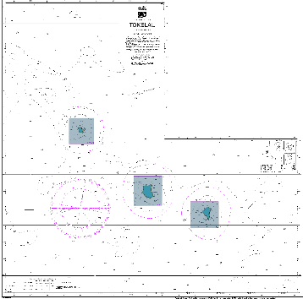
15th South West Pacific Hydrographic Commission Conference
Planned SWP surveys - SDB in Tonga, Niue, Cook Islands and Tokelau
Notes:
SDB provider note

Slide 15
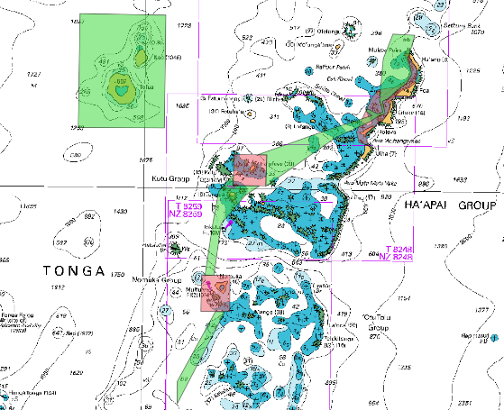
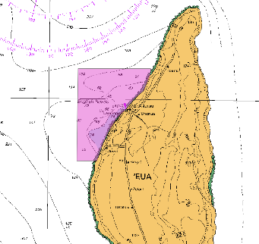
15th South West Pacific Hydrographic Commission Conference
Planned SWP surveys - LiDAR and MBES in Tonga
Notes:
Also, CB opportunities…set-to works installing tide gauges & survey control
Afloat – HMAF staff Cat-B surveyors

Slide 16
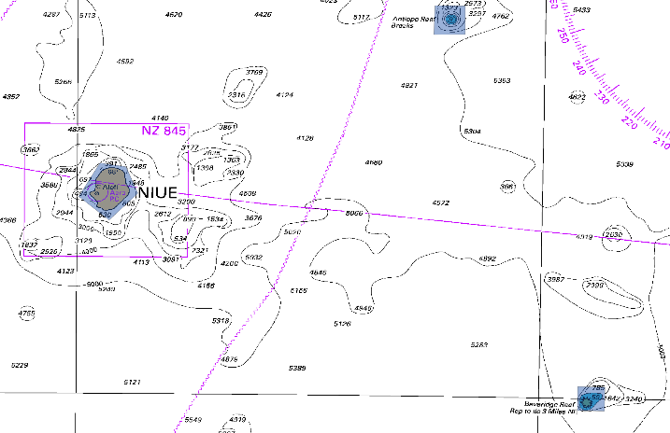
15th South West Pacific Hydrographic Commission Conference
Planned SWP surveys – LiDAR in Niue

Slide 17
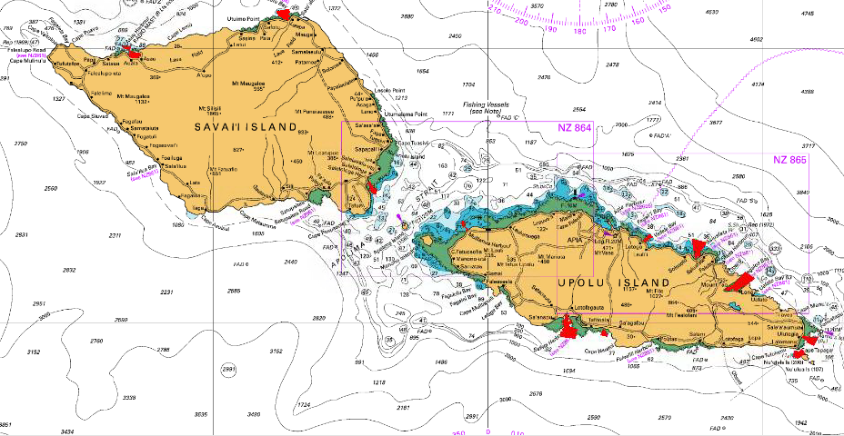
15th South West Pacific Hydrographic Commission Conference
Planned SWP surveys – MBES in Samoa
Asau
Matautu Bay
Salelologa
Mulifanua
Vailele Bay
Saluafata Bay
Fagaloa Bay
Aleipata
Safata Bay
Siumu Bay
1
2
3
4
5
6
7
9
8
10

Slide 18
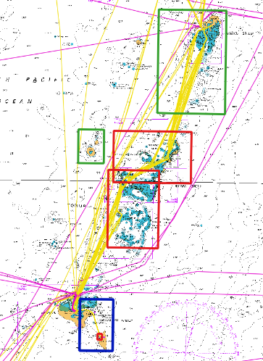
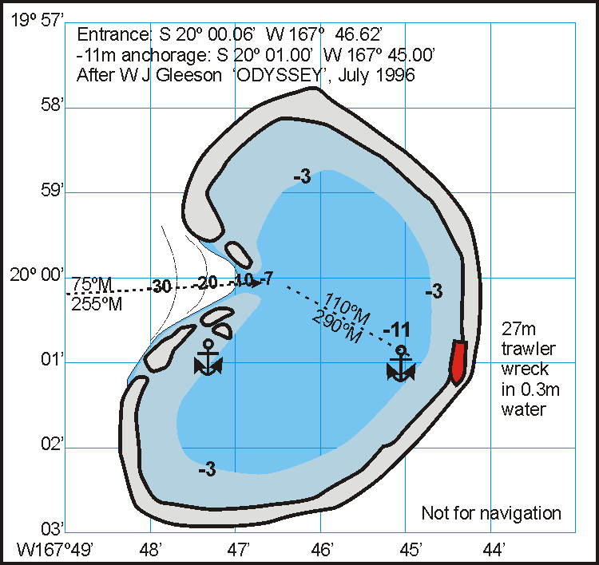
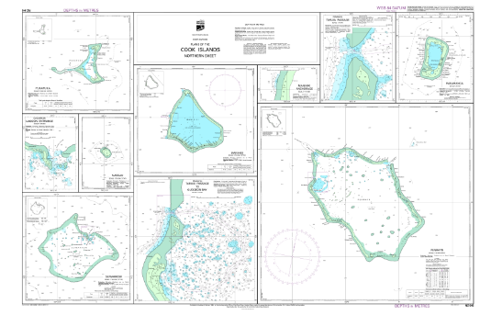
15th South West Pacific Hydrographic Commission Conference
Planned SWP charts
Cook Islands
Tonga
Niue
Notes:
First round of Cook Island charts updated by June 2018.
Further updates following results of SDB
Priority is Ha’apai Group, replacing fathoms charts

Slide 19
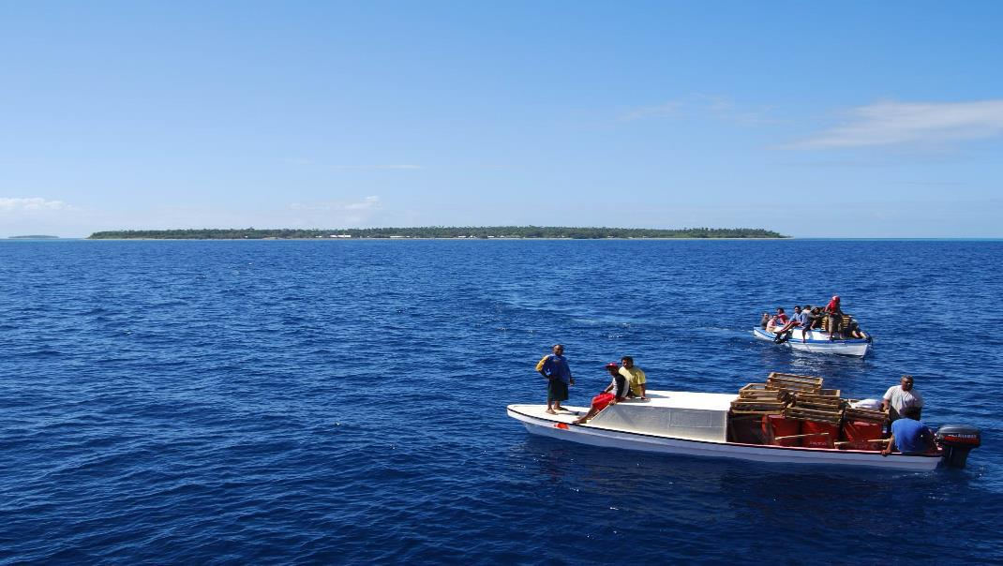
15th South West Pacific Hydrographic Commission Conference
Thank you

