Slide 1
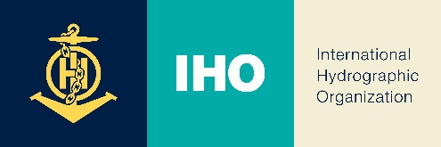
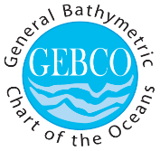
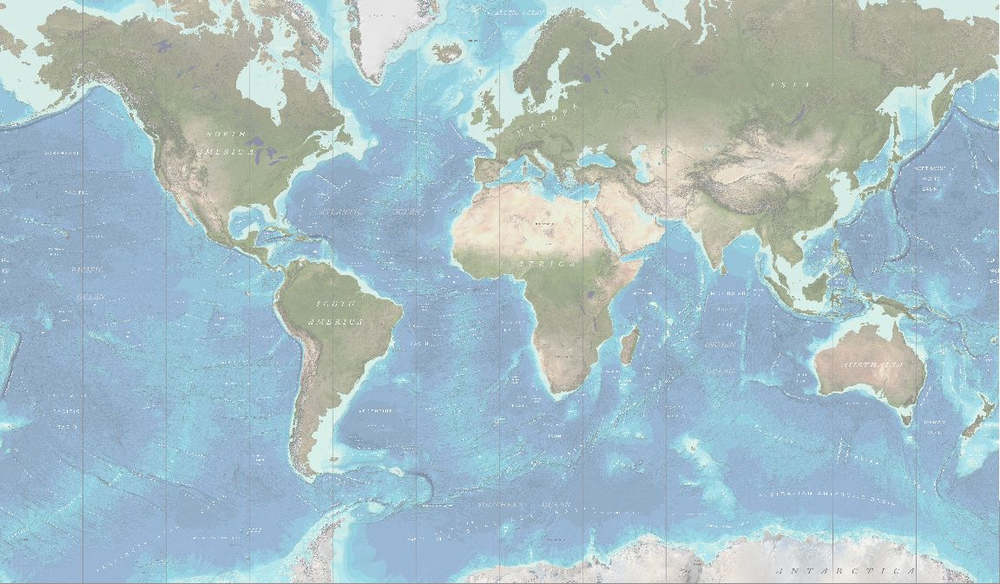
GEBCO Strategy Drafting Working Group
Breakout Sessions
GGC39 - Southampton, UK - 31 October - 1 November 2022

Slide 2
GEBCO Strategy Drafting
What's missing from the draft strategy
Focus on fundamental points
Do you recognized yourself fin this strategy?
Is it taking us forward enough into the 21 Century
Notes:
Think the Kodak moment? Are we missing something? Are we still relevant ?
SMART - Specific; Measurable; Achievable; Relevant and Time bound

Slide 3
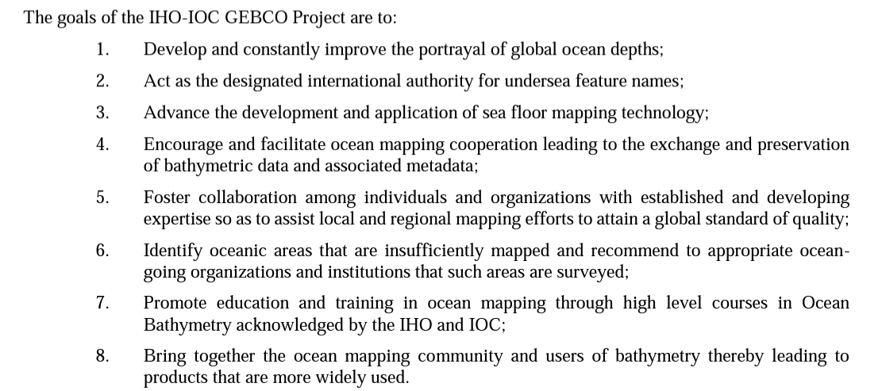
GGC TOR

Slide 4
GEBCO Strategy Drafting Breakout Session1
Vision
Ex. 1 -The public is provided with the most authoritative and up to date general bathymetric chart of the world oceans and seas
Ex. 2 - A healthy and sustainable ocean informed by a comprehensive ocean map
Mission
Ex. 1 - to compile open and available data from an authoritative public record of all bathymetric survey data of the world’s oceans and seas into the general bathymetric chart of the ocean by investing in, and building capacity for the active maintenance and update of these record.
Ex. 2 - to provide the most comprehensive and authoritative, publicly available bathymetric dataset for the world’s oceans.
Notes:
Think the Kodak moment? Are we missing something? Are we still relevant ?
SMART - Specific; Measurable; Achievable; Relevant and Time bound

Slide 5
GEBCO Strategy Drafting Breakout Session 2
Outcomes
3 or 4 Outcomes (where do you want to be in 1 or 2 generations)
Think outcomes of the decade
Objectives
3 or 4 Objectives (what do we want to deliver in 5-15 yrs)
SMART
Notes:
Think the Kodak moment? Are we missing something? Are we still relevant ?
SMART - Specific; Measurable; Achievable; Relevant and Time bound

Slide 6
Outcome Examples
Open and equitable access to bathymetric data, information, technology and innovation contributing to an Accessible Ocean.
Improved bathymetric data and information supporting better derived scientific knowledge and contributing to a Predicted, Safe, Healthy and Resilient Ocean.
A well-understood seabed contributing to an Inspiring and Engaging Ocean.

Slide 7
Objective Examples
Support the continuous improvement (both qualitative and quantitative) of bathymetric data acquisition and sharing, in support of global ocean seafloor mapping and a global ocean bathymetry map.
Maintain and make available the IHO-IOC GEBCO Gazetteer of Undersea Feature Names.
Encourage and promote technological innovation to improve and accelerate the data acquisition and development of our core activities.
Create a community that will assist in building science capacity, mobilise scientists, and facilitate an enabling environment for engagement of practitioners, decision makers and the private sector in the development and use of science-based solutions.
Raise awareness amongst academic institutions of gaps in education and training that may impact on the progress and development our objectives.

