Slide 1
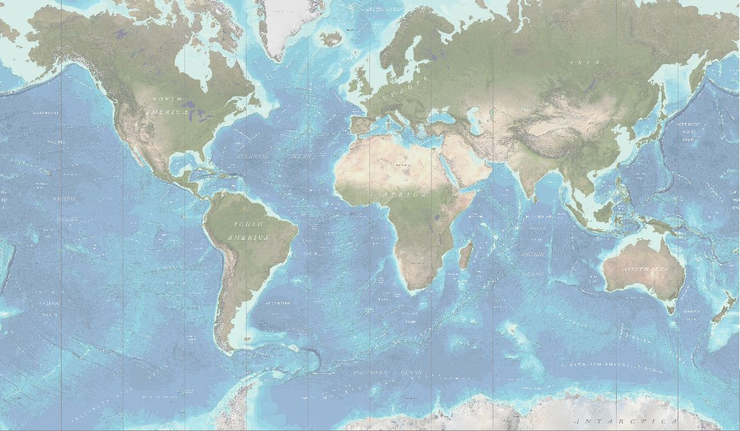
GEBCO Strategy Drafting Working Group (SDWG)
GGC39 - Southampton, UK - 31 October - 1 November 2022

Slide 2
GEBCO Strategy Drafting Working Group
Geoffroy Lamarche - David Millar - George Spoelstra - Kim Picard
TOR and SOP
Drafting history
Strategy Outline
Vision and Mission
Outcomes and Objectives
Tomorrow
Breaking out sessions
Reporting from Break out session
Next step
Notes:
Need to introduce the method
Explain the exercise
What do we want from the strategy
What do we expect from people
Who is the strategy for?
Position us better in today's world

Slide 3
Strategy Drafting Working Group Term of Reference
Review the current and future strategic context in which the GEBCO operates
Conduct a reflection and a drafting of a first strategy
Consider the goals and roles of sub-committees and projects and their interrelations
Propose an outline for the Strategy

Slide 4
Why do we need a Strategy ?
support a strong GEBCO governance
increase our visibility and relevance
provide direction toward achieving multi-generation outcomes
provide clarity on GEBCO's objectives within the complex structure and relationships between parent’s organisations, our subcommittees and subordinate projects.
ensure GEBCO complements and support parent’s organisations objectives.
ensure that our sub-committees and subordinate projects have the support they require to optimize their work and outcomes.

Slide 5
What do we want from the meeting?
Engagement
Buy-in
&
No ideas left behind
Convergence with Governance review
Consider our mission statement, and vision if it is deemed necessary and appropriate.
Discuss outcomes and objectives
Agree on outline

Slide 6
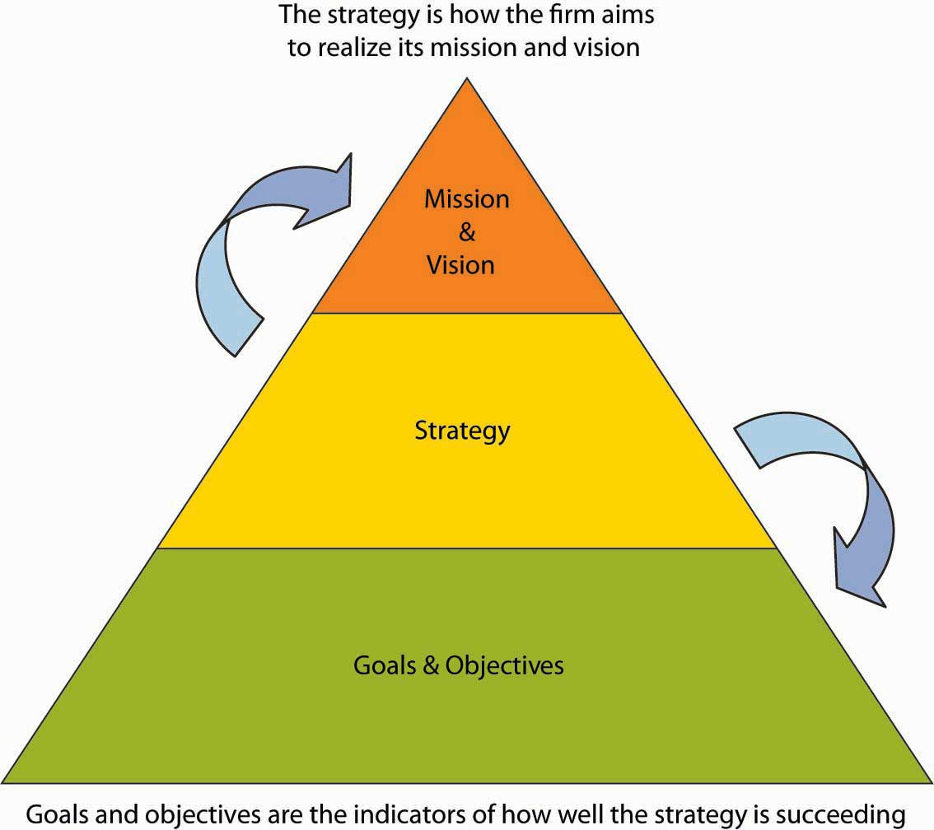
Outline
Introduction
GEBCO’s vision and mission
Outcomes
Objectives
Principles and strategies to deliver our objectives
A better future
Vision
Mission
Outcomes
Goals and Objectives

Slide 7
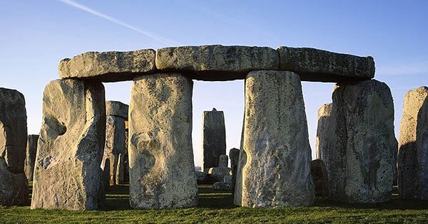
Four pillars of GEBCO's Strategy
Science and evidence-based decision
Education - Capability and capability building
Technology and innovation
Communication & outreach

Slide 8
Examples of our VISION
The public is provided with the most authoritative and up to date general bathymetric chart of the world oceans and seas
A healthy and sustainable ocean informed by a comprehensive ocean map
Notes:
Vision : the lofty end state, how would the world be a better place? It aligns people’s hearts; the present one is not a vision it’s a mission
The mission is the impact. How do we contribute to that vision; because then we get to the strategy, and how we want to do that
Vision and Mission frame the direction of GEBCO
Objectives
What area our 4 pilars
Includes the why

Slide 9
Examples of our MISSION
to compile open and available data from an authoritative public record of all bathymetric survey data of the world’s oceans and seas into the general bathymetric chart of the ocean by investing in, and building capacity for the active maintenance and update of these record.
to provide the most comprehensive and authoritative, publicly available bathymetric dataset for the world’s oceans.
Notes:
Vision : the lofty end state, how would the world be a better place? It aligns people’s hearts; the present one is not a vision it’s a mission
The mission is the impact. How do we contribute to that vision; because then we get to the strategy, and how we want to do that
Vision and Mission frame the direction of GEBCO
Objectives
What area our 4 pilars
Includes the why

Slide 10
Outcomes
Should be
aligned on the Decade outcomes
Open and equitable access to bathymetric data, information, technology and innovation contributing to an Accessible Ocean.
Examples
Improved bathymetric data and information supporting better derived scientific knowledge and contributing to a Predicted, Safe, Healthy and Resilient Ocean.
A well-understood seabed contributing to an Inspiring and Engaging Ocean.

Slide 11
Objectives
Support the continuous improvement (both qualitative and quantitative) of bathymetric data acquisition and sharing, in support of global ocean seafloor mapping and a global ocean bathymetry map.
Maintain and make available the IHO-IOC GEBCO Gazetteer of Undersea Feature Names.
Encourage and promote technological innovation to improve and accelerate the data acquisition and development of our core activities.
Create a community that will assist in building science capacity, mobilise scientists, and facilitate an enabling environment for engagement of practitioners, decision makers and the private sector in the development and use of science-based solutions.
Raise awareness amongst academic institutions of gaps in education and training that may impact on the progress and development our objectives.

Slide 12
Ocean Decade
The Science We Need for the Ocean We Want
The outcomes
An accessible ocean
A predicted ocean
A safe ocean
A healthy and resilient ocean
An inspiring and engaging ocean
Notes:
An accessible ocean with open and equitable access to bathymetric data, information, technology and innovation
A predicted ocean where society understands and can respond to changing ocean conditions through better scientific knowledge derived from the use of improved bathymetry.
A safe ocean where life and livelihoods are protected from ocean-related hazards through better scientific knowledge derived from the use of improved bathymetry.
A healthy and resilient ocean where marine ecosystems are understood, protected, restored and managed through more effective decision-making processes due to improved bathymetric information.
An inspiring and engaging ocean where society understands and values the seabed in relation to human wellbeing and sustainable development.

Slide 13
Break out Sessions
Session 1 - What's missing from the draft strategy
Focus on fundamental points
Do you recognized yourself fin this strategy?
Is it taking us forward enough into the 21 Century
Notes:
Think the Kodak moment? Are we missing something? Are we still relevant ?
SMART - Specific; Measurable; Achievable; Relevant and Time bound

Slide 14
Break out Sessions
Session 2 - Outcomes & Objectives
3 or 4 Outcomes (where do you want to be in 1 or 2 generations)
3 or 4 Objectives (what do we want to deliver in 5-15 yrs)
SMART
Think outcomes of the decade
Notes:
Think the Kodak moment? Are we missing something? Are we still relevant ?
SMART - Specific; Measurable; Achievable; Relevant and Time bound

Slide 15
What next
Write a full draft with your ideas/thoughts in mind
Final version in May for IHO GA dictates the timeline
Final draft in March
Final version in late April
Define the criteria for measuring success and propose priorities for the GEBCO
Define an implementation plan

Slide 16
A STRATEGY IS
A living document
Long term
Federative

Slide 17
Core Activities
Compilation
Curation
Distribution
Promotion
Scientific use
of bathymetric data

