Slide 1
GEBCO GUIDING COMMITTEE 39
3rd Session of the IHO Assembly AGENDA ITEM 7
IHO Director
RAdm Luigi SINAPI

Slide 2
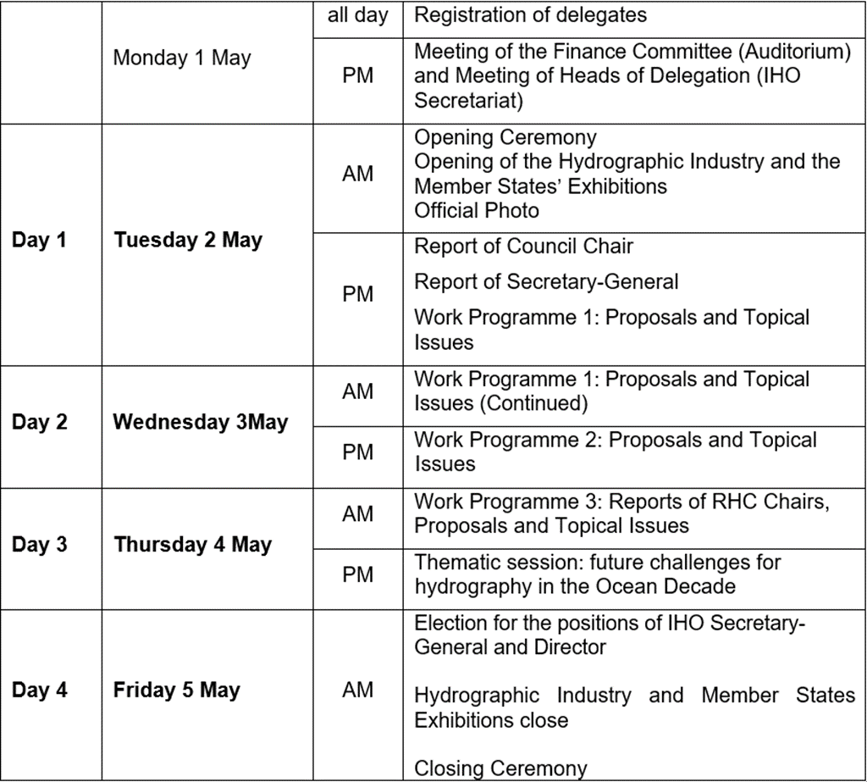
Provisional Agenda (ACL01REV1)

Slide 3
Provisional Agenda (DAY 1 – 2nd may 2023 AM)
Opening Ceremony
The Opening Ceremony for A-3 will take place on Tuesday morning, 2nd May 2023 (10.00-11.30)
Speakers:
Welcome by Secretary-General IHO
Introduction by Assembly Chair
Secretary-General IHO
Head of IOC / UNESCO (TBC)
Director OECD (TBC)
Opening Address: HSH Albert II (Host Country)
New Member States that have joined the IHO since A-2 will be invited to present their flag on this occasion

Slide 4
Thematic Session
Provisional Agenda (DAY 3 – 4th may 2023 PM)
General layout:
Three thematic Blocks
Three speakers per panel (10 – 15 minutes per speaker)
Moderated by the IHO Secretary-General and Directors
BLOCK 1: Survey and ocean mapping - DCOORD
BLOCK 2: S-100 next level of digitalization of hydrographic information - DTECH
BLOCK 3: Hydrography – Underpinning the digital twin of the Ocean - SG

Slide 5
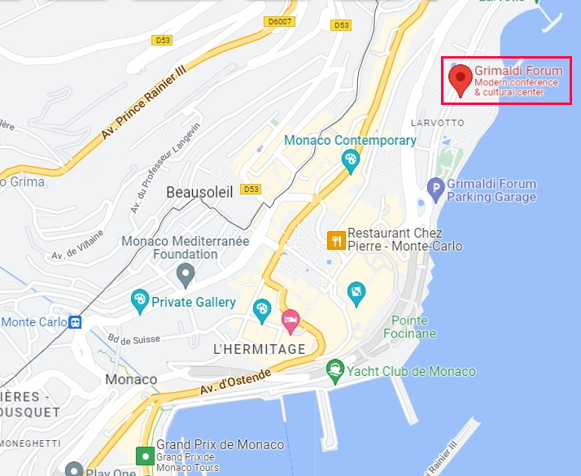
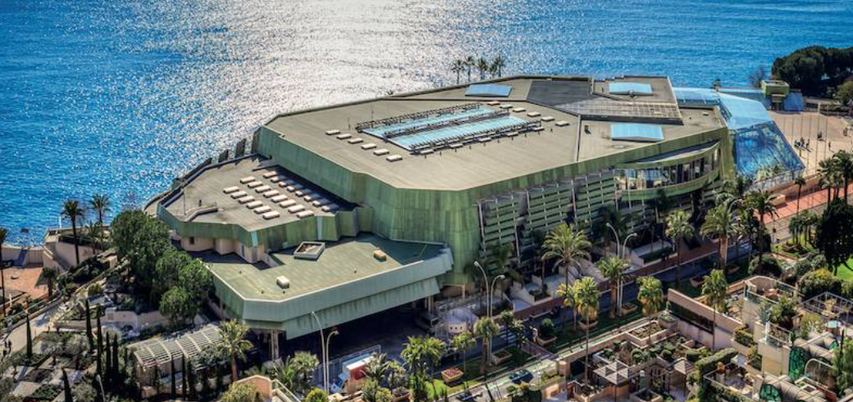
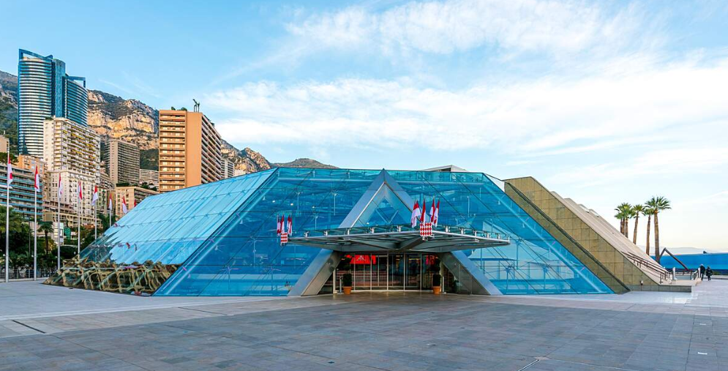
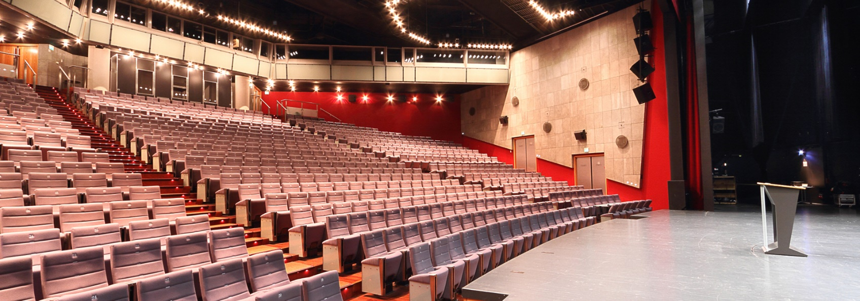
Admin/Logistic matters – venue

Slide 6
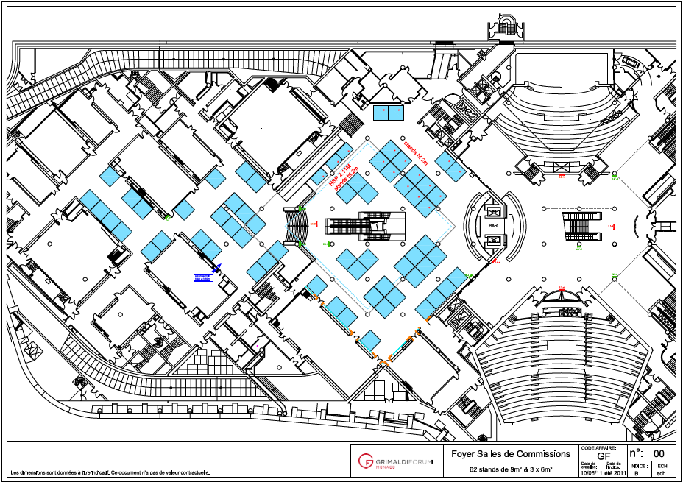
LOGISTICS: EXHIBITIONS’ AREAs
Secretariat Offices
Member State Exhibition
OCEAN MAPPING BOOTH
(GEBCO-SEABED2030-CSB)
Bar – Catering
Industry Exhibition
Auditorium

Slide 7
LOGISTICS: SHIPS VISITS
So far one Member State confirmed ship visit:
United States of America
Other interested Member States are invited to notify the IHO Secretariat no later than 7 November 2022
Diplomatic request to Monaco Government is required to enter and stay in the harbor
Reference: ACL05/Rev1

Slide 8
LOGISTICS: RECEPTIONS
Receptions expected for all A-3 week EVENINGS:
1st MAY 2023: Reception/Icebreaker at Grimaldi Forum (IHO)
2nd MAY 2023: FREE
3rd MAY 2023: FREE
4th MAY 2023: Reception hosted onboard US ship
5th MAY 2023: Reception hosted at the IHO Secretariat (IHO)

Slide 9
Action requested of the GGC:
The GGC is invited to:
To take note of the IHO A-3 preparations
To use all the opportunities offered by the IHO A-3 to celebrate the 120th Anniversary of GEBCO
To consider to establish a Project Team for the 120th Anniversary (composed of representatives of IHO & IOC Secretariats, GGC and GEBCO Subcommittees, Seabed2030)

