Slide 1
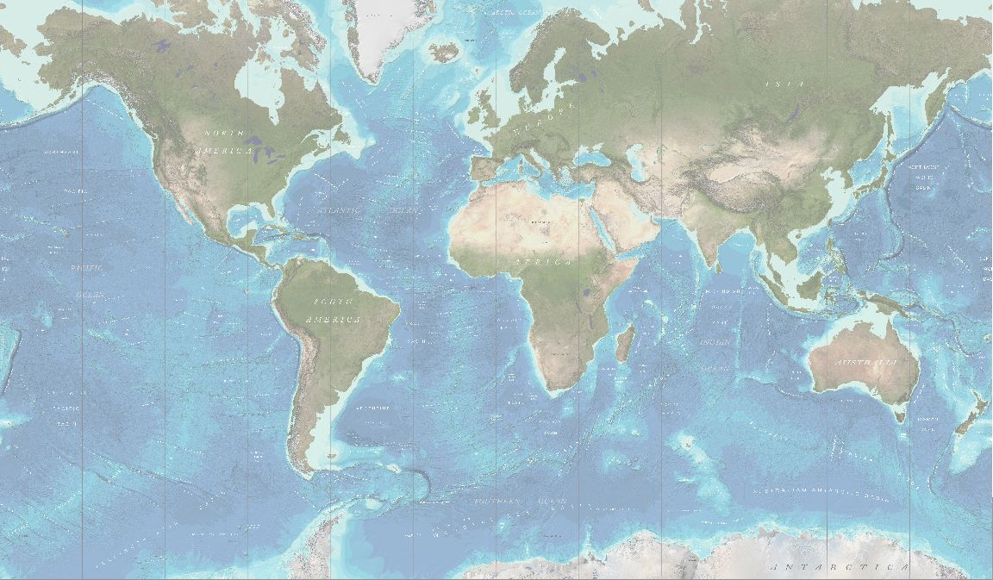
SCUFN Report
MOC, Southampton, UK / 31 Oct – 11 Nov, 2022

Slide 2
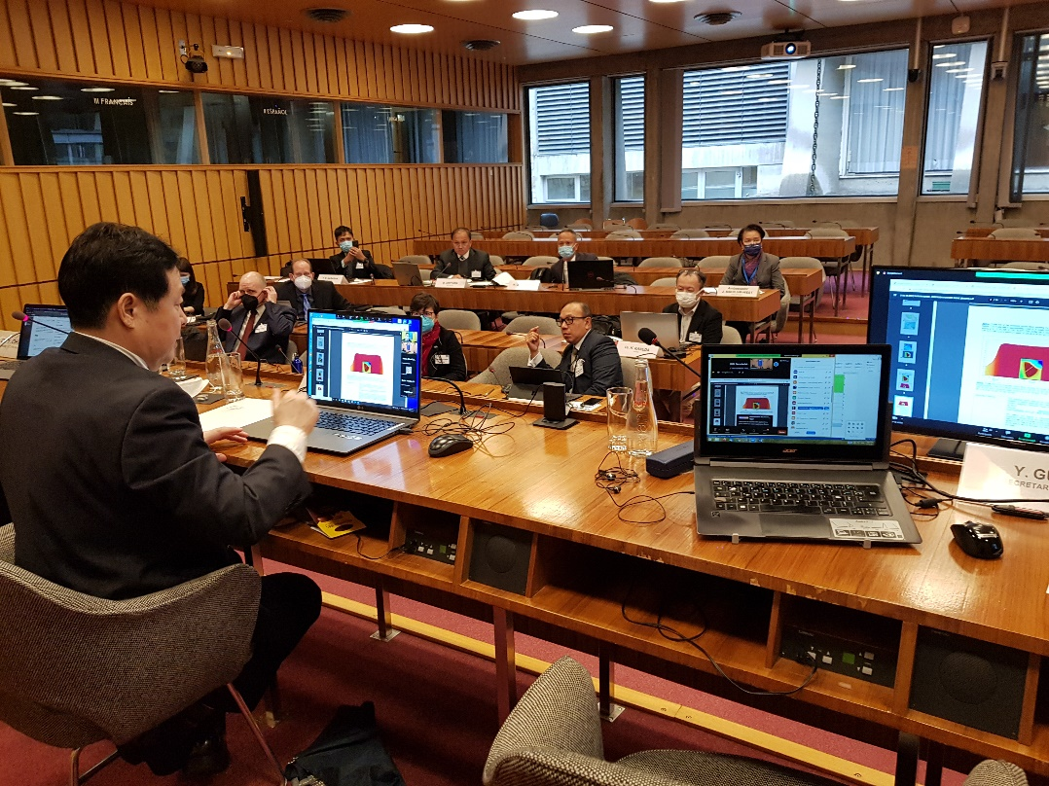
SCUFN35.2 Meeting
HOST: International Hydrographic Organization (IHO)
Venue: Monaco
Date: Nov 27 – Dec 3, 2022
(SCUFN35.1, UNESCO, 14-18 March, 2022)

Slide 3
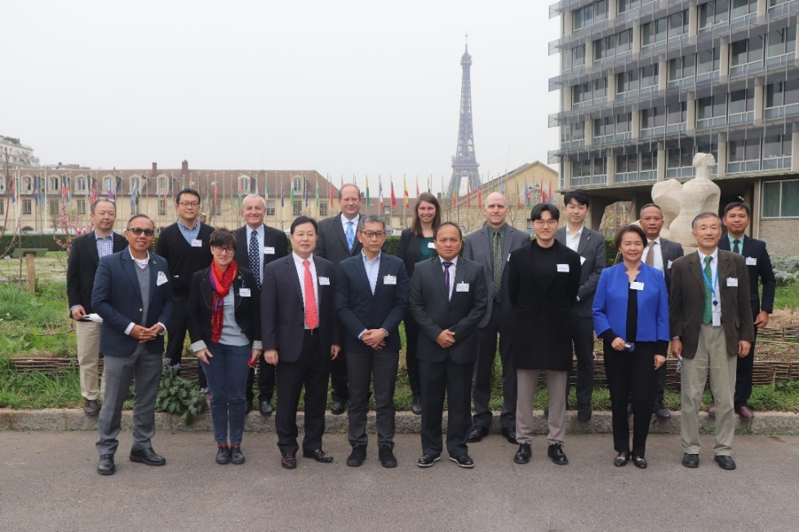
SCUFN Membership
Members Stepping Down
- Capt. Alekseev (Russian Fed, IOC) since19th of Mar.
- Dr. Han (ROK, IOC) and Dr. Lalancette (France, IHO) from 3rd of Dec.
Upcoming Members
- Ms. Lorena da Fonseca Sampaio (Brazil, IOC)
- Dr. Oke Dwiyana Pribadi (Indonesia, IHO)
- Dr. Hyun Suk Lee (ROK, IOC)

Slide 4
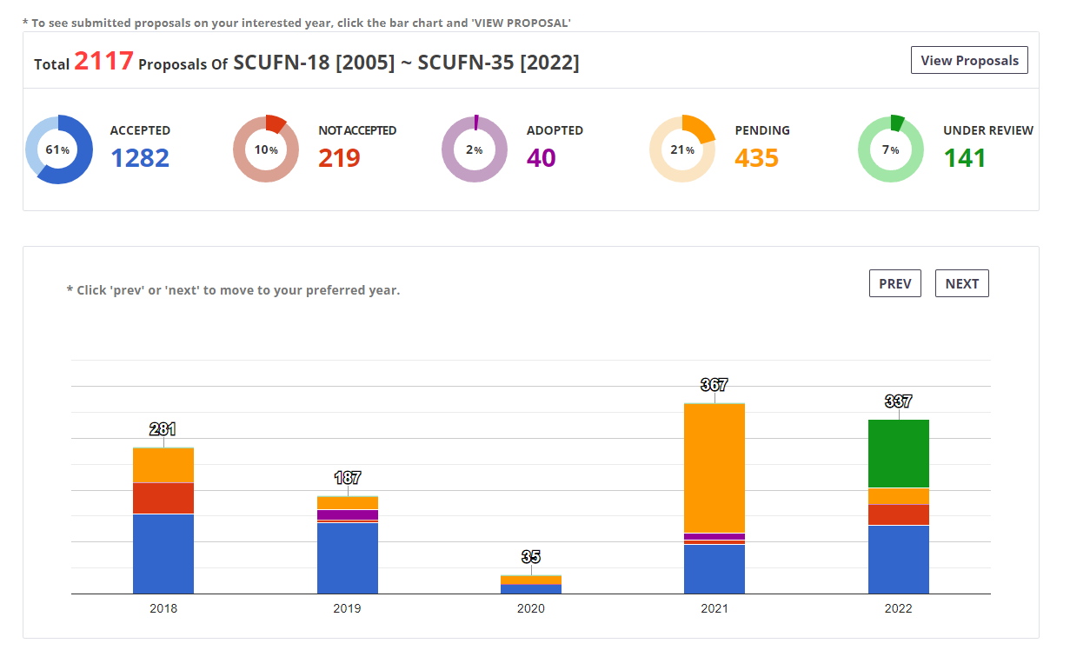
Review Proposals
Only review pending proposals
Newly received proposals will be reviewed next year

Slide 5
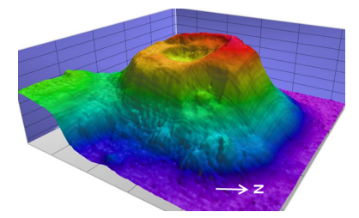
GEBCO Gazetteer & SCUFN Operational Web Services
SCUFN 35-1 Report by NOAA/NCEI on maintenance of the GEBCO Gazetteer (NOAA) and interoperability with SCUFN Operational Webservices
Synchronize
Submission
KHOA
SCUFN Operation Web Services
GEBCO Gazetteer
Review
Proposer
Request
SCUFN MEMBER
Accept
IHO Secretary
IHO DCDB
Sending

Slide 6
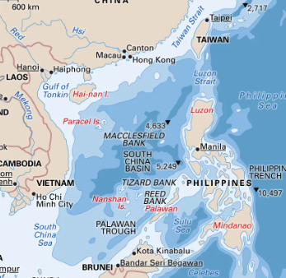
Significant Back Log of UFN Proposals
in the South China Sea
Despite arguments raised by some SCUFN Members to apply RoP 2.10 (political sensitivity), SCUFN decided at SCUFN35.1 (voting procedure, secret ballot) in March that SCUFN is legitimate to consider submitted proposals located in the SCS. In fact, SCUFN does not want to create a “black hole” of UFN in this area due to RoP 2.10 as it could be a precedent for other areas
Due to some arguments raised at SCUFN35.1 claiming that most features in the SCS were already named (by one country), SCUFN proposed to establish a sub working group (SCUFN subgroup B-6 1.D) to identify objective seniority in naming undersea features (peer-review publications vs national scientific publications for instance)
RoP of the subgroup B-6 1.D are in progress to do so: no consensus reached so far within the drafting group

Slide 7
Cookbook
Definition of Generic Names
The draft version was submitted by Kevin Mackay and Vaughan Stagpoole (NZ) in 2020
SCUFN members are under reviewing
Test it for about 3~4 years
After testing, the new generic term definitions will be listed on B-6
Repository of Typical Cases
SCUFN members welcomed the presentation by SCUFN members Ivaldi and Mackay on the prototype and agreed on the principles
The draft version will be proposed for formal adoption by SCUFN in the SCUFN35.2 meeting

Slide 8
Limit of areal extent
SCUFN does not have any minimum size for features to be named even though SCUFN will basically follow the GGC recommendation, which is GEBCO grid resolution
However, undersea features generally less than a few hundred meters across are usually not named except in the special case
The proposer of the name of a minor undersea feature would need to describe the reason for proposing a minor feature in a proposal
SCUFN will further work with specialists in several Geological Surveys and GGC members such as Geoffroy Lamarche and Kim Picard to set quantitative thresholds to define the optimal horizontal resolution between undersea features

Slide 9
Next Meeting
Date: Not fixed yet
Venue: Kenya (to be confirmed)

Slide 10
Thank you !!!!

