Slide 1
Governance Review –
Initial Findings
Sam Harper
GEBCO Secretary

Slide 2
01
Work undertaken to date
Status of project team work items:
Establishment of Project Team – Complete
Map organizational and functional structure – Complete
Identify relationships and conduct governance instrument gap analysis – In progress
Assess instruments and work plans of GEBCO bodies to identify initial findings – Complete bar SCUFN and SB2030
Financial review – not started
Legal review – not started
Final summary report and continuous improvement process development – not started

Slide 3
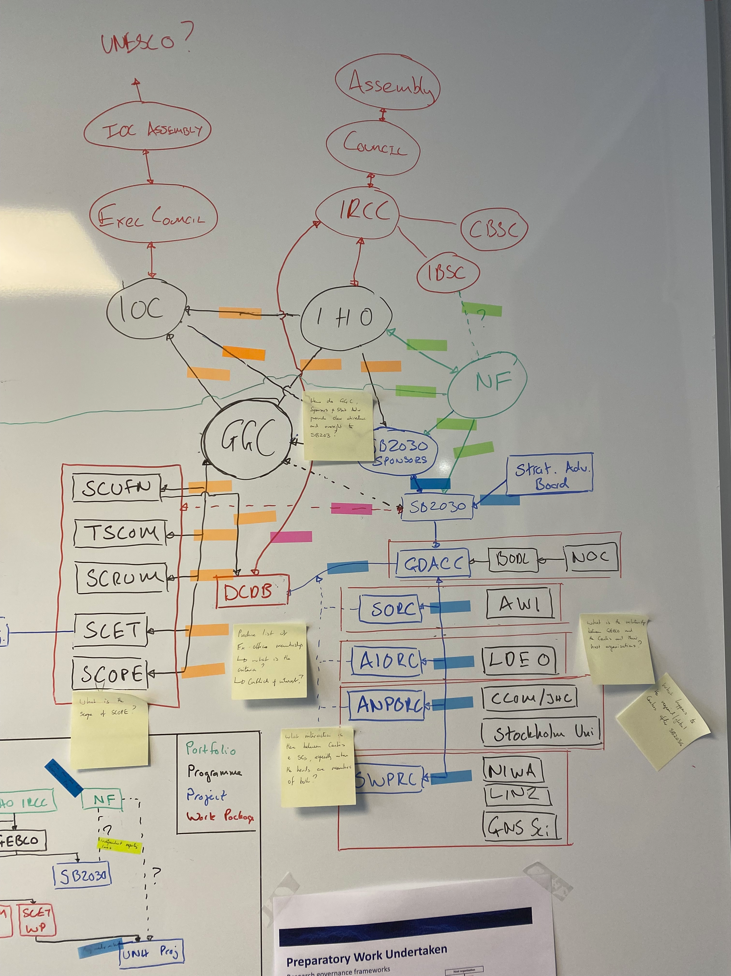
02
Work undertaken to date
Initial observations/challenges:
GEBCO is complex!
In mapping the organisatonal structure, there were over 27 functional relationships identified
Undertaking this work in parallel with the strategy development limits the depth of the analysis

Slide 4
03
Appointment of EAP
To date, three of the four positions identified have been filled with only a representative
from industry to be appointed. Currently the EAP is constituted of:
Legal Representative – Dr Virginie Tassin Campanella, Avocat à la Cour (Paris Bar)
& EU/EFTA Attorney-at-Law (Zürich Bar), Vice President of the Scientific Council
of INDEMER (Monaco)
Financial Representative – Mrs Sandrine Brunel, IHO Secretariat
Academic Representative – Dr Paul Elsner, University of London
Industry/Private Sector Representative – TBC

Slide 5
04
Initial Findings – Approach taken
In order to identify the initial set of findings presented in this paper, a series of guiding questions were developed to assist in the review of governance instruments and work plans:
Do the relevant governance instruments exist?
Are the governance instruments up to date and adequately support the work of the group or committee?
Is the work plan clear, current and logically structured?
Is the work of the GGC and SCs appropriately structured in terms of programme delivery hierarchy?
Is the membership of the group or committee appropriate and are there any barriers to effective contribution?
Are any relevant working practices sufficiently clear, formalised and fit for purpose?

Slide 6
05
Initial Findings – Parent Organisations
Finding Ref. | Type | Detail | Recommendation
IHO - IOC 1 | Instrument | MoU between two organisations is out of date and predates SB2030 and the UN Ocean Decade | Review and update MoU

Slide 7
06
Initial Findings – GGC
Finding Ref. | Type | Detail | Recommendation
GGC 1 | Instrument | ToRs largely fit for purpose but should be reviewed in light of Strategy to ensure that objectives are consistent | Review ToRs to ensure alignment with strategy
GGC 2 | Process | No portfolio board and lack of programme structure | Discuss at GGC39
GGC 3 | Membership | Membership (especially Ex-Officio) is potentially problematic in that there is the possibility for conflict of interest where committee members are the recipient of GEBCO project funds | Discuss at GGC39
GGC 4 | Finance | No formal guidance on finacial management and accountability | Note and include in financial review. Get external advice

Slide 8
07
Initial Findings – GGC
Finding Ref. | Type | Detail | Recommendation
GGC 5 | Personel | Difficulty with subordinate projects using IHO/IOC postal address and the status of individuals working on them | IHO to engage Gov of Monaco to discuss
GGC 6 | Membership | Unlike IHO/IOC apointed members of the GGC, it is not a condition of SC Chair's membership of GGC to be able to attend annual meetings, with associated T&S covered by their employer or individually. | Adjust ToRs to reflect that on taking up office, the expectation is that they will have the support of their organisation or the personal means to attend GGC meetings

Slide 9
08
Initial Findings - TSCOM
Finding Ref. | Type | Detail | Recommendation
TSCOM 1 | Instrument | ToRs largely fit for purpose but should be reviewed in light of Strategy to ensure that objectives are consistent | Review ToRs to ensure alignment with strategy
TSCOM 2 | Operations | Work Plan is very complex and could be rationalised | Rationalise work plan to reduce items and improve clarity
TSCOM 3 | Instrument | No instrument in place to describe the role of NOAA in hosting the Archived GEBCO grid in the DCDB | Incorporate into IHO - DCDB MoU
TSCOM 4 | Instrument | No instrument in place to describe the role of NOC/BODC in managing the GEBCO website | IHO/IOC to consider implementing an MoU

Slide 10
09
Initial Findings - TSCOM
Finding Ref. | Type | Detail | Recommendation
TSCOM 5 | Membership | Need for dedicated secretary that can accommodate more frequent meetings | Identify a secretary from within the membership, establish terms of service and update ToRs accordingly
TSCOM 6 | Instrument | No formal instrument/agreement to describe interface with SB2030 | ? Postpone until after GGC39
TSCOM 7 | Product | No formal statement of the ownership of GEBCO products | Give all GEBCO products an IHO/IOC formal publication reference e.g. Digital Atlas
TSCOM 5 | Membership | Need for dedicated secretary that can accommodate more frequent meetings | Identify a secretary from within the membership, establish terms of service and update ToRs accordingly

Slide 11
10
Initial Findings - SCRUM
Finding Ref. | Type | Detail | Recommendation
SCRUM 1 | Instrument | ToRs largely fit for purpose but should be reviewed in light of Strategy to ensure that objectives are consistent | Review ToRs to ensure alignment with strategy
SCRUM 2 | Work Plan | Potential overlap in terms of scope with TSCOM/SB2030 - May just need clarification in Work Plan | Work with other SCs and SB2030 team to review workplan and add notation where required to clarify areas of common interest
SCRUM 3 | Work Plan | Work plan is complicated and could be rationalised | Review Work plan once strategy has been published and agree prioritisation
SCRUM 4 | Process | Timing of meetings could be adjusted to have one preparatory virtual meeting and one in person meeting alongside Map the Gaps and GGC | SCRUM to consider and agree on a routine that works for membership

Slide 12
11
Initial Findings - SCOPE
Finding Ref. | Type | Detail | Recommendation
SCOPE 1 | Instrument | ToRs largely fit for purpose but should be reviewed in light of Strategy to ensure that objectives are consistent | Review ToRs to ensure alignment with strategy
SCOPE 2 | Process | Potential need to define a formal process for approval of comms material that affects other SCs or bodies. | Define process diagram that can be appended to ToRs
SCOPE 3 | Process | Timing of meetings could be adjusted to have one preparatory virtual meeting and one in person meeting alongside Map the Gaps and GGC | SCRUM to consider and agree on a rotuine that works for membership
SCOPE 4 | Membership | Role of Reps of IHO/IOC unclear and process for reviewing outward communications activity not in place. | Consider a new category of participation of IHO/IOC Comms Reps in SCOPE

Slide 13
12
Next Steps
Complete governance instrument gap analysis and codifying relationships – Dec 22
Complete review of SCUFN and SB2030 governance interactions and produce initial findings – Nov 22
GGC members to review initial findings and pass comments back to GRPT – Nov 22
Undertake Finance review – Nov/Dec 22
Undertake Legal Review – Nov/Dec 22
Draft Summary report submitted to EAP for review – Beginning Jan 23
Final summary report and continuous improvement process development submitted to GGC for review – End Jan 23
Final report reviewed and endorsed by GGC at inter session meeting – March 23

Slide 14
13
Action requested of GGC
The GGC is requested to:
a. Note the contents of this report and the proposed next steps;
b. Discuss the initial findings (time allowing);
c. Take any other action deemed appropriate.

