Slide 1
SCRUM
SubCommittee for Regional Undersea Mapping
26th Oct, 2022
09:00-10:30
Ms. Aileen Bohan (Chair)
Capt. Hugo Montoro (Vice-chair)

Slide 2
01
Welcome and Opening Remarks
02
SCRUM Review
2022 Achievements
RHC Interactions
Review of IBC Status
03
Regional Updates
Geoscience Australia/ AusSeabed
Canadian Hydrographic Service
04
Workplan and Budget Request 2023

Slide 3
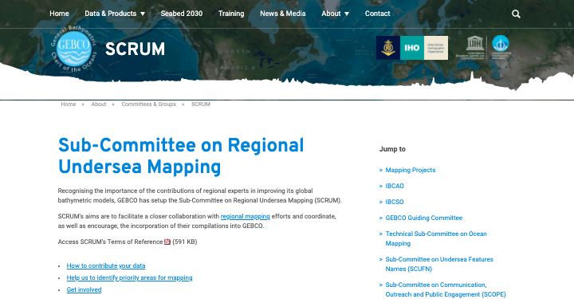
01
What is SCRUM
SCRUM’s aims are to facilitate a close collaboration with regional mapping efforts and coordinate and encourage the incorporation of their compilations into GEBCO
https://www.gebco.net/about_us/committees_and_groups/scrum/
Notes:
To begin, SCRUM exists to facilitate closer collaboration with regional mapping efforts, along with coordinating and encouraging the incorporation of compilations into GEBCO. Our web page can be seen here on the right, and includes instructions on how to contribute data, link to the youtube channel and access to the prioritisation app. Recognising the importance of the contributions of regional experts in improving its global bathymetric models, GEBCO has setup the Sub-Committee on Regional Undersea Mapping (SCRUM)
SCRUM's aims are to facilitate a closer collaboration with regional mapping efforts and coordinate, as well as encourage, the incorporation of their compilations into GEBCO.

Slide 4
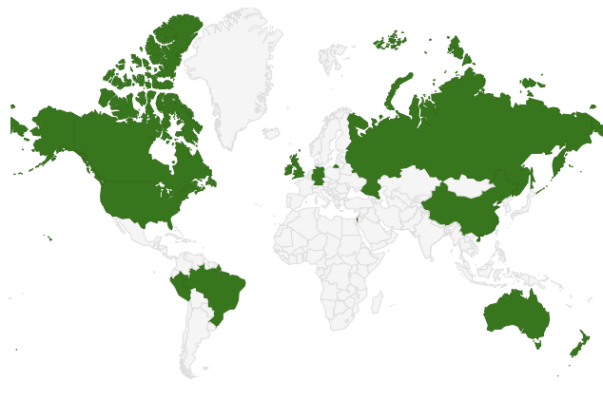
01
Aileen Bohan (Chair) | Ireland | INFOMAR, Geological Survey Ireland
Hugo Montoro (Vice Chair) | Peru | Direccion de Hidrografía y Navegacion de la Marina de Guerra del Peru
Vicki Ferrini | USA | Lamont-Doherty Earth Observatory of Columbia Univ.
Serge Lévesque | Canada | Canadian Hydrographic Service
Miao Fan | China | National Marine Data & Information Service
Boris Dorschel | Germany | Alfred Wegener Institute
Rochelle Wigley | USA | Center for Coastal & Ocean Mapping/ University of New Hampshire
Pauline Weatherall | United Kingdom | British Oceanographic Data Center
Mark Zimmermann | USA | National Oceanic and Atmospheric Administration
John Hall | Israel | Geological Survey of Israel (Retired)
Shereen Sharma | Australia | Seabed 2030
Yulia Zarayskaya | Russia | Geological Institute of the Russian Academy of Sciences
Robin Beaman | Australia | James Cook University
Jan Erik Arndt | Germany | Alfred Wegener Institute
David Armstrong | USA | National Geospatial Agency
Jaya Roperez | New Zealand | National Institute of Water and Atmospheric Research
Ana Carolina Lavagnino | Brazil | Federal University of Espirito Santo
SCRUM Members
Notes:
Our total membership currently stand at 17 people, representing 13 coastal states on 5 different continents. You can see our nice distribution here. We plan to have a meeting in the coming weeks, to discuss our workplan for the coming year and distribute tasks.

Slide 5
Aileen Bohan (Chair) | Ireland | INFOMAR, Geological Survey Ireland
Hugo Montoro (Vice Chair) | Peru | Direccion de Hidrografía y Navegacion de la Marina de Guerra del Peru
Vicki Ferrini | USA | Lamont-Doherty Earth Observatory of Columbia Univ.
Serge Lévesque | Canada | Canadian Hydrographic Service
Miao Fan | China | National Marine Data & Information Service
Boris Dorschel | Germany | Alfred Wegener Institute
Rochelle Wigley | USA | Center for Coastal & Ocean Mapping/ University of New Hampshire
Pauline Weatherall | United Kingdom | British Oceanographic Data Center
Mark Zimmermann | USA | National Oceanic and Atmospheric Administration
John Hall | Israel | Geological Survey of Israel (Retired)
Shereen Sharma | Australia | Seabed 2030
Yulia Zarayskaya | Russia | Geological Institute of the Russian Academy of Sciences
Robin Beaman | Australia | James Cook University
Jan Erik Arndt | Germany | Alfred Wegener Institute
David Armstrong | USA | National Geospatial Agency
Jaya Roperez | New Zealand | National Institute of Water and Atmospheric Research
Ana Carolina Lavagnino | Brazil | Federal University of Espirito Santo
01
Aileen Bohan (Chair) | Ireland | INFOMAR, Geological Survey Ireland
Hugo Montoro (Vice Chair) | Peru | Direccion de Hidrografía y Navegacion de la Marina de Guerra del Peru
Vicki Ferrini | USA | Lamont-Doherty Earth Observatory of Columbia Univ.
Serge Lévesque | Canada | Canadian Hydrographic Service
Miao Fan | China | National Marine Data & Information Service
Boris Dorschel | Germany | Alfred Wegener Institute
Rochelle Wigley | USA | Center for Coastal & Ocean Mapping/ University of New Hampshire
Pauline Weatherall | United Kingdom | British Oceanographic Data Center
Mark Zimmermann | USA | National Oceanic and Atmospheric Administration
John Hall | Israel | Geological Survey of Israel (Retired)
Shereen Sharma | Australia | Seabed 2030
Yulia Zarayskaya | Russia | Geological Institute of the Russian Academy of Sciences
Robin Beaman | Australia | James Cook University
Jan Erik Arndt | Germany | Alfred Wegener Institute
David Armstrong | USA | National Geospatial Agency
Jaya Roperez | New Zealand | National Institute of Water and Atmospheric Research
Ana Carolina Lavagnino | Brazil | Federal University of Espirito Santo
SCRUM Membership
Notes:
To begin, SCRUM exists to facilitate closer collaboration with regional mapping efforts, along with coordinating and encouraging the incorporation of compilations into GEBCO. Our web page can be seen here on the right, and includes instructions on how to contribute data, link to the youtube channel and access to the prioritisation app. Recognising the importance of the contributions of regional experts in improving its global bathymetric models, GEBCO has setup the Sub-Committee on Regional Undersea Mapping (SCRUM)
SCRUM's aims are to facilitate a closer collaboration with regional mapping efforts and coordinate, as well as encourage, the incorporation of their compilations into GEBCO.

Slide 6
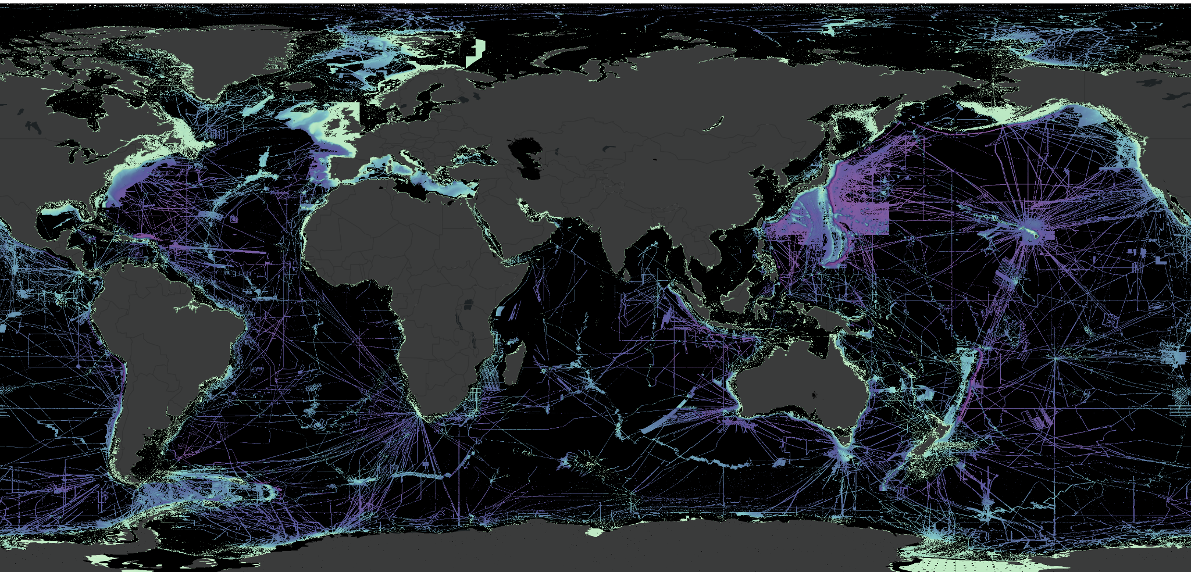
02
SCRUM 2022 Achievements
GEBCO 2022 Grid review
Prioritisation discussions with TSCOM and Seabed 2030
IOC State of Ocean Report
Thanks Pauline
Wind in the Sails workshop
Virtual SCRUM meeting held in Sept
Seabed Mapping Session held at a Marine Safety Information workshop, organised by South-East Pacific Regional Hydrographic Commission
Notes:
To begin, SCRUM exists to facilitate closer collaboration with regional mapping efforts, along with coordinating and encouraging the incorporation of compilations into GEBCO. Our web page can be seen here on the right, and includes instructions on how to contribute data, link to the youtube channel and access to the prioritisation app. Recognising the importance of the contributions of regional experts in improving its global bathymetric models, GEBCO has setup the Sub-Committee on Regional Undersea Mapping (SCRUM)
SCRUM's aims are to facilitate a closer collaboration with regional mapping efforts and coordinate, as well as encourage, the incorporation of their compilations into GEBCO.

Slide 7
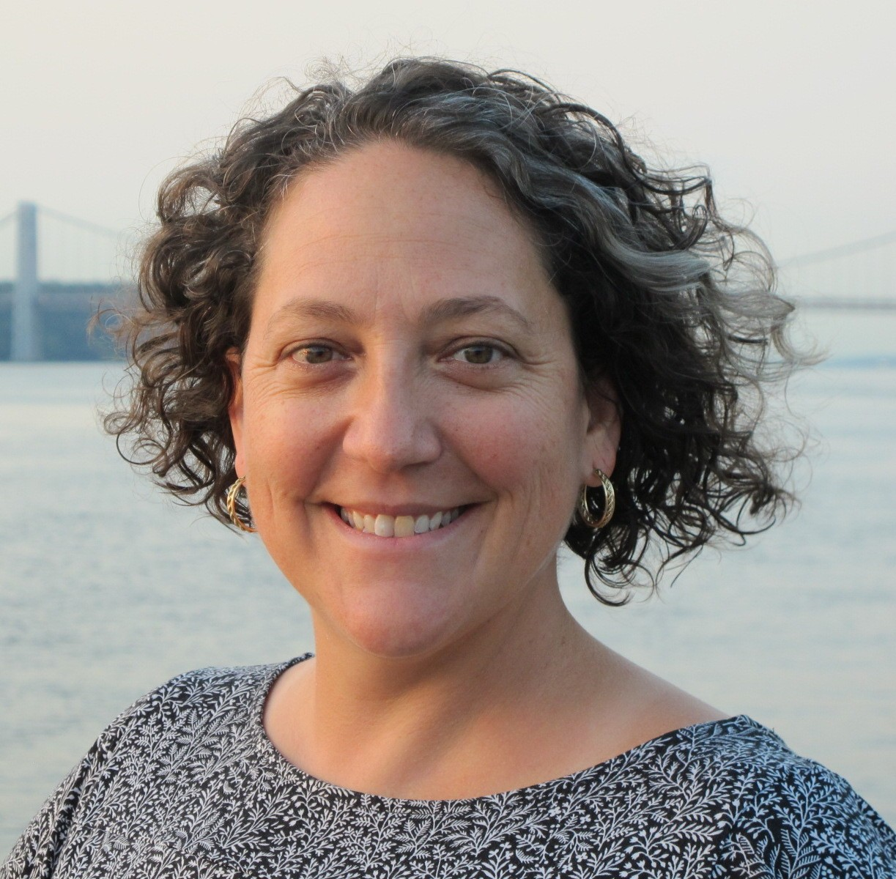
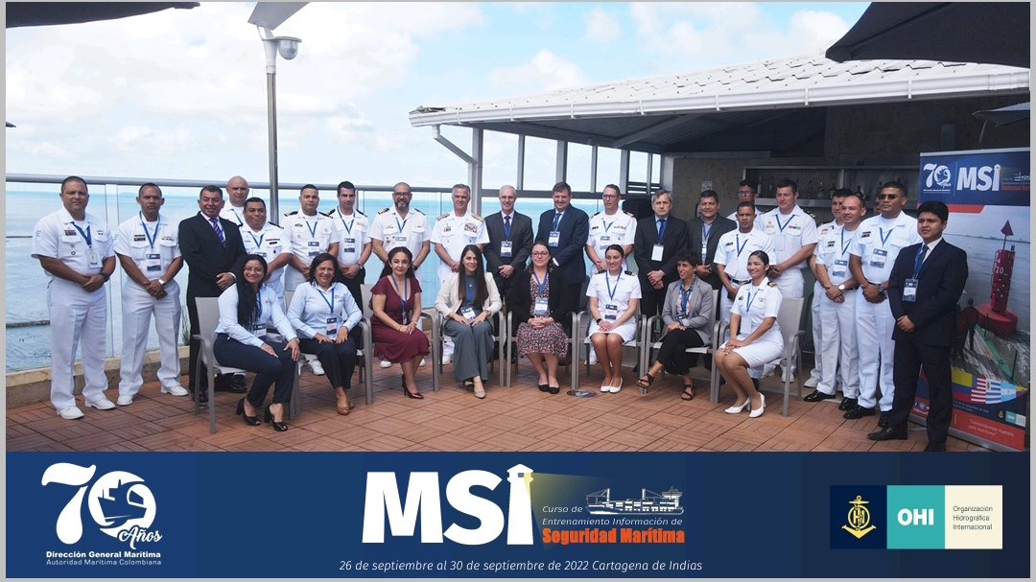
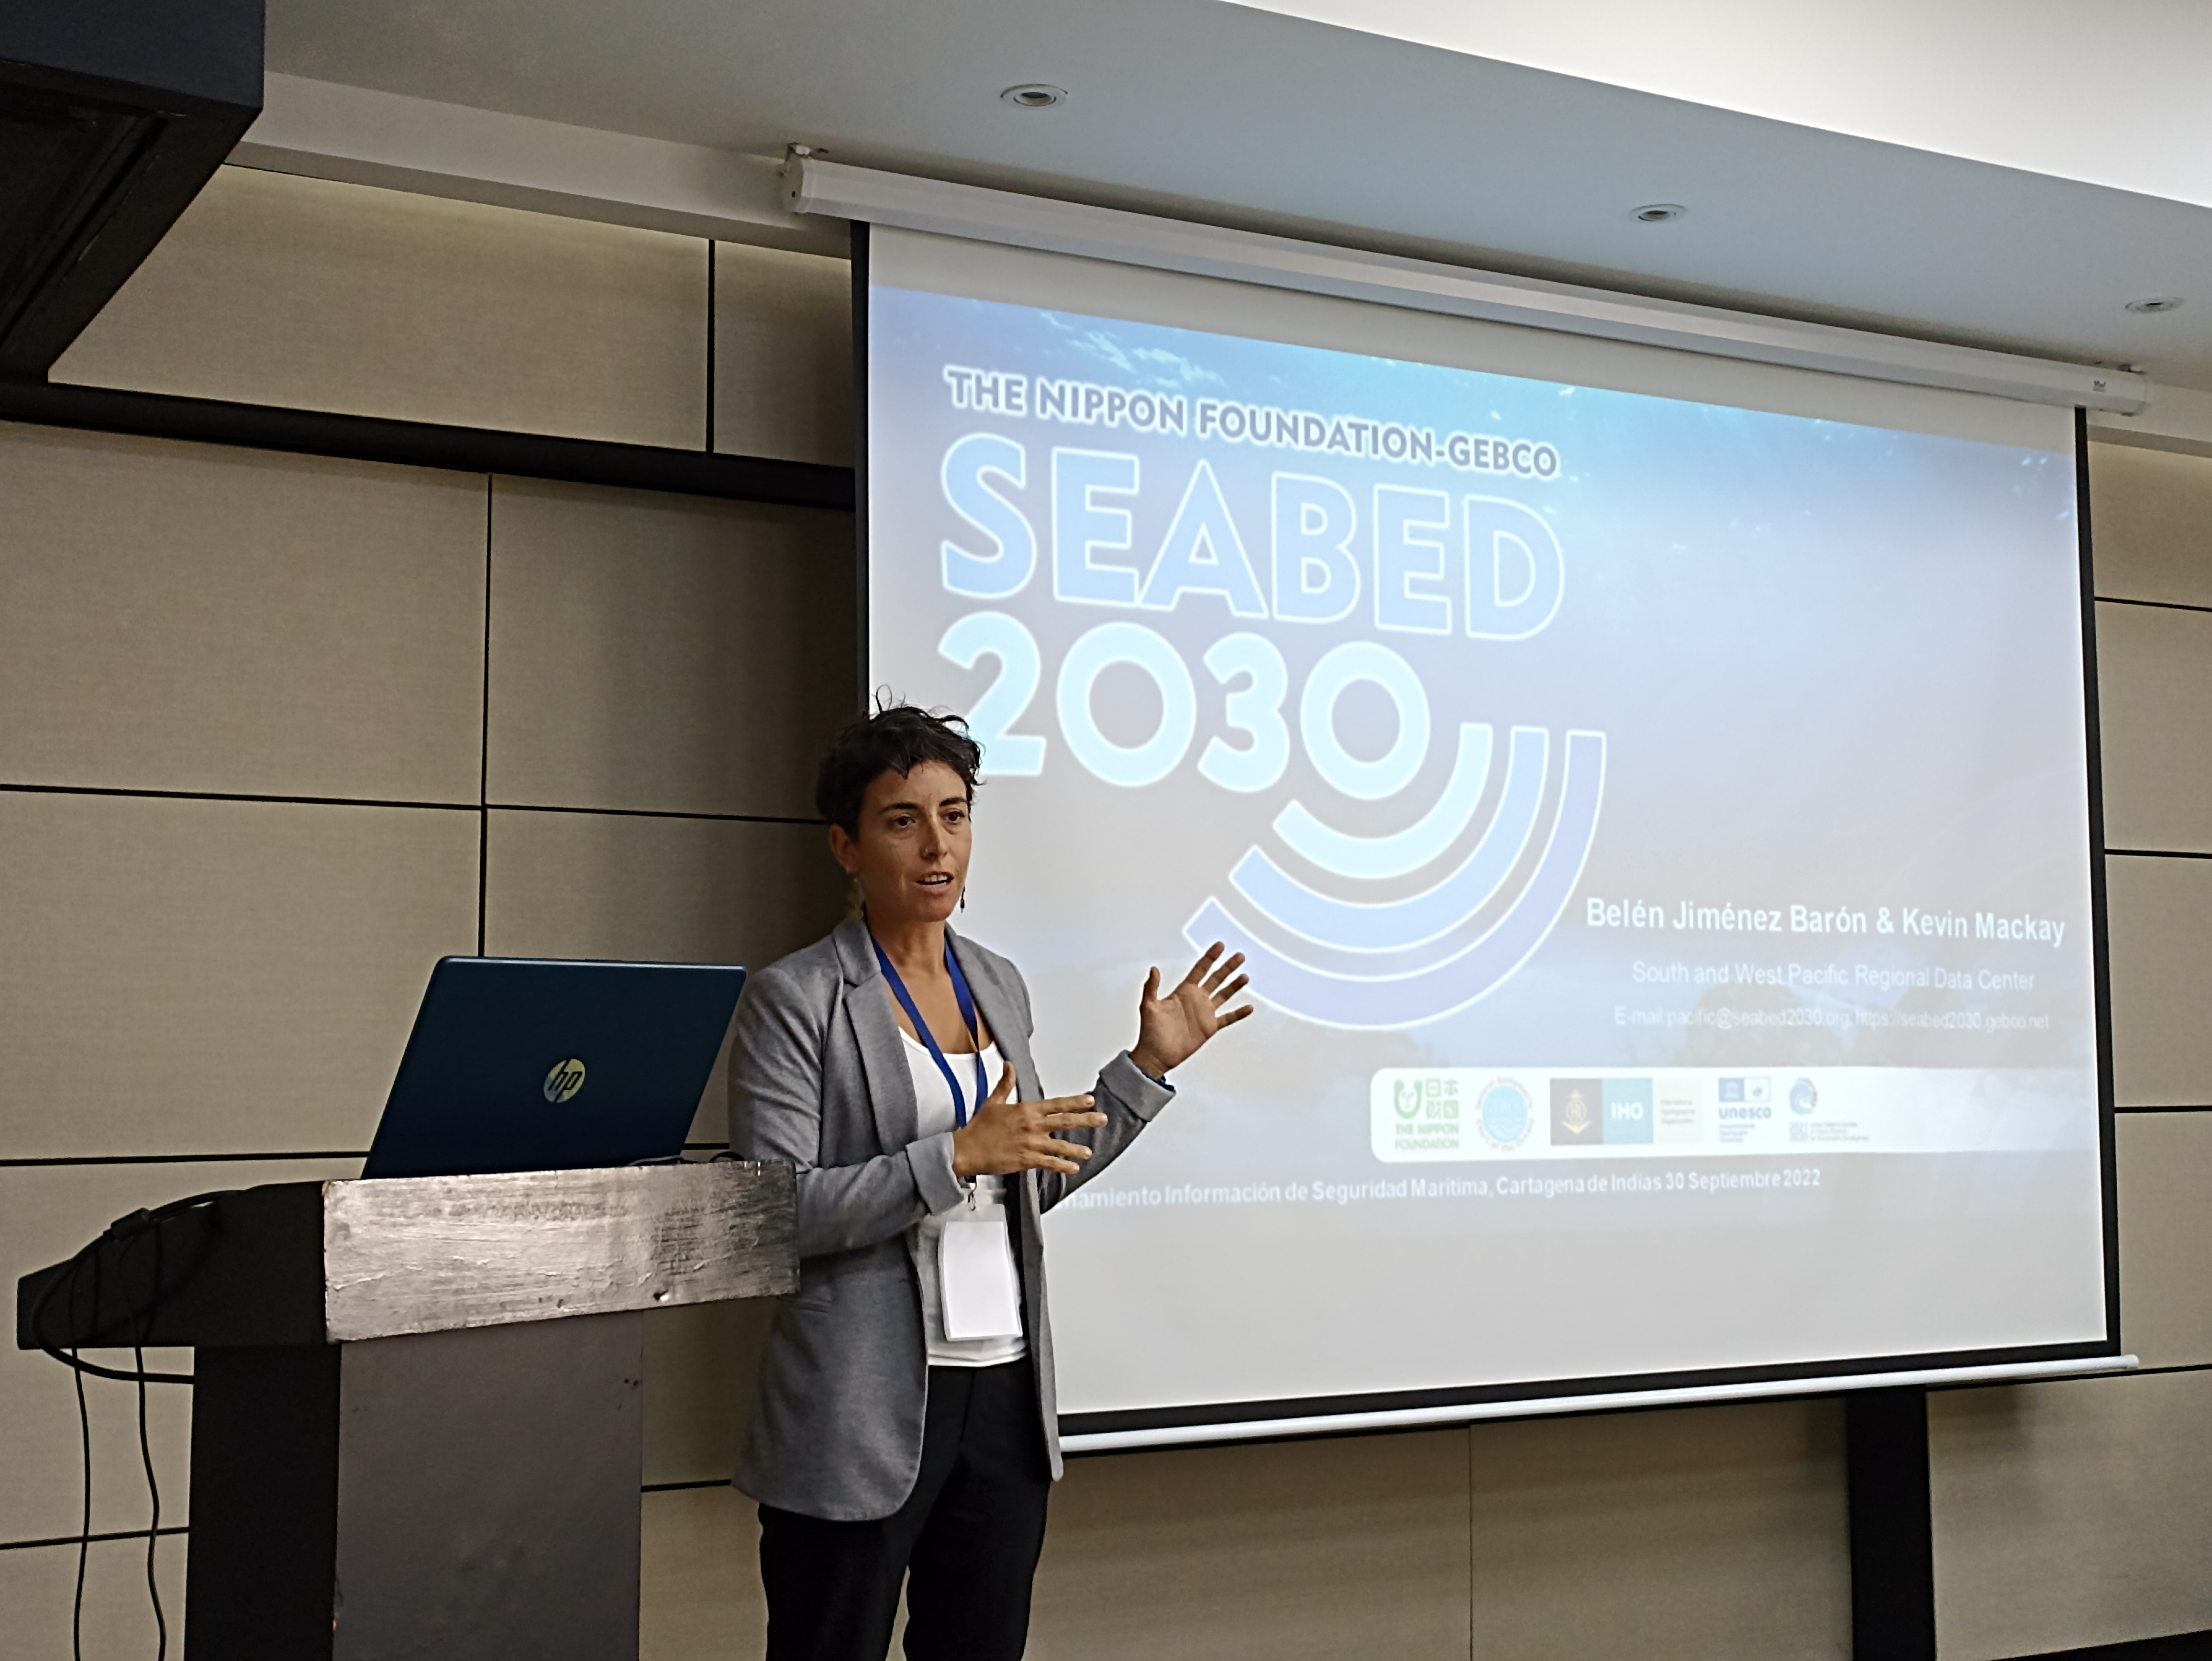
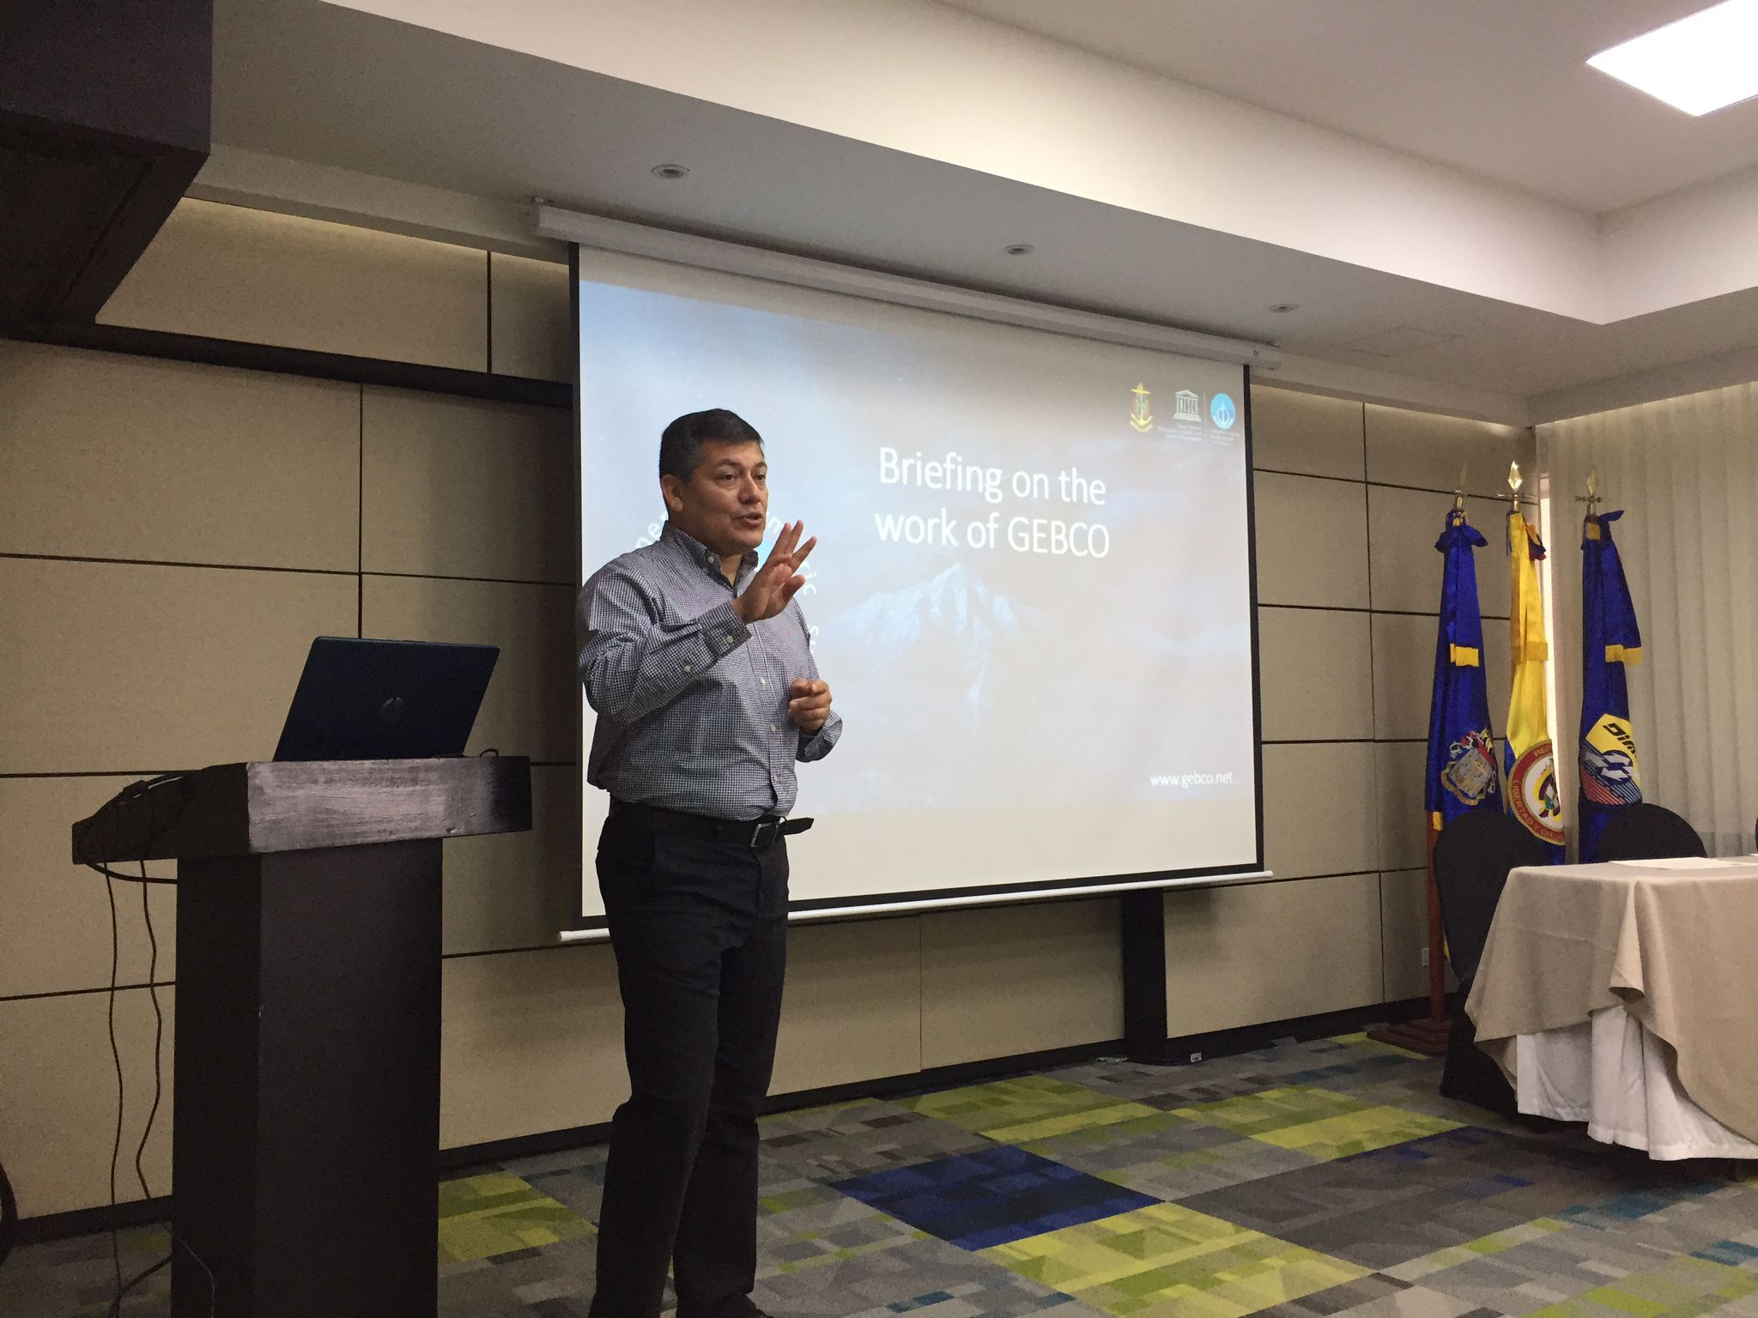
02
GEBCO morning at MSI workshop in Colombia
Vicki Ferrini
Head
Atlantic and Indian Oceans Regional Center
SEABED 2030
September 30th, 2022
Belen Jimenez Baron
Data Manager
South and West Pacific Ocean Regional Center – SEABED 2030
Hugo Montoro
Vice-Chair SCRUM
Notes:
Under the auspices of the IHO Capacity Building Committee, a Marine Safety Information Workshop was held in the last week of September, attended by professional hydrographers from 8 Latin American countries belonging to 3 Regional Organizations: Argentina, Chile, Colombia, Ecuador, Guatemala, Peru, Uruguay and the Dominican Republic. In coordination with the Colombian Hydrographic Service, host of the event, a session called GEBCO Morning, was scheduled. During this day, three talks were given in which the work of GEBCO was described. It was a successful event in a region that seeks a greater degree of involvement in topics related to seabed mapping and crowdsource bathymetry. The Presenters were Vicki Ferrini, Belen Jimenez and Hugo Montoro.

Slide 8
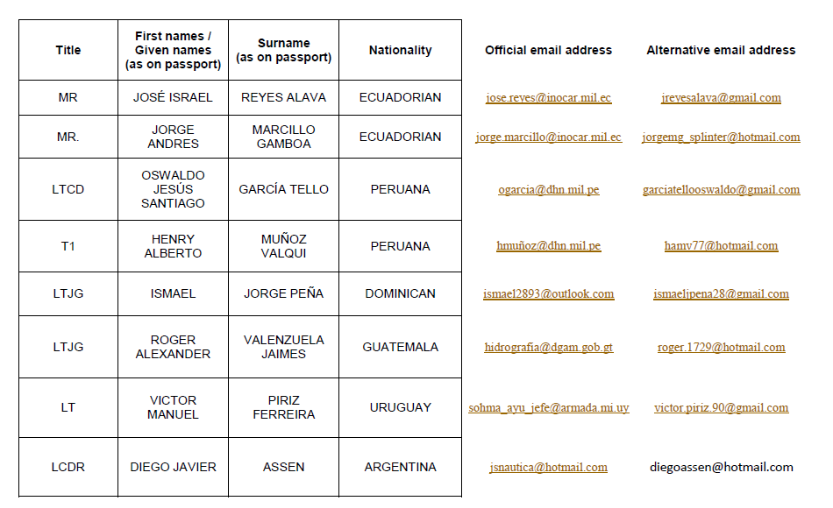
02
Attendees

Slide 9
02
2022 IHO/IOC Meetings Attended
Type | Regional Body | 2021 Location | 2022 Dates | GEBCO/SB2030/CSB Presentation?
RHC | NHC (Nordic) | Stravanger | April 2022 | Evert Flier
RHC | NSHC (North Sea) | Reykjavik | April 2022 | Thomas Dehling & Evert Flier
RHC | MBSHC (Mediterranean and Black Seas) | Ljubljana + Virtual | March 2022 | Yes- “Italy”
RHC | ARHC (Arctic) | St. Johns | Sept 2022 | Evert Flier
RHC | BSHC (Baltic Sea) | Stockholm | Sept 2022 | Martin Jakobsson
RHC | USCHC (US and Canada) | Ottawa | June 2022 | Andy Armstrong
RHC | EAHC | Tokyo | Sept 2022 | Yes?
RHC | EAtHC (Eastern Atlantic) | Cabo Verde | Sept 2022 | João Vicente
RHC | SEPRHC |  | N/A
RHC | SWPHC (South-West Pac) | VIRTUAL | Feb 2022 | Stuart Caie
RHC | MACHC (Meso American & Caribbean Sea) | Saint Louis | Nov 2022 | Cecelia Guzman/ Vicki Ferrini
RHC | SAIHC (Southern African and Islands) | Maputo + Virtual | May 2022 | Christoff Theunissen
RHC | NIOHC (N. Indian Ocean) | Bali | Aug 2022 | Yes-IHO
RHC | RSAHC (ROPME Sea Area) | Muscat | Nov 2022 | In agenda
RHC | SWAtHC (SW Atlantic) | Montevideo | Aug 2022 | Vicki Ferrini via Niki Eugenio Silvera
RHC | HCA (HC on Antarctica) | VIRTUAL | June 2021 | Evert Flier
Notes:
Mediteranean and black sea HC - minutes refer to GEBCO/Serabed2030 presentation by “Italy”
EAHC - CSB, GEBCO and SB2030 al mentioned in report. not sure who gave.
MAHC and Red Sea

Slide 10
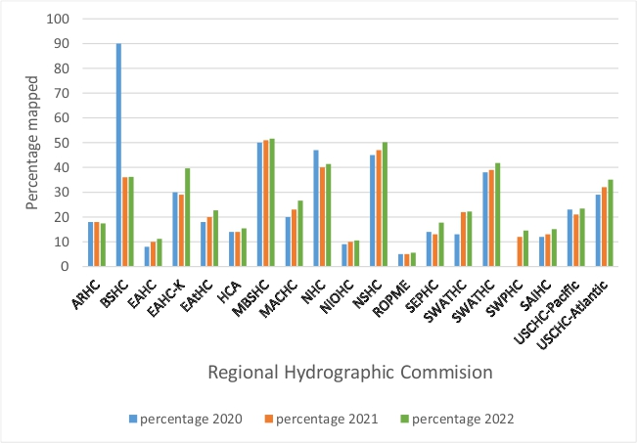
02
RHC% mapped from Seabed 2030 Project
https://www.gebco.net/about_us/committees_and_groups/scrum/mapping_projects/
Notes:
Another workplan item of SCRUMs is ensuring he publishing of % mapped for the RHCs. Due to a refinement in the calculations are carried out for areas mapped, this has resulted in a decrease in % area mapped- most notably in the Baltic Sea. The current solution is that the table has been posted, with an explanatory sentence for now. The ideal situation would be recalulation, but this is beyond the control of SCRUM.
“Please note that there is a ‘reduction’ of the percentage coverage mapped between 2020 and 2021 for some RHC areas. This is largely caused by a refinement of our calculations for areas based on pre-generated grids. For some regions, these sections were classed as ‘mapped’ in the GEBCO_2020 Grid but for the GEBCO_2021 Grid it has been possible to break these areas down and identify cells within a pre-generated grid that are based on measured data and those that are based on interpolation. This has resulted in a reduction in the reported percentage coverage mapped for these areas but more accurately reflects to actual observational coverage.”

Slide 11
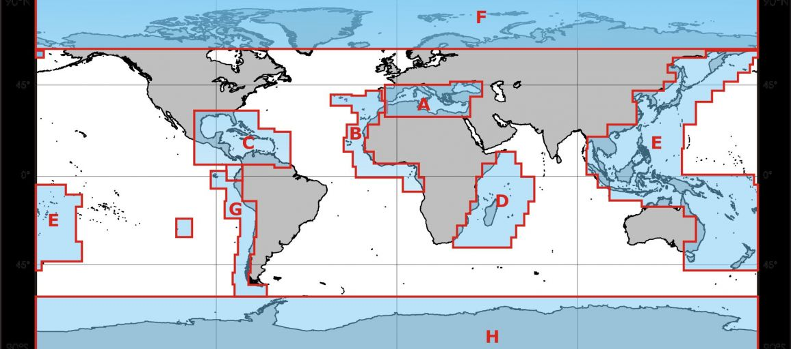
02
IBC Status Review
IBC | Region | Status | Last Active
IBCAO | Arctic Ocean | Active | 2020
IBCSO | Southern Ocean | Active | 2020
IBCCA | Carribean Sea & Gulf of Mexico | Active | 2020
IBCEA | Central Eastern Atlantic | Inactive | 2003
IBCM | Mediterranean | Complete | 1999
IBCSEP | South Eastern Pacific | Re-initiating | 2008
IBCWIO | Western Indian Ocean | Inactive | 1997
Notes:
To begin, SCRUM exists to facilitate closer collaboration with regional mapping efforts, along with coordinating and encouraging the incorporation of compilations into GEBCO. Our web page can be seen here on the right, and includes instructions on how to contribute data, link to the youtube channel and access to the prioritisation app. Recognising the importance of the contributions of regional experts in improving its global bathymetric models, GEBCO has setup the Sub-Committee on Regional Undersea Mapping (SCRUM)
SCRUM's aims are to facilitate a closer collaboration with regional mapping efforts and coordinate, as well as encourage, the incorporation of their compilations into GEBCO.

Slide 12
03
Regional Updates
Kim Picard -Geoscience Australia/ AusSeabed
Serge Lévesque - Canadian Hydrographic Service
Notes:
To begin, SCRUM exists to facilitate closer collaboration with regional mapping efforts, along with coordinating and encouraging the incorporation of compilations into GEBCO. Our web page can be seen here on the right, and includes instructions on how to contribute data, link to the youtube channel and access to the prioritisation app. Recognising the importance of the contributions of regional experts in improving its global bathymetric models, GEBCO has setup the Sub-Committee on Regional Undersea Mapping (SCRUM)
SCRUM's aims are to facilitate a closer collaboration with regional mapping efforts and coordinate, as well as encourage, the incorporation of their compilations into GEBCO.

Slide 13
04
SCRUM Workplan 2023
Task | Work Item | Status
B | Ensure conduct of SCRUM meeting in 2022 | Planned
D | Encourage the contribution of bathymetric data to the IHO DCDB, identify priority areas for regional mapping and promote data contribution through GEBCO participation in IHO/IOC Regional Meetings | Ongoing
E | Maintain IHO bathymetric publications including: B-4, B-9, B-10 and B-11 | Ongoing
H | Ensure IHO-IOC GEBCO Web site is kept current and updated regularly | Ongoing
K | Provide scientific support and advice to Seabed 2030 Project Director, RDACCs and GDACC | Ongoing
Notes:
Encourage the contribution of bathymetric data to the IHO DCDB.Identify priority areas for regional mapping and support the organization of regional mapping projects.Promote data contribution through GEBCO participation in RHCs and IOC regional meetingsPromote data contribution by supporting participation at Regional Mapping Meetings
funding there to assist in attendance.

Slide 14
04
SCRUM Workplan 2023
Task | Work Item | Status
D1 | Encourage the contribution of bathymetric data to the IHO DCDB | Ongoing
D2 | Identify priority areas for regional mapping and support the organization of regional mapping projects. | Ongoing
D3 | Promote data contribution through GEBCO participation in RHCs and IOC regional meetings | Ongoing
D4 | Promote data contribution by supporting participation at Regional Mapping Meetings | Ongoing
Notes:
Develop and make publicly available materials to highlight and foster regional activities and initiatives including up to date GEBCO slide deck virtual engagement materials such as videos of presentations.
Develop and refine messaging for IHO & IOC to facilitate increasing the support of coastal states to provide and release data from within their waters of national jurisdiction.
Gather input from regarding stakeholder needs via regional engagement
Work with Seabed 2030 GDACC to update metrics of completeness for RHCs and put on SCRUM web pages
Work with Seabed 2030 RDACCs and GDACC to ensure that reasons for embargo and/or no public access are captured and articulated to IHO/IOC
Gather input about IBC status and plans

Slide 15
04
SCRUM Workplan 2023
Task | Work Item | Status
D5 | Develop and make publicly available materials to highlight and foster regional activities and initiatives | Planned
D6 | Develop and refine messaging for IHO & IOC to facilitate increasing the support of coastal states to provide and release data from within their waters of national jurisdiction | Ongoing
D7 | Work with Seabed 2030 Project to update metrics of completeness for RHCs and post on SCRUM web page | Completed
D8 | Work with Seabed 2030 RDACCs and GDACC to ensure that reasons for embargo and/or no public access are captured and articulated to IHO/IOC | Planned
D9 | Gather input about IBC status and plans | Ongoing
D10 | Convene SCRUM-focused sessions of a webinar series in conjunction with Seabed 2030 and Map the Gaps | Planned
Notes:
Develop and make publicly available materials to highlight and foster regional activities and initiatives including up to date GEBCO slide deck virtual engagement materials such as videos of presentations.
Develop and refine messaging for IHO & IOC to facilitate increasing the support of coastal states to provide and release data from within their waters of national jurisdiction.
Gather input from regarding stakeholder needs via regional engagement
Work with Seabed 2030 GDACC to update metrics of completeness for RHCs and put on SCRUM web pages
Work with Seabed 2030 RDACCs and GDACC to ensure that reasons for embargo and/or no public access are captured and articulated to IHO/IOC
Gather input about IBC status and plans

Slide 16
04
New Items/Items to be endorsed
Notes:
Seabed2030 coordinator - someone involved in Seabed2030 project. Shereen.

Slide 17
Thank you for joining us!
GEBCO SCRUM
@gebco_scrum
gebco.scrum@gmail.com

