Slide 1
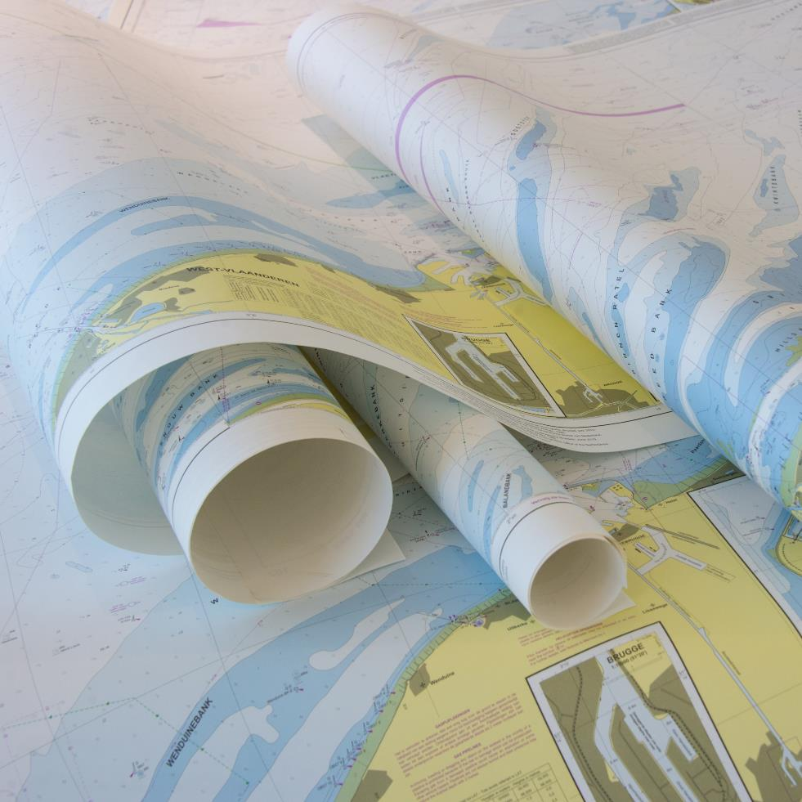
North Sea Hydrographic Commission report to IRCC11
GENOA June 2019
Chair: Steve Timmermans (Belgium) Vice-chair: Hilmar Helgason
Members: Belgium, Denmark, France, Germany, Iceland, Netherlands, Norway, United Kingdom
Last meeting 33rd Conference: 27th and 28th March 2017, Ostend, Belgium

Slide 2
Activities 2017-2019
22nd Tidal WG, Ostend, 25-26 Oct 2017
8th Resurvey WG, Paris, 18-19 Sep 2018
NS ICCWG, correspondence
33rd NSHC Conference, Ostend, 27-28 Mar 2018
34th NSCH Conference, Reykavik, 26-27 Mar 2020
IRR10 recommendations, actions and decisions

Slide 3
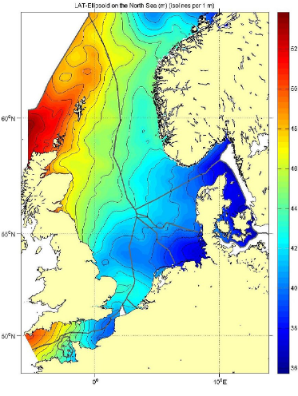
22nd Tidal WG (1/3): Common Reference Surface
WP Item 18/01: Improve North Sea wide realization of reference surfaces
Thanks to R. Kuilman NLHO

Slide 4
22nd Tidal WG (2/3) : Common Reference Surface
 | BE | DK | FR | GE | NL | NO | UK | SW | IC
BE
DK | 1
FR | 2 | 1
GE | 1 | 4 | 1
NL | 4 | 1 | 1 | 4
NO | 1 | 2* | 1 | 1 | 1
UK | 3 | 3 | 4 | 3 | 3 | 2*
SW | 1 | 2* | 1 | 1 | 1 | 2* | 1
IC | 1 | 1 | 1 | 1 | 1 | 1 | 1 | 1
Legend:
1: no common LAT boundary
2: differences on a common boundary but not checked
2*: differences on a common boundary, not checked, different CD
3: differences on a common boundary checked to be not significant
4: differences on a common boundary checked to be outside ‘1% norm’

Slide 5
22nd TWG (3/3): Common Reference Surface - Results
Next steps for WP Item 18/01: NO PROGRESS
Revisit the usefulness of the 1% norm
Now arbitrarily chosen: LAT difference/ depth
Make a proposal for something more practical
Continue studying differences with the aim to improve the LAT surfaces
Examine the origin of the observed differences
Make error estimates on each reference surface
Compare whole reference surfaces iso. only borders

Slide 6
8th Resurvey WG (1/2)
Updated TOR
Merge with Dover straits area resurvey WG
Include alternative survey means
Exchange of updated resurvey plans
Main focus is on critical areas for resurvey and other areas of mutual interest
Agreed on common categories of resurvey intervals :0-1 years/as required, 1-6 years, 6-12 years, 12-25 years, >25 years
Port areas excluded from the area of interest of RWG

Slide 7
8th Resurvey WG (2/2)
Evaluation of Risk assessment will start on the Dover Strait Area
‘And then?’
Big progress in use of SDB and new generations of Bathy Lidar Equipment by NSHC members
Significant experience with these techniques is gathered outside of NSHC area
Evaluation of IHO guidance document on Crowd Sourced Bathymetry
Challenge: quality CSB data vs existing survey data

Slide 8
North Sea Int. Chart Coordination WG
ENC coverage is complete, except for Greenland
ENC are being rescheduled to grid based by NL, GE and DE
All overlaps and gaps are low risk and pose no demonstrable risk to navigation
Issue overlaps between 5-30 mtr in USB1-3
UB1=3; UB2=9; UB=9 ( Dec 2018)
Raised during WEND 8; extend the buffer overlap?

Slide 9
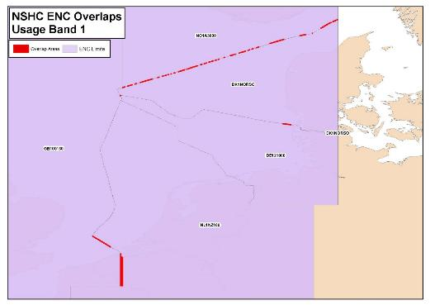
Existence of overlapping ENCs that may have a possible impact on safe navigation
Overview
NSHC ENC OVERLAPS
Usage Band 1
3 ENC overlaps

Slide 10
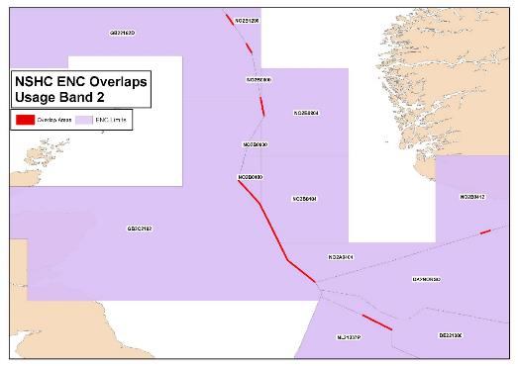
Existence of overlapping ENCs that may have a possible impact on safe navigation
General
NSHC ENC OVERLAPS
Usage Band 2
9 ENC overlaps

Slide 11
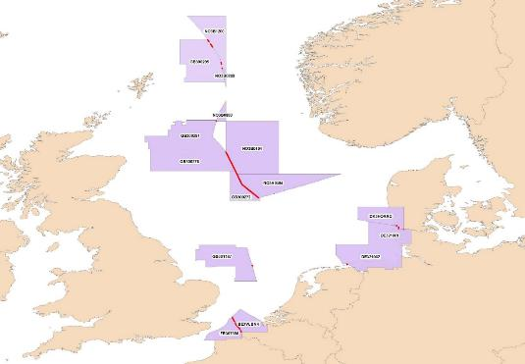
Existence of overlapping ENCs that may have a possible impact on safe navigation
Coastal
NSHC ENC OVERLAPS
Usage Band 3
9 ENC overlaps

Slide 12
33nd NSHC: Open AP and decisions (1/2)
1/2018: Crowd sourced data: RWG investigates how CSB can support work of NSHC;
2/2018: DE organises workshop on sharing knowledge and experiences of Contouring algorithms; CLOSED
6/2016: Vertical reference (LAT) comparison: in accordance with AP 18/1 of TWG;
Including validity of 1% norm

Slide 13
33nd NSHC: Open AP and decisions (2/2)
3/2010: overview and harmonization of resurvey schemes, availability on NSHC.pro for whole NSHC region
6/2014: North Sea wide Risk Assessment, including Dover straits
There will be no North Sea wide Risk assessment, but the RWG will reconsider this for the DSSS area due to its specific characteristics. (see AP10 of 7th RWG)
8/2014: MS nominate contact person for MSDI WG
list is not complete

Slide 14
IRRC10 Recommendations (1/4)
Recommendation 1-7, 13-14, 21
No collective deliverable, responsibility individual MS
Recommendation 8 on CATZOC for C-55
Responsibility individual nation, but action for NSHC 34
Recommendation 9 on overlap and one year clock
No overlap with demonstrable risk to navigation

Slide 15
IRRC10 Recommendations (2/4)
Recommendation 10 and 11 on management of overlap
Discussed during WEND 8, issue for NS ICCWG and NSHC 34
Recommendation 12 on ENC schemes
Done through chair NS ICCWG
Recommendation 15-17 on data gathering for CSB
Action for NSHC RWG and discussion during 34th NSHC

Slide 16
IRRC10 Recommendations (3/4)
Recommendation 18-19 on shallow water bathy to GEBCO and GEBCO
Integral to NSHC conference and EMODNET (HRSM)
Recommendation 20 on populating CATZOC and DQWG
Nil inputs received, but OBE as DQWG developed own proposal
Recommendation 22 on TWCWG and CB
NSHC has no CB-programs

Slide 17
IRRC10 Recommendations (4/4)
Recommendation 22 on tide gauges and current meters
Action for NSHC TWG

Slide 18
IRRC10 Actions
Action1, 2, 6-19
No action required by NSHC
Actions 3-5 on resolution 2/1997
Action 3: completed
Action 4-5: awaiting revised draft

Slide 19
IRRC10 Decisions
No addition NSHC actions resulting from IRCC10 decisions

Slide 20
Action required?
The IRCC is invited to note the report of the NSHC.
Thank you for your attention

