Slide 1
IRCC-9
Meso-American and Caribbean Sea Hydrographic Commission Report to IRCC

Slide 2
Organization
Chair: RADM Fernando Alfonso Angli Rodriguez (MX)
Vice Chair: Kathryn Ries (US)
Members: Brazil, Colombia, Cuba, France, Guatemala, Jamaica, Mexico, Netherlands, Suriname, Trinidad and Tobago, United Kingdom, United States of America, Venezuela.
Associate Members: Antigua and Barbuda, Barbados, Belize, Costa Rica, Dominican Republic, El Salvador, Guyana, Haiti, Honduras, Nicaragua, Panama, Saint Lucia, Saint Kitts and Nevis, Saint Vincent and the Grenadines.
Industry Participation – EOMAP, Fugro Pelagos, IIC Technologies, Ocean Wise Ltd., Teledyne CARIS, and ESRI
Organizational Participation – IALA, IC-ENC, IMO, INEGI, THSOA, University of the West Indies and York University
Notes:
13 members
14 associate members

Slide 3
Capacity Building Committee
Chair: Jeff Bryant (UK)
Vice Chair: Nickolas Roscher (BR)

Slide 4
Activities Completed in 2016
Training Courses
MSI Course delivered in St Lucia August 2016
MSDI Workshop for Spanish Speakers delivered in Mexico October 2016 (in conjunction with FOCHIAMECA)
Tide Training Course with SWAtHC delivered in Brazil October 2016
Seminars
Hydrographic Awareness Seminar / Satellite Bathymetry Workshop – December 2016

Slide 5
Technical Visit Planned 2017
Haiti
  Paulo Matos (BR)
  Eric Langlois (FR)
  Jim Rogers (US)

Slide 6
Marine Economic Infrastructure Program
Chair: Jim Rogers (US)

Slide 7
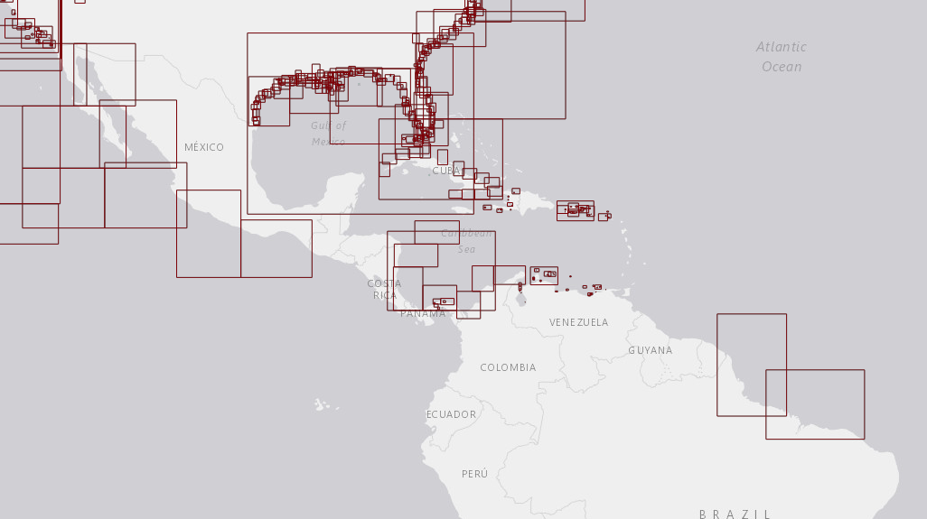
MACHC ENC Online - http://www.iho-machc.org/

Slide 8
MACHC Integrated Charting Committee
Chair: John Nyberg (US)
Vice Chair: Paulo Matos (BR)

Slide 9
MACHC ENC Availability Summary – 2016

Slide 10
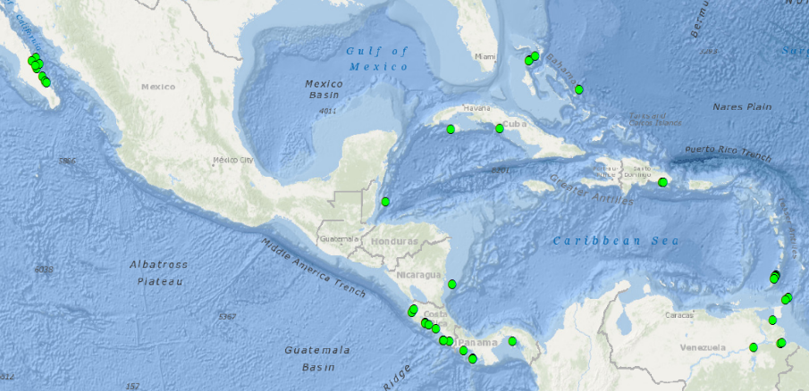
Port Analysis Evaluation - Gaps
46 out of the 373 world-wide Cruise Ship Ports/Anchorages not covered by Band 4, 5, or 6 ENCs are located in the MACHC
Notes:
Two more Cruise Ship Ports/Anchorages identified in Summer 2015 have already been covered by new large scale ENCs since the last analysis:
* Portulano El Gran Roque, VZ500309
* Bahia de Santiago de Cuba, CU511905
Mexico and Cuba have reported plans to
fill many identified gaps

Slide 11
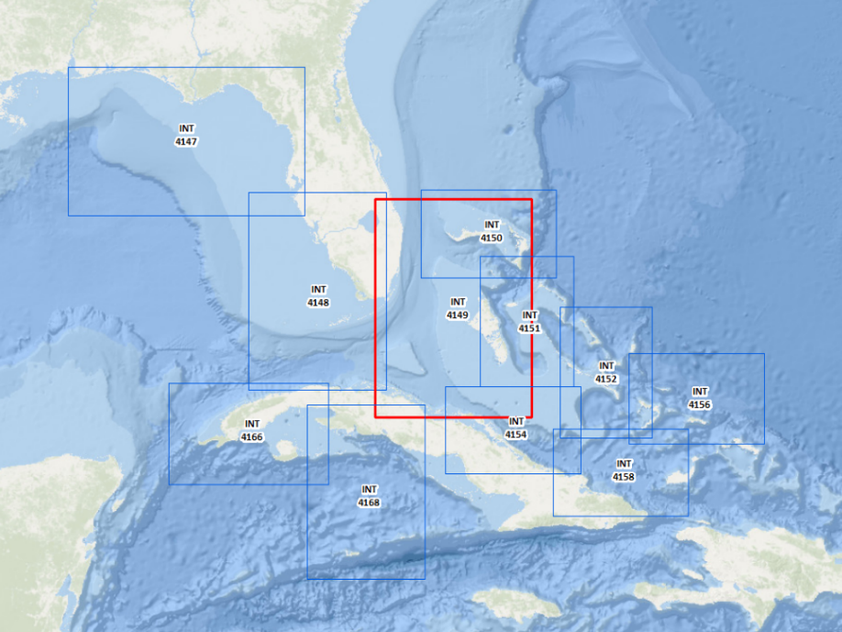
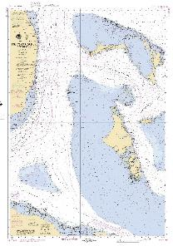
New US/Cuba/UK INT Chart 4149

Slide 12
Difficulties encountered and challenges yet to be addressed
Further developments on the use of Spanish are needed – more CB courses in Spanish
The high cost of carrying out surveys and the limits on national budgets
Full ENC coverage has not yet been achieved

Slide 13
Actions Required of IRCC 9
Please note this report

Slide 14
Thank You

