Slide 1
Report of the Marine Spatial Data Infrastructure Working Group (MSDIWG)
To IRCC9
June 2017
By Jens Peter Hartmann (MSDIWG Chair)

Slide 2
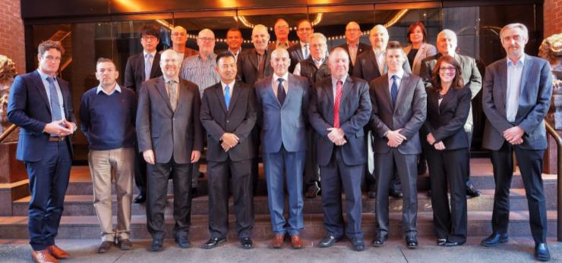
Meetings Held During Reporting Period The MSDIWG8 meeting of IHO Marine Spatial Data Infrastructures Working Group (MSDIWG) took place in Vancouver, Canada from 31 January to 2 February 2017. The MSDIWG meeting was preceded firstly on 30 January by an OGC Marine Domain WG meeting. Next Planned Meeting: The IHO/MSDIWG will hold a day-long Open Forum and the ninth MSDIWG meeting on 29 January - 1 February 2018, hosted by the Brazilian Hydrographic Service. The OGC MDWG meeting is planned on Friday February 2.

Slide 3
What is MSDI?
Policy & Governance
(People)
Technical Standards
(Standards)
Information Systems
(ICT)
Geographic Content
(Data)
Stakeholders
Benefits
Funding
Access to data
S-100
OGC
WMS
WFS
✔
?
Data, not products “New” data
GIS
Internet
✔
?
The importance of authoritative data.

Slide 4
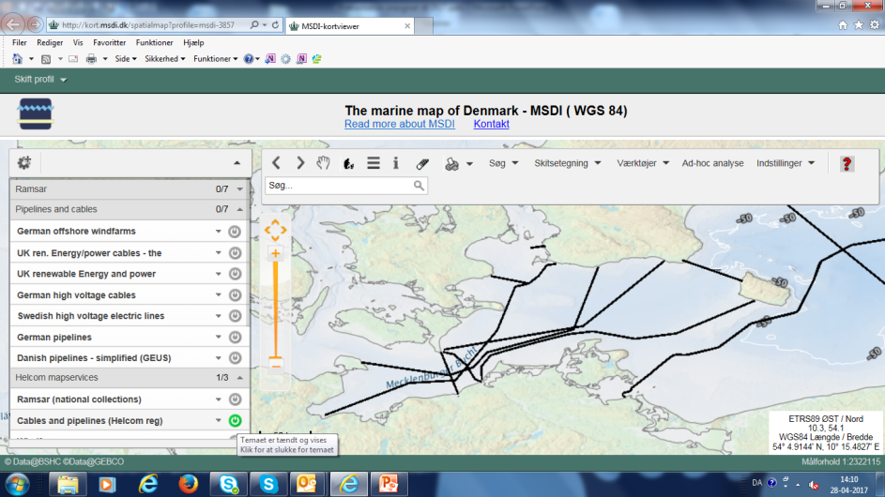
Use Case - Marine Cables
Marine Cables from the HELCOM secretariat

Slide 5
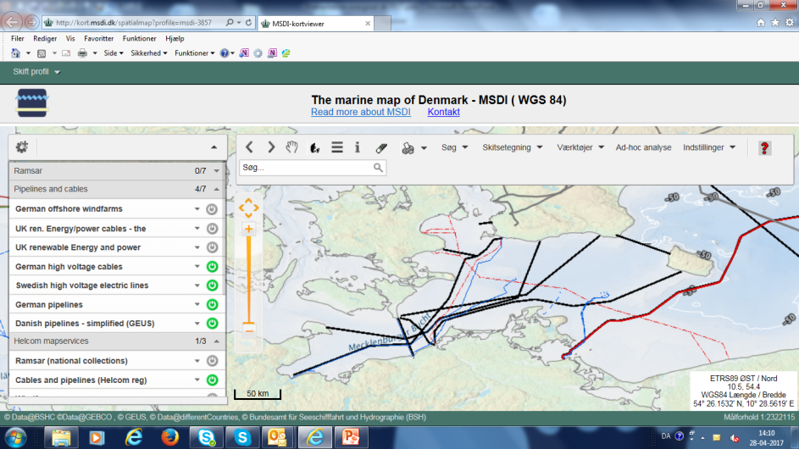
Use Case - Marine Cables
The importance of authoritative data.
Marine Cables from the HELCOM secretariat and national authorities

Slide 6
Work Programme A new 2017-2020 Work Programme was redeveloped at MSDIWG8 based on resent changes and change in focus on MSDI from a regional and national perspective. In order to deliver this Work Programme there are established 8 MSDI Tasks: A. Communication and dissemination B. Operational - Data sharing and management C. Policies and governances – RHC. (Ensure that MSDI is a standing agenda item for RHCs’ meetings (IHO Res 2/1997, as amended, refers)) D. Standards (OGC and HSSC) E. Innovation – Future perspectives (2021 - 2023) F. Training and education G. Maintain and extend the publication IHO MSDI C-17 (IHO Task 3.9.2.1 refers) H. Conduct annual meetings of MSDIWG, arranged back to back with 1- day MSDI Open Forum (IHO Task 3.9.1 refers)
See Annex B for full details of the work programme.

Slide 7
Progress on IRCC8 and HSSC8 Action Items
IRCC8/15 Finalize the ongoing revision of the IHO Publication C-17 and submit to IHB to seek comments from MSs (7e).
This action item was completed by October 2016 (CL 59/2016). Comments were received and reviewed during MSDIWG8 and revised draft New Edition 2.0.0 of C-17 is being submitted to IRCC9 (doc. IRCC9-07E2 refers).
IRCC8/18 Finalize the white paper to be presented at the next Conference/Assembly and to submit to IRCC for intersessional endorsement (7e).
The white paper was produced by the MSDIWG and submitted to the IRCC Chair as part of the MSDIWG report to the Assembly (see paragraph 6c).
IRCC8/20 Follow up the developments at the OGC Maritime Domain Working Group and report back to IRCC (7e) MSDIWG IRCC9.
The MSDIWG chair will make a presentation about the OGC Marine Domain WG at IRCC9

Slide 8
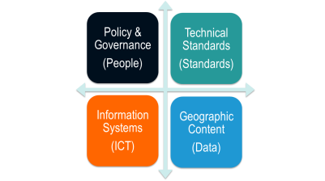
HSSC8/31 MSDIWG invited to consider the concept of Ecological Marine Units promoted by ESRI. HSSC report to IRCC-9. At the MSDIWG8 meeting the concept of Ecological Marine Units was presented by ESRI and the MSDIWG discussed the concept. The MSDIWG will follow the development of concept for Ecological Marine Units.
HSSC8/64 HSSC and MSDIWG invited to pass wider geospatial research topics to the OGC Marine Domain WG (MDWG) for inclusion in its work programme. The OGC MDWG meeting was arranged as a back to back meeting with the MSDIWG8 meeting and relevant geospatial research topics were passed to the OGC MDWG.
HSSC8/65 HSSC to invite MSDIWG to liaise with OGC MDWG. HSSC report to IRCC-9. The MSDIWG has established close cooperation with the OGC MDWG, several MS are now members of both WG’s

Slide 9
Problem Statement for Marine Domain WG
Geospatial data has been successfully standardized for navigational purposes by hydrographic agencies for years.
Data now in demand for a much wider range of applications.
Chart data is a major source of information but does not lend itself automatically for wider use.
Bathymetric grids, points clouds, seafloor sediment mosaics and water column data may require further standardization.
Data volumes and sources increasing driving standardized sensor processing and management techniques.

Slide 10
Purpose of the Marine DWG
There is a gap in the current OGC baseline regarding marine geospatial data with an emphasis on hydrography and ocean mapping.
To support smart exchange methods required for interoperability with organizations such as the International Hydrographic Organization (IHO) and International Oil and Gas Producers (IOGP) and their data standards.
Although this group will not be the platform for creating new standards, it will be the platform to discuss and understand any issues, concerns, or barriers to interoperability to ensure that marine data can be used effectively by the wider community.
Motivated by the widening use of marine data for purposes other than safe navigation, described frequently as Marine Spatial Data Infrastructure (MSDI).

Slide 11
Functions of the OGC DWG
Provide a forum to discuss and recommend document actions related to Interoperability
Develop Change Requests for existing OGC Standards;
Develop engineering reports for release as OGC White Papers, Discussion Papers or Best Practices Papers;
Provide informational presentations and discussions about the market use of adopted OGC Standards;
Have a formal approved charter that defines the DWG’s Scope of Work;
have all-member voting policies

Slide 12
The OGC DWG
The DWG will also ensure that the evolving IHO standards (e.g. S-100) are brought to the attention of the OGC members and the evolving OGC standards are brought to the attention of IHO members in an effort to ensure best practices are being used and the latest technical approaches considered.
The DWG will work closely with the IHO MSDI Working Group and potentially its adjacent groups/commissions/committees under the IHO Inter-regional Coordination Committee and the IHO Hydrographic Services and Standards Committee and other related organizations.
Membership will be open to those with an interest in the marine geospatial data community. Active membership is defined by regular member contributions of material or participation in Marine DWG meetings and discussions

Slide 13
Marine DWG Members
There are currently 56 members
With only a handful from Hydrographic Offices
Group chairs include:
Sebastian Carisio – NGA
Jonathan Pritchard – UKHO
Andy Hoggarth – Teledyne CARIS
It’s important the Hydrography has a voice and an opportunity to compare ideas with peers in the wider geospatial community
Encourage regional member state participation at OGC TC meetings either in person or remotely via web conference

Slide 14
Concept Development Initiative – Defining the Future of Marine Spatial Data Infrastructure.
At the MSDIWG meeting in Vancouver 2017, the MS discussed the possibility to create an IHO/OGC study that could establish the framework for future development of MSDI.
After the MSDIWG meeting OGC has developed a proposal for a concept development study for MSDI, with the ultimate intent after completion to propose to IHO a full pilot timed for 2018 to be funded by the IHO. See attached structured proposal for a concept development study for MSDI at Annex D.
The proposal presents an approach for evaluating the current state and defining the potential future of Marine Spatial Data Infrastructures (MSDIs). The initiative will emphasize on the rapid evolution of technologies and methodologies for generating non-navigational location-based information of value to a broad range of users.

Slide 15
The goal of the MSDIWG proposal:
The goal of this proposal is to evaluate the current state and define the potential future of Marine Spatial Data Infrastructures (MSDIs).
It has the following objectives: - Document the current state of MSDIs - Document the needs for a MSDI based on current emerging technologies - Document strategies to interoperate with other Spatial Data Infrastructures - Develop a common interoperability reference architecture - Engage with experts from across the user community as well as from the community of technology / information and services providers, including hydrographic offices, industry, government, research, and other SDOs.

Slide 16
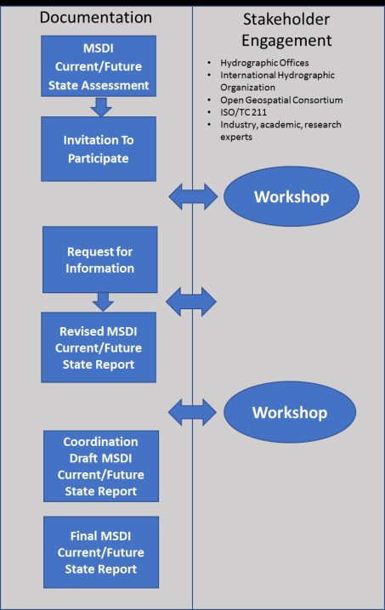
MSDI Tasks / Deliverables
The Concept Development Study (CDS) will engage the marine community in assessing current MSDI capabilities and architecture.
The CDS will also identify potential MSDI
future states based on a range of factors including the rapid evolution of technologies and the broadening base of potential contributors of useful hydrographic information.
The CDS will engage the hydrographic community, Standards Development Organizations (SDO) membership and other experts from industry, government, academia and research in the cooperative definition of a current and future state of MSDI.

Slide 17
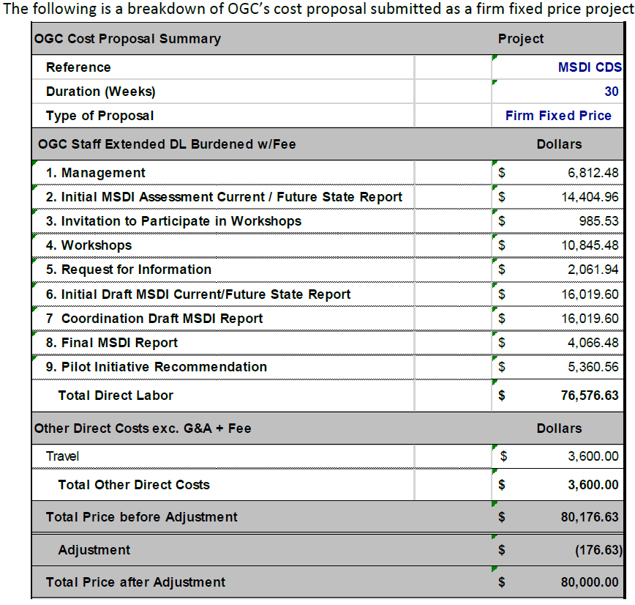
Costs.
The facilities for the workshops should be arranged and provided by IHO/HO. OGC will provide net meeting services as required to support remote participation by participants unable to travel. If desired, OGC can assist in identifying potential meeting locations by working with its member representatives, who may have facilities and interest in hosting workshop events.
Persons invited to attend workshops in person are expected to cover their own travel costs.

Slide 18
Action required of IRCC
The IRCC9 is invited to:
a. note the report
b. acknowledge the work done on the draft Edition 2.0.0 of the IHO Publication C-17
c. endorse the Edition 2.0.0 of the IHO Publication C-17
d. note the new MSDIWG White Paper produced by the MSDIWG and discuss the way forward.
e. note the creation of the OGC Maritime Domain WG.
f. discuss the structured proposal for a concept development study for
MSDI and the possibilities for IHO to fund the study and to take actions as deemed appropriate.
g. (Endorse the need to include MSDI agenda items in National reports to RHCs and to nominate RHC MSDI ambassadors to provide such reports.)

