Slide 1
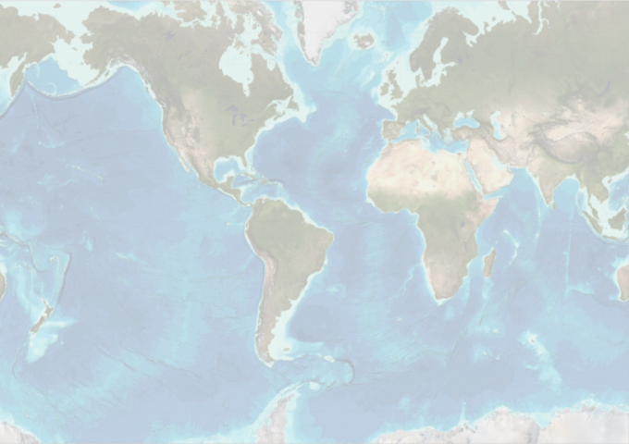
GEBCO
GENERAL BATHYMETRIC CHART OF THE OCEANS
Annual report to IRCC-9
Shin Tani (RADM. ret.)
Chairman
Joint IHO-IOC Guiding Committee for GEBCO
Paramaribo, Suriname
13 June 2017

Slide 2
Promoting structure for GEBCO
1903-
IHO
UNESCO IOC
Joint IHO-IOC Guiding Committee for GEBCO (GGC)
Sub-Committee for Undersea Feature Names (SCUFN)
Technical Sub-Committee on Ocean Mapping (TSCOM)
Sub-Committee on Regional Undersea Mapping (SCRUM)
IHO Data Centre for Digital Bathymetry (IHO DCDB)
Notes:
GEBCO operates under the auspices of the International Hydrographic Organization (IHO) and the Intergovernmental Oceanographic Commission (IOC) of UNESCO.

Slide 3
Members of GGC
IHO Appointed Members: Term Period:
VADM (ret.) Shin Tani (Japan) (Chair) (2013-2018)
RADM Patricio Carrasco (Chile) (2013-2018)
Prof. Hyo Hyun Sung* (Republic of Korea) (2014-2019)
Capt. Norhizam Hassan (Malaysia) (2015-2020)
Dr. Graham Allen (United Kingdom) (2015-2020)
IOC Appointed Members:
Dr. Martin Jakobsson (Sweden)* (Vice-chair) (2013-2018)
Dr. Robin Falconer* (New Zealand) (2013-2018)
Dr. Marzia Rovere (Italy) (2014-2019)
Dr. Johnathan Kool (Australia) (2016-2021)
Capt. Leonid Shalnov (Russian Federation) (2016-2021)
Ex-officio Members:
Dr. Hans-Werner Schenke (Germany) (Chair of SCUFN)
Dr. Karen Marks (USA) (Chair of TSCOM)
Dr. Vicki Ferrini (USA) (Chair of SCRUM)
Ms. Jennifer Jencks (USA) (Director of IHO-DCDB)
Notes:
GEBCO operates under the auspices of the International Hydrographic Organization (IHO) and the Intergovernmental Oceanographic Commission (IOC) of UNESCO.

Slide 4
Gatherings
GEBCO Meetings
19-23 September 2016 29th SCUFN, NCEI, Boulder, Colorado, USA
10-14 October 2016 GEBCO Meetings, SHOA, Valparaíso, Chile
10-11 32nd TSCOM and SCRUM
12 11th GEBCO Science Day
13-14 33rd GGC
Forum for Future Ocean Floor Mapping (F-FOFM)
15-17 June 2016 Novotel Hotel, Monaco
12-13 Polar Mapping Workshop at IHB
14 GEBCO Scholar’s meeting at IHB
Notes:
GEBCO operates under the auspices of the International Hydrographic Organization (IHO) and the Intergovernmental Oceanographic Commission (IOC) of UNESCO.

Slide 6
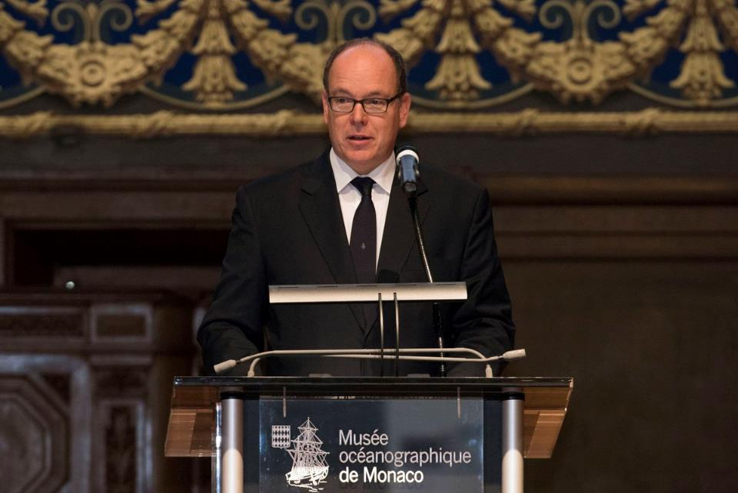

Slide 8
Outcome
ToR of GGC says:
Aims to provide the most authoritative, publicly-available bathymetric datasets for the world’s oceans
GEBCO 2014 (30 arc-second bathymetric grid)
GEBCO World Map 2014
Maintains and makes available a gazetteer of undersea feature names
GEBCO Gazetteer of Undersea Feature Names
Notes:
GEBCO operates under the auspices of the International Hydrographic Organization (IHO) and the Intergovernmental Oceanographic Commission (IOC) of UNESCO.

Slide 9
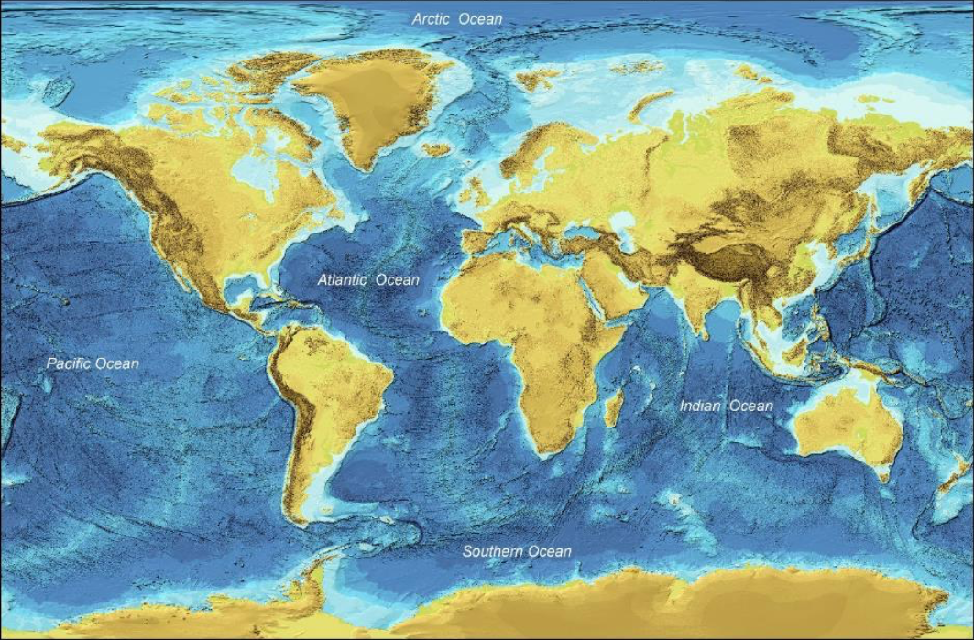
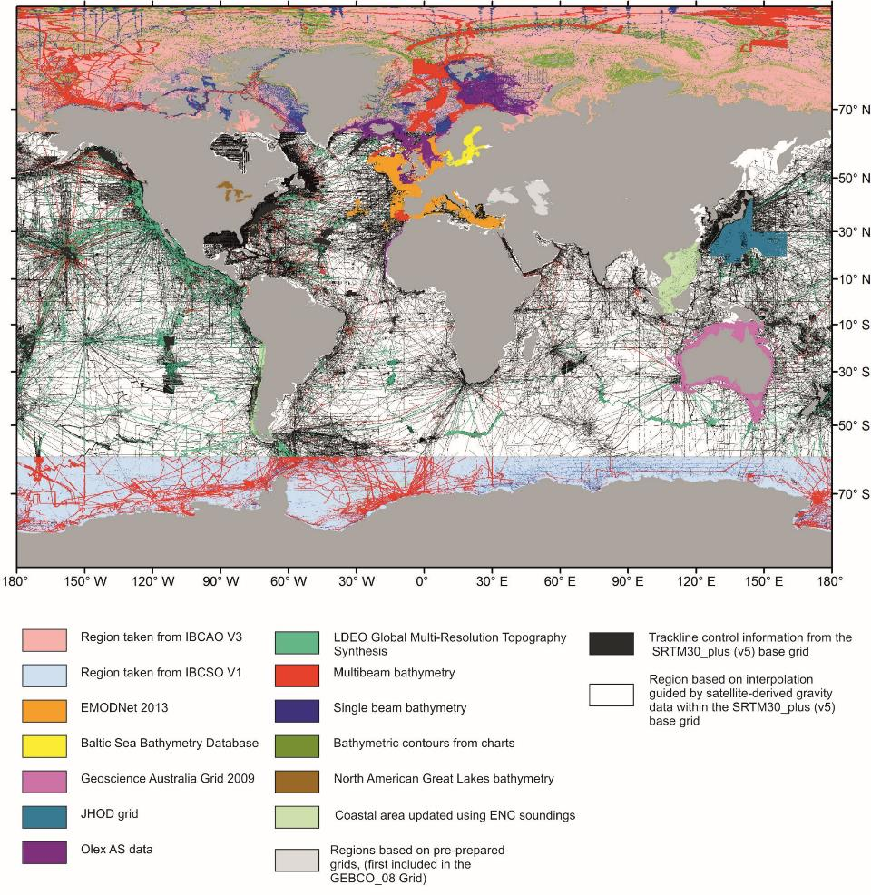

Slide 11
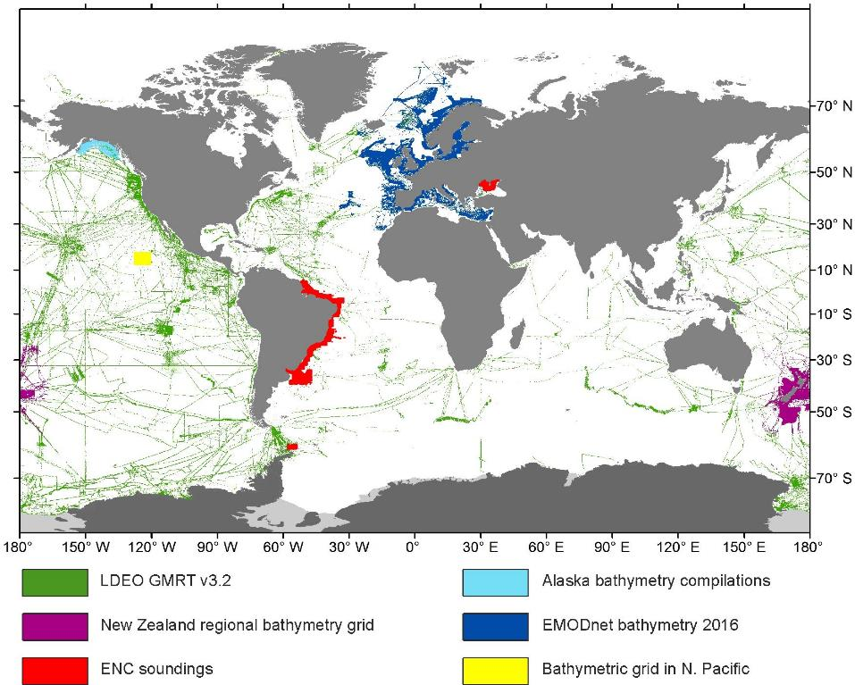

Slide 12
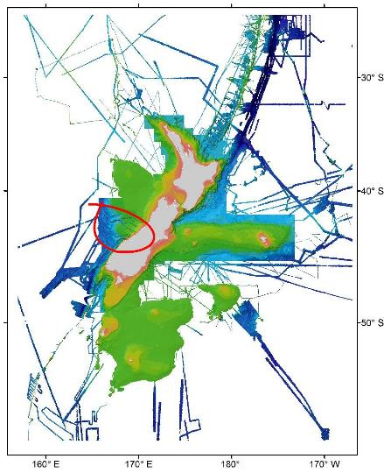

Slide 13
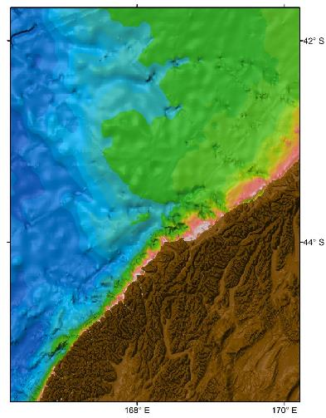
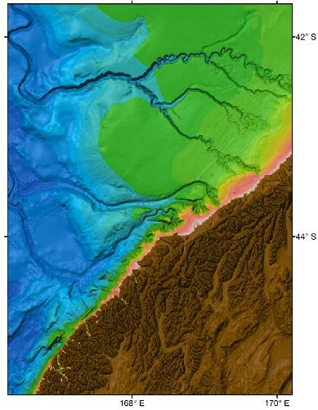
50 km

Slide 14
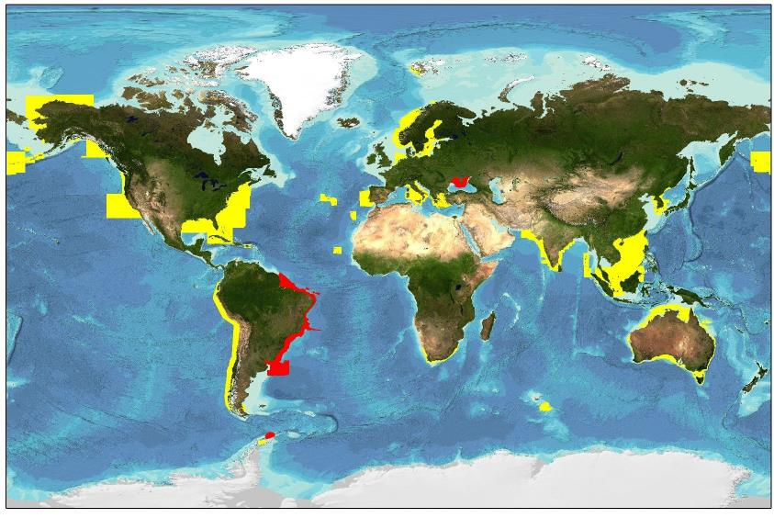
ENC bathymetric sounding data coverage – provided by IHO Member States
ENC coverage supplied in 2016 shown in red

Slide 15
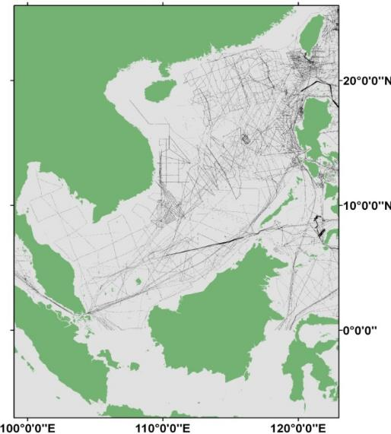
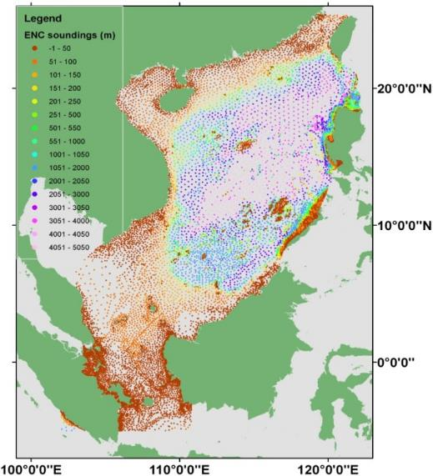
Regional mapping work: improving GEBCO’s global grid
Existing GEBCO
Source tracklines
ENC sounding coverage

Slide 16
SCUFN
Over 3000 UFN were reviewed and edited by an external contractor, as an ongoing maintenance requirement.
Top priority includes production of an S-100 Product Specification for UFN data.
Naming of features which falls within 200 NM limit has to be taken care of by GGC.

Slide 17
Interaction with RHCs
More than 20 observers joined the GGC meeting.
GGC secured that all the RHCs would be participated by GEBCO people.

Slide 18
B-7 GEBCO Guideline
Traditionally GEBCO has focused on areas deeper than 200m (written in B-7)
It is now actively collecting data in shallower water areas to support coastal activities such as coastal zone management and the mitigation of seaborne disasters such as storm surges and tsunami inundation.
B-7 (GEBCO Guideline) is now covered by the current ToR and B-11 (GEBCO Cook Book).
B-7 is outdated and has to be withdrawned.

Slide 19
IOC
IOC’s attitude to GEBCO has been dramatically changed.
IOC reviewed and the subsequent discussions and decisions made at the 49th meeting of the IOC Executive Council. IOC’s working group will collect, integrate and assess the user requirements to GEBCO products.

Slide 20
Seabed 2030
Ultimate objective
Leave no features of the world ocean floor
larger than 100 metres unmapped
Three pillars
Compile unreleased data
Create maps and make them available to public
Identify and fill in gaps, dev of new tech.

Slide 21
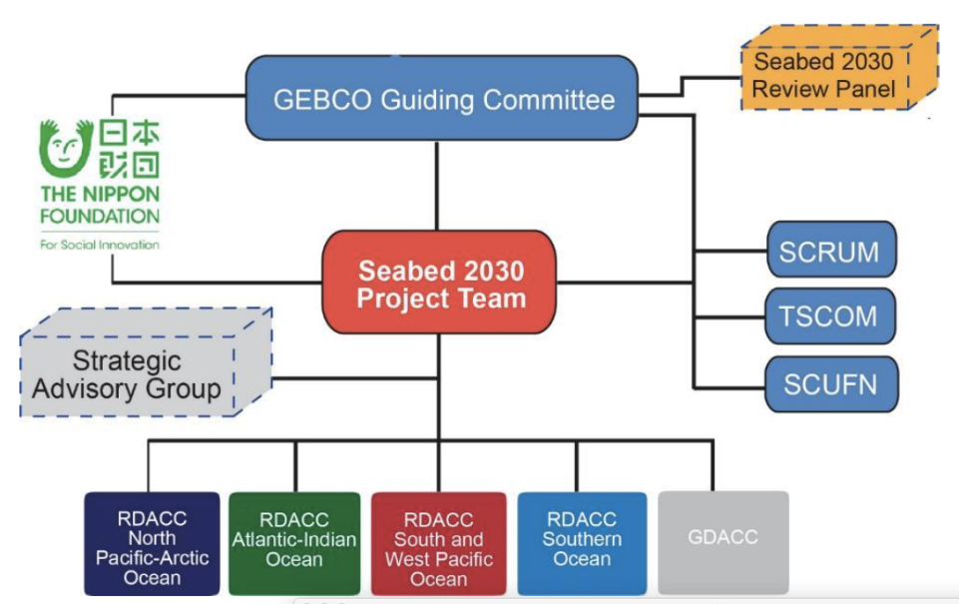

Slide 22
NF-GEBCO CB
Almost all the 72 graduates engage in the bathymetry related jobs.

Slide 23
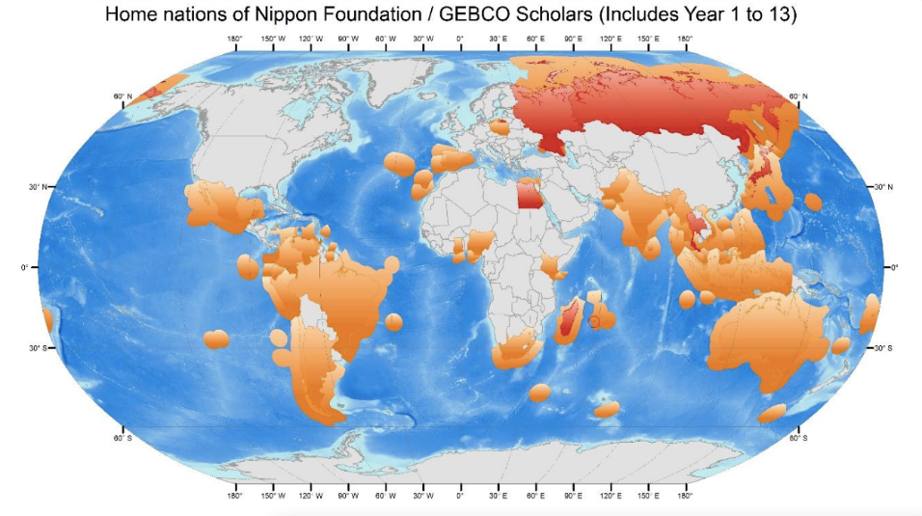

Slide 24
78 Students (including Year 13) from 48 different organizations of 35 countries.
• Navy: 31% • Asia: 56.4%
• Hydrographic Office: 27% • Europe: 11.5%
• University: 25% • Americas: 16.7%
• Research Institute: 17% • Africa: 12.8%
• Australasia: 2.6%
Backgrounds
Hydrographers, Oceanographers, Marine Scientists, GIS specialists, Geologists,
Fisheries Scientists, Physicists, Engineers, Meteorologists, Astronomers,
Geodesists, Naval Scientists, Mathematicians Geographers.
Qualifications of students to date (including post-training qualifications)
• PhD: 19%
• MSc: 44%
• BSc: 26%
• Naval Degree / Other: 11%
79% Male 👲 21% Female 👧

Slide 25
IRCC is invited to
Note the contents of the report;
Approve the withdrawal of IHO Publication B-7
– GEBCO Guidelines;
Encourage RHCs to organize contribution of bathymetric data in shallower coastal areas from their member states to GEBCO in order to support the production of higher resolution gridded data products of GEBCO;
Encourage RHCs to invite and communicate with GEBCO members to their meetings as appropriate;

Slide 26
IRCC is invited to
Take any actions deemed necessary, such as;
Encourage Member States to participate in and contribute to GEBCO project.
Continue supporting GEBCO’s regional projects.
Pay attention to and support Seabed 2030, which is a new direction of GEBCO based on F-FOFM

Slide 27
Thank you for your kind attention

