Slide 1
IRCC-9
Agenda item 11
Update on the development of the IHO GIS and related web-based services
IHO Secretariat

Slide 2
Contents
Single Interface to IHO GIS Applications
IHO Country Information Database
IHO Regional Information Database
IHO ENC Catalogue
INToGIS
On-Line Registration Service for IHO Meetings
Action required of IRCC

Slide 3
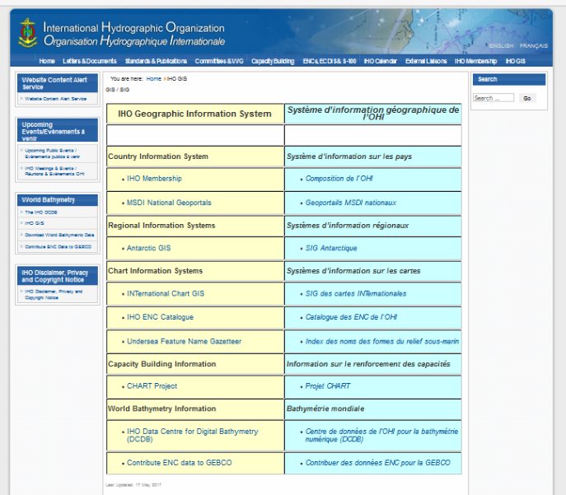
Single Interface to IHO GIS Applications

Slide 4
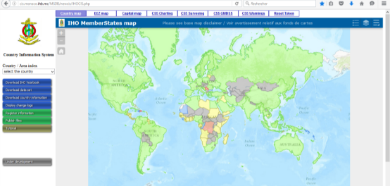
IHO Country Information Database
Upgrade of the database to include additional information including
the date of signature of the SOLAS Convention, when applicable
the existence of a Nominated Hydrographic Authority
the existence of an MSI Capability, and
the identification of the Primary Charting Authority

Slide 5
IHO Country Information Database
Currency of the information available in P-5
Bahrain
Brunei Darussalam
Chile
Ecuador
Finland
Netherlands
Poland
Thailand
Trinidad and Tobago
Venezuela
Viet Nam
Cuba
Croatia
Ireland
Monaco
Cyprus
DPRK
Serbia
Estonia Pakistan

Slide 6
IHO Country Information Database
Statistics on the status of hydrographic services
Capability | Number of IHO coastal States* | Number of other UN coastal States | Total
 | 86 | 64 | 150
Signatory to SOLAS | 86 (100%) | 58 (91%) | 144 (96%)
MSI Capability | 76 (88%) | 14 (22%) | 90 (60%)
Nominated Hydrographic Authority | 86 (100%) | 51 (80%) | 137 (91%)
Own Charting Authority | 65 (76%) | 3 (5%) | 68 (45%)
*
* Serbia not included

Slide 7
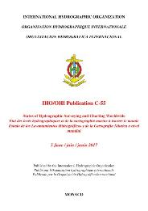
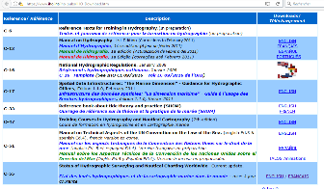
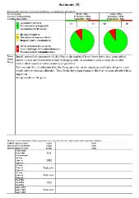
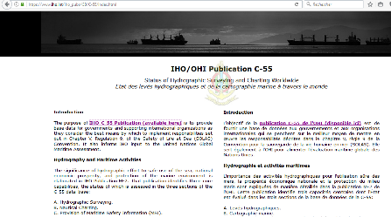
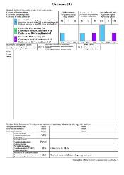
IHO Country Information Database
Transfer to the CIS of the data supporting C-55
New on-line pdf version of C-55 generated automatically from the database

Slide 8
IHO Country Information Database
Currency of the information available in C-55 (number of areas)
63%
14 %
23 %

Slide 9
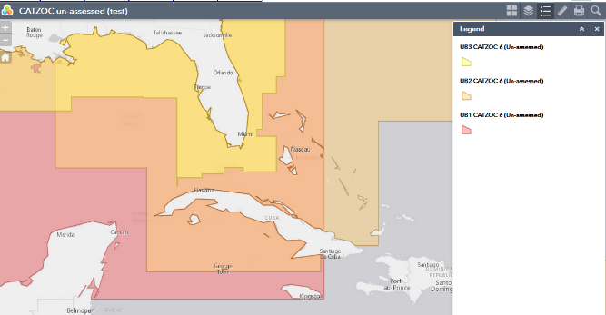
IHO Regional Information Database
On-going development of GIS outputs derived from C-55 data (for internal use of the Secretariat)
Use of composite CATZOC reports to brief RHC meetings: subject to the approval of RENC members (see action WENDWG7/09)

Slide 10
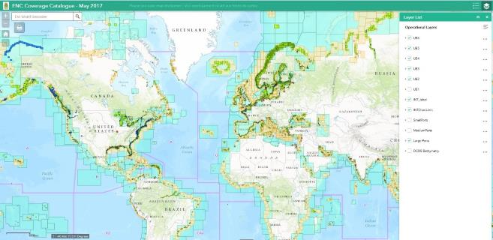
IHO ENC Catalogue
Additional layers
Limits of INT Chart Regions
Ports (from NGA Pub 150)
DCDB Bathymetry
Work in progress to reflect the availability of ENCs in accordance with the “Diagram of ENC Data Flow Producers-RENCs-Distributors” maintained by the WENDWG

Slide 11
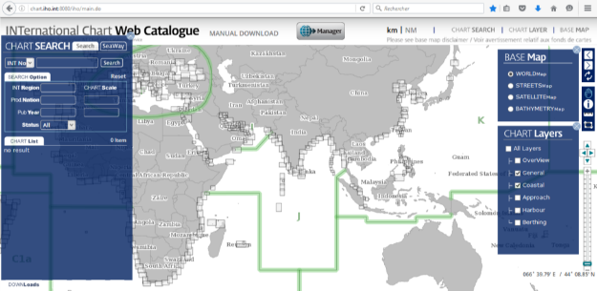
INToGIS
On-line web-based interactive version of IHO Publication S-11 Part B - Catalogue of INT Charts made available in January 2016 (see IHO CL 89/2015)
The INToGIS application seems to work well
Home> Standards & Publications> S-11> Part B (link)

Slide 12
On-Line Registration Service for IHO Meetings
Service used successfully for HSSC-8 and A-1
Upgrade requirements based on the lessons learned submitted to KHOA for further consideration
On-line registration is now the preferred mode of registration for the meetings organized by the IHO Secretariat

Slide 13
Action required of IRCC
IRCC is invited to:
Note the report
Request RHCs to review entries related to their region in IHO C-55 and P-5 (Yearbook) at least annually;
Provide guidance on further development of web-based applications that may be required to support its work;
Take any other actions as appropriate

