Slide 1

CATEGORY A HYDROGRAPHY COURSE
OCEANOGRAPHY FACULTY
COLOMBIAN NAVAL ACADEMY "ALMIRANTE PADILLA"
27 de Noviembre de 2018

Slide 2
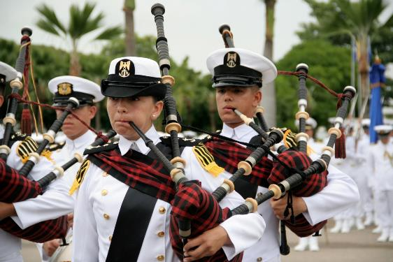
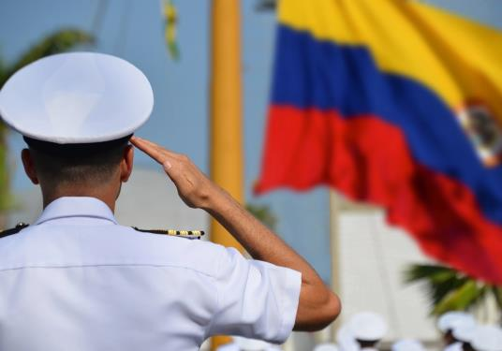
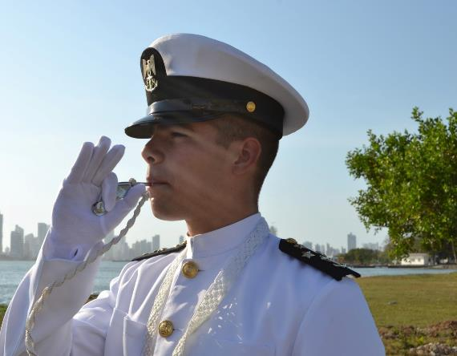
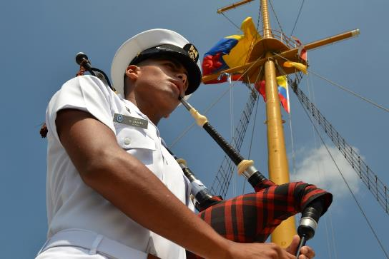
AGENDA
Introduction.
Colombian Hydrography
Colombian Naval Academy “Almirante Padilla”
Hydrography Program.
Scientific Research.
Quality and Autoevaluation.

Slide 3
AGENDA
1. Introduction
Coral Reef San Andres, Providence and Santa Catalina Achipelago

Slide 4
COLOMBIA MARITIME COUNTRY
589.560 km2
339.100 km2
45 %
Maritime Territory
1.141.748 km2
Notes:
Colombia is a bi-oceanic country with a privileged geographic position over the world, it has three thousand and hundred eighty-nine kilometers of coastline on the Caribbean and Pacific, nine hundred twenty-eight thousand and six hundred square kilometers of maritime surface, two thousand eight hundred sixty square kilometers of coral areas, four archipelagos an at least one hundred islands.

Slide 5
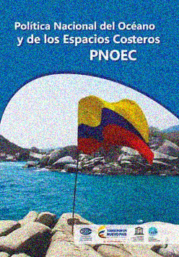
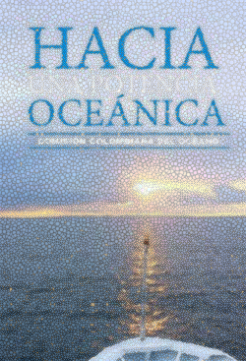
COLOMBIA MARITIME COUNTRY
Middle Maritime
Power
Maritime and Oceanic Privileged position.
Politic Frameof Maritime Power
National Maritime Interest
MMP
Notes:
Aware of importance, it is structured a National Policy of the Ocean and the Maritime Spaces (PNOEC) for the period to twenty sixty to twenty thirty, document that projects the route of Colombia to be a Maritime Middle Power (MMP), in where recognize the, Maritime and Oceanic Privileged position, National Maritime Interest, and Politic Will of Maritime Power .
This Policy projects the path of Colombia towards a Maritime Middle Power (MMP), through guidelines for cooperation and integration in marine affairs, economic development, sustainable use of resources, ordering of the marine-coastal territory, protection of biodiversity and defense of the sobering; always seeking the welfare of Colombians.

Slide 6
Maritime
Interests
COLOMBIA MARITIME COUNTRY
Maritime Education
Scientific, Technological and Innovation Research
Maritime Integral Security
Transport & Maritime Trade
Sovereignty
Marine and submarine minery
Notes:
This new policy was projected with vision 2030, and will seek the promotion of the National Maritime Interests, the appropriation and recognition of the maritime territory, the sustainable use of resources, the conservation of the environment, the ordering and governance of the territory, the surveillance and control permanent of the jurisdictional spaces, and the growth and competitiveness of the sectors that develop maritime activities, safeguarding the resource for the current and future generations, increasing the quality of life of the inhabitants of the coastal zones and promoting the national development.
This renewed approach also incorporates scenarios of multilateral participation and concepts such as "Blue Economy" and "Integral Maritime Security" as management tools.

Slide 7
Maritime
Interests
COLOMBIA MARITIME COUNTRY
Marine-Coastal Environmental Resources
Naval Power
Naval and Maritime Industry
Marine-Coastal Regulation
Awareness, Territorial Appropriation and Maritime Culture
Fishing and Aquaculture
Maritime Tourism and Recreation

Slide 8
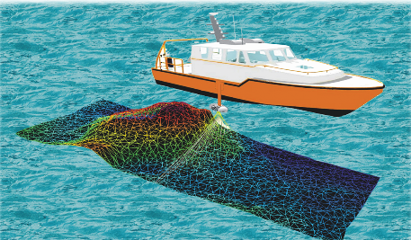
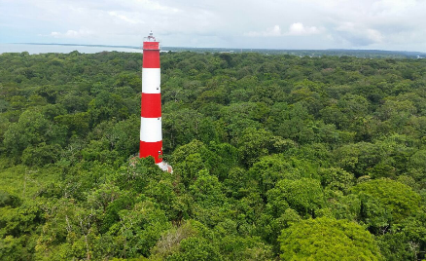

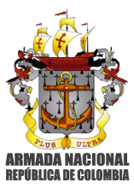
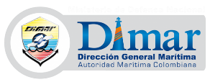
Strategy
Developers
COLOMBIA MARITIME COUNTRY
Notes:
Colombia in its privileged position and as mentioned above requires a "strategy that leads to think about the reduction of risks in the development of maritime activities, contemplating new aids to navigation, monitoring systems, generation of Colombian nautical cartography, and acquisition of equipment for Surveillance, Control and Maritime Traffic "(Comision Colombiana del Oceano, 2017).
In this task, the National Government, through the Ministry of National Defense, has delegated to the Colombian Navy, and the Maritime General Direction, so that by working in a coordinated manner, they generate strategies and lines of action.

Slide 9

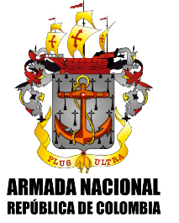
COLOMBIA MARITIME COUNTRY
Colombian Navy
Strategy
COLOMBIA, PAÍS MARÍTIMO
NATIONAL DEFENSE & SECURITY
MARITIME AND
RIVERIAN SECURITY
INTERNATIONAL
PROJECTION
ENVIROMENTAL
SECURITY
MARITIME
DEVELOPMENT
Notes:
i. Strengthening of activities aimed at administering, preserving and defending the marine, submarine, coastal and fluvial Colombian territory.
1. Fluvial and Maritime Vertex
a. State presence in all oceanic’s and fluvial spaces through the protection of human live.
b. To guarantee the free navigation.
c. Establish and maintain the enough cartography and maritime signaling in ports, coasts and rivers.
2. Maritime Development Vertex
a. Keep, enhance and promote the national cartographic service.
b. Keep a meteorological service with operational focus, able to give opportune and reliable information.
c. Contribute to navigation security, and support whom use the sea as a economic support.
Cambiar por la estrategia pentagonal arc
International Role
Strengthening of the presence and leadership in international maritime coordination scenarios such as Antarctic Treaty, GMDSS, and the security system of the Colombian west Caribbean.

Slide 10
AGENDA
2. Colombian Hydrography

Slide 11
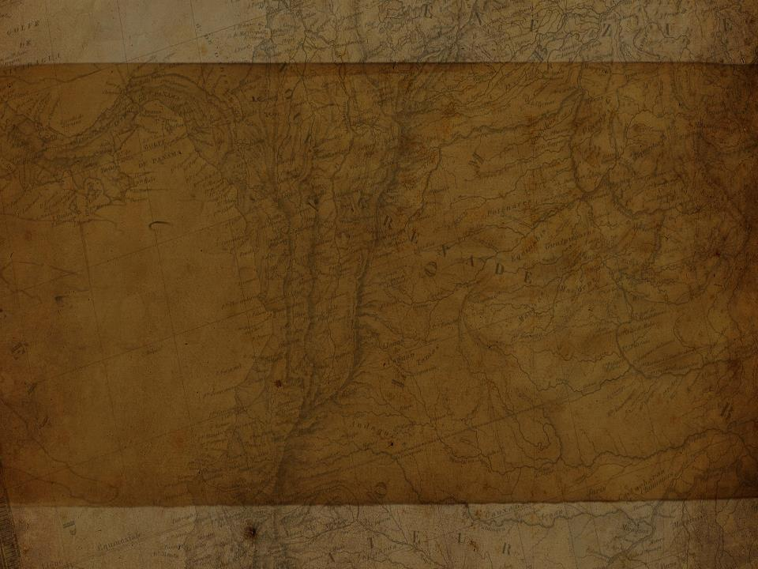
Hydrography History in Colombia.
1980
Acquisition of the ARC Providencia and ARC Malpelo hydrographic platforms as part of the "National Cartographic Plan" for the elaboration of nautical cartography
1968
First hydrographic survey on board the ARC "Quindío" elaboration of the Nautical Chart Col 101
1947
Cooperative agreement between DIMAR and NAVOCEANO
1965
DIMAR creates the Hydrography Division in Bogotá
1975
Creation of the CIOH and transfer of the Division of Hydrography to Cartagena
1980
Creation of the Colombian Hydrographic Service (SHN).

Slide 12
Hydrography History in Colombia.
2001
Presentation Hydrography course before the IHO achieving the recognition of the certification as Category A Hydrographers.
1998
Colombia is recognized as an active member of the International Hydrographic Organization (OHI).
2010
Expiration of the accreditation granted by the IHO to the hydrography program of the ENAP
1981
Oceanographic officers complement their training as hydrographers in international training centers.
2004
Opening of the first "Geographic Information Systems" (GIS) Laboratory in the Colombian Caribbean region.
2000
Preparation and edition of national electronic cartography under internationally established standards in S-57 format

Slide 13

Hydrography History in Colombia.
2017
Update of the postgraduate program in Hydrography for Officers with the purpose of recovering the recognition of the certification as Category A Hydrographers before the IHO.
2018
November - Colombian Naval Academy "Almirante Padilla" in gaining recognition of the Programme against Edition 1.0.1 of
the Standards S-5A
2014
Active participation with teachers and students of the Naval School "Almirante Padilla" in the PAC, which continues to date.
2014
Acquisition of hydrographic platforms, new technology equipment and bathymetric data management software, strengthening the national hydrographic capacity.
2018
April - Submission at the "Annual Meeting of the IBSC-41 Bandung (Indonesia)
2018
December –Workshop of support of Courses in hydrography with the support of Captain Leonel Pereira Manteigas of the Portuguese navy

Slide 14
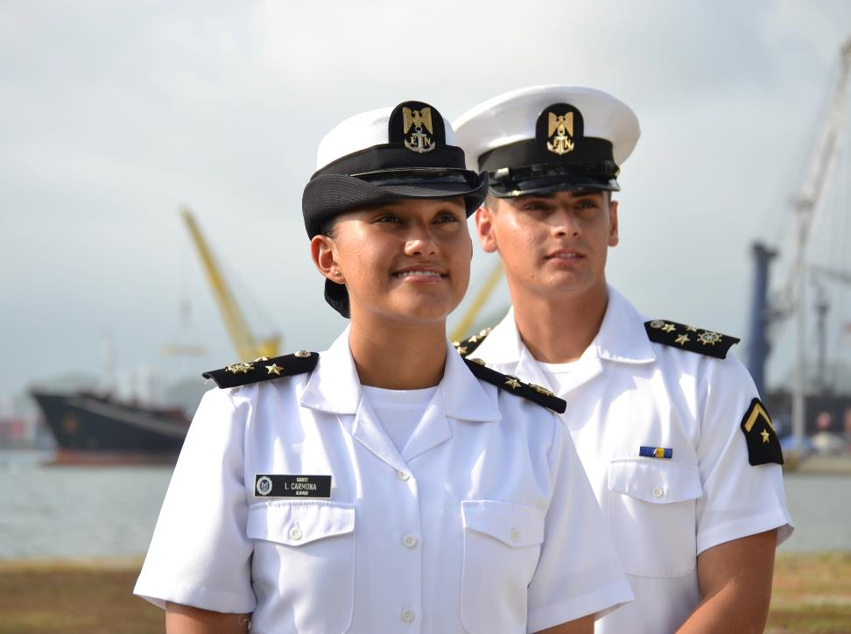
AGENDA
3. Colombian Naval Academy
“Almirante Padilla”

Slide 15
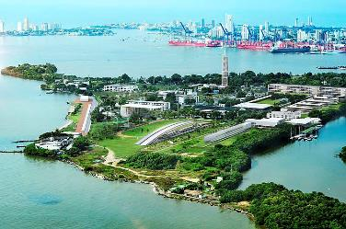
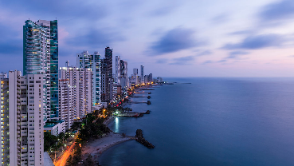
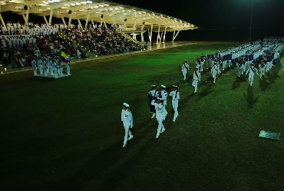
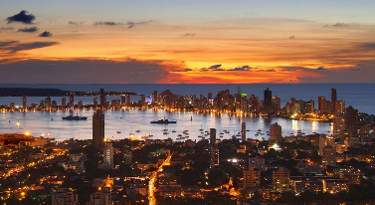
Colombian Naval Academy
“Almirante Padilla”
Colombian Naval Academy &
National Maritime University
Located on the Island of Manzanillo in the City of Cartagena de Indias

Slide 16
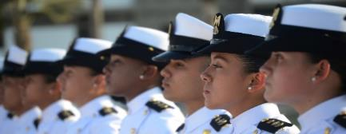
Colombian Naval Academy
“Almirante Padilla”
Education
Roles
Naval & Military Academy
(82 Years)
University
(41 Years)
SUBALTERNO
APRENDIZ
SUBALTERNO
EJEMPLAR
LÍDER
SUPERVISOR
LÍDER
ORGANIZACIONAL
Essential Functions of Colombian Education
Teaching
Investigation
Social Projection
International Projects
Notes:
Education roles.
The Colombian Naval Academy has two roles in education.
Is Colombian Navy Naval Academy, along 80 years has trained officers who are crews of Colombian Navy Ships, and Colombian Marines.
And in the other role is a University with more than 40 years. As University is compromised with the essential functions of Colombian education established by the Ministry of Education, which are: Teaching, investigation, and social projection.

Slide 17
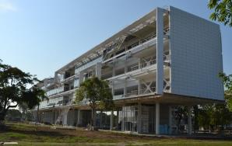
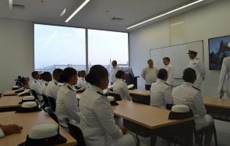
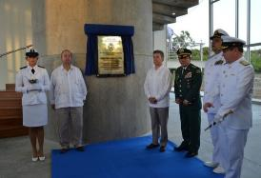
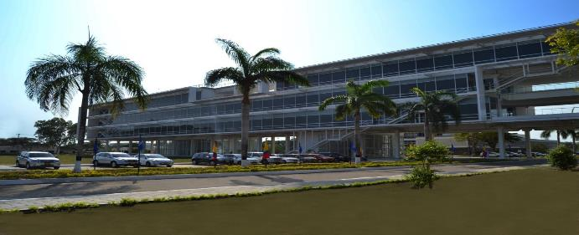
ACADEMÍA NAVAL Y
UNIVERSIDAD MARÍTIMA DE COLOMBIA
Colombian Naval Academy
“Almirante Padilla”
Academic support resources
& Infrastructure
44
Hectares for
Academic development
Notes:
As I mentioned earlier, the Colombian Naval Academy is in Manzanillo Island in Cartagena de Indias, where the academy has 44 hectares.
52 classrooms. (12.597 square meteres)
10 laboratories (hydrography, oceanography laboratories, naval architecture, electronic, automatic control, communications, etc..), 8 specialized classrooms (systems, GIS, war games, GMDSS, tactics, navigation, seamanship),

Slide 18
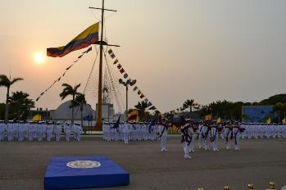
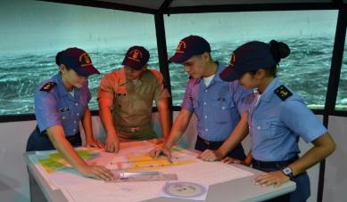
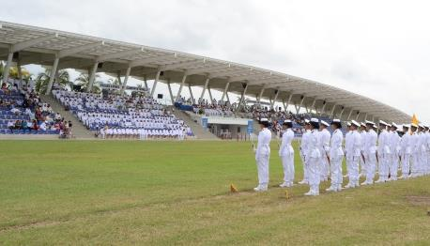
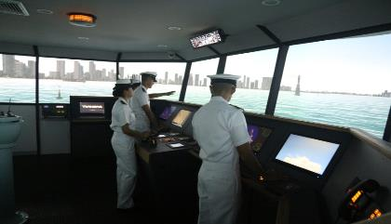
Colombian Naval Academy
“Almirante Padilla”
Academic support resources
& Infrastructure
Notes:
Library.
Full mission simulator, GMDSS simulator, planetarium (the only one in the Caribbean Colombian coast).
Two auditoriums with capabilities for four hundreds a one hundred students, six multiples classrooms, five rooms for meetings and video conferences.
Coffees and snacks bar, mailing office.

Slide 19
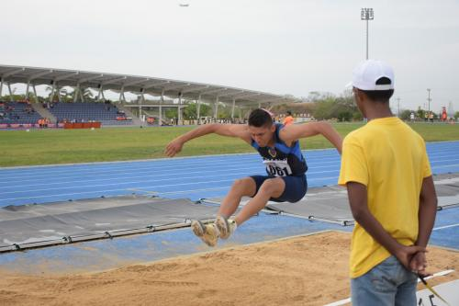
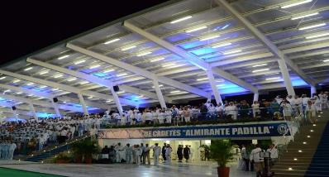
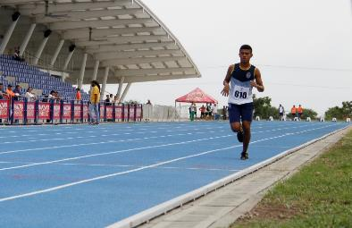
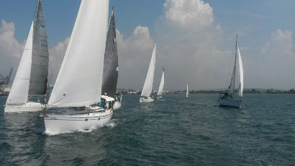
ACADEMÍA NAVAL Y
UNIVERSIDAD MARÍTIMA DE COLOMBIA
Colombian Naval Academy
“Almirante Padilla”
Academic support resources
& Infrastructure
Notes:
Sports areas for practice soccer, swimming, running, basketball, volleyball, and others
Boats for sailing, and practice traditional nautical sports as bow.
Team of dive.

Slide 20
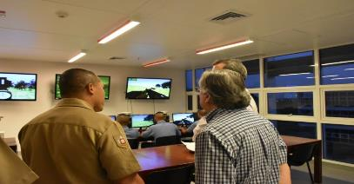
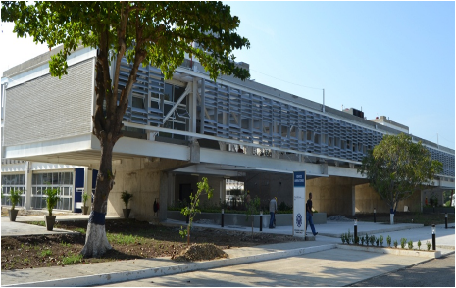
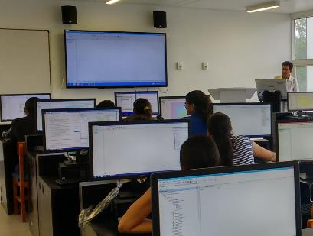
Colombian Naval Academy
“Almirante Padilla”
Laboratories &
Specials Class rooms
Notes:
The institution has libraries, archives, practice sites, laboratories, computer resources, audiovisual equipment and other sufficient and adequate bibliographic and technological resources.

Slide 21
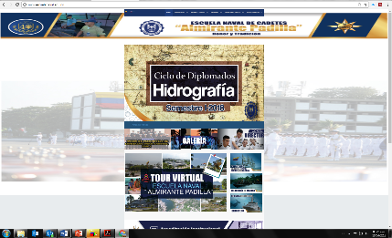
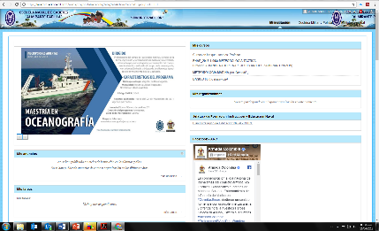
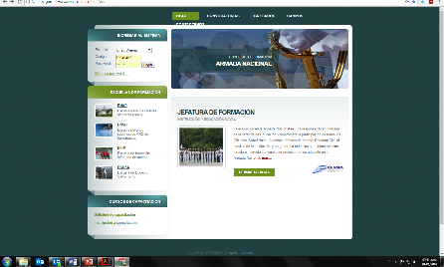

Technologic
Infrastructure
Colombian Naval Academy
“Almirante Padilla”
http://www.escuelanaval.edu.co/
https://avafp.blackboard.com
http://www.smaarc.edu.co/smaArc/
Notes:
Technologic infrastructure as, web server, data server, email server, web- academic based system (BlackBoard).

Slide 22
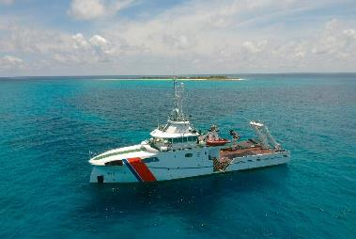
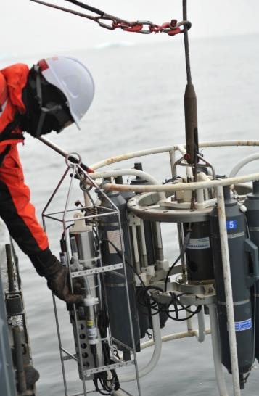
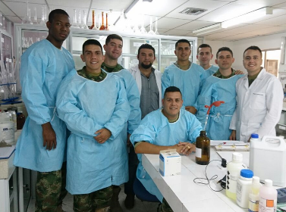
Colombian Naval Academy
“Almirante Padilla”
Institutionals
Laboratories
Notes:
In the Island of Manzanillo there is also the Center for Oceanographic and Hydrographic Research of the Caribbean (CIOH), with whom there is an agreement of academic cooperation and therefore we can use its laboratories of Chemistry, Geology, Hydrography, and Cartography. Also through this agreement we can uses the platforms from the Colombian Hydrographic Service under the command of the CIOH.
This center has 3 Oceanographic and Hydrographic platforms, with capabilities to do surveys in depth and shallow waters, with multibeam and single beam sounders, likewise magnetometers, and side scan sonar, sub bottom profiler, sound velocity profilers, Also fast boats with the same type of sensors used to do surveys.
Finally in the center the students will be able to do the post processing, as part of the final project, using the software available for this purpose.

Slide 23
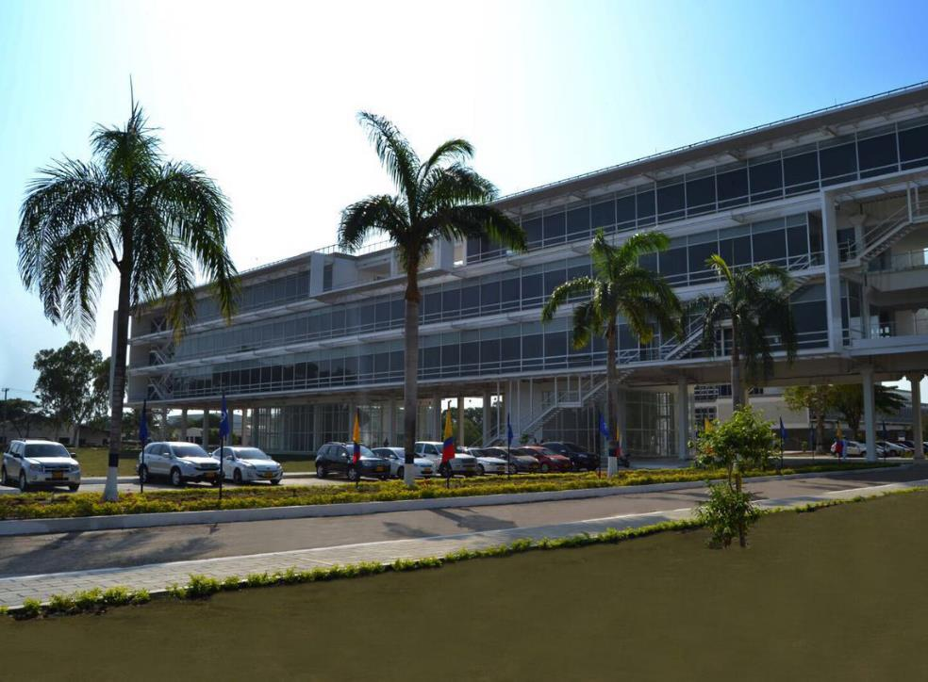
AGENDA
4. Hydrography Program

Slide 24

CATEGORY A HYDROGRAPHY COURSE
PROGRAM’S NAME | CATEGORY A HYDROGRAPHY COURSE
Institution submitting the Program for recognition | Colombian Naval Academy "Almirante Padilla" Institutional Accreditation in High Quality - Resolution 24403 Nov/17 Ministry of National Education
Previous recognition year (if applies) | 2001
Standard and Edition against which recognition is sought | S-5A Ed.1.0.1
Level of recognition sought | Category A
Duration of the program in week and study hours (Theory, Practical and Self-Guided | 59 Weeks Theory: 886 +145* Practical: 477 + 51* Tutorial:14 Self-Guided:637 + 102* *From the exemptions just the topics accounting to the cross-reference
Duration of the final project CMFP | 6 weeks
Country of submitting institution | Colombia
Language in which the program is delivered | Spanish
Program Coordinator’s name and full contact details | Camilo Andrés Platz Marroquín jpfof@enap.edu.co Physic Oceanography Faculty
Submitting institution primary full contact details for IBSC correspondence | Alejandro Rueda Duran jdfof@enap.edu.co Physic Oceanography Faculty Isla de Manzanillo - Bosque
Program capacity (Expected/actual number of students taking the program each year) | 8 to 10 students per course
Methodology | On-site

Slide 25
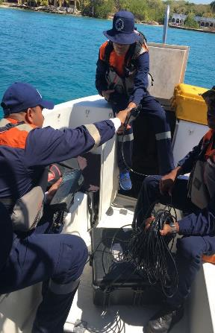
Hydrography Program
Program
Objective
The objective of this program is to train high level professionals that promote the development of the hydrographic knowledge in aspects such as the defense, national security, the control of the marine traffic, the administration of the coastal zone, the exploration and exploitation of the marine resources and the protection of the environment.
Notes:
No cuadran las cuentas de los docentes ocasionales: Verificar con Moises.

Slide 26
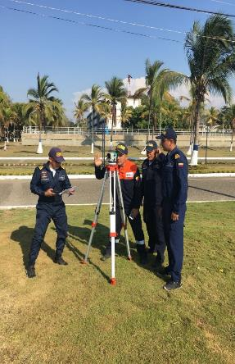
Hydrography Program
Graduate
Profile
DISEÑO DEL PROGRAMA
The Officer who completes the program, will be able to play on board the hydrographic units of the Colombian Navy located throughout the national geography, having as main work the cartographic generation, planning, organization, direction, execution, investigation and hydrographic management of the country, participation in the generation of strategic plans of new national cartography and actively participating in the geopolitical marine decisions of the country.

Slide 27
PLAN DE ESTUDIOS HIDROGRAFÍA CATEGORÍA A
Periodo I |  |  | Periodo II |  |  | Periodo III |  |  | Periodo IV |  |  | Periodo V |  |  | Periodo VI
T | P | SG | T | P | SG | T | P | SG | T | P | SG | T | P | SG | T | P | SG
146 | 29 | 87 | 153 | 58 | 96 | 149 | 84 | 114 | 145 | 70 | 104 | 272 | 113 | 176 | 35 | 125 | 60
Weeks |  | 8 | Weeks |  | 10 | Weeks |  | 10 | Weeks |  | 12 | Weeks |  | 13 | Weeks |  | 6
Hours x week |  | 33 | Hours x week |  | 31 | Hours x week |  | 35 | Hours x week |  | 34 | Hours x week |  | 36 | Hours x week |  | 36
T | P | SG | T | P | SG
46 | 13 | 30 | 36 | 18 | 24
Geodesy I H100 |  |  | Geodesy II H101
T | P | SG | T | P | SG | T | P | SG | T | P | SG | T | P | SG
40 | 12 | 27 | 50 | 25 | 32 | 36 | 12 | 24 | 50 | 15 | 24 | 43 | 5 | 24
Marine Geology OF103 |  |  | Positioning I H102 |  |  | Subsea Positioning H103 |  |  | Geographical Information Systems H109 |  |  | Legal Aspects H110
T | P | 1 | T | P | SG | T | P | SG | T | P | SG | T | P | SG
60 | 4 | 32 | 43 | 5 | 24 | 38 | 10 | 24 | 49 | 15 | 32 | 65 | 32 | 48
Descriptive Physical Oceanography OF108 |  |  | Marine Meteorology OF106 |  |  | Numerical Methods CB110 |  |  | Oceanic Waves OF121 |  |  | Management of Hydrographic Data H108
 |  |  | T | P | SG | T | P | SG | T | P | SG | T | P | SG
 |  |  | 24 | 8 | 16 | 19 | 13 | 16 | 36 | 12 | 24 | 49 | 19 | 32
 |  |  | Computational Tools I OF210 |  |  | Computational Tools II OF211 |  |  | Remote Sensors OF304 |  |  | Water and Flow Levels H106
 |  |  |  |  |  | T | P | SG | T | P | SG | T | P | SG | T | P | SG
 |  |  |  |  |  | 56 | 49 | 50 | 65 | 43 | 48 | 65 | 42 | 48 | 35 | 125 | 60
 |  |  |  |  |  | Instrumentation in Hydrography H104 |  |  | Survey Operations and Applications H105 |  |  | Hydrographic Data Acquisition and Processing H107 |  |  | Final Project CMFP
 |  |  |  |  |  |  |  |  |  | Total Course
T | P | SG | T | P | SG | T | P | SG |  | T | P | SG
81 | 31 | 56 | 319 | 82 | 191 | 500 | 364 | 390 |  | 900 | 477 | 637
Basic Science |  |  | Foundation Science |  |  | Hydrographic Science |  |  |  | Hydrography Category A

Slide 28
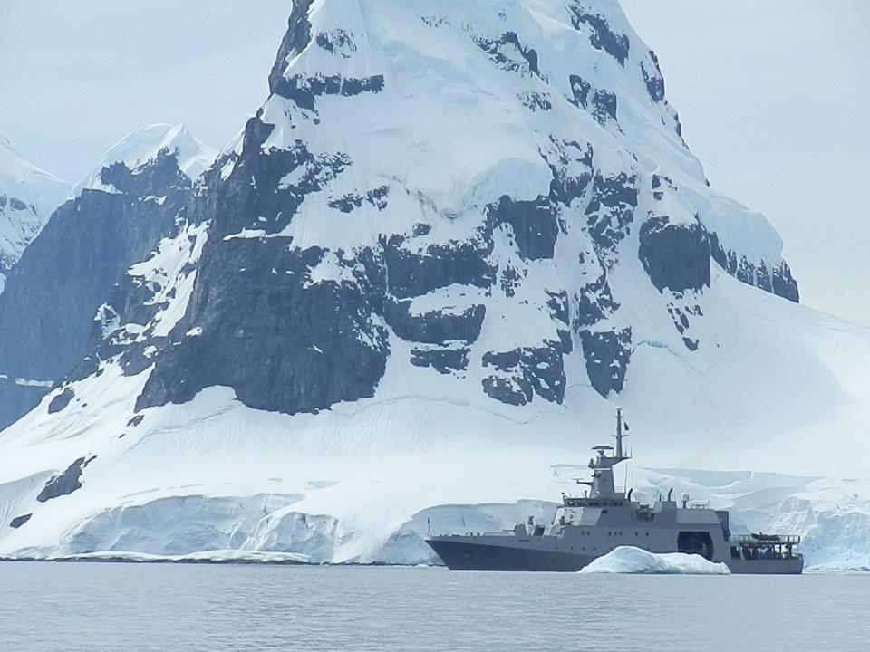
AGENDA
5. Scientific Research

Slide 29
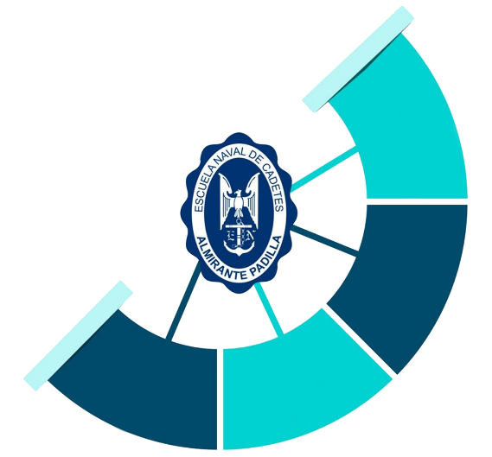
Science & technology
Colombian Navy System
Scientific research
OCEANOGRAPHY
FACULTY
Oceanology Research Group (GIO)
CIOH
CCCP
CCO
I + D + i
NAVAL AND MARINE SCIENCES
FACULTY
Naval And Marine
Sciences Research Group (POSEIDON)
CIMAR – CAVNA – ESFOR
CEF – JONA - COFNA
TRAINING
ACADEMIES
ADMINISTRATION
FACULTY
ENGINEERING
FACULTY
GSED
DIABA
JOLA
COTECMAR
DARET
JEMAT
Logistics Management
Research Group (LOGER)
Control Communications and
Naval Design Research Group (GICCDN)

Slide 30
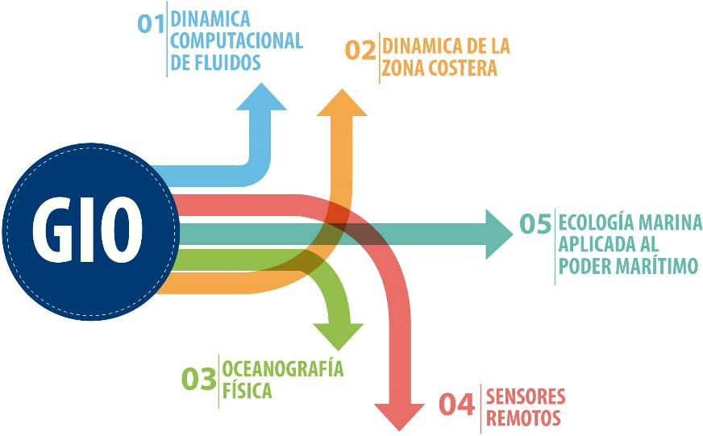

Research group
OCEANOLOGY(A1)
Scientific research
COMPUTATIONAL FLUIDS
DYNAMICS
DYNAMICS OF THE
COASTAL ZONE
MARINE ECOLOGY APPLIED TO
MARITIME POWER
PHYSICAL OCEANOGRAPHY/HYDROGRAPHY
REMOTE SENSING

Slide 31





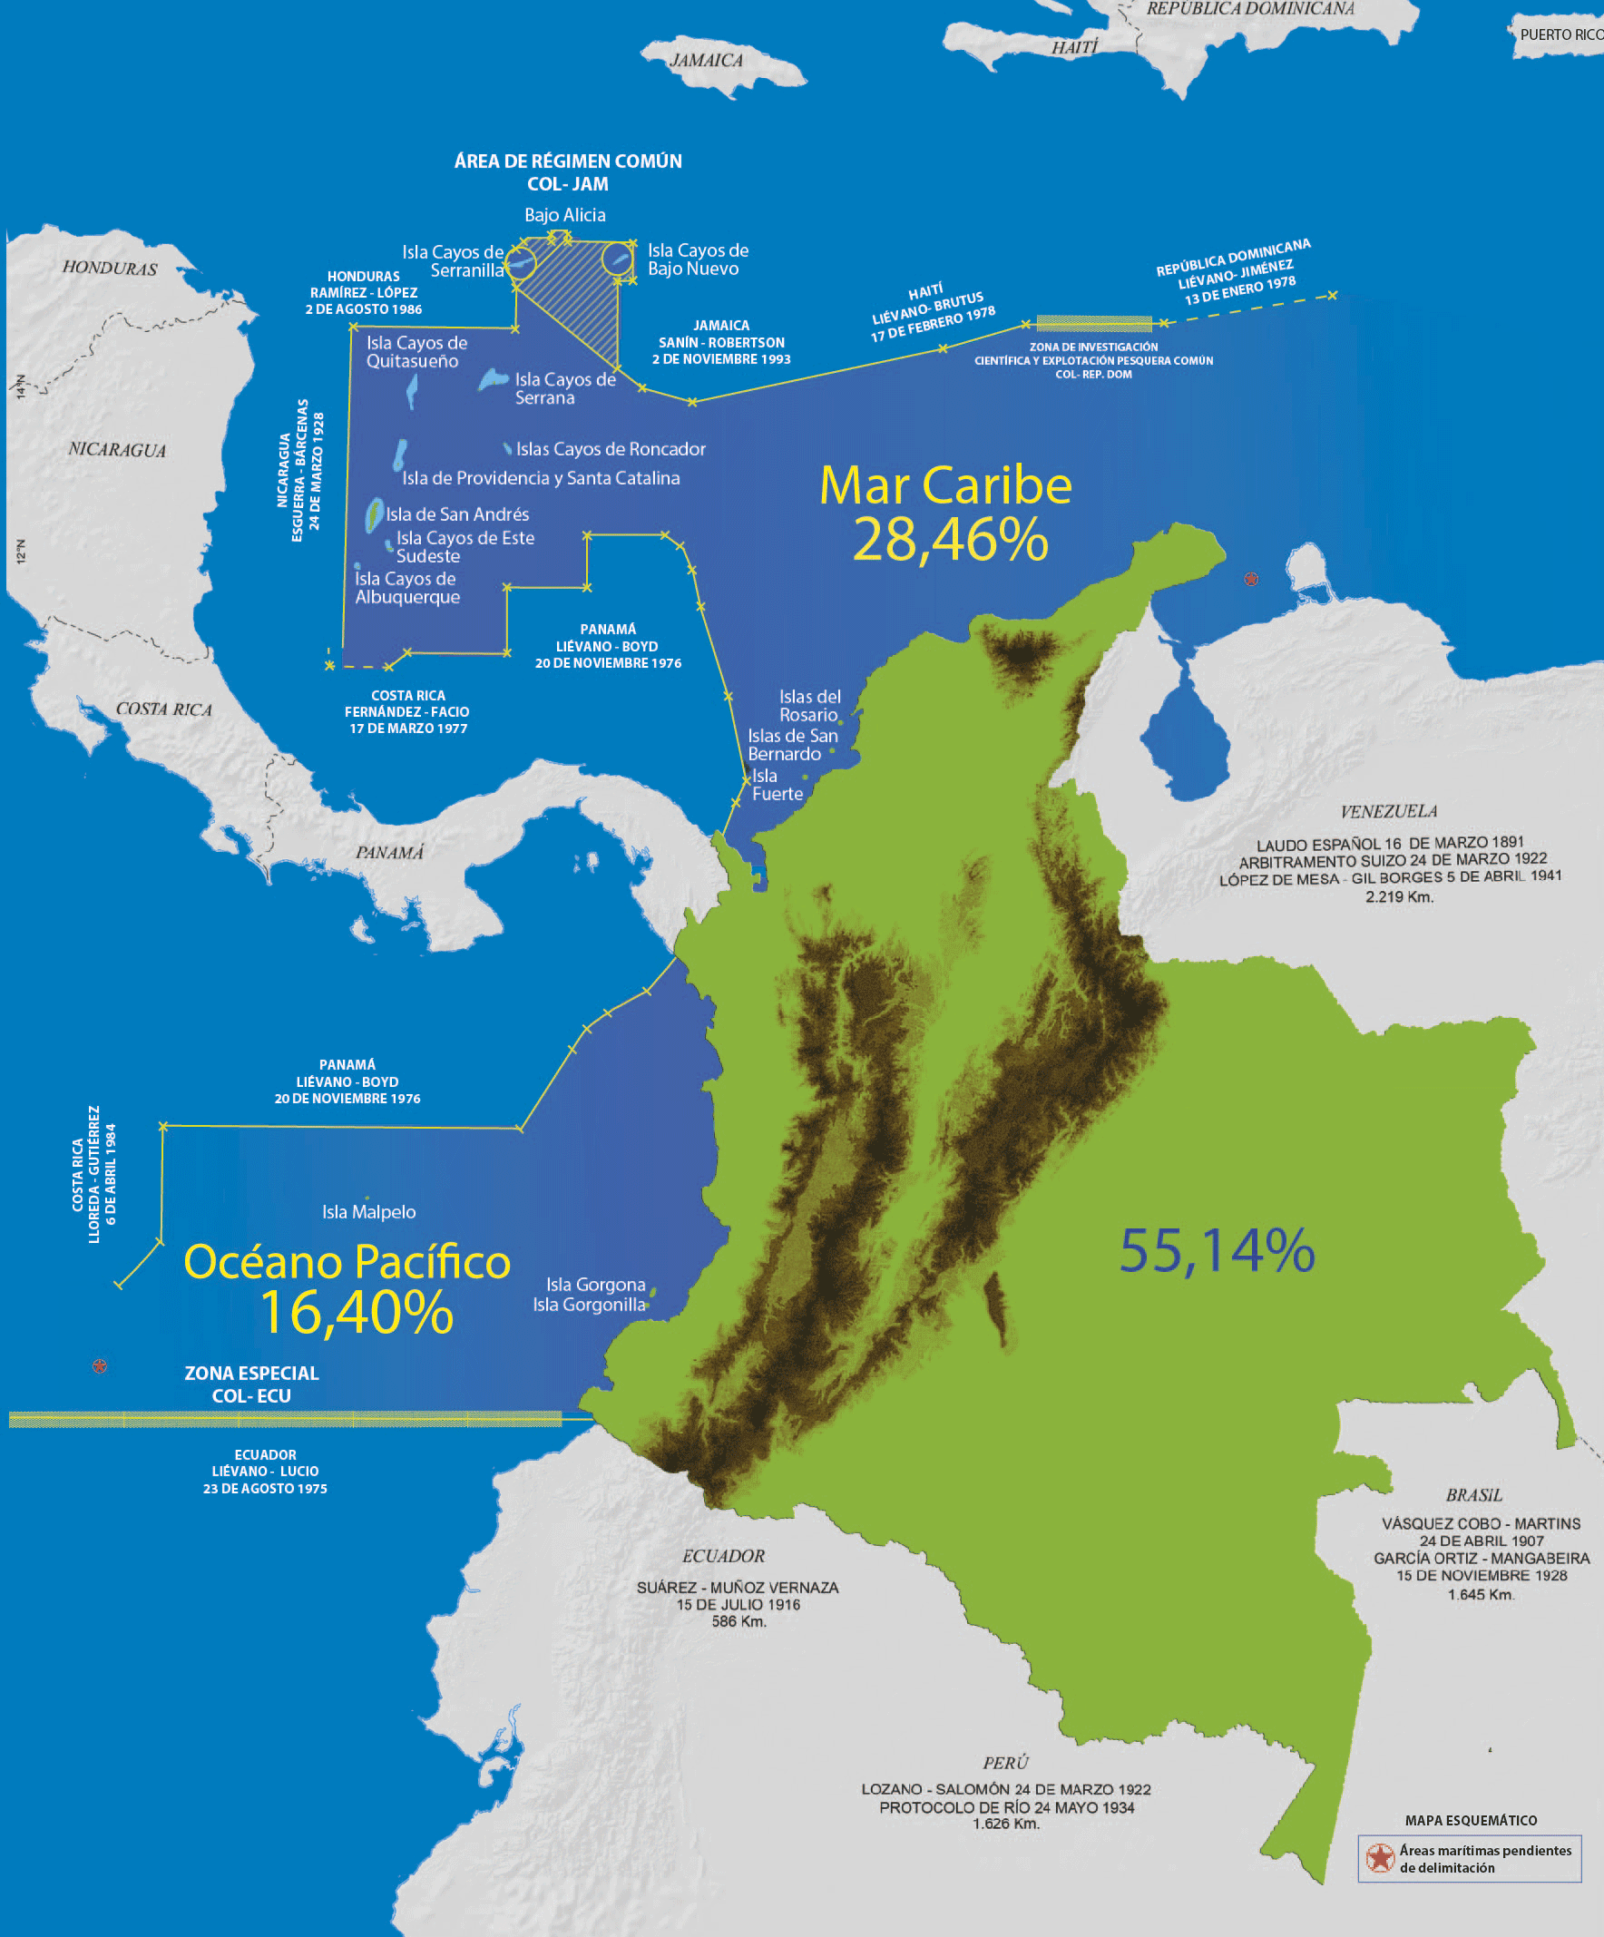
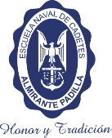




Program
Allied
Scientific research
Public
COLOMBIAN
MARITIME
UNIVERSITY
Private

Slide 32
