Slide 1
Agenda Item 4
IHO Secretariat Report
VTC, 9 – 10 June 2021
By IHO Director
CBSC19-04B

Slide 2
Status of IHO Membership
LEBANON: 94TH IHO Member State
4 Member States suspended: Democratic Republic of the Congo, Serbia, Syria and Vanuatu

Slide 3
IHO Outreach
World Hydrography Day (WHD):
One hundred years of international cooperation in hydrography
Substantial increase in online communication, including social media
IHO Centenary Celebrations (IHO-100)

Slide 4
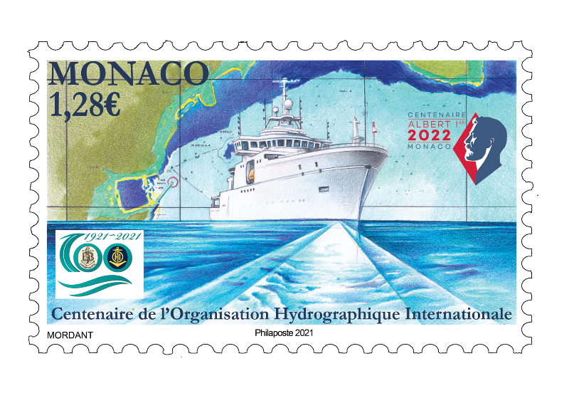
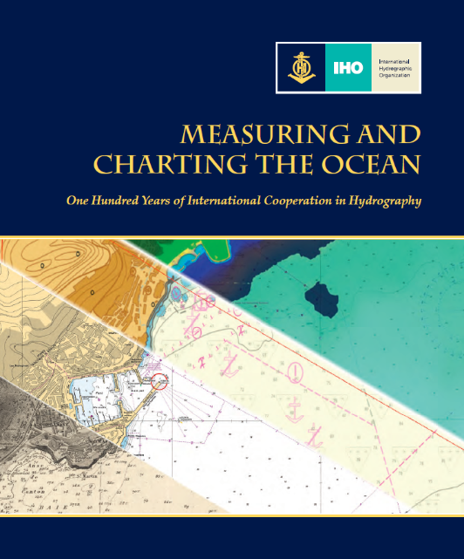
IHO Outreach
IHO Prestige Book
Commemorative Stamp
IHO CL´s 01-16-21/2021 on WHD/IHO-100
21 June 2021 – Hybrid Celebrations
Peak-of-the-Peak Day programme:
- Event on the IHO terrace (speeches on the IHO Centenary)
Italian Navy Tall-Ship Amerigo Vespucci
Surveys and AUVs exhibition in Monaco’s waters

Slide 5
IHO Outreach
International Hydrographic Review (IHR):
Capt (ret) Brian Connon (USA) as new IHR Editor
Ideal opportunity for RHC and MS to publicise technical and other achievements in the Regions
A new IHR Website, will be fully operational by 2021 (the launch of the website is scheduled by the Peak-of-the-Peak day)

Slide 6
Capacity Building Programme
Probably most of the 2021 CBWP will need to be moved to the 2022CBWP
A Project Team has been established to draft a revised Capacity Building Strategy (CBS)
Empowering Women in Hydrography (EWH) Project:
CL 20/2021: CANADA-IHO Agreement
Project work-plan for the period 2021-2024
Member States to consider (A-2 Decision 36) to take part in the Project

Slide 7
IHO Secretariat Infrastructure
Work in progress to improve the IHO GIS and the IHO CIS, with the kind contribution from the RoK and from Japan
The service provider of the cb.iho.int server is experiencing some connectivity problems, which will be fixed soon

Slide 8
Action Requested of CBSC
Note this report
Take any actions as considered appropriate

Slide 9
Thank you for the attention!
IHOhydro
IHOhydro
International Hydrographic Organization

