Slide 1
CSBWG-14 HO SubGroup Gather and prioritize HO-specific issues relating to CSB data Team: Pete Wills (CA), Hans Olias (Swe), Giuseppe Masetti (Dan), Andy Talbot (UK), Anthony Klemm (US-NOAA), Akim Mahmood (US-NGA) August 16 2023

Slide 2
Group Objectives
Produce guidance for use of CSB data for SOLAS navigational products.
Data quality
Volumes
Providing working examples.
Data processing
Engage with industry (software developers) to ensure the required tools exist to be able to efficiently use CSB data from DCDB for SOLAS navigational products.
Engage with other IHO working groups to ensure suitable standards exist for describing CSB data and displaying CSB data on ECDIS.
Trusted CSB? Semantics causing confusion
Share knowledge and best practice on CSB between MS.
Group Issues
other objectives dependent on automating data accessibility.
Need easy way to identify what needs reviewing in area of interest
Need to participate in DCDB development to ensure HO’s are getting what they need and it is aligned with B-12.
Is it easier to have all data go through the HO?
Notes:
Access→QA Tools→Navwarn assessment tools→

Slide 3
Data flow
HO Db
CSB Data on Official Products
Data from Hydrographic Office or Contractors
*
3rd Party Data
Controlled data
*
QA
yes
Uncontrolled data
no
*
3rdParty
National
Database
DCDB
CSB Data
HO as a Trusted Node
* NAVWARN Assessment
Notes:
CSB is just one kind of 3rd party data that Hydrographic Offices must (should) deal with.

Slide 4
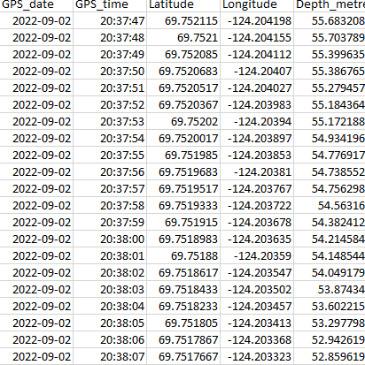
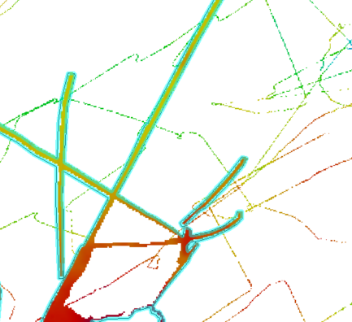
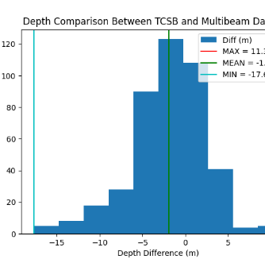
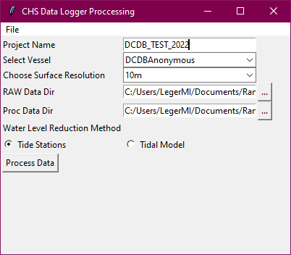
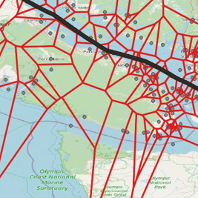
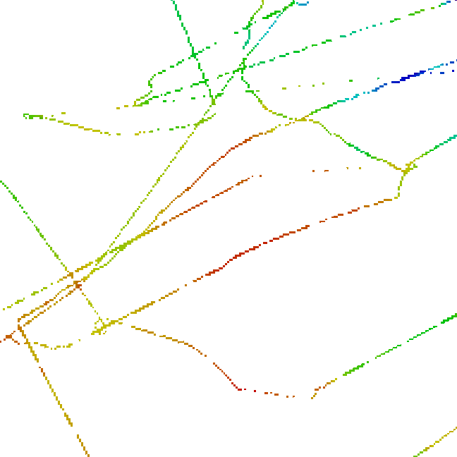
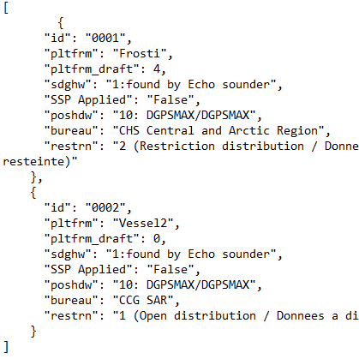
Raw file
Date, Time, Lat, Lng, Speed, Depth
Regional
BDB
Data Processing and QA Workflow
Valid MBES
Gridded Raw file
Calibration/QA
Remaining lever arm Shift / CatZOC
Voronoi
ZDF file
Coded by Michel Leger, CHS ATL
3rdParty_
National_
BDB
3rdPartyBDB loading
JSON file

Slide 5
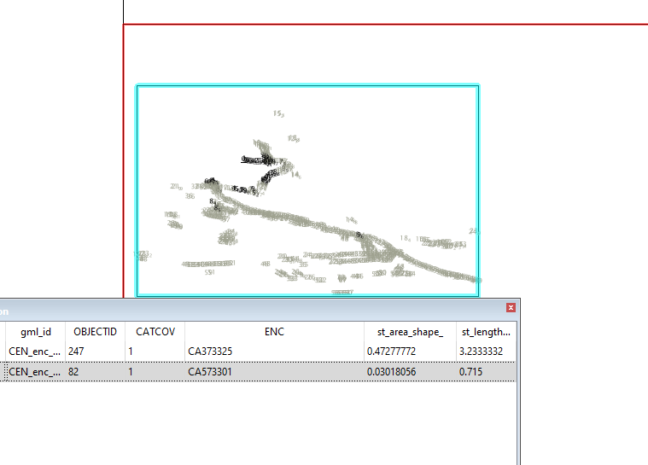
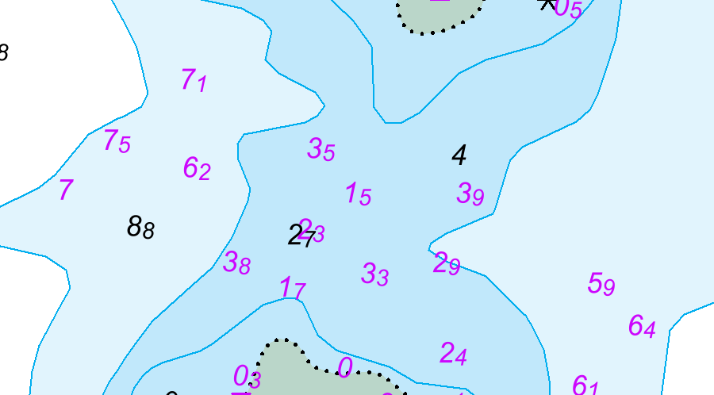
NAVWARN Assessment
HydrOffice CATools leveraged for Chart Comparison algorithm (https://www.hydroffice.org/catools/main)
Python Script Developed to Compare soundings from surface in S57 file with Current ENC’s using CATools chart comparison methods coupled with CHS NAVWARN criteria.
Query overlapping charts with soundings via S-57 Catcov1 WFS layer, to build directory paths
Output selected shoal soundings (purple) that are deemed to be potential NAVWARNS.

Slide 6
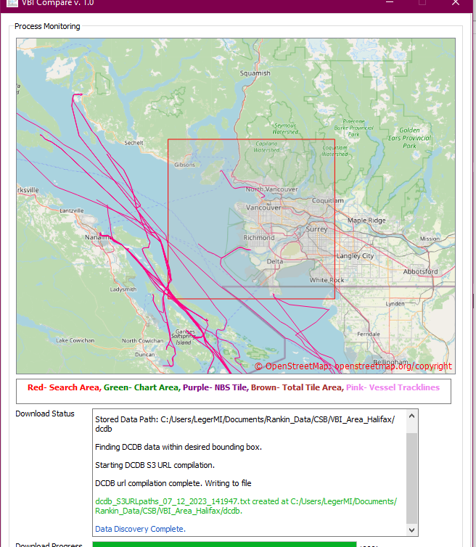
VBI Compare in Canadian Waters
Leverage VBI Compare’s DCDB search algorithm to Retrieve DCDB Datasets within Canadian Waters
Future Developments with leveraging and contributing to VBI for CHS
Investigate and develop a Script to monitor when New data is uploaded to DCDB
ENC Extents
Add functionality to connect to NONNA and CHS BDB holdings to leverage and analyze datasets through the Reputation Calculation.
Add linkage between VBI and CHS’s CSB Automated Processing Workflow

