Slide 1
Challenges in Accessing IHO DCDB’s CSB data
v4
Initial Assessment on Programmatic Retrieval of CSB Data through IHO DCDB Services
Submitted by Denmark on behalf of the HO subWG (Canada, Sweden, UK, USA)

Slide 2
Introduction
Hydrographic Offices (as well as other organizations) may have interest in monitoring the CSB data collected by IHO DCDB to:
Identify potential areas for navigational warnings
Evaluate possible chart discrepancies
Explore an internal QA workflow for CSB data
Eventually update nautical documentation (after the QA workflow).
The monitoring of IHO DCDB’s CSB data should be automated to the greatest possible extent to:
Ease the work of HO analysts and reduce the time required for the analysis
Minimize the reaction time to ensure safety of navigation.

Slide 3
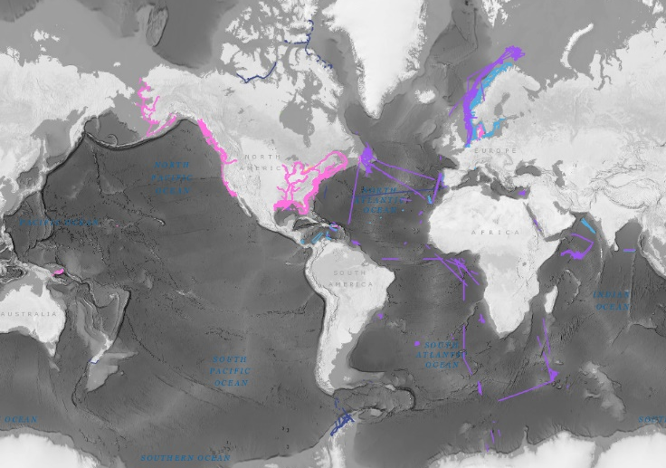
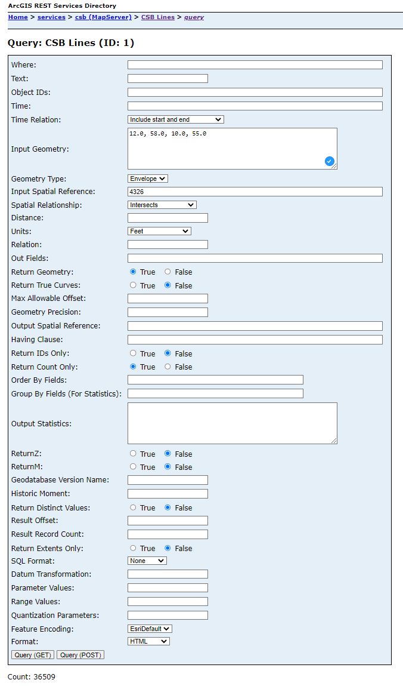
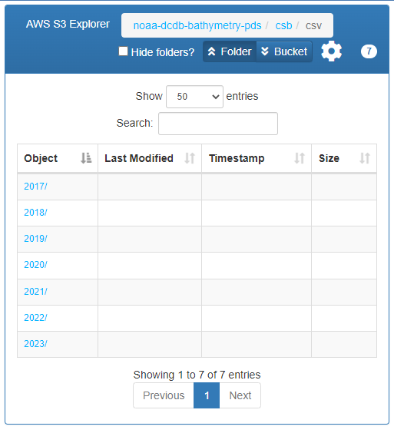
HOW TO ACCESS IHO DCDB’s CSB data?
CSB Data can be programmatically accessed through:
Web Interface + email → Fragile/cumbersome to script (web scraping)
OGC Services → Lack of depth values
ArcGIS REST + S3 Bucket:
Is this combination a temporary solution?
DCDB answer on 31/05/2023:
Using the ArcGIS REST service to discover the file’s uuid and then constructing the S3 object key is still the best suggestion we have to offer for file-based access. We recognize this approach is less than ideal and see it as a temporary solution while we are investigating better alternatives.
Next steps:
Investigate alternatives to make it easier to identify S3 objects of interest based on platform and provider names.
A second alternative is to use the pre-release version of the CSB pointstore API
+

Slide 4
How to Organize the retrieved CSB DATA?
CSB Data from S3 Bucket are in CSV format with 8 (undocumented?) fields:
UNIQUE_ID
FILE_UUID
LON
LAT
DEPTH
TIME
PLATFORM_NAME
PROVIDER
Data retrieved on May 18, 2023

Slide 5
How to Organize the retrieved CSB DATA?
CSB Data from S3 Bucket are in CSV format with 8 (undocumented?) fields:
UNIQUE_ID
FILE_UUID
LON → always DD? which accuracy?
LAT → always DD? which accuracy?
DEPTH → in meters? which accuracy?
TIME → always ISO 8601? which accuracy?
PLATFORM_NAME
PROVIDER
Timestamped x, y, z
DCDB answer on 31/05/2023:
Language will be updated to reflect that all fields are from the original, as-provided files, which are consistent with B-12 guidance related to units, formats, etc.
Data retrieved on May 18, 2023

Slide 6
How to Organize the retrieved CSB DATA?
CSB Data from S3 Bucket are in CSV format with 8 (undocumented?) fields:
UNIQUE_ID
FILE_UUID
LON
LAT
DEPTH
TIME
PLATFORM_NAME
PROVIDER
How to use these 4 fields to retrieve:
All the CSB data for a specific vessel?
Vessel names are not unique!
Group CSB data by vessel journey?
Journey provides context for data validation!
Retrieve the corresponding journey metadata?
DCDB answer on 31/05/2023:
The CSB objects (i.e. files) in the S3 bucket are not optimized for access by criteria other than date but we are looking at options to enhance the flexibility (see previous response).
Regarding the issue of unique vessel names, the uniqueID is included in the CSV files available for download via the NODD bucket. Will include this information in a future FAQ document.
Metadata associated with a given file is not currently available via web-based access. Metadata for a “journey” would first require identifying the individual files associated with a “ journey”.
Data retrieved on May 18, 2023

Slide 7
How to Organize the retrieved CSB DATA?
CSB Data from S3 Bucket are in CSV format with 8 (undocumented?) fields:
UNIQUE_ID
FILE_UUID
LON
LAT
DEPTH
TIME
PLATFORM_NAME
PROVIDER
Is this field actually required?
Data retrieved on May 18, 2023

Slide 8
What does ‘anonymous platform’ mean?
CSB Data from S3 Bucket are in CSV format with 8 (undocumented?) fields:
UNIQUE_ID
FILE_UUID
LON
LAT
DEPTH
TIME
PLATFORM_NAME → Anonymous
PROVIDER
Data retrieved on May 18, 2023

Slide 9
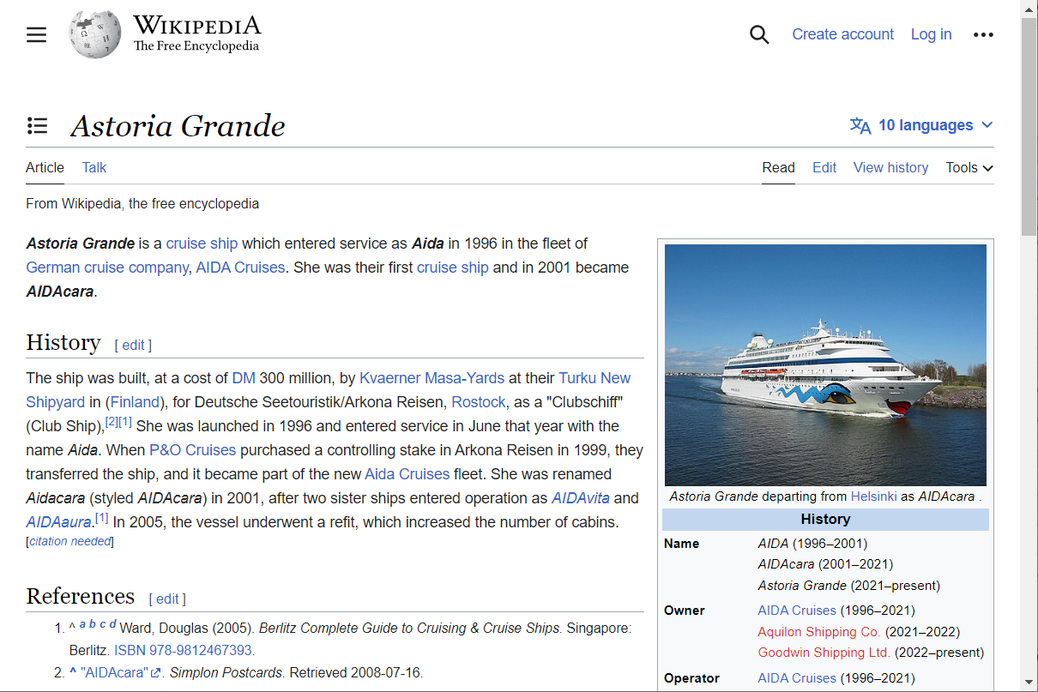
A need for anonymity Checks?
DCDB answer on 31/05/2023:
In the example shown, “AIDACARA” is included in the unique_ID, which our system then includes in the FILE_UUID.
This unique_ID is set by trusted nodes and is intentionally beyond the control of the DCDB. We leverage whatever is provided to us.
It is important to protect the trust that the DCDB and Trusted Nodes have earned.
Data retrieved on May 18, 2023

Slide 10
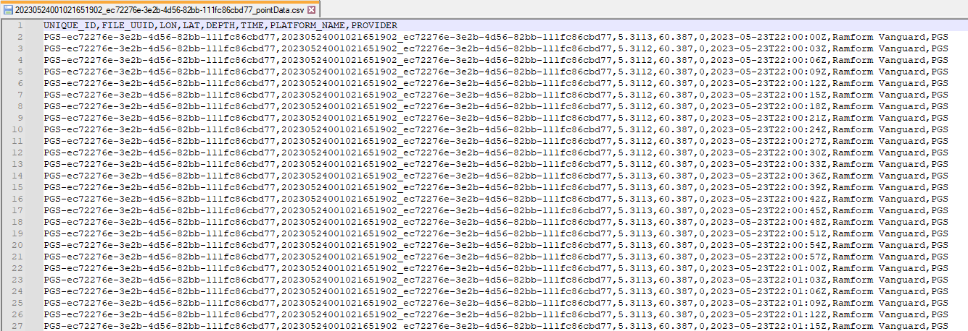
HOW DO WE interpret zero depth?
There may be different reasons for zero depth: e.g., the sonar has lost the bottom in deep waters.
DCDB answer on 31/05/2023:
B-12 defines depth as 'The distance from the vertical reference point to the seafloor.' With this, zero depth would mean the vertical reference point is at the seafloor.
Data retrieved on May 23, 2023
What is the percentage of zero-depth entries in DCDB's CSB database?
Should entire tracklines with only zero-depth values be removed?

Slide 11
should significant digits be enforced?
Having 3 decimal digits for latitude and 0 decimal digits for depth is not ideal.
Data retrieved on May 23, 2023
What is the submission policy about significant digits?
Is rounding and/or truncation applied?

Slide 12
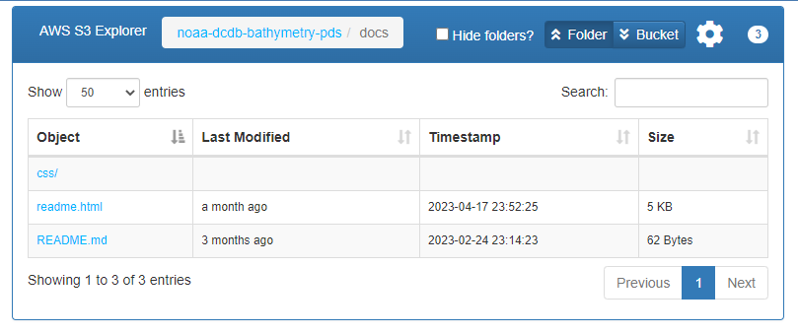
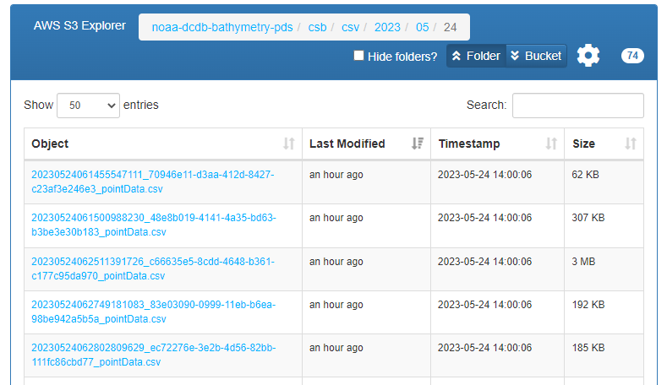
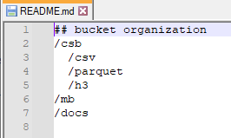
Additional info from DCDB's CSB AWS
AWS S3 Explorer: https://noaa-dcdb-bathymetry-pds.s3.amazonaws.com/index.html
Landing Page
Docs Page
Example of daily CSV Page
Accessed 25 July 2023
?
DCDB answer on 31/05/2023:
parquet, h3, and mb in the README.md are forward-looking and will be removed from documentation until those additional formats are ready.

Slide 13
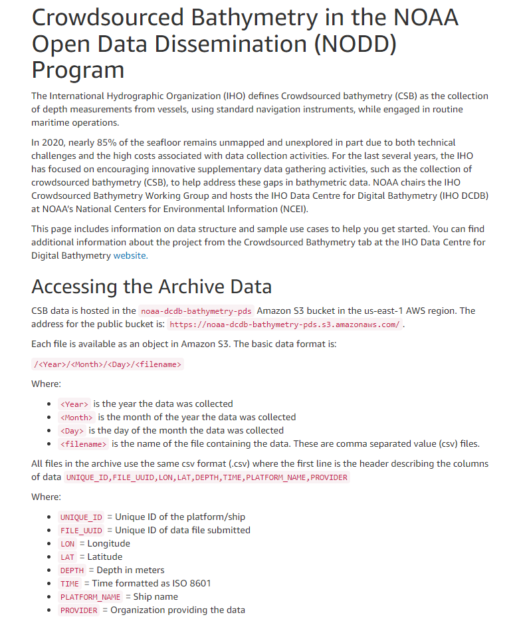
AWS S3 README.html
https://noaa-dcdb-bathymetry-pds.s3.amazonaws.com/docs/readme.html
S3 CSV format description
Should B-12 be mentioned?
Is UNIQUE_ID unique for a vessel across trusted nodes?
Is FILE_UUID unique for a journey? If not, how to retrieve all the files related to the same journey?
What to use the PROVIDER for?
Is ‘platform’ and ‘ship’ used interchangeably?
'Vessel Name' is recommended metadata in B-12 3.3.3
…
DCDB answer on 31/05/2023:
The unique_ID is set by the trusted node and is intentionally outside the scope of the DCDB. If the same vessel were to contribute via multiple trusted nodes, it would likely have a different unique_ID from each.
The concept of a “cruise” or “journey” is not inherent in the data submissions and what appears on the map as a single continuous track may consist of multiple independent files with separate FILE_IDs.
PROVIDER allows filtering to select data from a given trusted node.
Accessed 25 July 2023

Slide 14
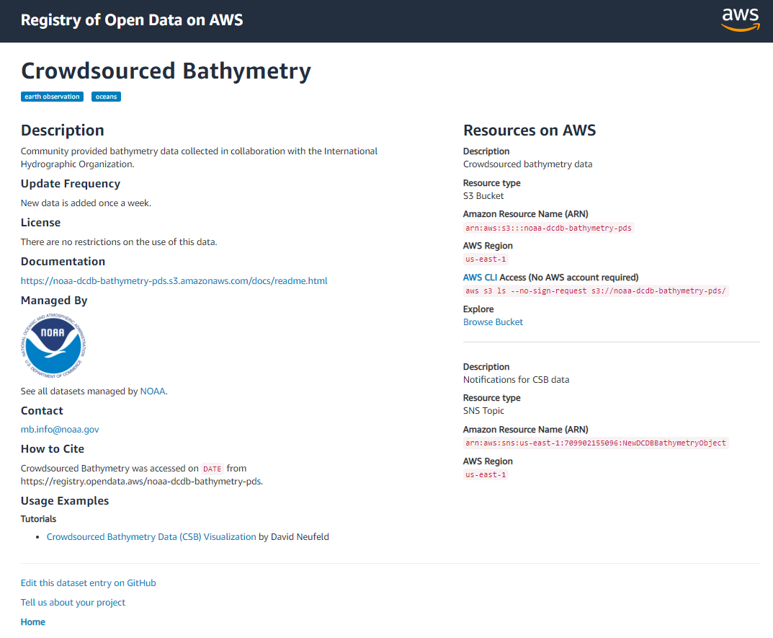
Additional info from the Registry of Open Data
https://registry.opendata.aws/noaa-dcdb-bathymetry-pds/
Update Frequency
Syncing delay with web interface (?)
License
"There are no restrictions on the use of this data" maps to a well-known license? Is the same as CC0?
What about previous CC-BY data? How to honor the attribution requirement?
How CSB data are licensed is critical for being used in HO products.
Tutorials
Does the tutorial provide the suggest way to retrieve CSB data?
DCDB answer on 31/05/2023:
DCDB will update noaa-dcdb-bathymetry-pds documentation as able to reference B-12, standardize the terms “ship” and “platform”, and clarify update frequencies
DCDB answer on 31/05/2023:
Language on the registry relating to licensing will be updated, referencing B-12. Conversation needed to discuss prior CCBY license.
Accessed 25 July 2023

Slide 15
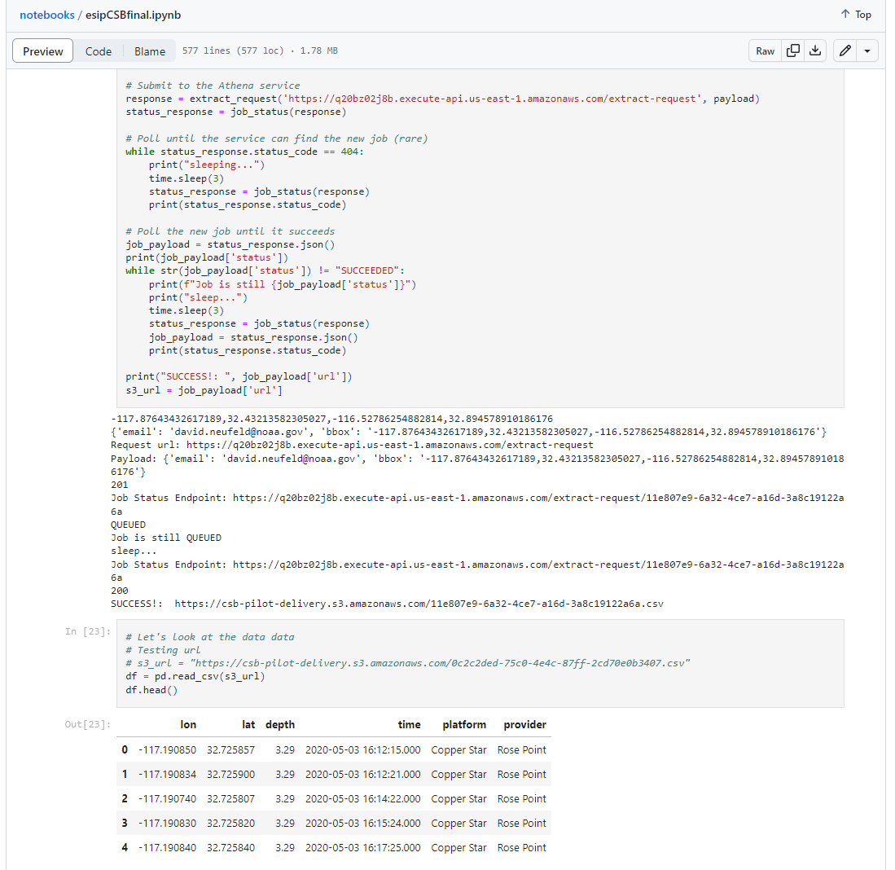
CSB Visualization Notebook
https://github.com/dneufeldcu/notebooks/blob/main/esipCSBfinal.ipynb
Outdated or future design?
DCDB answer on 31/05/2023:
The referenced example was contributed and has not been updated to reflect the most recent changes in the archive. It still may be of interest to those building their own access tools for the archive.
Accessed 25 July 2023

Slide 16
RECOMMENDATIONS
The IHO DCDB services for CSB data may be improved by focusing on:
Easing the retrieval of a complete set of CSB data information:
Position and depth (i.e., x, y, z)
Timestamp
Metadata
Auxiliary measurements (if available)
Data license
Publishing a page collecting official documentation:
ArcGIS REST & S3 .csv format description
Example scripts (e.g., filters by area, time and platform) in a IHO’s GitHub repository.
DCDB answer on 31/05/2023:
The files available via S3 access do not contain metadata, auxiliary measurements, or data license.
DCDB answer on 31/05/2023:
https://noaa-dcdb-bathymetry-pds.s3.amazonaws.com/docs/readme.html contains information on, and examples for, programmatic access of CSV files based on date.
Contributed tutorials and examples are welcome.
?

Slide 17
Recommendations
The CSBWG is requested to:
Note the information provided.
The IHO DCDB is requested to:
Take actions, as appropriate, to improve accessibility of the CSB data through improved data services and related documentation/example scripts.
Engage HOs in the testing and development of enhancements to the DCDB's CSB data interface.
DCDB answer on 31/05/2023:
Although the pointstore API is in a pre-release state and not intended for any production workflow, we are working on documentation to make it easier to use outside the DCDB Map Viewer. Suggestions for additional filtering options or other enhancements are welcome

