Slide 1
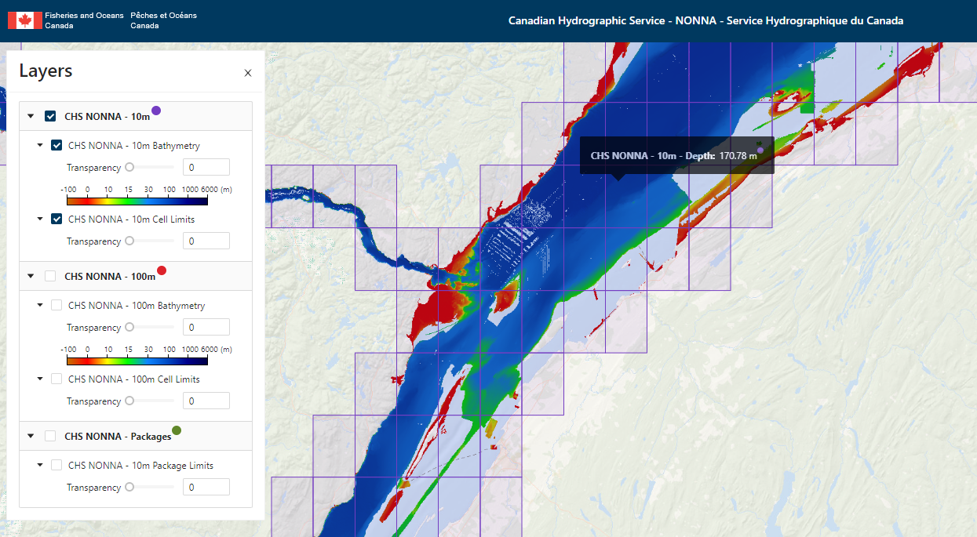
May 2023
Potential CARIS tools in support of CSB, GEBCO & Seabed 2030
https://data.chs-shc.ca/
Notes:
Screen capture: CARIS Cloud is powering CHS NONNA portal: https://data.chs-shc.ca/dashboard/map

Slide 2
Overview
CARIS Cloud can be the link between stakeholders interested in sharing their data and Seabed2030.
Selected BDB data can be uploaded, processed and transferred to Seabed2030 data holdings automatically at specifications configured by the user.
CARIS BDB Server
Upload & Process data
CARIS Cloud Account
Data transfer
Seabed2030
Notes:
CARIS Cloud can be the link between stakeholders interested in sharing their data and Seabed2030. Propose that we focus on the use case of Hydrographic Offices wanting to share data as a pilot project to start with. We can expand the concept to other stakeholders from there.
There are many reasons HOs do not currently share data with Seabed 2030 / GEBCO and level of effort to do so is one of the reasons. This can remove that barrier.

Slide 3
BDB Server 5.4
BDB Server 5.4 with connection to CARIS Cloud account to schedule and configure data pipeline to automatically upload and process BDB data and make it available to CARIS Cloud users
Select gridded data to upload
Configure processes to execute when uploading data. For example:
Generate gridded tile products with resolution, extent and formats (CSAR, ASCII, BAG, S-102, GeoTIF) specified by users
Update raster mosaic distributed as OGC services (WMS, WMTS)
Run process manually or automatically at some cadence
CARIS BDB Server
Upload & Process data
CARIS Cloud Account
Data transfer
Seabed2030
Notes:
CARIS Cloud pipeline does not include point cloud processing at the moment, but we would be interested in discussing the possibility to define a data pipeline to process crowdsourced bathymetry in a grid.
What are HO requirements to configure data for sharing? Some process options to consider are resolution, extents, coverage bands to include, coverage metadata, additional metadata.
What are GEBCO/Seabed requirements in terms of how they can/want to receive the data? Some considerations on formats, size, metadata.

Slide 4
CARIS Cloud with Bathy Data Service app
Cloud hosted solution to upload & process, manage, disseminate hydrospatial data and products
Several applications can be activated, notably Bathy Data Service to enable gridded bathymetry pipeline
REST API to define and execute jobs (chains of processes)
CARIS BDB Server
Upload & Process data
CARIS Cloud Account
Data transfer
Seabed2030
Notes:
Consideration for cost to set up and run the service. Is the service missing any key capabilities to meet requirements of an HO focused pilot project?

Slide 5
Transfer to GEBCO / Seabed 2030 / DCDB
CARIS Cloud has a modern REST API, which can be used by other systems to receive notifications when new data is available and to download the data.
CARIS Cloud also has a simple and customizable Discovery Viewer to find and download data
CHS NONNA portal is an example: https://data.chs-shc.ca/dashboard/map
CARIS BDB Server
Upload & Process data
CARIS Cloud Account
Data transfer
Seabed2030
Notes:
What are GEBCO / Seabed’s requirements for ingesting data from CARIS Cloud? Considerations around security, size, etc.

