Slide 1
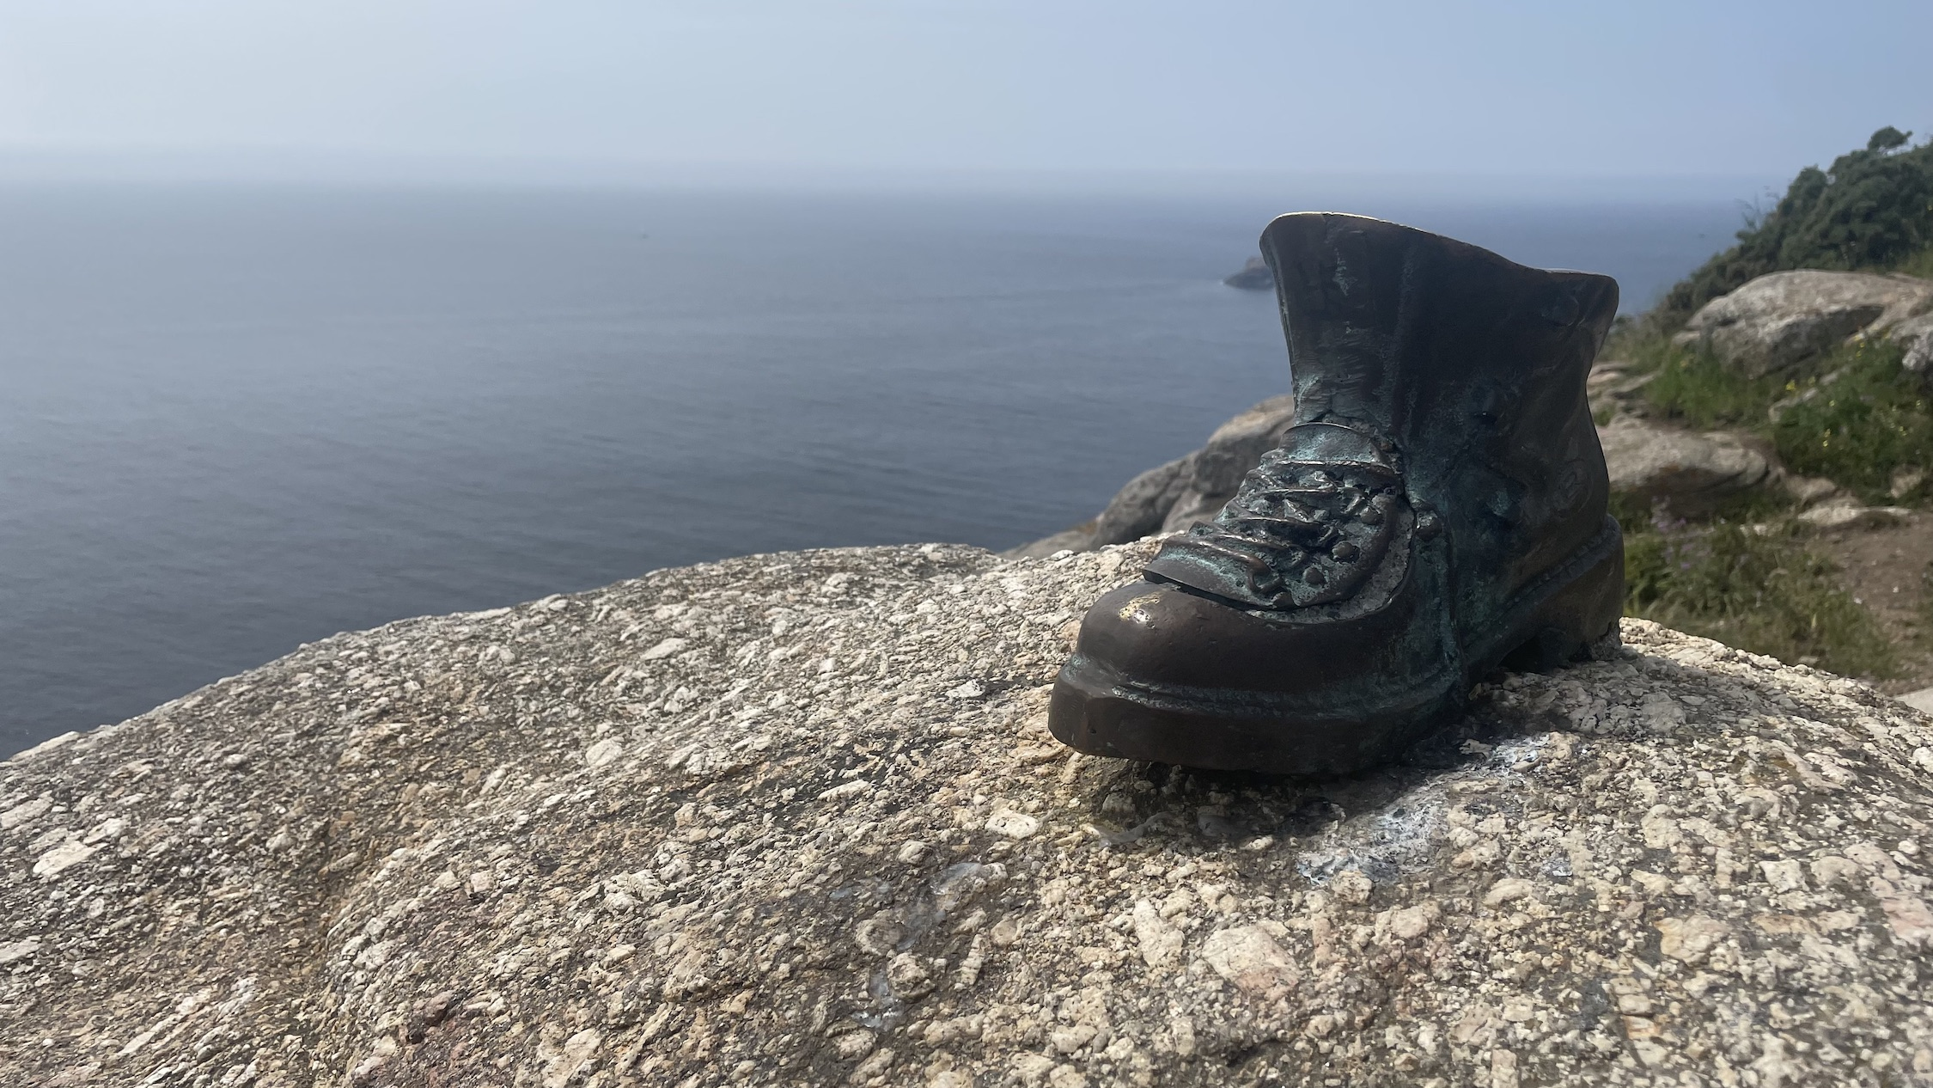
Data Life Cycle (Task Group 7)
IHO Crowdsourced Bathymetry Working Group
Brian Calder, Guiseppe Masetti, Brian Miles, Guillaume Morissette, Shaul Solomon,
Colin Thompson, Georgie Zelenak

Slide 2
Clarify all aspects of the CSB data cycle and capture known issues, requirements and suggested enhancements.

Slide 3
Capture Processing
Metadata
Data Format Extension
Data Access
Use Cases
Availability

Slide 4
Capture Processing
Review, recommend, and document (in conjunction with the available open source code development projects) the data flow of standard processing stages for data capture, including extensions for uncertainty estimation and associated metadata/data format extensions.

Slide 5
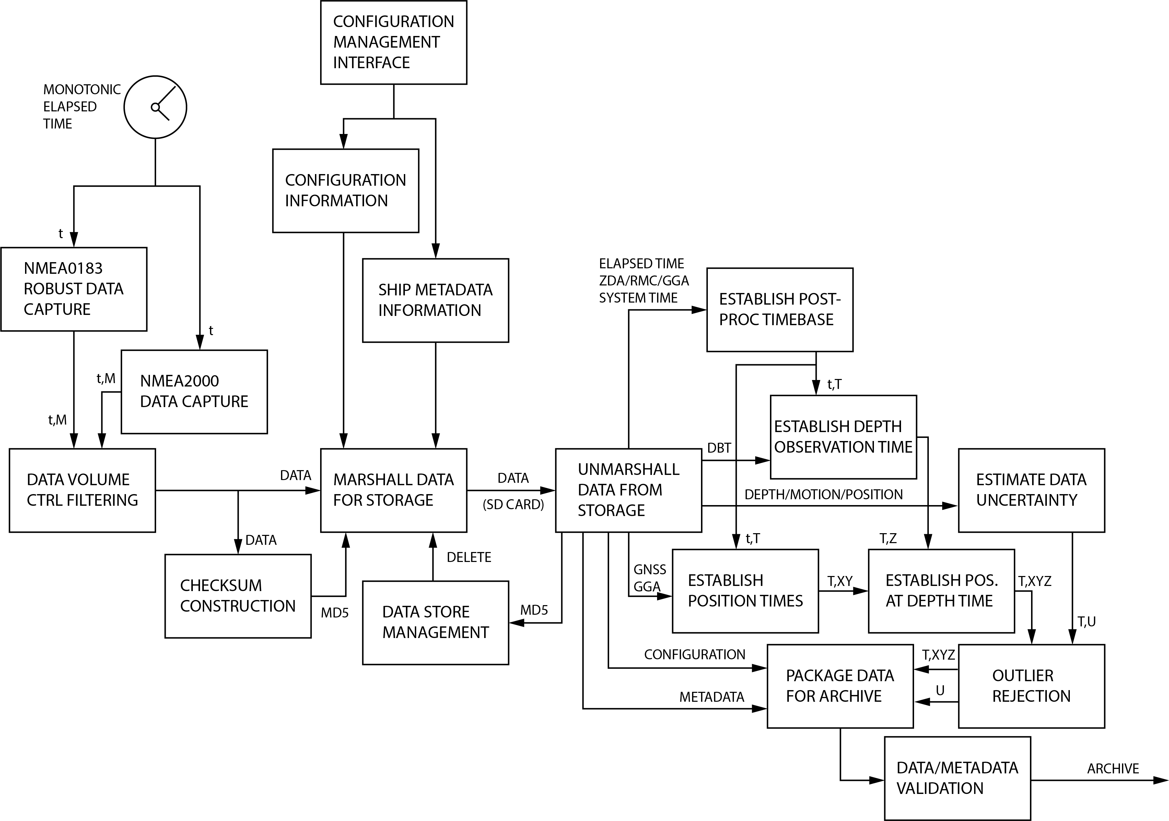
Source: WIBL Project [http://wibl.ccom.unh.edu]

Slide 6
Metadata
Review the current metadata structure for CSB data for completeness, encoding methods, validation mechanisms, and support for end-user database mapping (e.g., for groups of collectors and other aggregations), and recommend modifications.

Slide 7
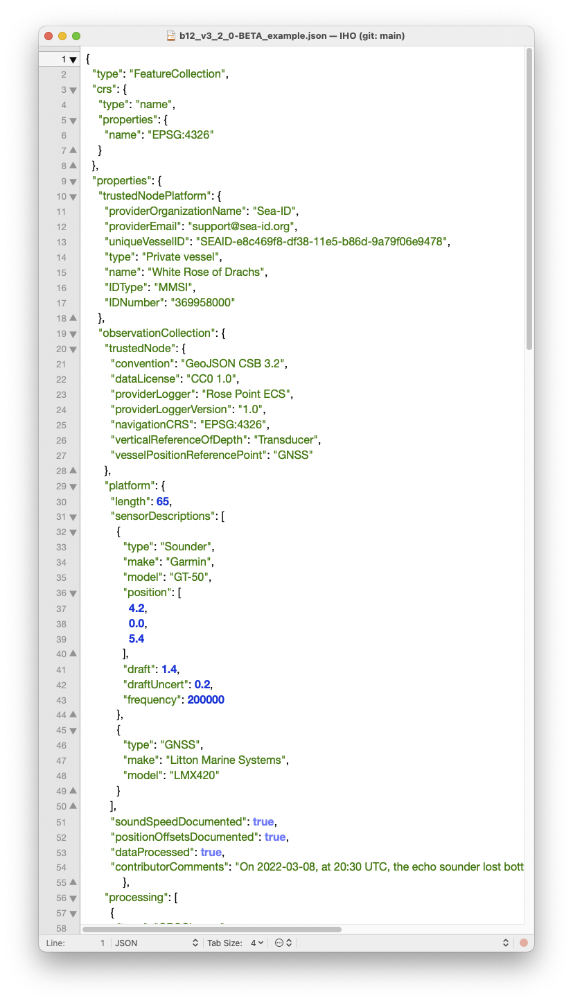
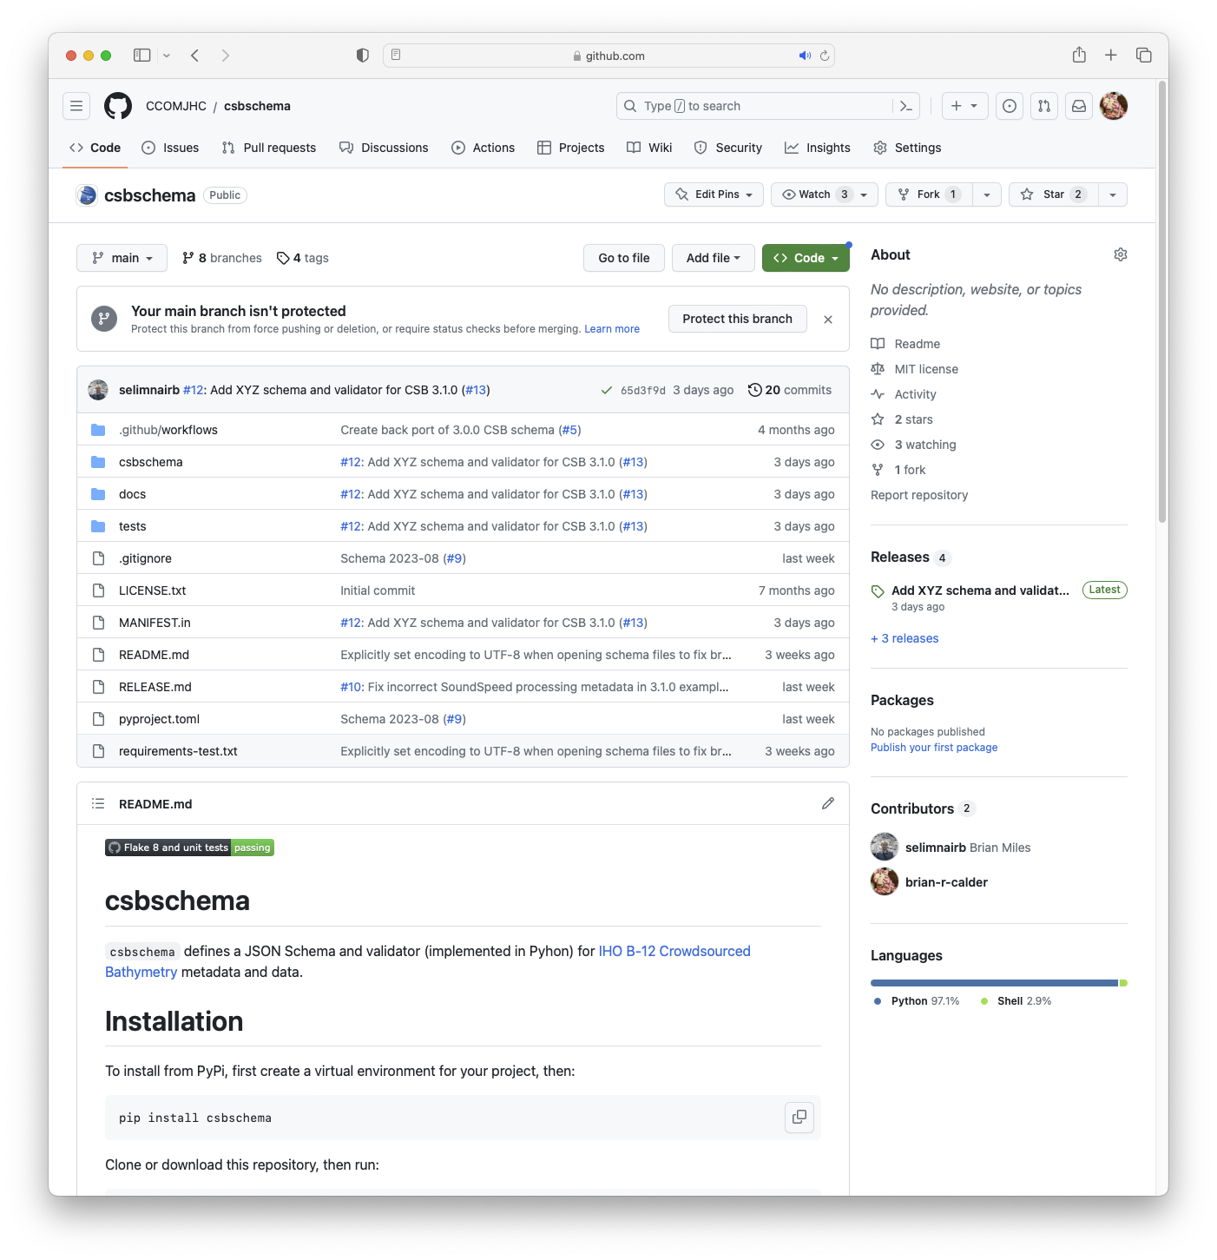
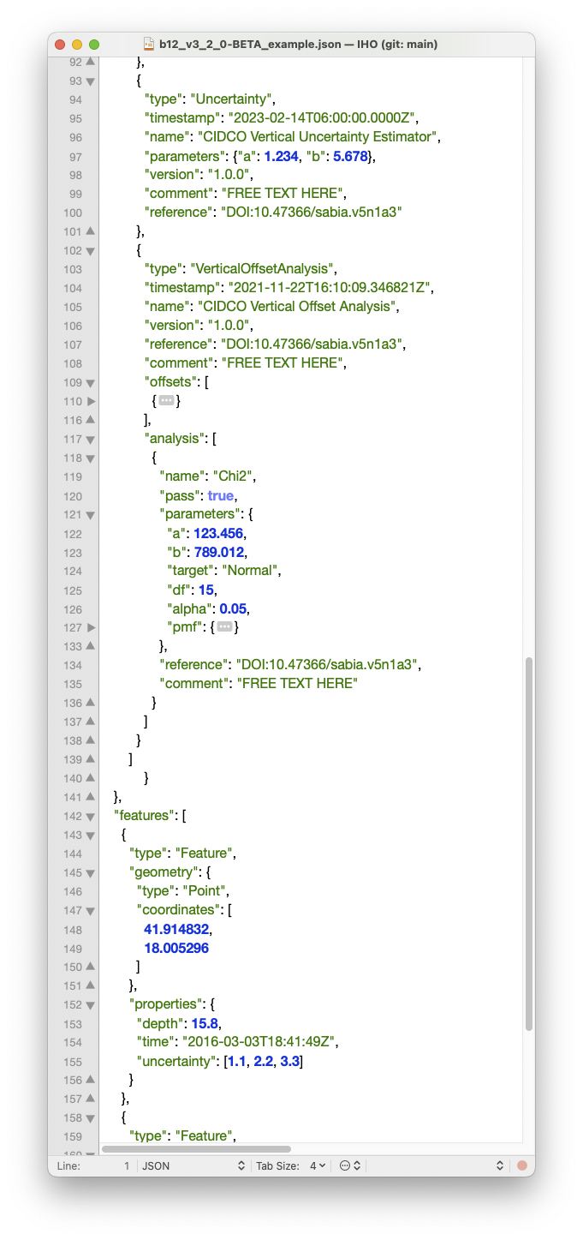

Slide 8
Data Format Extensions
Consider potential extensions of the current GeoJSON to include such features as heading, motion time series, and uncertainty estimates.

Slide 9
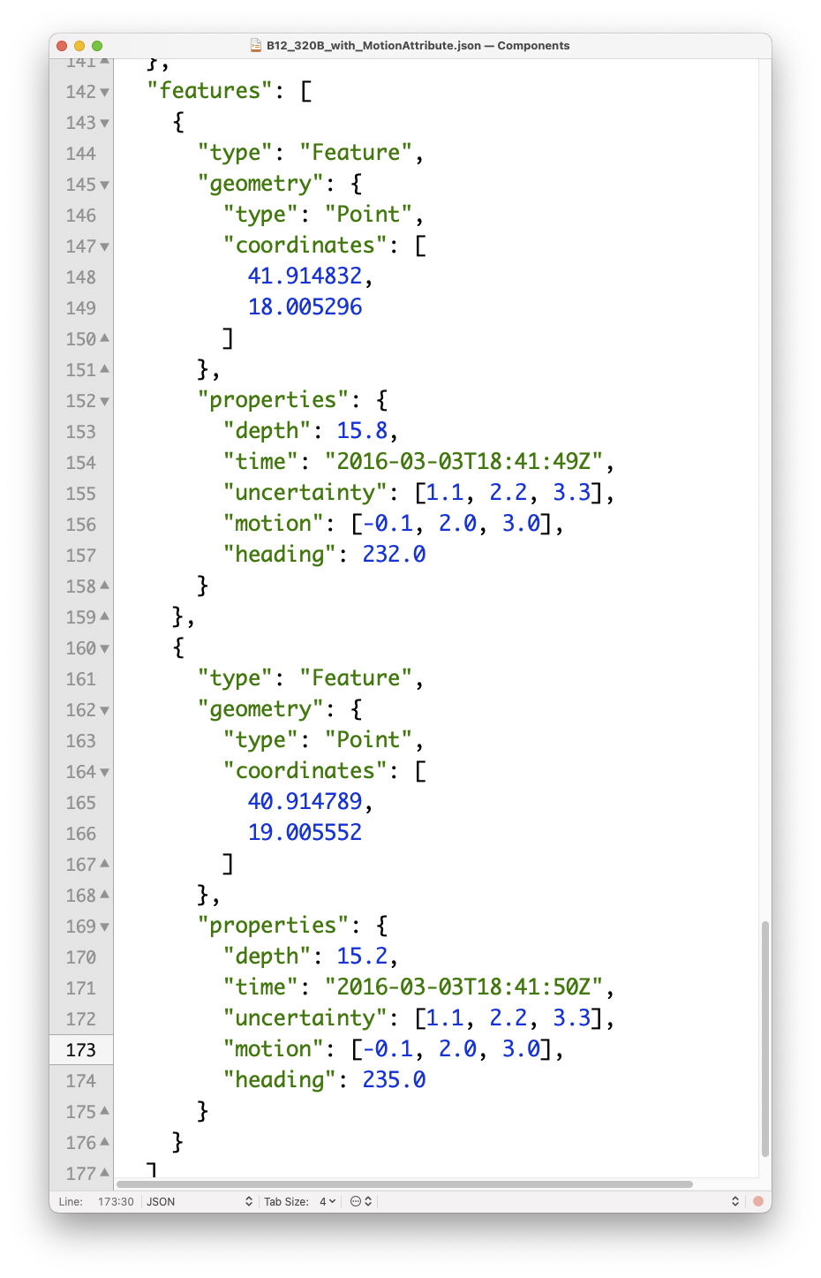
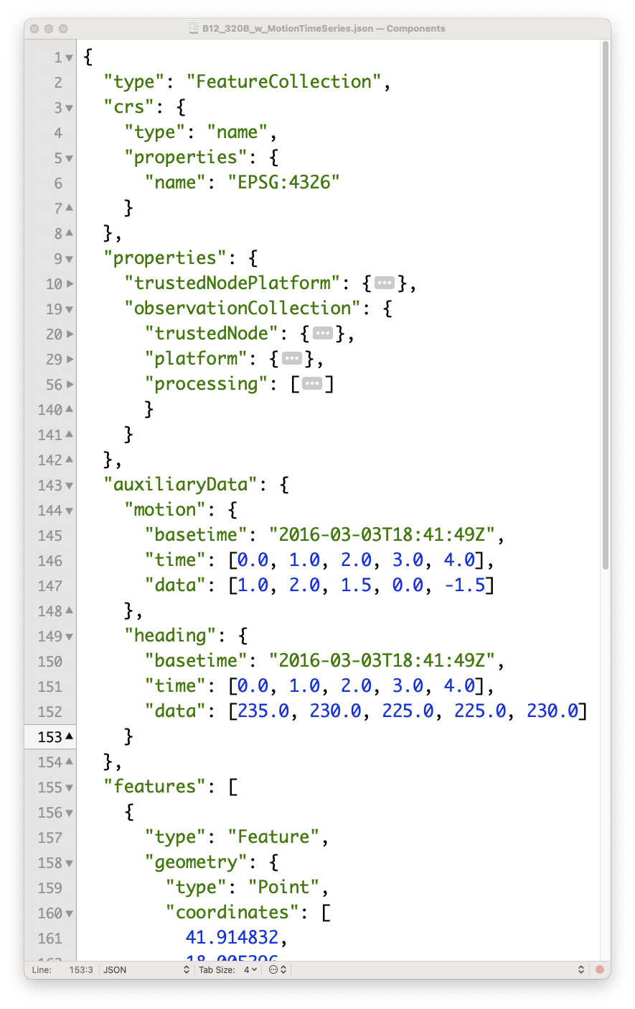

Slide 10
Data Access
Investigate and consider extensions to the DCDB S3 data store and OGC services, particularly with respect to searchability and metadata access for individual observers, and make suggestions for future development at DCDB.

Slide 11
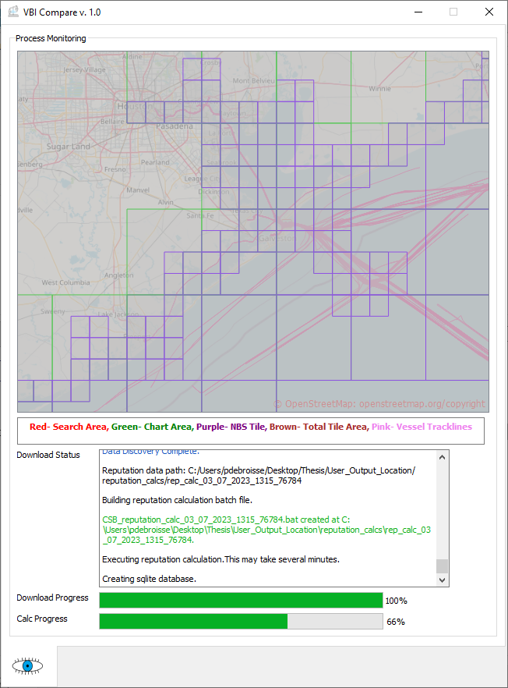
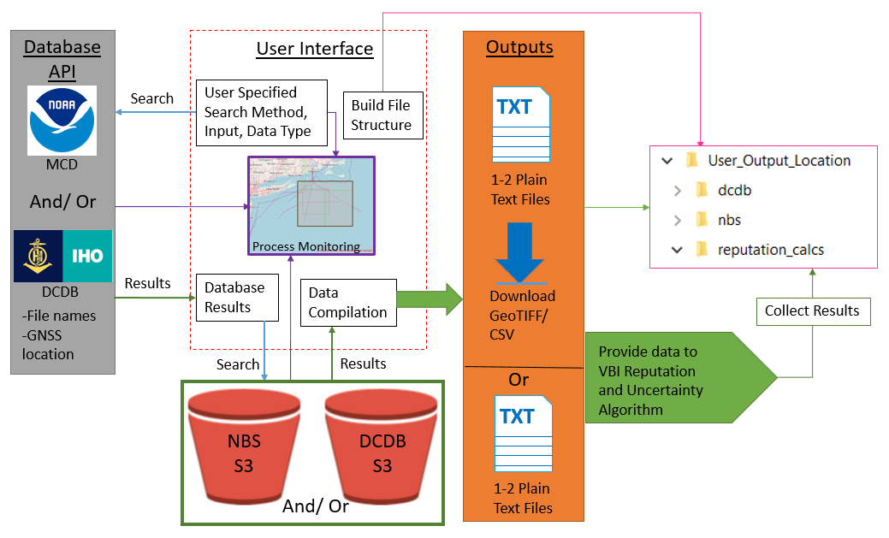
Source: Debroisse, 2023

Slide 12
Use Cases
Establish recommendations for one or more use cases of CSB, and associated guidelines for data products (e.g., interpretation of quality, known problems, required processing, etc.). Collaborate with other task groups preparing specialized products (e.g., for HO use).

Slide 13
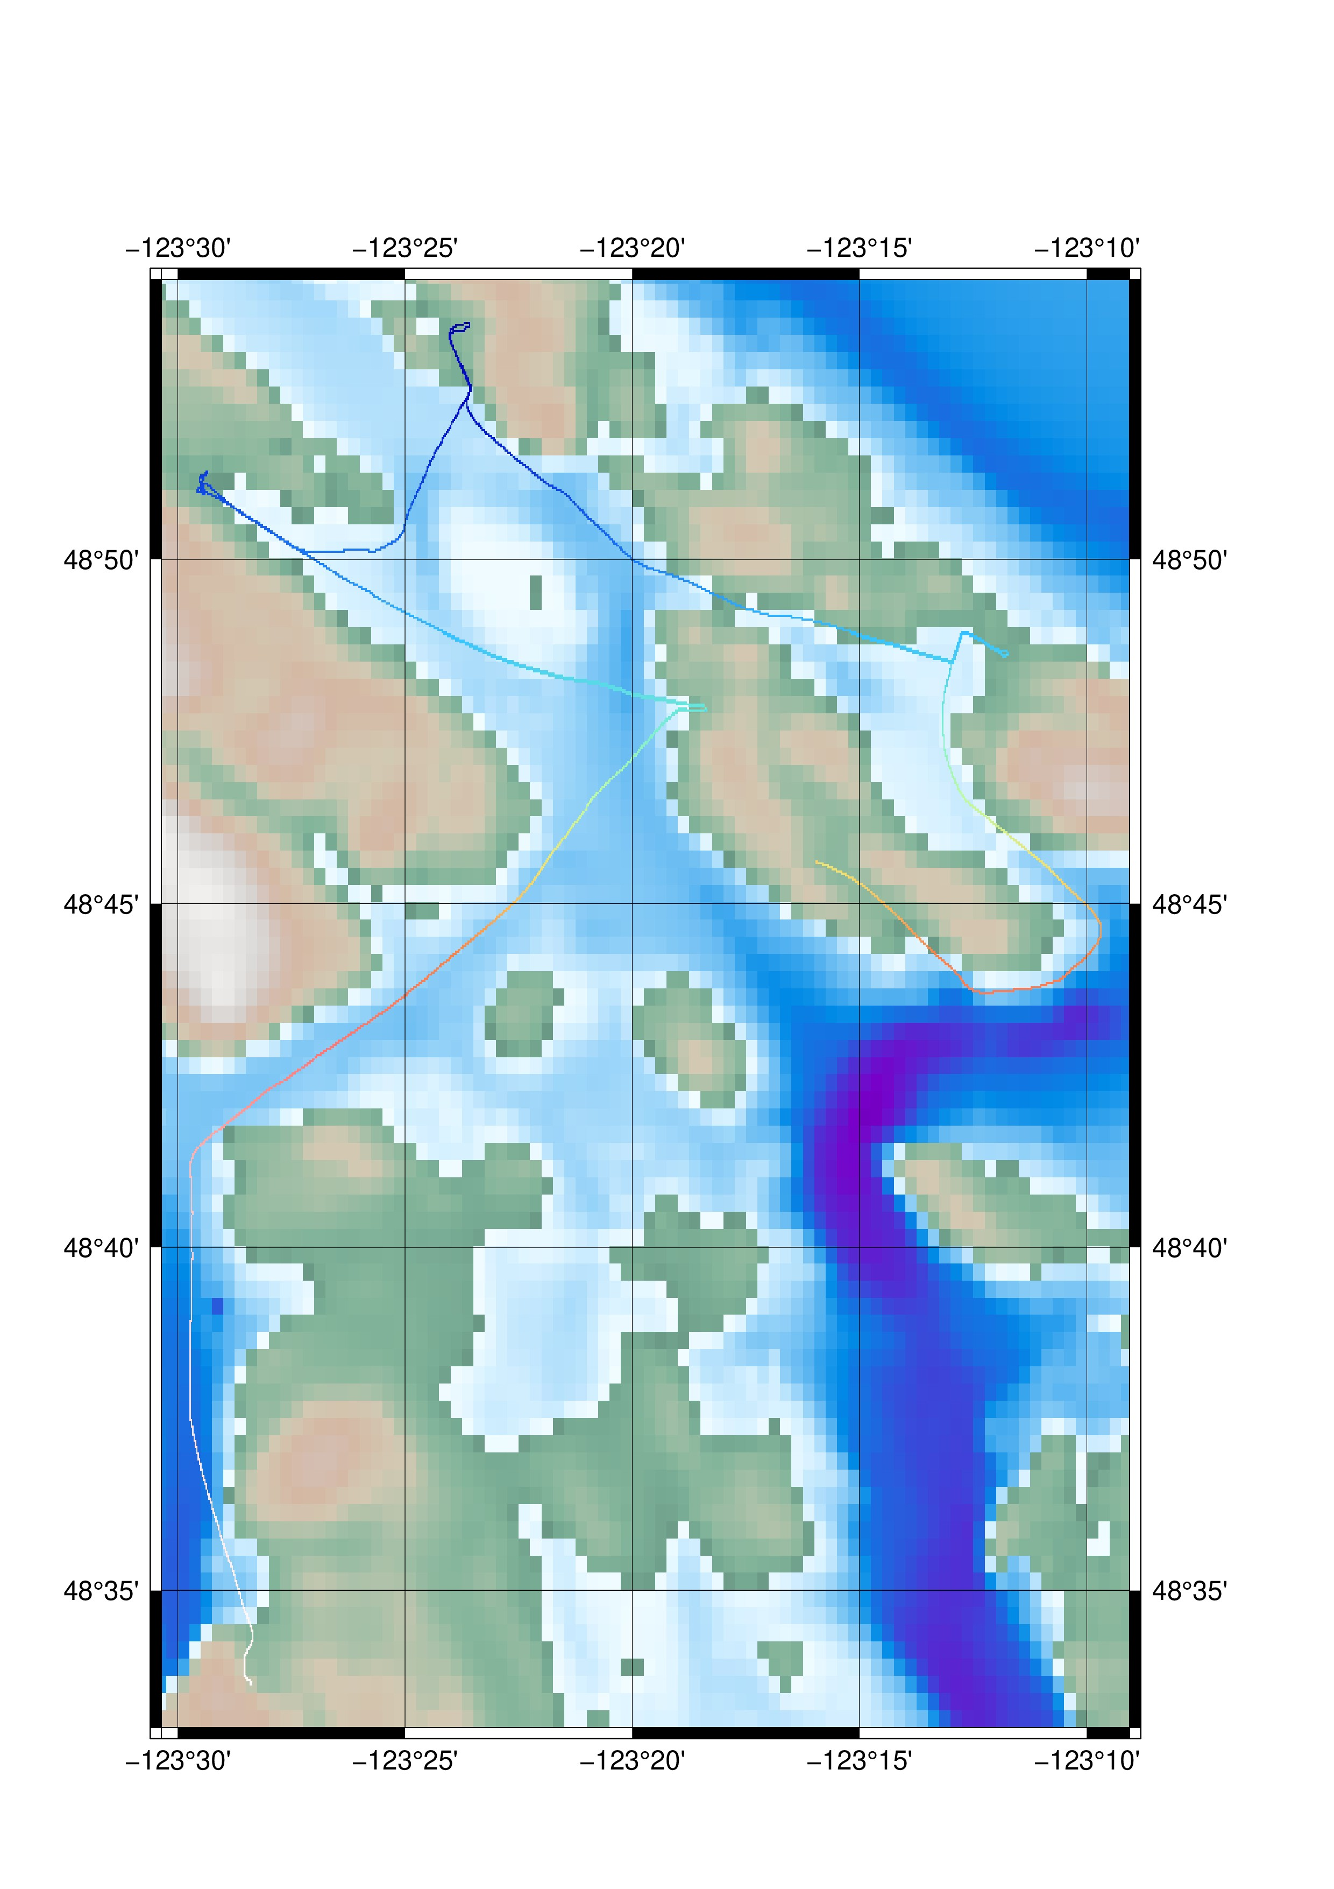
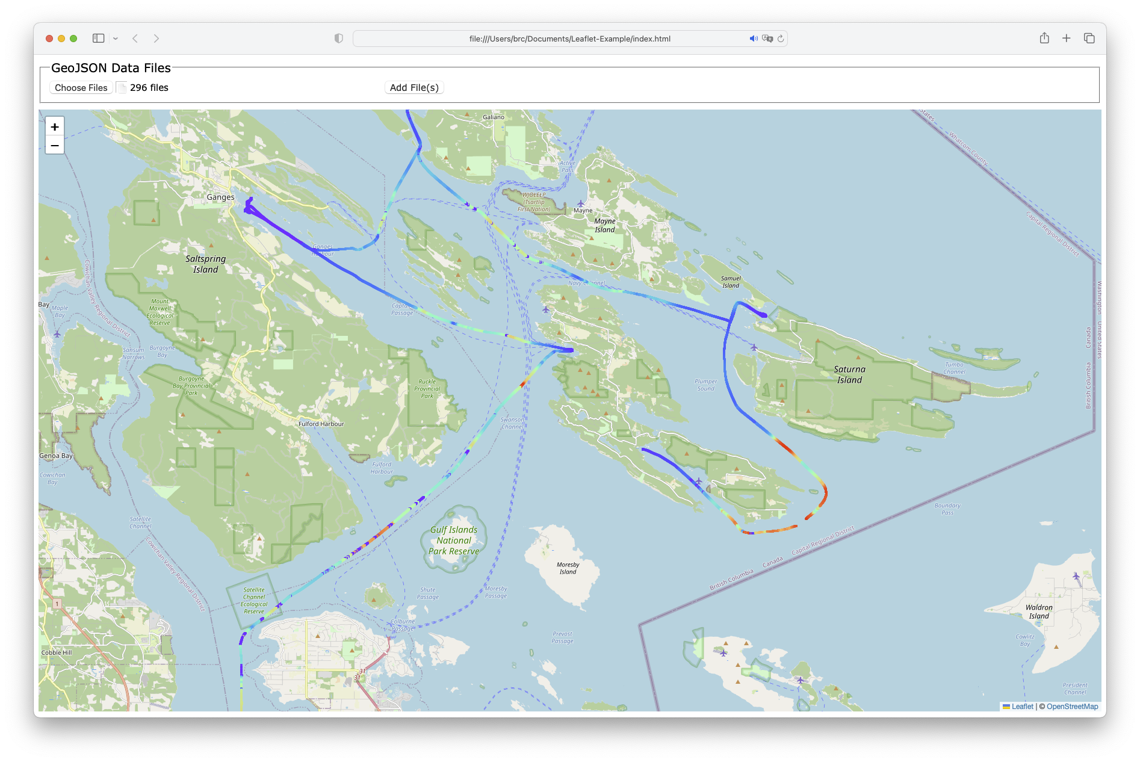
Source: Calder & Johnson, 2023

Slide 14
Availability
Promote and contribute to an open source reference implementation of available algorithms for all the processing steps, preferably with a permissive license such as MIT or CC0.

Slide 15
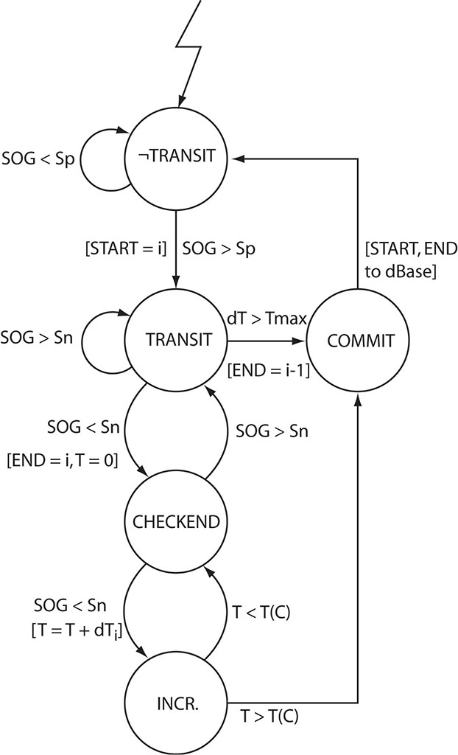
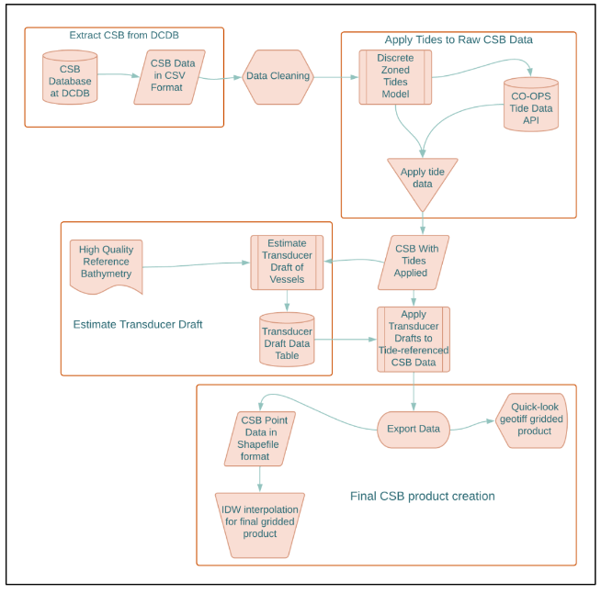
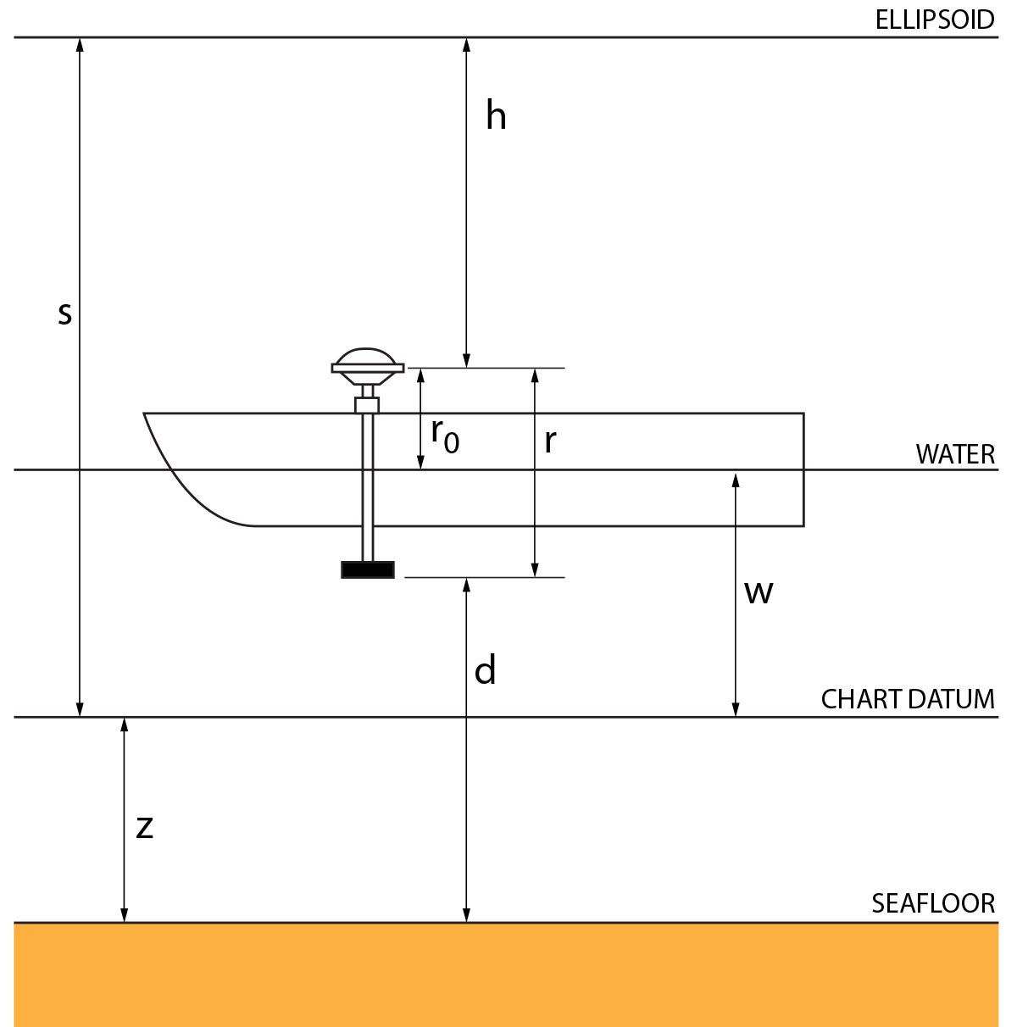
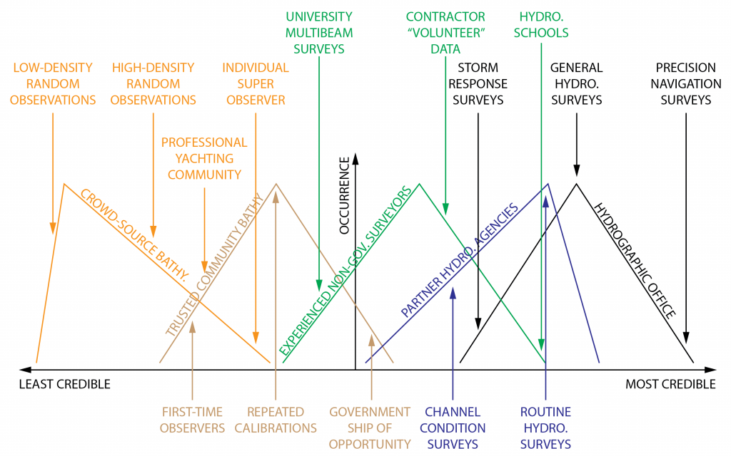
Source: Calder & Schwehr,
2009
Source: Calder et al., 2020
Source: Klemm & Krabiel (US Hydro 2023)
Source: Calder, 2021

Slide 16
Prioritisation
Data Access
Capture Processing
Data Format Extensions
Metadata
Use Cases
Availability

Slide 17
Recommendations
WG is requested to note this information
WG is requested to consider metadata schema information
WG is solicited for other prioritization data
WG is requested to encourage participation in fact-finding, service definition, and use cases, etc.

