Slide 1
Develop a Recognition & Incentive Strategy
Work Item Update

Slide 2
Background
Team Members:
David Millar (Fugro – USA)
Matt Zimmerman (FarSounder – USA)
Linden Brinks (GLOS – USA)
Jennifer Cheveaux (Seabed 2030 – UK)
Sarah Grasty (USF COMIT – USA)
Bill Staby (WOC – USA)
Scope:
Develop a recognition & incentive strategy by compiling a list with short summaries of potential incentives and recognitions that would motivate individuals / organizations to participate in CSB.

Slide 3
background
Not in Scope:
Implementation of the recognition & incentive strategy
Approach to task:
Initial virtual kick-off meeting on 19 April
Progress work via e-mail communications and shared documents
Use Google Drive to host shared documents
Consider NLA International-Seabed 2030 “Seabed 2030 Economic Impact Sectors Document” and IHO CSBWG 2-page flyers to develop list of various target sectors
Develop lists of recognition and incentives by sector

Slide 4
Work Items from report on CSBWG to IRCC
Work Item | Title | Priority H-high M-medium L-low | Next milestone | Start Date | End Date | Status P-planned O-ongoing C-completed S-Superseded | Contact Person(s) | Related Pubs / Standard | Remarks
J-1 | Compile a list of potential types of recognition and potential incentives that would motivate individuals and/or organizations to participate in CSB |  | For each potential type, develop a short summary of action required to support its implementation | 2023 | August 2023 | O | Fugro/D Millar
J-2 | Develop Recognition and Incentive Strategy Plan |  | Gather feedback at CSBWG14 and finalize | 2023 | Dec 2023 | P | Fugro/D Millar

Slide 5
SECtors Considered
Commercial data collectors / survey companies
Commercial maritime support vessels
Commercial shipping
Commercial cruise ships
Commercial fishing and aquaculture
Mega Yachts / Super Yachts / Trawler Yachts
Recreational boaters
Government
Philanthropic ocean science
Commercial Trusted Nodes – Software
Commercial Trusted Nodes – Hardware
Non-Commercial Trusted Nodes

Slide 6
incentives considered
Corporate / Community Citizenship / Ocean Stewardship
Brand Awareness
Tax Incentives
Business Opportunities
Operational Improvement
Customer / Stakeholder Engagement
Education / Outreach
Goodwill
Public Recognition of Contribution
It’s Fun! (gamify)
Give Data / Get Data
Supports hydrography
Supports ocean science
SDG14 & Ocean Decade
Marketing
Product testing
Fundraising opportunities
Mandates
Cost incentives
Planning and coordinating future mapping

Slide 7
recognitions considered
MOUs / partnerships for ESG
Logo placement and acknowledgement
Valuation of contribution (tax)
Promote participation / philanthropy
Rewards (certificates, plaques, flags)
Awards
Maps showing coverage
Naming of underwater features

Slide 8
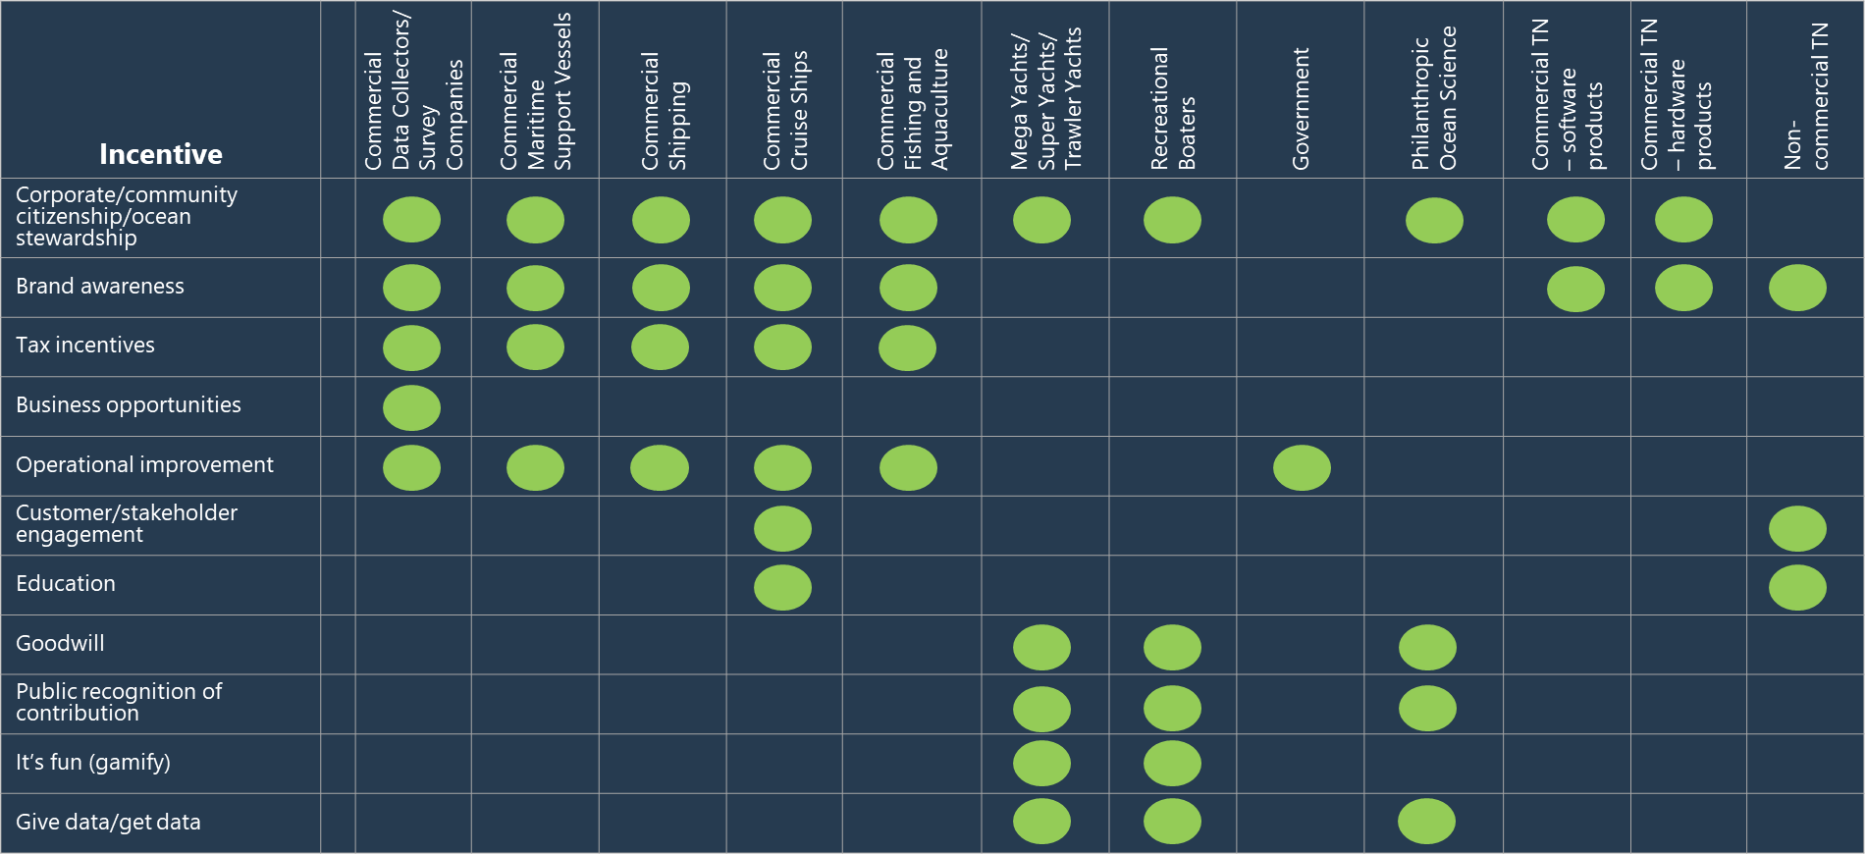
incentives by sector

Slide 9
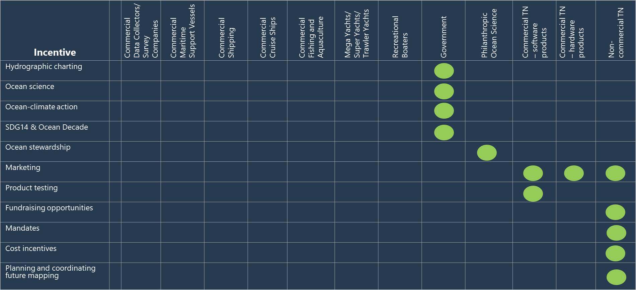
incentives by sector (continued)

Slide 10
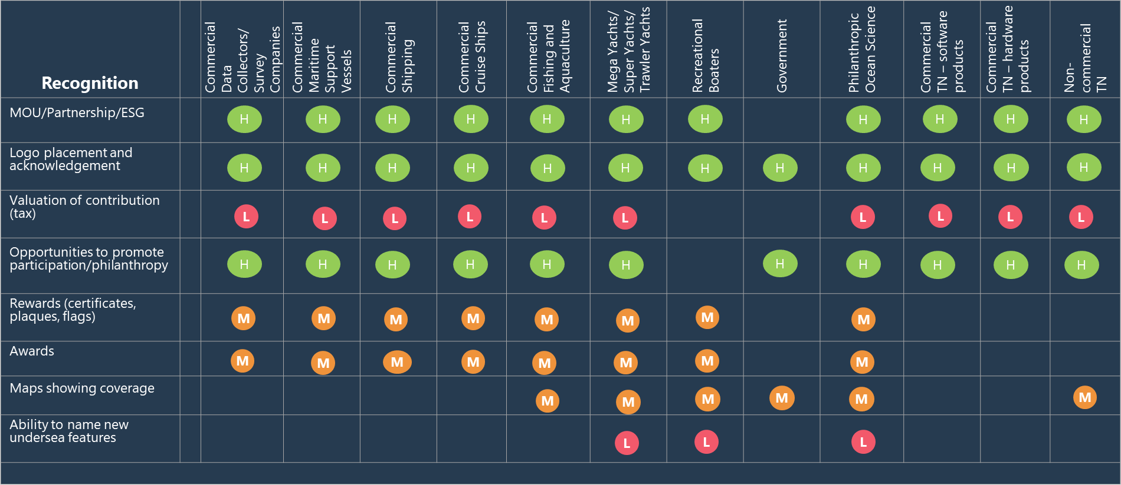
proposed prioritized recognition by sector

Slide 11
next steps
Our team’s next steps:
Incorporate CSBWG feedback on work too date
Validate with sector representatives?
Finalize strategy by developing short summary descriptions for each incentive / recognition
Action for CSBWG
Note the information provided
Provide team with feedback on work too date
Decide on need / approach to validation

