Slide 1
Crowdsourced Bathymetry : Leveraging pre-collected, Safety of Navigation Data for Beneficial Purposes
CSBWG-14, Stavanger Norway
Steven G. Keating, United States Observer to the Advisory Board on the Law of the Sea
17-18 August 2024
2023-01751

Slide 2
Acknowledgement
Thanks to the IHO Secretariat for providing Member States and the Public with Exceptional Web Access to Information relating to Hydrography and the advancement of International Cooperation for Hydrographic Services.
Thanks to the IHO Crowdsourced Bathymetry Working Group (CSBWG) for its collaborative work to study CSB and advocate for its acceptance by the international maritime community. Thanks also to CSBWG Chair, Co-Chair, and Secretary for their important service.

Slide 3
Purpose of Presentation
Discuss and Demonstrate how Crowdsourced Bathymetry is consistent with and advances the objectives of the Law of the Sea, The UN Decade of Ocean Science, GEBCO, and Seabed 2030.

Slide 4
Why Bathymetry Matters
Mariner’s Rule
Draft < water depth to avoid…

Slide 5
Vessel Grounding

Slide 6
Basic Assumptions for Discussion
CSB does not conflict with the Law of the Sea Convention or other international conventions which are part of the broader body of the Law of the Sea.
CSB seeks to use technology to leverage pre-collected sounding data in a manner that advances the objectives of the Law of the Sea to improve the means of navigation and preserve the marine environment.

Slide 7
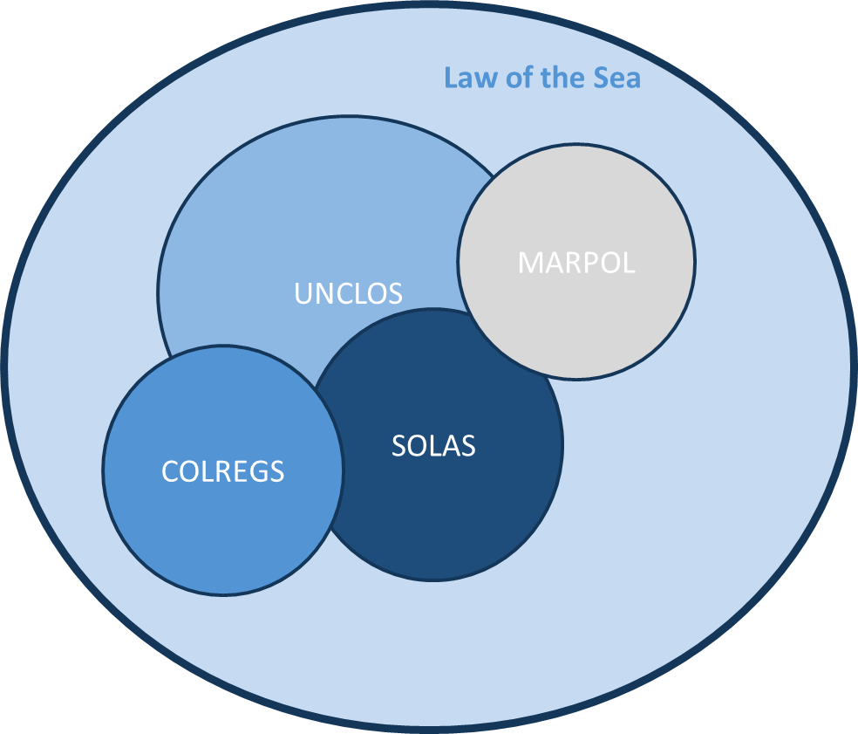
The Meta Set of the Law of the Sea
In this Presentation:
The Term “Law of the Sea”
includes the broad set of the Customary Law of the Sea as well as the international conventions relating to the sea, such as UNCLOS, SOLAS, MARPOL, COLREGS, etc.

Slide 8
From the Preamble of UN Convention on the Law of the Sea:
Recognizing the desirability of establishing through this Convention, with due regard for the sovereignty of all States, a legal order for the seas and oceans which will facilitate international communication, and will promote the peaceful uses of the seas and oceans, the equitable and efficient utilization of their resources, the conservation of their living resources, and the study, protection and preservation of the marine environment…

Slide 9
CSB seeks to leverage data already collected IAW Law of the Sea
Much potential CSB data will come from those vessels mandated by law to collect depth sounding information pursuant to the International Convention for the Safety of Life at Sea (SOLAS), Chapter V, Regulation 19, paragraph 2.3.
“All ships of 300 gross tonnage and upwards and passenger ships irrespective of size shall, in addition to meeting the requirements of paragraph 2.2, be fitted with: an echo sounding device, or other electronic means, to measure and display the available depth of water;
In addition, prudent mariners operating vessels of smaller size generally operate echo sounding devices or fathometers to ascertain water depth.

Slide 10
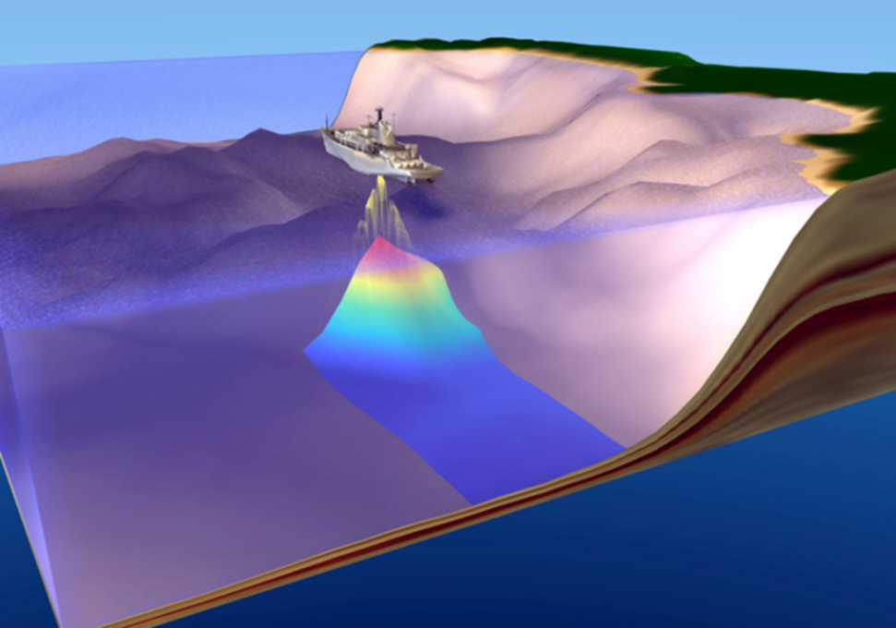
Relevance of Depth Soundings to the Law of the Sea
Soundings = Depth (x, y, Z) is an important data factor, applications of which are essential to avoiding groundings that result in pollution and damage to the marine environment.
Depth soundings are crucial information found on nautical charts essential for safety of navigation.

Slide 11
A Vessel Aground is a Hazard to the Environment
All mariner’s have a responsibility to avoid grounding the vessel.
The American Practical Navigator advises:
“Use the fathometer to determine whether the depth of water under the keel is sufficient to prevent the ship from grounding and to check the actual water depth with the charted water depth at the fix position. The navigator must compare the charted sounding at every fix position with the fathometer reading and report to the captain any discrepancies. Taking continuous soundings in restricted waters is mandatory.”
-American Practical Navigator, 2017 Ed, § 1015, Vol. 1, page 174
Not only does SOLAS require the operation of an echosounder for covered vessels, but best practices in Navigation involve the mariner having situational awareness of the depth of the water she or he is navigating.

Slide 12
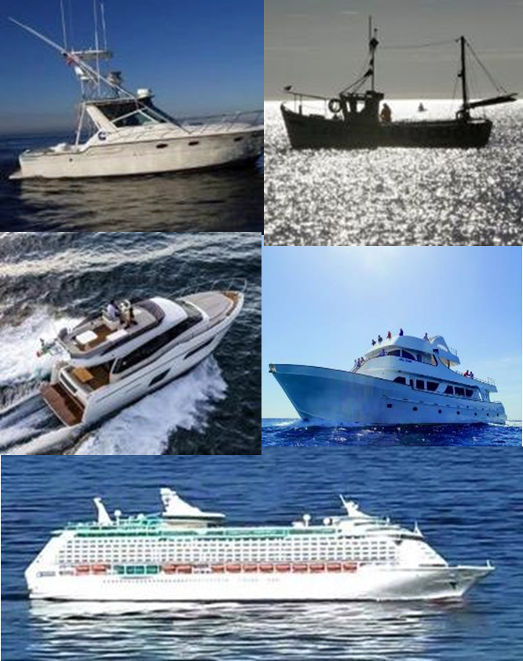
Defining Crowdsourced Bathymetry
Crowdsourced bathymetry (CSB) is the collection and sharing of depth measurements from vessels, using standard navigation instruments, while engaged in routine maritime operations.*
*Definition from IHO Publication B-12, Guidance on Crowdsourced Bathymetry, page 3

Slide 13
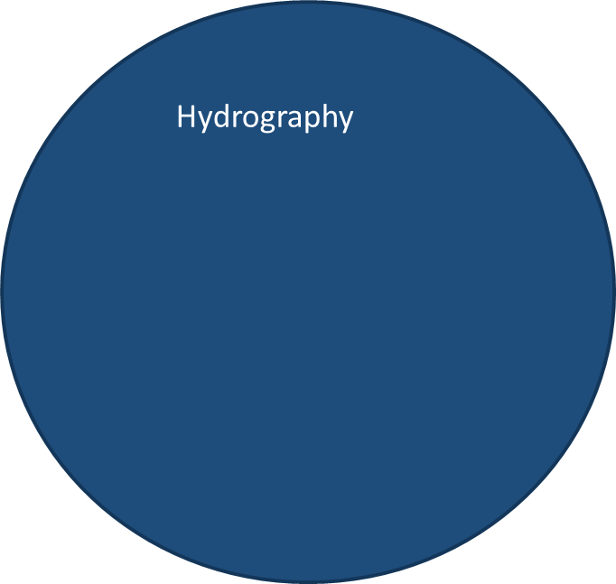
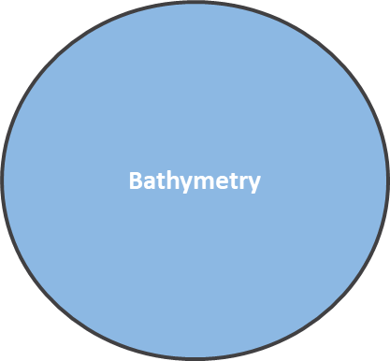
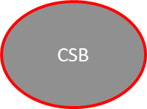
Key Concepts
Hydrography
That branch of applied science which deals with the measurement and description of the physical features of the navigable portion of the EARTH's surface and adjoining coastal areas, with special reference to their use for the purpose of NAVIGATION. IHO Hydrographic Dictionary, S-32
Bathymetry
The determination of ocean depths. The general configuration of the SEA FLOOR as determined by profile analysis of depth data. IHO Hydrographic Dictionary, S-32
Crowdsourced bathymetry
Crowdsourced bathymetry (CSB) is the collection and sharing of depth measurements from vessels while engaged in routine maritime operations.

Slide 14
Key Concept, Standard Navigation Instruments (SNI)
This term is not defined in UNCLOS
Closest term within the broader Law of the Sea is “shipborne navigational systems and equipment” found in SOLAS, 1974, Chapter V, Regulation 19.2
Examples include but are not limited to:

Slide 15
Key Concept: Routine Maritime Operations (RMO)
This is a term of art not defined in treaty or code, but for the purposes of CSB, RMO is intended to mean maritime operations which are not hydrographic surveying nor Marine Scientific Research, but rather activities such as transiting from one point to another, passenger carriage, yachting, fishing, towing, etc.

Slide 16
LOGICAL DEDUCTIONS
SAFE OPERATION OF A VESSEL IS A PRESUMPTION FOR ROUTINE MARITIME OPERATIONS.
SITUATIONAL AWARENESS OF ECHOSOUNDING DATA IS AN ESSENTIAL PART OF SAFE OPERATION OF A VESSEL.
ENHANCED GLOBAL SHARING OF CSB DEPTH INFORMATION CAN HELP IMPROVE THE MEANS OF NAVIGATION BY FILLING GAPS IN WATERS THAT HAVE NOT BEEN SURVEYED, AND BY PROVIDING CHANGE DETECTION* IN HIGHLY TRAFFICKED AREAS.
*“CSB data collected from 2012-2013 inside Baltimore’s Inner Harbor was used to located anomalous depth measurements that could indicate the Presence of submerged debris.” See Sedaghat, Hersey, and McGuire, Detecting Spatio-Temporal Outliers in Crowdsourced Bathymetry Data, 2013, https://dl.acm.org/doi/10.1145/2534732.2534739

Slide 17
Presenter’s Comment
Suggest the next time B-12 is updated to amend the CSB definition to reflect that CSB data was already “collected” pursuant to SOLAS, Chapter V, or best safety of navigation practices to operate an echo sounder.
Proposed update for definition:
Crowdsourced bathymetry (CSB) is the voluntary donation, aggregation, and sharing of pre-collected depth measurements from vessels, using shipborne navigational systems and equipment, while engaged in routine maritime operations.*
Rationale: This updated definition aligns with actual practice and the terms already used in SOLAS.

Slide 18
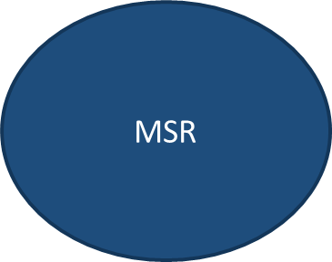
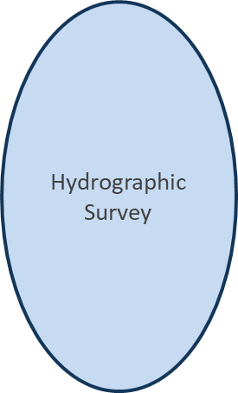
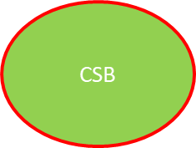
What CSB is NOT
Hydrographic Surveying
A SURVEY having for its princi­pal purpose the determina­tion of DATA relating to bodies of water. A hydrographic survey may consist of the deter­mination of one or several of the following classes of DATA: DEPTH of water; confi­guration and NATURE OF THE BOTTOM; directions and force of CUR­RENTS; HEIGHTS and TIMES of TIDES and water stages; and location of topographic features and fixed objects for survey and naviga­tion purposes. From IHO Hydrographic Dictionary, ENG ID 5244
Marine Scientific Research (MSR)
Not defined in UNCLOS, though not for want of trying. See Marine Scientific Research, A revised guide to the implementation of the relevant provisions of the United Nations Convention on the Law of the Sea.
Provisions governing MSR appear throughout UNCLOS (see Arts. 21, 40, 56, 143, 238-257, 263, 264, 266, 270, 275, 297, etc.)

Slide 19
The IHO Supports CSB as Voluntary and Collaborative
The IHO established the Crowdsourced Bathymetry Working Group (CSBWG) as a result of the IHO’s 5th International Hydrographic Conference in 2014.
Objectives of the CSBWG include but are not limited to:
Maintain IHO B-12, IHO Guidance on Crowdsourced Bathymetry
Monitor development of best practices and CSB initiatives
Promote ways to increase data contributions and incentives to participate
Liaise closely with the IHO Data Centre for Digital Bathymetry (DCDB) as it develops technology to collect and distribute CSB to the public

Slide 20
More on the DCDB (from IHO Website)
The International Hydrographic Organization Data Centre for Digital Bathymetry (IHO DCDB) was established in 1990 to steward the worldwide collection of bathymetric data. The Centre archives and shares, freely and without restrictions, depth data contributed by mariners.
The IHO DCDB is hosted by the U.S. National Oceanic and Atmospheric Administration (NOAA) on behalf of the IHO Member States.
The DCDB also contains oceanic soundings acquired by hydrographic, oceanographic, and other vessels during surveys or while on passage. Data are publicly available and used for the production of improved and more comprehensive bathymetric maps and grids, particularly in support of the GEBCO Ocean Mapping Programme.
IHO Member States and others can contribute bathymetric data and metadata via File Transfer Protocol (FTP), email, or mail (CD, DVD, and hard drive) in a variety of standard formats.

Slide 21
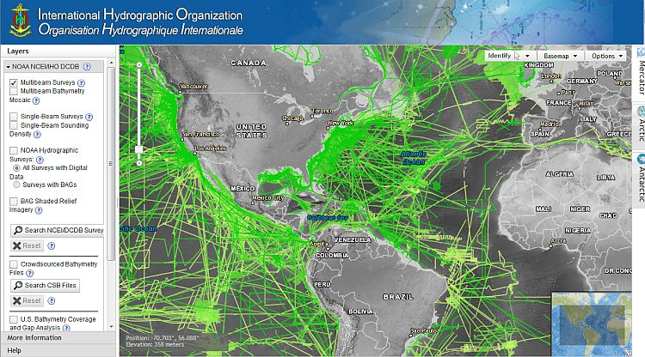
Important Distinction
While the DCDB contains multibeam and single beam sounding data from hydrographic, academic, and other types of systematic and opportunistic surveys, CSB data is different because its collection is incidental to routine maritime operations. (e.g., transit soundings vice systematic surveying.)

Slide 22
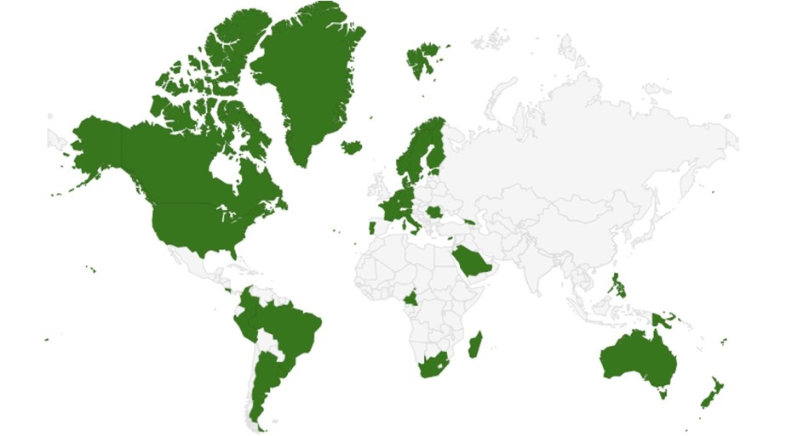
Geographic Filtering
Coastal states were requested by the IHO to indicate their position on the public sharing of CSB data collected within waters subject to their national jurisdiction.
To date, 33 coastal states (green) have replied positively.
Slide courtesy of IHO DCDB – Publicly Available Information
Notes:
Early in the Initiative, the IHO knew that many coastal nations might have issue with CSB data collection in their waters. The result was an official IHO request for countries to indicate their position on the provision of CSB data collected within waters of national jurisdiction into the public domain. To date, 33 MS (green) have replied positively. France and Australia are the most recent signatories. And the UK has indicated that they’re moving closer…

Slide 23
Geographic Filtering
In response to feedback provided to the IHO, the DCDB implemented (and continues to update) a geographic filter for incoming data to take into account coastal countries’ positions on the distribution of CSB collected in their areas of jurisdiction.
National Hydrographic Office
Stored. Allow for addition to GEBCO grid only
Data Provider
Archived. Made publicly discoverable & accessible
IHO DCDB
IHO Geographic Filter
Stored. No further distribution
Slide courtesy of IHO DCDB – Publicly Available Information
Notes:
The IHO DCDB was asked by the IHO to implement a geographic filter into our data ingest pipeline for all incoming data that would take into account national positions. And so we did. We implemented a set of topologically correct polygons for each EEZ & TS where each polygon is attributed with flags indicating the restriction(s) - YES/NO…and then further caveats provided by the country would be adhered to (READ boxes).

Slide 24
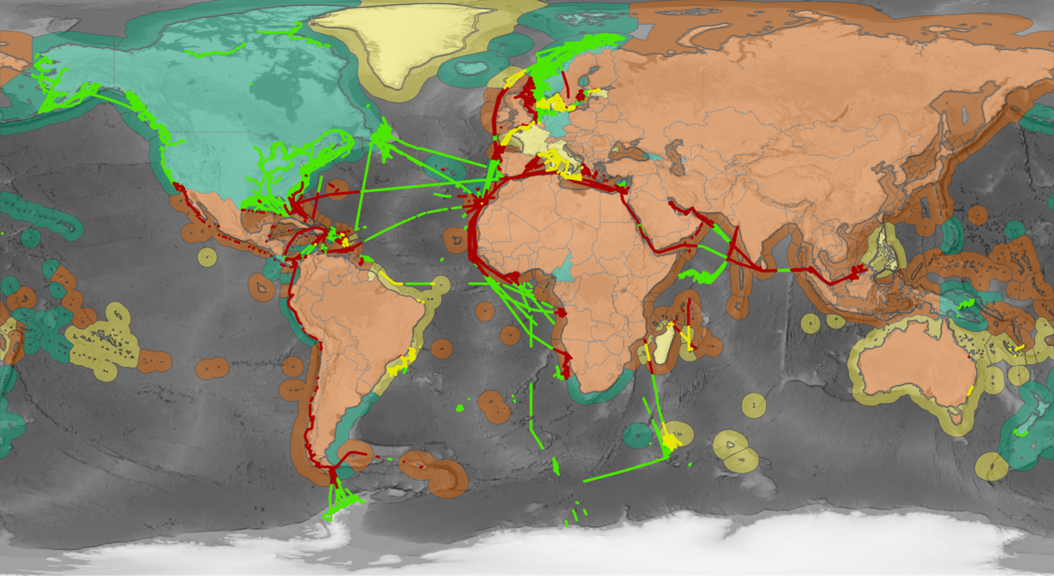
Geographic Filter
Green = Positive Response
Yellow = Positive Response w/ caveats unable to adhere to
Red = Negative Response, No Response
Map for illustrative purposes only. (Credit: Marine Regions)
Slide courtesy of IHO DCDB – Publicly Available Information
Notes:
In this image you can now see an illustration of the data that was submitted to the DCDB but filtered out based on responses to the circular letter. The data in red and yellow are not publicly accessible and is not discoverable on the viewer. The coastal States in Yellow provided positive responses, but included caveats…many which cannot be adhered to. Some states requested the ability to review the data prior to distribution.

Slide 25
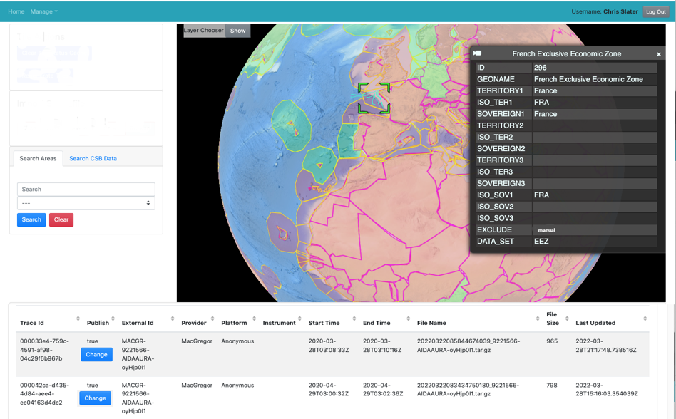
Geographic Filter
Pre Approval Capability
The DCDB is currently working to automate the notification and approval process of data for coastal states who have provided positive responses but request pre-approval of data before the public distribution from DCDB.
Notes:
The DCDB is working on a solution to this but acknowledges that this request will be time intensive - both the building of an application and also the review process of the coastal state

Slide 26
The CSB Initiative depends upon The Support of Coastal States*
The IHO Secretariat has issued Circular Letter (IHO CL21/2020) to request IHO Member States (MS) to indicate their positions on the provision of CSB data within waters of national jurisdiction.
The IHO received 33 replies out of 95 MS
The DCDB has ~30 GB of CSB data from contributing vessels.
Due to restrictions placed by some MS, data from approximately 13 CSB-supporting countries are presently discoverable and accessible via DCDB.

Slide 27
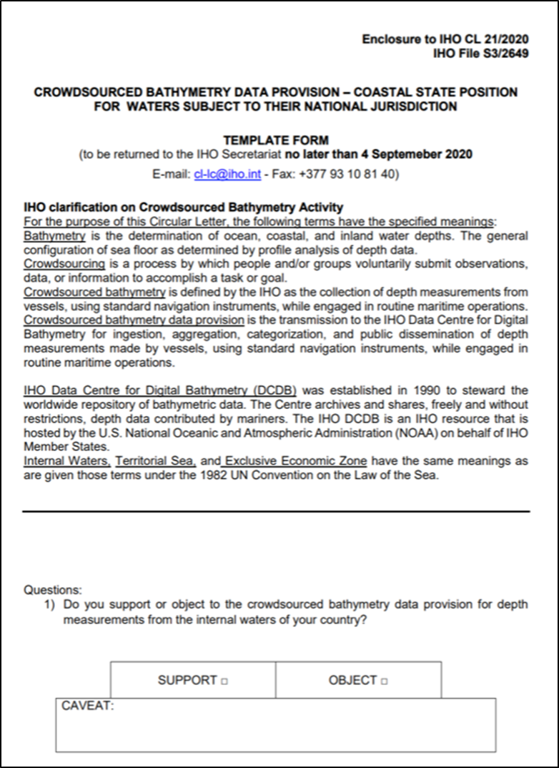
CL Questionnaire asks:
Do you support or object to the CSB data provision for depth measurements from the internal waters, territorial sea, or EEZ of your country?
Do you wish to be informed when such information is received by the IHO DCDB?
Do you wish to review such information before its ingestion into the IHO DCDB?
Do you wish for the opportunity to put caveats on the further dissemination of such data?

Slide 28
Problems of Perception (paraphrased from Report of CSBWG to IHO Inter-Regional Coordination Committee 13 – 23-25 June 2021)
…confusion continues to exist between the opportunistic and random CSB data gathering activity and the UNCLOS regulated planned scientific data gathering and systematic hydrographic survey operations….
…many coastal states continue to misunderstand the objectives and focus of the CSB initiative, which is to collect data in poorly surveyed or unsurveyed areas. CSB data can play a role in completing the picture of the seabed by supporting the objectives of numerous international projects and initiatives, such as Seabed 2030, the UN Decade for Ocean Science for Sustainable Development and UN Sustainable Development Goal 14, and a plethora of scientific research, modelling, management and planning uses, which might include safety of navigation either directly onto charts or as a comparator to published data. Increased awareness and information as well as continued stakeholder engagement/involvement should all help to overcome these reservations.

Slide 29
IHO Member State Support to Public Availability of CSB is Essential to Achieve Goals of:
UN Decade Goal to Create a Digital Model of the Ocean (Challenge Goal 8)
GEBCO
SEABED 2030

Slide 31
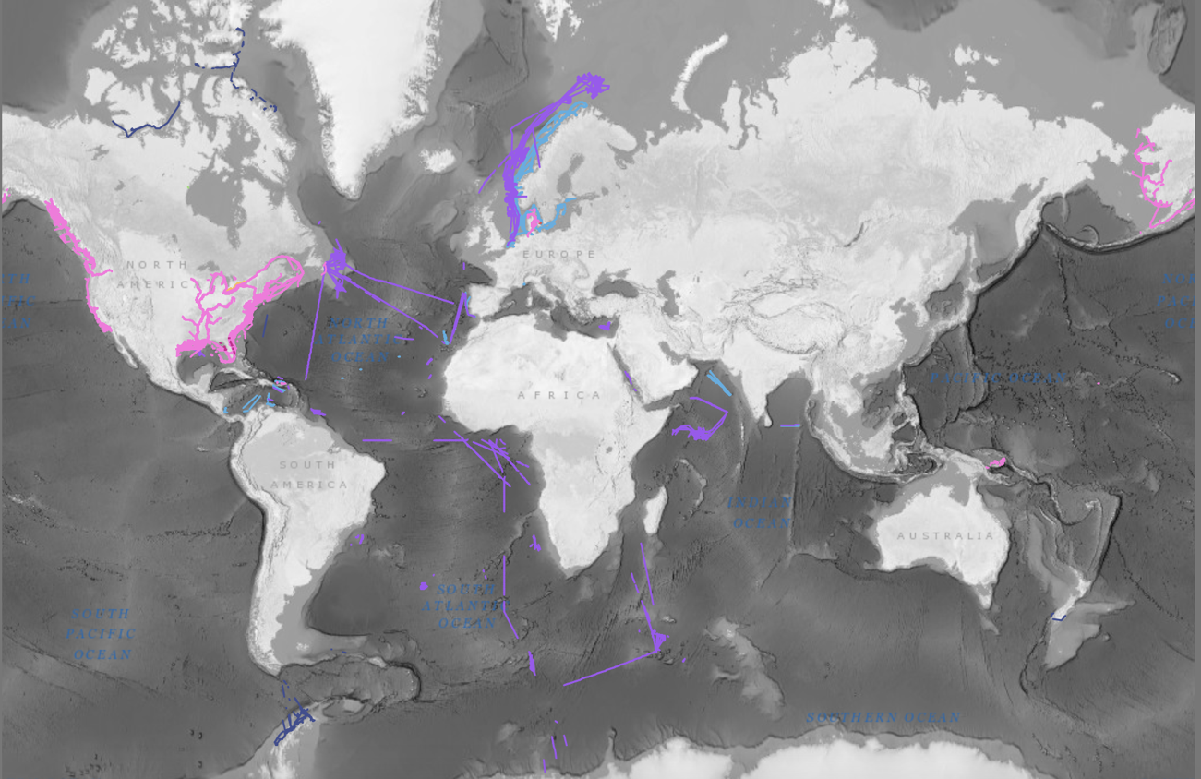
“If we got 1% of all seagoing vessels logging data, and on average they spent half their time at sea, then that’s about 5 billion data points a day.
- Tim Thornton, TeamSurv
iho.int/en/crowdsourced-bathymetry
Slide courtesy of IHO DCDB – Publicly Available Information
jennifer.jencks@noaa.gov

Slide 32
Conclusion
CSB uses data incidentally collected as part of Safety of Navigation, either mandated by SOLAS or established best practices
There is no express prohibition on the sharing of CSB data in UNCLOS, SOLAS, or other international law conventions
The aggregation of CSB data in the DCDB and the unencumbered sharing of such data promotes the equitable and efficient utilization of resources consistent with UNCLOS and advances the goals of GEBCO and SEABED 2030

Slide 33
Thank You for Your Consideration
QUESTIONS?

